Slide 1

TMT02: Linux on Azure for the Microsoft Specialist
Tim Warner
Author, Tech Evangelist,
Pluralsight
Level: Intermediate

Slide 2

Our Agenda
Deploy Linux cloud VMs
Connect to your instances
Perform configuration management

Slide 3
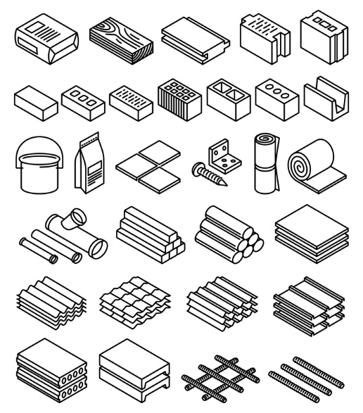
Session Materials
http://timw.info/linux

Slide 4


Slide 5
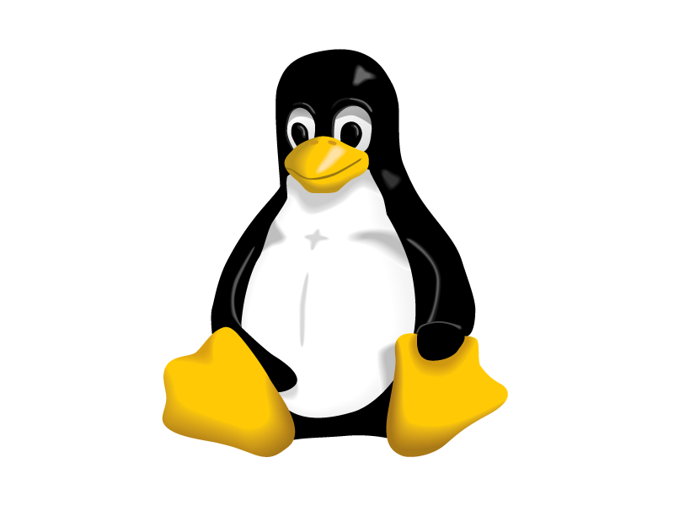
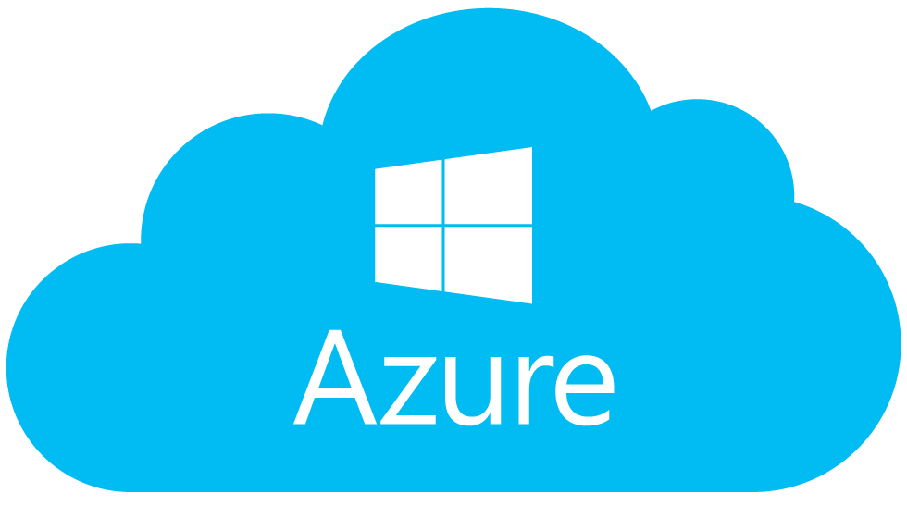
deploy linux cloud vms

Slide 6
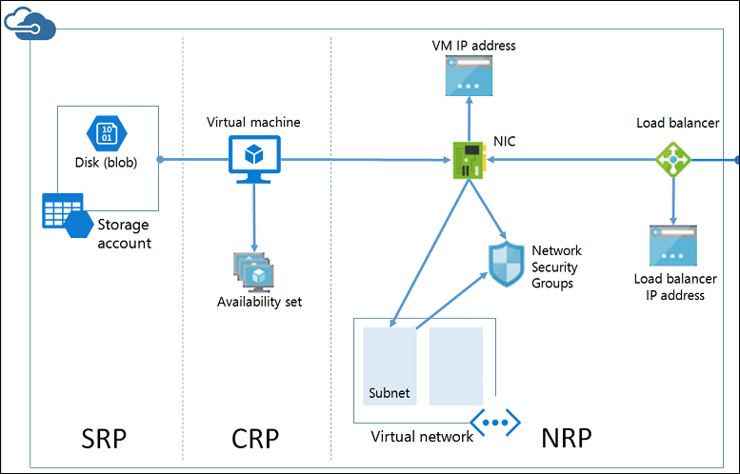
ARM Compute Architecture
timw.info/armarch

Slide 7
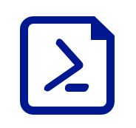
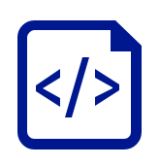
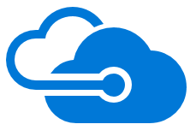
VM Deployment Methods
Azure Portal
Rich VM marketplace
"Hand-holding"
PowerShell
Remember that ASM and ARM are separate and incompatible
ARM Template
Declarative JSON syntax
Azure QuickStart Templates

Slide 8
Goal: Deploy Linux-based VMs in three ways
Portal
PowerShell
ARM template

Slide 9
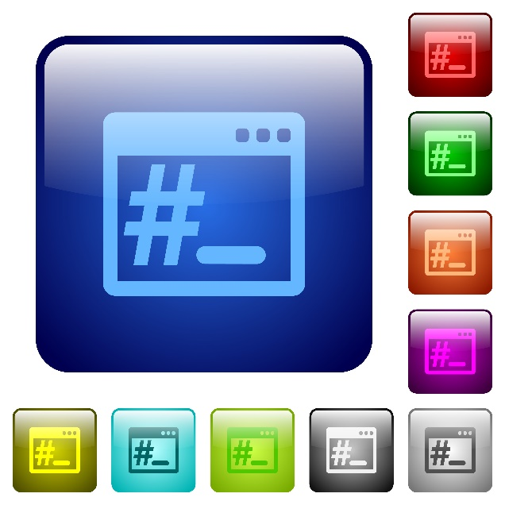
connect to your cloud vms

Slide 10
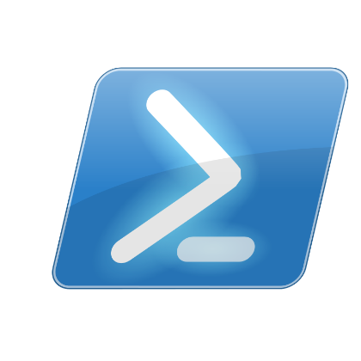

Two Options
Secure Shell (SSH)
PuTTY Windows GUI
PowerShell will eventually have native SSH
Git tools include SSH
Bash environment in Windows 10
PowerShell Remoting (eventually)
PowerShell Core runs on Linux
Remoting will use SSH as transport

Slide 11
Primary goal: Connect to cloud VM by using SSH
Secondary goal: Check out PowerShell on Linux

Slide 12

perform configuration management

Slide 13
CM Options
On-board with Chef or Puppet
Push DSC configuration via OMI
On-board with Azure Automation DSC / OMS

Slide 14
Goal: Investigate CM options in the Azure Portal
DSC
Azure Automation DSC
Other options

Slide 15

closing thoughts

Slide 16

Closing Thoughts
We're going to see more and more "Microsoft loves Linux" moving forward
Learn PowerShell. Now.
Get comfortable with: SSH, Bash, Git

Slide 17



Tim Warner
http://timw.info/linux
@TechTrainerTim

