Slide 1
Disección Wifi

Slide 2
# ls
Radios
Diseccion Paquetes 802.11
Estructura General
WPA2 HandShake
Python + Scapy
Wifi Scanner
FAAP – Forever Alone AP :(
Wifi Click-Hacking

Slide 3

Radios
Transmisión de datos basada en el estándar 802.11 de la IEEE.
Usa OFDM (Orthogonal Frequency Division Modulation)

Slide 4
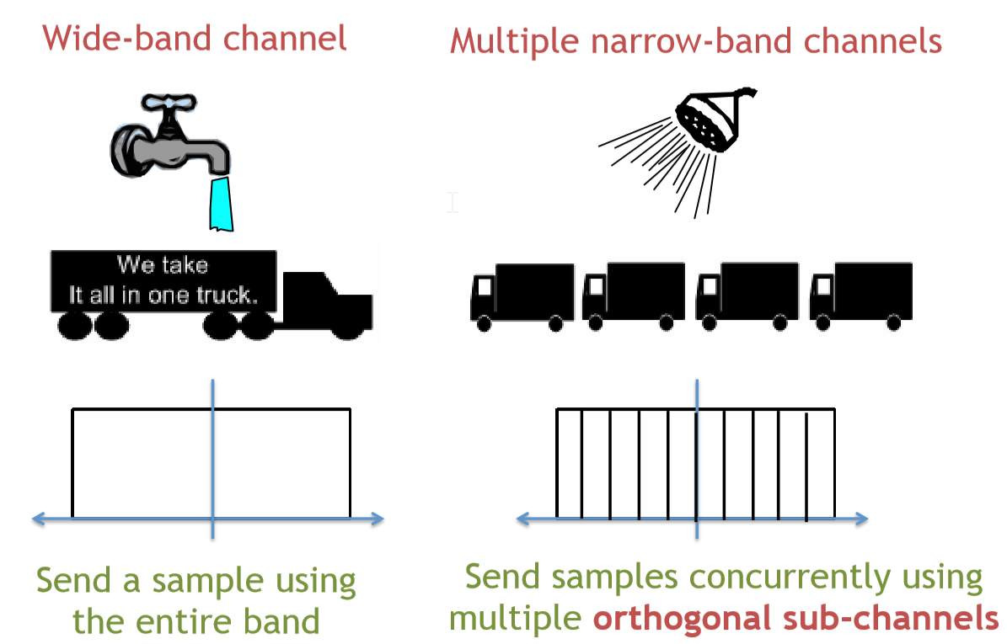
Radios

Slide 5
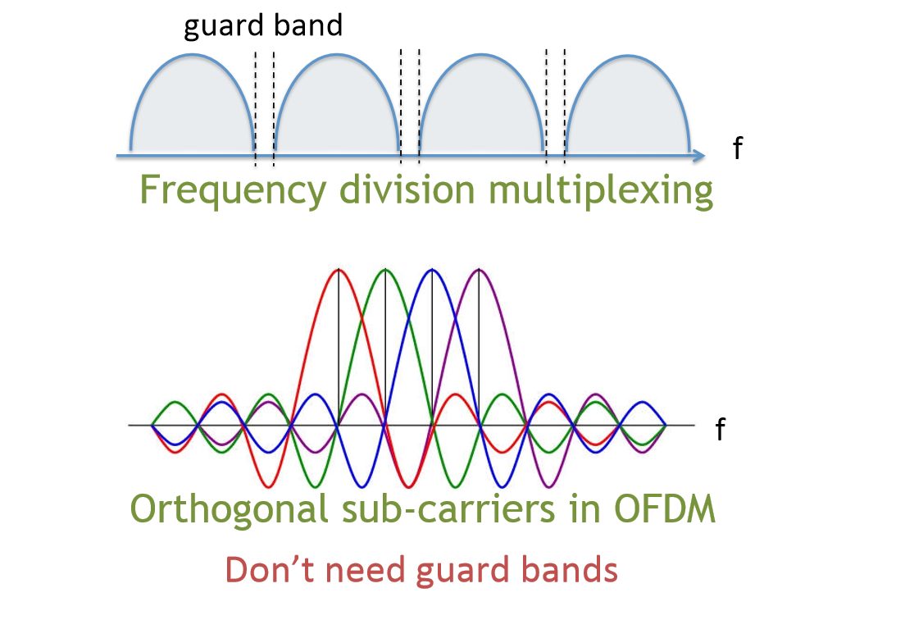
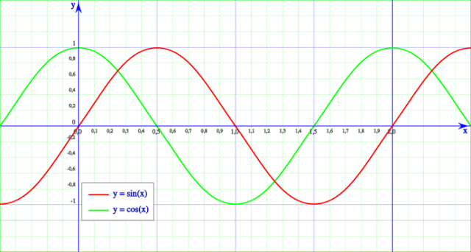

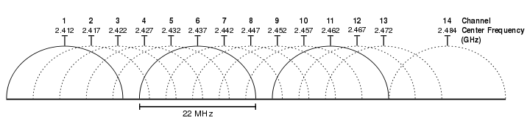
Radios

Slide 6
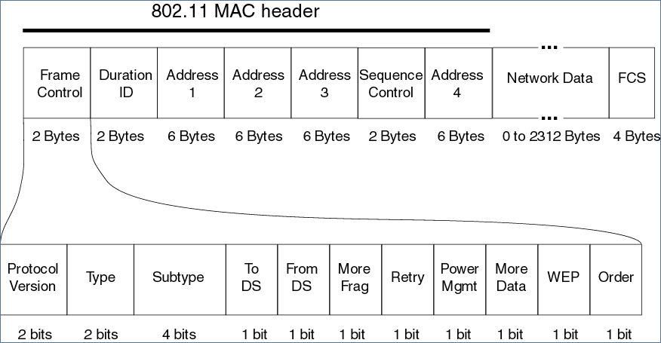
Paquete 802.11
https://www.savvius.com/resources/compendium/wireless_lan/wlan_packet_types

Slide 7

WPA2 – 4 way hand sahke

Slide 8
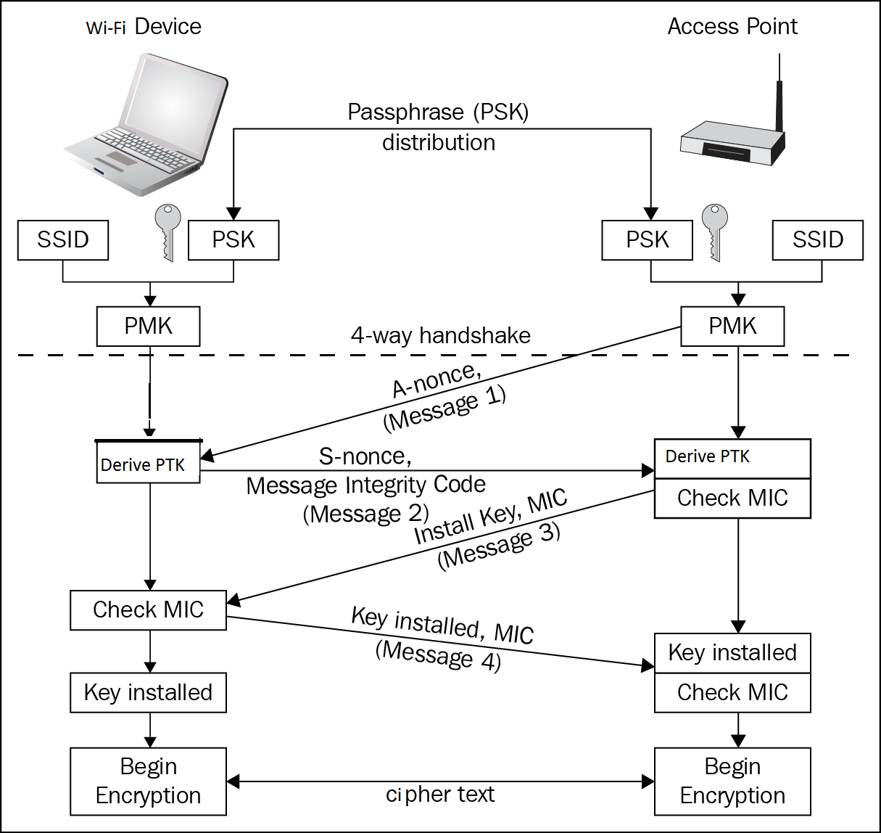
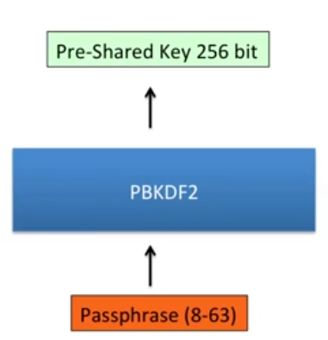
WPA2 – 4 way hand sahke
Password Base Key Derivation Function
PBKDF2 (Passphrase, SSID, lenSSID, 4096, 256)

Slide 9
WPA2 – 4 way hand sahke
3.97 pairwise master key (PMK): The highest order key used within this standard. The PMK may be derived from a key generated by an Extensible Authentication Protocol (EAP) method or may be obtained directly from a preshared key (PSK).
3.99 pairwise transient key (PTK): A value that is derived from the pairwise master key (PMK), Authenticator address (AA), Supplicant address (SPA), Authenticator nonce (ANonce), and Supplicant nonce (SNonce) using the pseudo-random function (PRF) and that is split up into as many as five keys, i.e., temporal encryption key, two temporal message integrity code (MIC) keys, EAPOL-Key encryption key
(KEK), EAPOL-Key confirmation key (KCK)
3.84 message integrity code (MIC): A value generated by a cryptographic function. If the input data are changed, a new value cannot be correctly computed without knowledge of the cryptographic key(s) used by the cryptographic function. This is traditionally called a message authentication code (MAC), but the acronym MAC is already reserved for another meaning in this standard.
Ref IEEE Std 802.11™

Slide 10

Wireless Click Hacking

Slide 11


