Slide 1
Network Security I
Physical Security

Slide 2
Network Security I - Physical Security
* Locks

Slide 3
Network Security I - Physical Security
* Locks
* RFID/NFC cards/tags

Slide 4
Network Security I - Physical Security
* Locks
* RFID/NFC
* Keys/Servers location

Slide 5
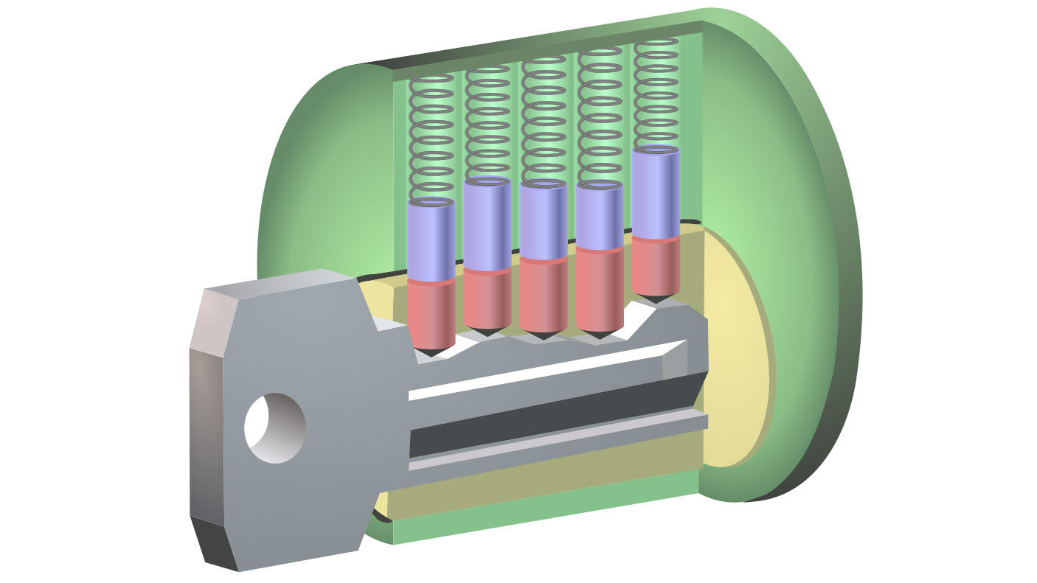
Network Security I - Physical Security
* locks

Slide 6
Network Security I - Physical Security
* locks
pins
shear line

Slide 7
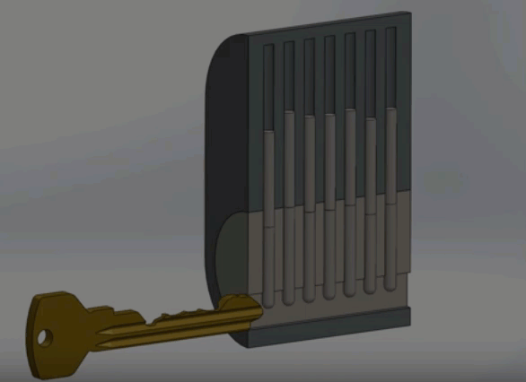
Network Security I - Physical Security
* locks

Slide 8
Network Security I - Physical Security
* RFID/NFC tags
* RFID
- Low Frequency
- High Frequency
- High Frequency with encryption
* NFC tags
- pure tags
- tags with encryption

Slide 9
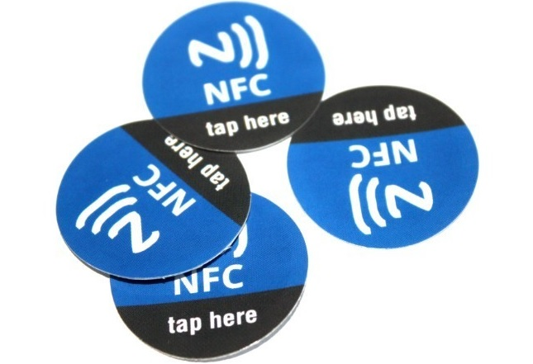
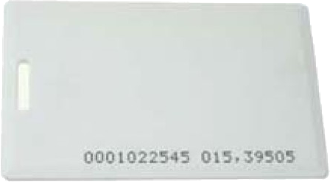
Network Security I - Physical Security
* RFID/NFC tags
* RFID
- Low Frequency 125–134.2 kHz
- High Frequency 13.56 MHz
- High Frequency with encryption
* NFC tags
- pure tags
- tags with encryption

Slide 10
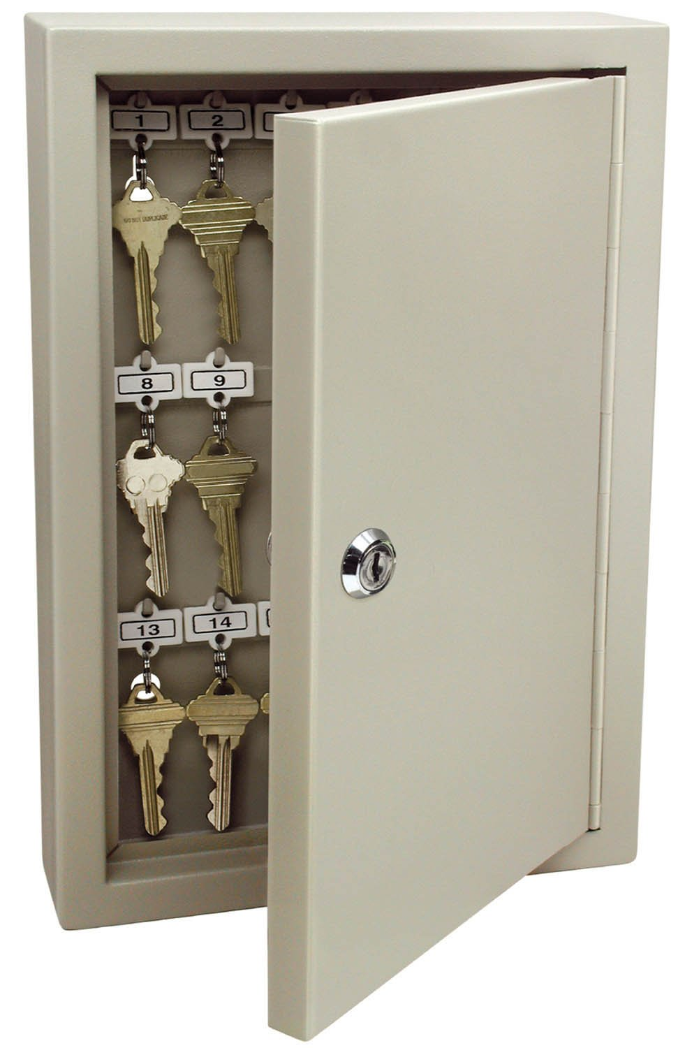
Network Security I - Physical Security
* Keys/Servers location
* Keys are usually
left with the
security guards

Slide 11
Network Security I - Physical Security
* Keys/Servers location
* In most buildings there is one central system for access control
* Its easy to social engineer issuing a new card
* Any of the administrators has access to all offices in the building

Slide 12

Network Security I - Physical Security
* Questions?

