Slide 1
Network Security I
http://netsec.1h.cx/
Introduction
to
networks

Slide 2
Who is Boyan Krosnov
Pre-1999
FMI и Lirex
CCIE #8701
Reykjavik; Dublin; London; Kuala Lumpur
packetscale
storpool

Slide 3
Administrativia
In the next 4 weeks
  Introduction to networks (this lecture)
  Ethernet
  Wi-Fi
  IP, IPv6
  ICMP, UDP, TCP
  DHCP
Test – somewhere in november
Demo
Lightning Talks
Open lectures
All lectures are recorded

Slide 4
Acknowledgements
Some materials are based on work by
MIT OpenCourseWare – http://ocw.mit.edu/
Flickr users
  photoblog0001, 10ch, sniffles, zoemaclean, williamhook, a_sorense, affan-basalamah
Steve Deering – the IP hourglass

Slide 5
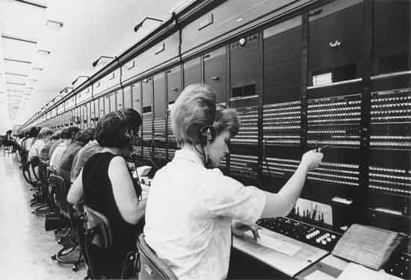
History of the networks

Slide 6
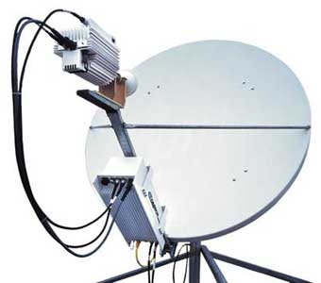
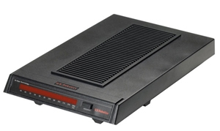
History of Internet
First packet switching networks - 1969
ALOHAnet & early Ethernet– from 1970
IPv4 – 1981, standard Ethernet - 1982
Millitary networks, academic networks
commercial networks
Web – 1990

Slide 7
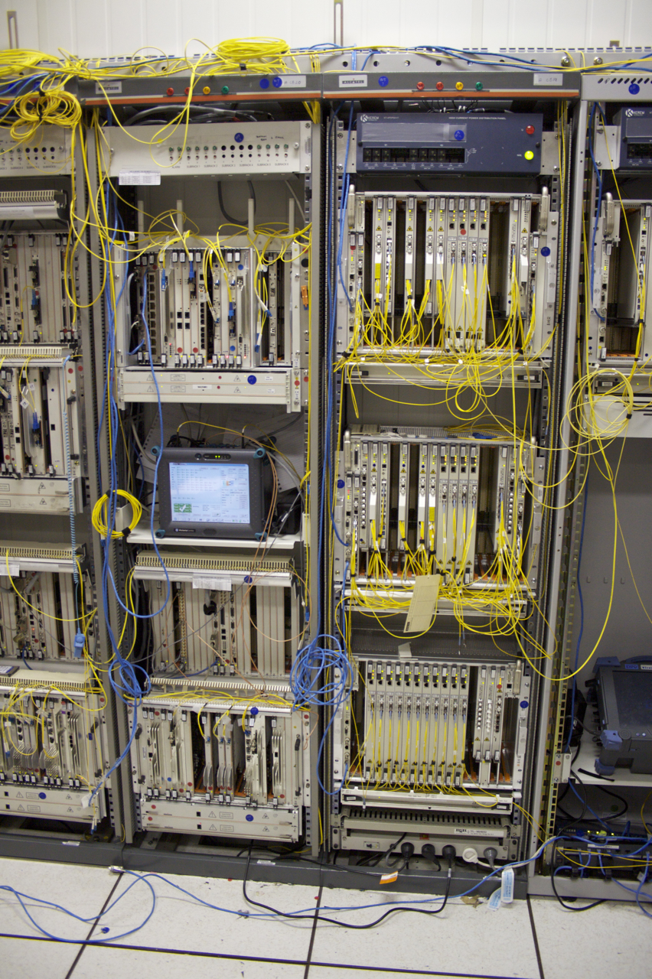
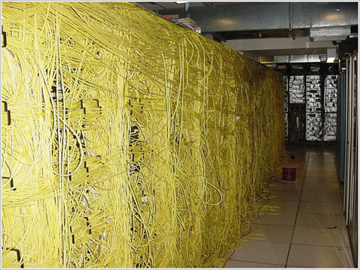
Internet today

Slide 8
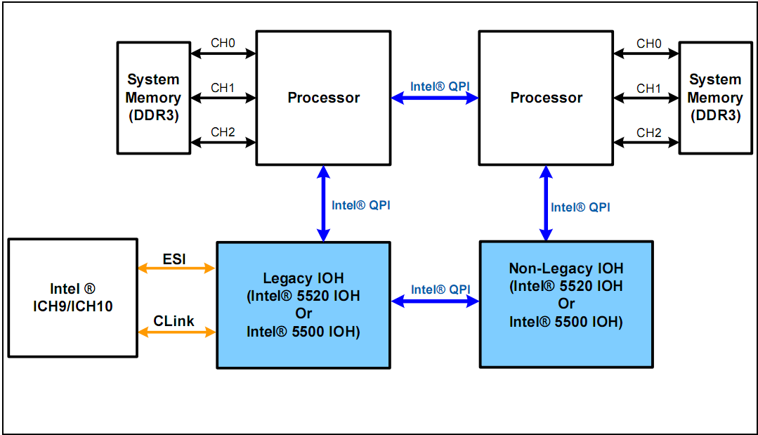
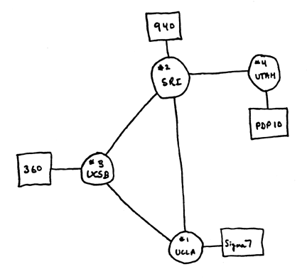
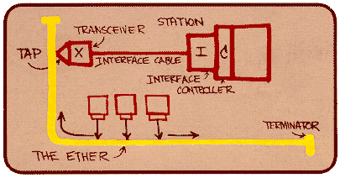
Networks in the future
M2M – Refregirators in the Internet
On-board network
On-chip network
© Intel

Slide 9
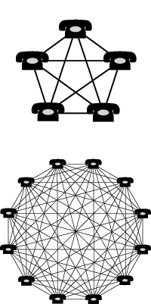
Why network security?
Communication – email, sms, phones, video calls
Entertaiment – games, music, movies, books
Business – banking, commerce
Life online
Network effect
Security in Depth

Slide 10
Circuit switched networks
Pros
  Fixed delays
  Guaranteed consistent and uninterrupted delivery of traffic
Cons
  Links are not used when there is no active session
  Not effective for bursty traffic
  It is typically made for fixed speeds (for example 64 kbps)
  Variable speeds are difficult to implement and maintain

Slide 11
Packet switched networks
Choose the route for each packet
Different packets may take different routes
Packets may arrive in different order at the receiving end
E.g., IP (The Internet Protocol)
Circuit emulation / Virtual Circuit Switching
  ATM
  Pseudo-wire, TDMoIP, TDMoE, etc.

Slide 12
Standards
IETF, IEEE, TIA
Metro Ethernet Forum
Wimax Forum / WiSOA
Wi-Fi Alliance
3GPP
W3C, etc.
Most, wide-spread protocols are free

Slide 13
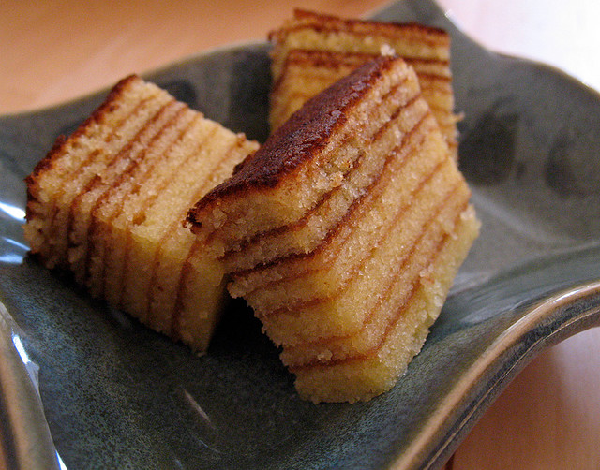

Layered reference models

Slide 14
Layered models
Find the differences

Slide 15
Protocol stacks
TCP/IP
SS7
OSI, Appletalk, IPX, SNA etc.

Slide 16
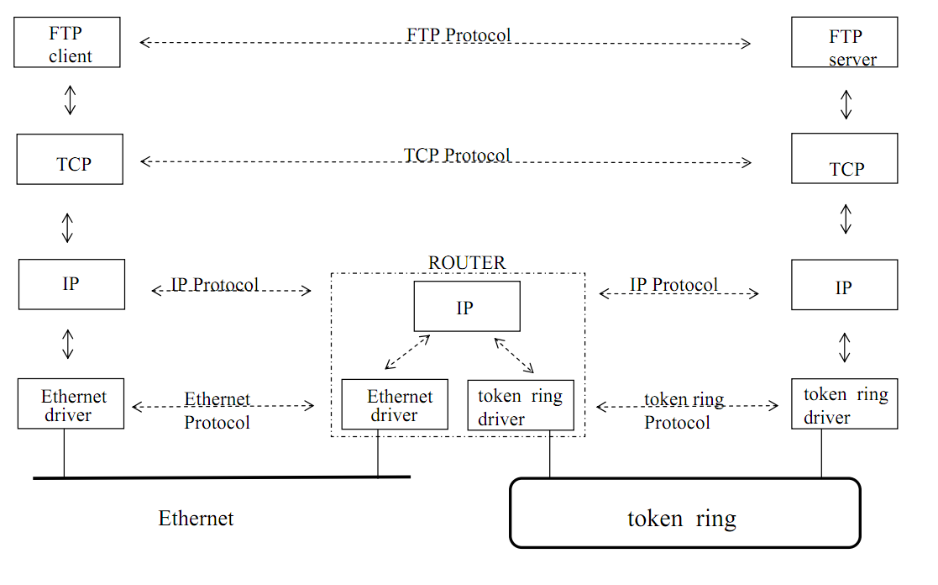
TCP/IP стек

Slide 17
TCP/IP стек

Slide 18
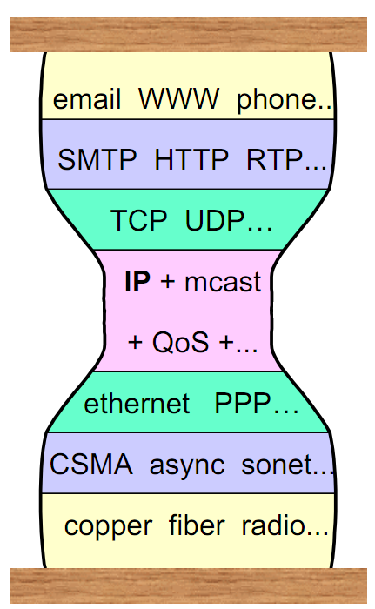
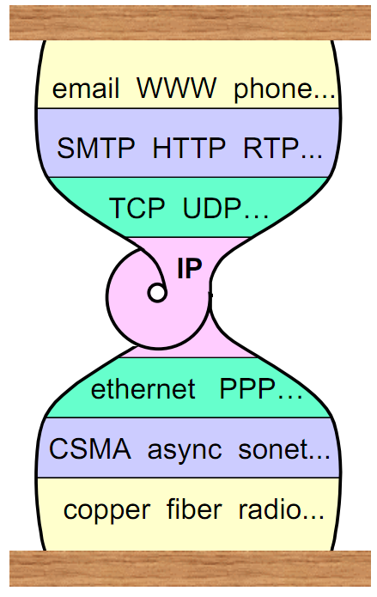
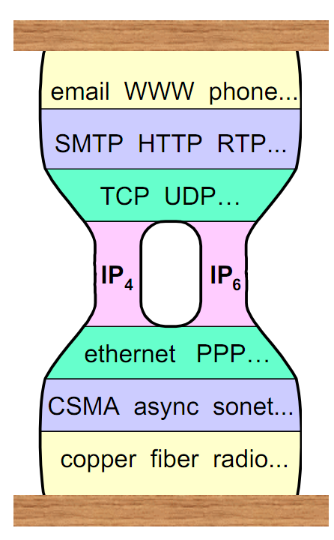
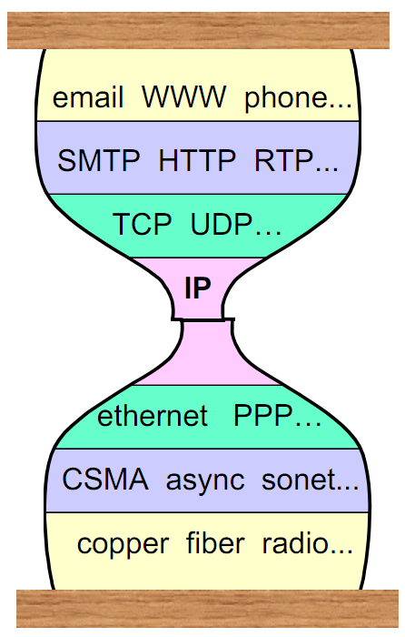
TCP/IP стек
Fat hourglass
Tunneling
IPv6
NATs, proxies

Slide 19
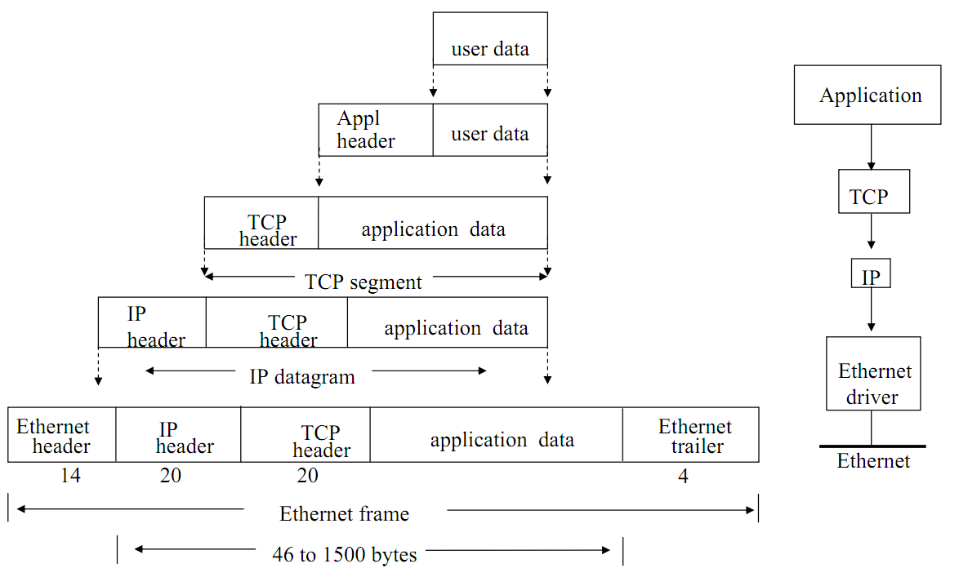
TCP/IP Encapsulation

Slide 20
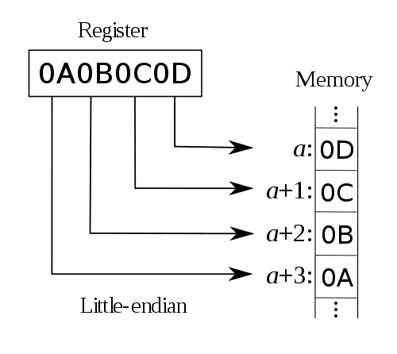
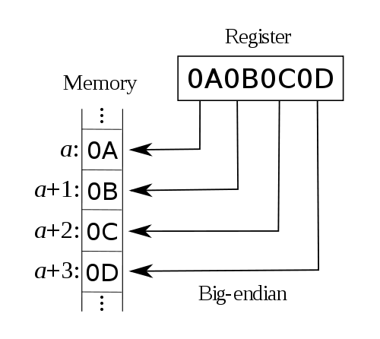
Byte order
Octet vs. Byte
LSB first – little endian – x86
MSB first – big endian – TCP/IP

Slide 21
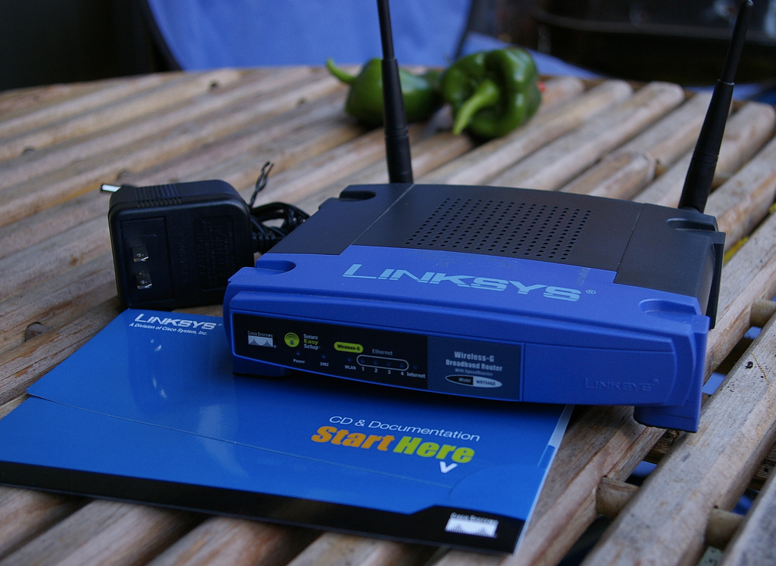
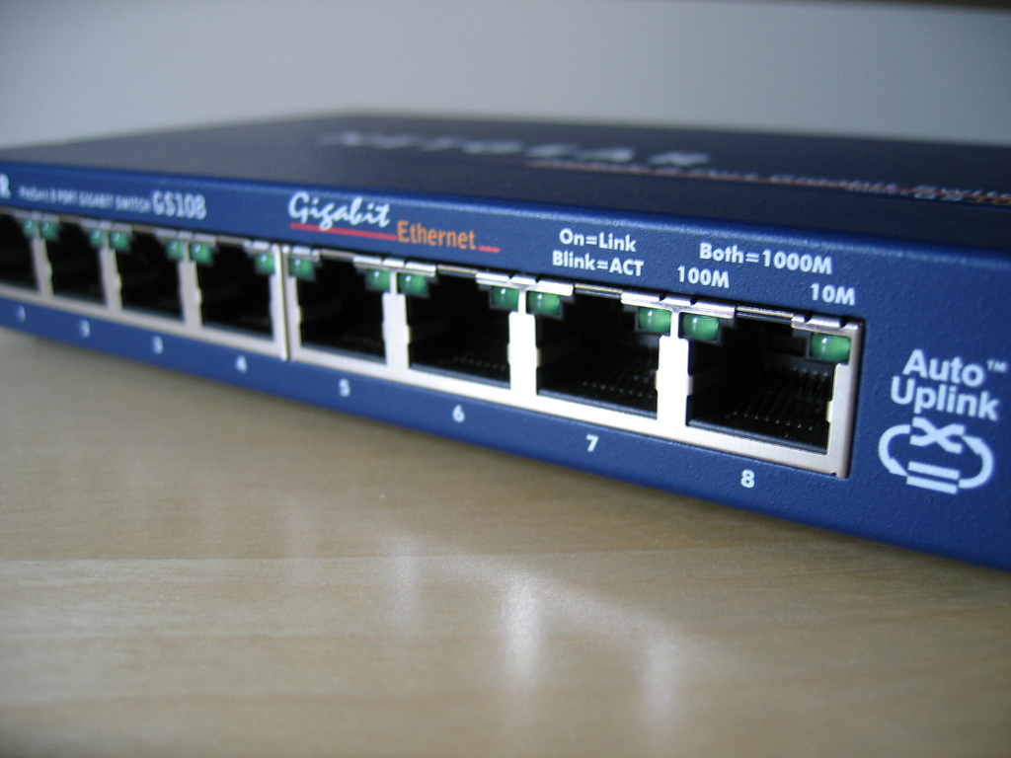
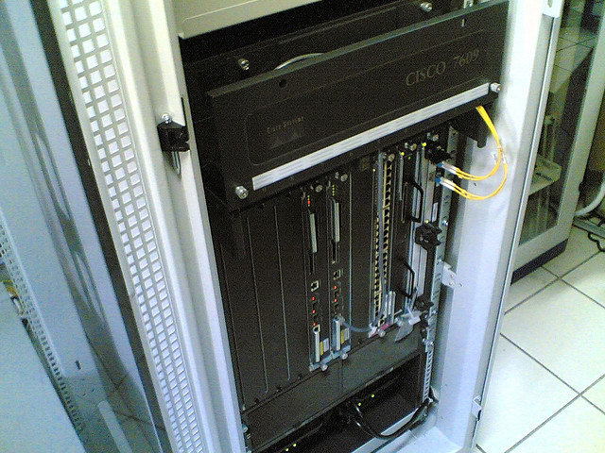
Boxes

Slide 22

Questions

