Slide 1
Network Security I
Introduction to cryptography

Slide 2
What is cryptography
The science for „hiding“ of information from third parties
Achieves its goals by converting the input data (plaintext) through various algorithms and keys to encrypted data (cyphertext)

Slide 3
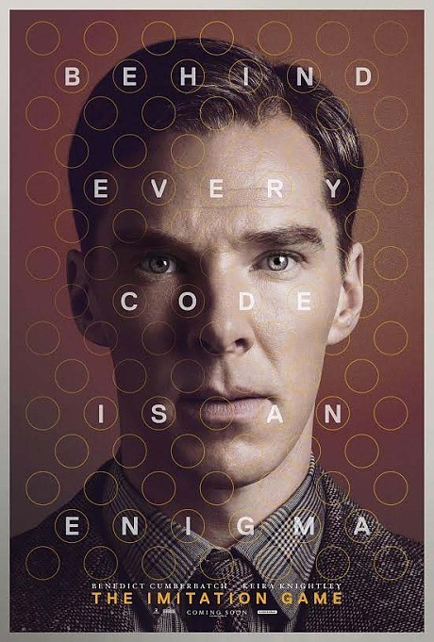
Very interesting movies
National Geographic
- Codebrakers
The Imitation Game
The complexity of CODES

Slide 4
!!! WARNING !!!
Cryptography is one of the most complex branches of mathematics
A small error almost always leads to a total breach of the cryptosystem
DO NOT create your own crypto algorithms
Carefully study what you are using
Check the following books
  Applied Cryptography
  Cryptography Engineering (C.E.)
  It is scary !!!

Slide 5
Basic concepts
Plaintext
Cyphertext
Entropy
Encryption / decryption (not to be confused with archieving / compression )
Signing (so-called digital signature)
Authorization
Random generator
Wikipedia: Entropy

Slide 6
Historical ciphers
Substitution
Caesar cipher (permutation)
Vigenère cipher
Vernam cipher (one-time pad)
  The only mathematically proven, secure cipher
Enigma

Slide 7
Caesar cipher
Offset with N = 3
a b c d e f g h i j k l m n o p q r s t u v w x y z
d e f g h i j k l m n o p q r s t u v w x y z a b c

Slide 8
Substitution
Hidden message-> Lmhhnj ....
H -> L I -> M D -> Н
D -> H E -> N N -> J
Vigenère cipher
Text | А | Т | Т | А | C | K | A | T | D | A | W | N
Key | L | E | M | O | N | L | E | M | O | N | L | E
Ciphertext | L | X | F | O | P | V | E | F | R | N | H | R

Slide 9
A B C D E F G H I J K L M N O P Q R S T U V W X Y Z
A A B C D E F G H I J K L M N O P Q R S T U V W X Y Z
B B C D E F G H I J K L M N O P Q R S T U V W X Y Z A
C C D E F G H I J K L M N O P Q R S T U V W X Y Z A B
D D E F G H I J K L M N O P Q R S T U V W X Y Z A B C
E E F G H I J K L M N O P Q R S T U V W X Y Z A B C D
F F G H I J K L M N O P Q R S T U V W X Y Z A B C D E
G G H I J K L M N O P Q R S T U V W X Y Z A B C D E F
H H I J K L M N O P Q R S T U V W X Y Z A B C D E F G
I I J K L M N O P Q R S T U V W X Y Z A B C D E F G H
J J K L M N O P Q R S T U V W X Y Z A B C D E F G H I
K K L M N O P Q R S T U V W X Y Z A B C D E F G H I J
L L M N O P Q R S T U V W X Y Z A B C D E F G H I J K
M M N O P Q R S T U V W X Y Z A B C D E F G H I J K L
N N O P Q R S T U V W X Y Z A B C D E F G H I J K L M
O O P Q R S T U V W X Y Z A B C D E F G H I J K L M N
P P Q R S T U V W X Y Z A B C D E F G H I J K L M N O
Q Q R S T U V W X Y Z A B C D E F G H I J K L M N O P
R R S T U V W X Y Z A B C D E F G H I J K L M N O P Q
S S T U V W X Y Z A B C D E F G H I J K L M N O P Q R
T T U V W X Y Z A B C D E F G H I J K L M N O P Q R S
U U V W X Y Z A B C D E F G H I J K L M N O P Q R S T
V V W X Y Z A B C D E F G H I J K L M N O P Q R S T U
W W X Y Z A B C D E F G H I J K L M N O P Q R S T U V
X X Y Z A B C D E F G H I J K L M N O P Q R S T U V W
Y Y Z A B C D E F G H I J K L M N O P Q R S T U V W X
Z Z A B C D E F G H I J K L M N O P Q R S T U V W X Y
Vigenère
cipher

Slide 10
A B C D E F G H I J K L M N O P Q R S T U V W X Y Z
A A B C D E F G H I J K L M N O P Q R S T U V W X Y Z
B B C D E F G H I J K L M N O P Q R S T U V W X Y Z A
C C D E F G H I J K L M N O P Q R S T U V W X Y Z A B
D D E F G H I J K L M N O P Q R S T U V W X Y Z A B C
E E F G H I J K L M N O P Q R S T U V W X Y Z A B C D
F F G H I J K L M N O P Q R S T U V W X Y Z A B C D E
G G H I J K L M N O P Q R S T U V W X Y Z A B C D E F
H H I J K L M N O P Q R S T U V W X Y Z A B C D E F G
I I J K L M N O P Q R S T U V W X Y Z A B C D E F G H
J J K L M N O P Q R S T U V W X Y Z A B C D E F G H I
K K L M N O P Q R S T U V W X Y Z A B C D E F G H I J
L L M N O P Q R S T U V W X Y Z A B C D E F G H I J K
M M N O P Q R S T U V W X Y Z A B C D E F G H I J K L
N N O P Q R S T U V W X Y Z A B C D E F G H I J K L M
O O P Q R S T U V W X Y Z A B C D E F G H I J K L M N
P P Q R S T U V W X Y Z A B C D E F G H I J K L M N O
Q Q R S T U V W X Y Z A B C D E F G H I J K L M N O P
R R S T U V W X Y Z A B C D E F G H I J K L M N O P Q
S S T U V W X Y Z A B C D E F G H I J K L M N O P Q R
T T U V W X Y Z A B C D E F G H I J K L M N O P Q R S
U U V W X Y Z A B C D E F G H I J K L M N O P Q R S T
V V W X Y Z A B C D E F G H I J K L M N O P Q R S T U
W W X Y Z A B C D E F G H I J K L M N O P Q R S T U V
X X Y Z A B C D E F G H I J K L M N O P Q R S T U V W
Y Y Z A B C D E F G H I J K L M N O P Q R S T U V W X
Z Z A B C D E F G H I J K L M N O P Q R S T U V W X Y
Vigenère
cipher
А | Т | Т
L | E | M
L

Slide 11
A B C D E F G H I J K L M N O P Q R S T U V W X Y Z
A A B C D E F G H I J K L M N O P Q R S T U V W X Y Z
B B C D E F G H I J K L M N O P Q R S T U V W X Y Z A
C C D E F G H I J K L M N O P Q R S T U V W X Y Z A B
D D E F G H I J K L M N O P Q R S T U V W X Y Z A B C
E E F G H I J K L M N O P Q R S T U V W X Y Z A B C D
F F G H I J K L M N O P Q R S T U V W X Y Z A B C D E
G G H I J K L M N O P Q R S T U V W X Y Z A B C D E F
H H I J K L M N O P Q R S T U V W X Y Z A B C D E F G
I I J K L M N O P Q R S T U V W X Y Z A B C D E F G H
J J K L M N O P Q R S T U V W X Y Z A B C D E F G H I
K K L M N O P Q R S T U V W X Y Z A B C D E F G H I J
L L M N O P Q R S T U V W X Y Z A B C D E F G H I J K
M M N O P Q R S T U V W X Y Z A B C D E F G H I J K L
N N O P Q R S T U V W X Y Z A B C D E F G H I J K L M
O O P Q R S T U V W X Y Z A B C D E F G H I J K L M N
P P Q R S T U V W X Y Z A B C D E F G H I J K L M N O
Q Q R S T U V W X Y Z A B C D E F G H I J K L M N O P
R R S T U V W X Y Z A B C D E F G H I J K L M N O P Q
S S T U V W X Y Z A B C D E F G H I J K L M N O P Q R
T T U V W X Y Z A B C D E F G H I J K L M N O P Q R S
U U V W X Y Z A B C D E F G H I J K L M N O P Q R S T
V V W X Y Z A B C D E F G H I J K L M N O P Q R S T U
W W X Y Z A B C D E F G H I J K L M N O P Q R S T U V
X X Y Z A B C D E F G H I J K L M N O P Q R S T U V W
Y Y Z A B C D E F G H I J K L M N O P Q R S T U V W X
Z Z A B C D E F G H I J K L M N O P Q R S T U V W X Y
Vigenère
cipher
А | Т | Т
L | E | M
L | X

Slide 12
A B C D E F G H I J K L M N O P Q R S T U V W X Y Z
A A B C D E F G H I J K L M N O P Q R S T U V W X Y Z
B B C D E F G H I J K L M N O P Q R S T U V W X Y Z A
C C D E F G H I J K L M N O P Q R S T U V W X Y Z A B
D D E F G H I J K L M N O P Q R S T U V W X Y Z A B C
E E F G H I J K L M N O P Q R S T U V W X Y Z A B C D
F F G H I J K L M N O P Q R S T U V W X Y Z A B C D E
G G H I J K L M N O P Q R S T U V W X Y Z A B C D E F
H H I J K L M N O P Q R S T U V W X Y Z A B C D E F G
I I J K L M N O P Q R S T U V W X Y Z A B C D E F G H
J J K L M N O P Q R S T U V W X Y Z A B C D E F G H I
K K L M N O P Q R S T U V W X Y Z A B C D E F G H I J
L L M N O P Q R S T U V W X Y Z A B C D E F G H I J K
M M N O P Q R S T U V W X Y Z A B C D E F G H I J K L
N N O P Q R S T U V W X Y Z A B C D E F G H I J K L M
O O P Q R S T U V W X Y Z A B C D E F G H I J K L M N
P P Q R S T U V W X Y Z A B C D E F G H I J K L M N O
Q Q R S T U V W X Y Z A B C D E F G H I J K L M N O P
R R S T U V W X Y Z A B C D E F G H I J K L M N O P Q
S S T U V W X Y Z A B C D E F G H I J K L M N O P Q R
T T U V W X Y Z A B C D E F G H I J K L M N O P Q R S
U U V W X Y Z A B C D E F G H I J K L M N O P Q R S T
V V W X Y Z A B C D E F G H I J K L M N O P Q R S T U
W W X Y Z A B C D E F G H I J K L M N O P Q R S T U V
X X Y Z A B C D E F G H I J K L M N O P Q R S T U V W
Y Y Z A B C D E F G H I J K L M N O P Q R S T U V W X
Z Z A B C D E F G H I J K L M N O P Q R S T U V W X Y
Vigenère
cipher
А | Т | Т
L | E | M
L | X | F

Slide 13

One-time pad
Hidden message-> Lmhhnj ....
H -> L I -> M D -> Н
D -> H E -> N N -> J
One-time pad
http://en.wikipedia.org/wiki/One-time_pad

Slide 14
Basic primitives
Random generators
Hash functions
Block and stream ciphers
Symmetric and asymmetric algorithms
Schemes for applying ciphers
Linux Random Generator is not secure
Ensuring randomness
Open Hardware Random Number Generator

Slide 15
Random generators
Very important for almost any cryptosystem
Used in key generation, padding and more.
They are defined by how much entropy they provide
Description of the linux random generator
  Sources of entropy
  Entropy pool and mixing
  Types of output (random, urandom)
Linux Kernel RNG

Slide 16
Random number generator attacks
Software RNGs
  Direct cryptanalytic attack
  Input-based attacks
  State compromise extension attacks
Hardware RNGs
RNG subversion
Wikipedia: Random number generator attack

Slide 17
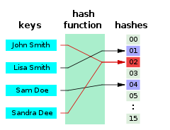
Hash functions

Slide 18
Hash functions
They give us a "signature" based on supplied input data
They are defined as one-way functions, producing a fixed size output for any random input
Objectives: irreversible, highly dependent on the entrance, difficult to detect collisions
MD4, MD5, SHA-1, SHA-2

Slide 19
Attacks on Hash features
Exhaustive search (bruteforce)
Collision attacks
  h(plaintext A) = xxx & h(plaintext B) = xxx
Rainbow tables
  calculated all possible results from h()
Timing attacks
Cryptanalysis
  attacks on the compression functions
  attacks on the padding algorithm

Slide 20
Symmetric block ciphers
Fundamental in cryptography
Given a key, they encrypt a block of data with a fixed length
Wanted properties:
  Without the key, the plaintext cannot be retrieved from the ciphertext
  From the combination of ciphertext and plaintext, one can not derive the key
Such are:
  Data Encryption Standard (DES)
  Advanced Encryption Standard (AES)

Slide 21
Block cipher systems
ElectronicCodeBook(ECB) – each block is encrypted separately with the key
  The same text encrypted twice gives the same cyphertext
  Replay attacks
CypherBlockChaining(CBC) – the first block is XORed with IV, following blocks – with the resulting cyphertext, from the previous
PCBC, CFB, OFB, CTR
Wikipedia: Block cipher modes of operation

Slide 22
Initialization Vector (IV)
Additional data selected to make our block cipher more secure
  fixed-IV
  counter-IV
  random-IV
  nounce-generated-IV
Nounce - number used once
  usually unique number for the unique key

Slide 23

Block cipher systems - XOR
Exclusive OR
INPUT OUTPUT
A B
0 0 0
0 1 1
1 0 1
1 1 0

Slide 24

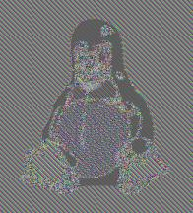

Block cipher systems
Plaintext
ECB
CBC/PCBC/CTR

Slide 25
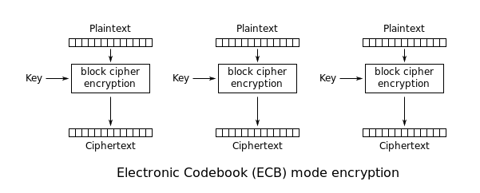
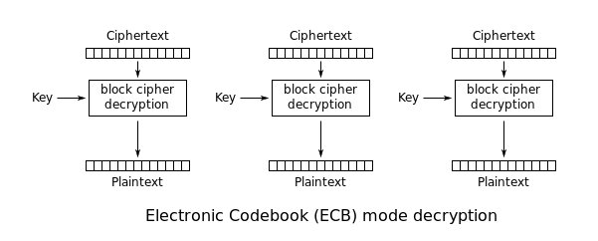
Block cipher systems - ECB

Slide 26
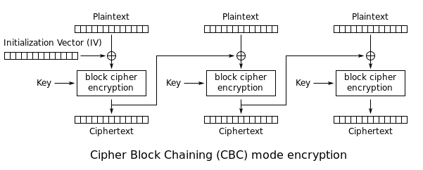
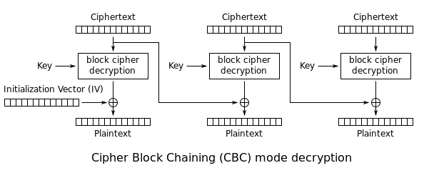
Block cipher systems - CBC

Slide 27
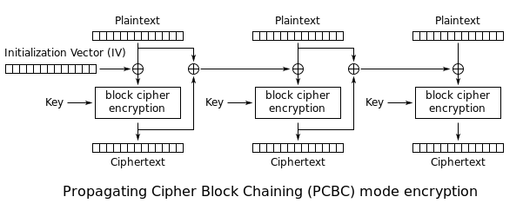
Block cipher systems - PCBC

Slide 28
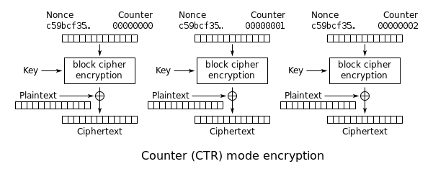
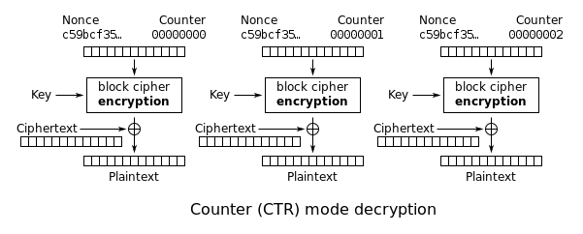
Block cipher systems - CTR

Slide 29
Attacks against block ciphers
Choosen plaintext
Birthday attacks (Sweet32, CVE-2016-2183)
Weak keys
Wikipedia: Birthday_problem

Slide 30
Review
What is cryptography
Historical ciphers (Caesar, one-time pad)
Hash functions (MD5, SHA-1, SHA-2, others)
Symmetric block ciphers (DES, AES,)
Mode for using block ciphers
Easy vs. hard
What knowledge has the attacker

Slide 31
Symmetric stream codes
The key is used to generate a stream (keystream)
The plaintext is XORed with that stream
Synchronous and self-synchronizing
Linear Feedback Shift Registers – with additions
Attacks: reused key, substitution(bit flipping)
Voice, wireless, SSL, Gpcode.ak :)

Slide 32
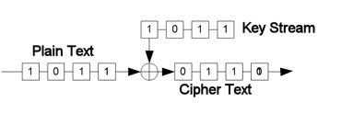
Synchronous symmetric ciphers

Slide 33
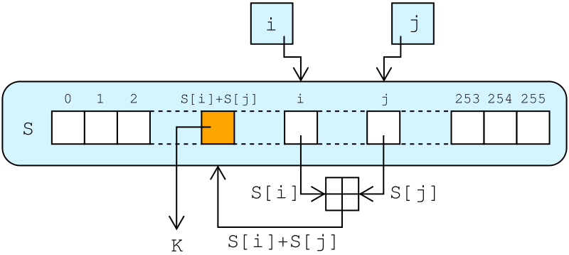
Self-synchronizing stream ciphers
Example from RC4
i := 0
j := 0
while GeneratingOutput:
i := (i + 1) mod 256
j := (j + S[i]) mod 256
swap values of S[i] and S[j]
k := S[ (S[i] + S[j]]) mod 256]
output k
endwhile

Slide 34
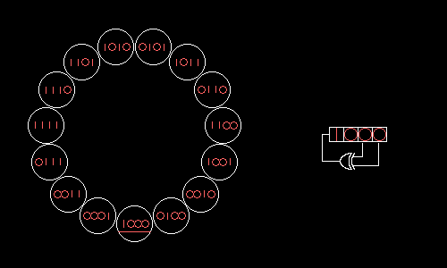
Linear Feedback Shift Registers

Slide 35
Asymmetric ciphers
Two keys, public (pub) and private (priv)
The public is given to the world
Something encrypted with the public key, can only be decrypted with the private key
Signing - a hash is made from the plaintext, after which the result is encrypted with the private key, which can be validated with public key

Slide 36
Asymmetric ciphers
(m^{e})^{d} ≡ m (mod n)
(m^{d})^{e} ≡ m (mod n)
d = pub/priv key
e = priv/pub key
Encryption: Decription:
c ≡ m^{e} (mod n) c^{d} ≡ (m^{e})^{d} ≡ m (mod n)

Slide 37
RSA
Prime numbers and random numbers
n=p*q, D – mutually prime with (p-1)*(q-1), E
Private key – pair(D, n) public - pair(E, n)
a^{E} mod n – hard with large p, q
Easy to implement, time consuming, difficult to "break"
Still good and used (others: DSA, ElGamal, elliptic curve)

Slide 38
RSA
Two prime numbers p и q
we choose n = p x q
D mutually prime with (p-1)x(q-1)
We search for such a number E, that
DE = 1 (mod(n))
Wikipedia: RSA_(algorithm)

Slide 39
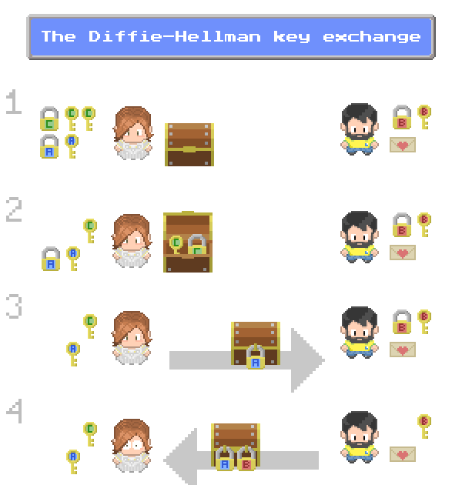

Slide 40
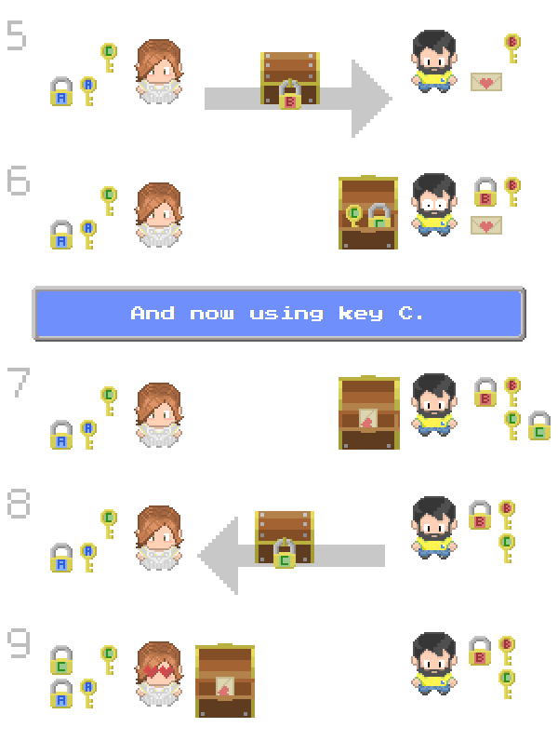

Slide 41
Challenge-response
А and B have a shared secret
A a sends a challenge(random number) to B
B concats a the secret to the challenge and calculates a hash, out of the resulting string, which is then sent to A
  alternatively, encrypts with a simmetrical cipher
A makes the same operation and verifies the result with the recieved data
Man-in-the-middle attack

Slide 42
Server sends a unique challenge value sc to the client
Client generates unique challenge value cc
Client computes cr = hash(cc + sc + secret)
Client sends cr and cc to the server
Server calculates the expected value of cr and ensures the client responded correctly
Server computes sr = hash(sc + cc + secret)
  Server sends sr
  Client calculates the expected value of sr and ensures the server responded correctly

Slide 43
HMAC
A and B both have a shared secret
A sends a bitstream to B, with concatenated hash from the bitstream with the secret
B can verify if the hash matches the supplied data and can certify that it cam from A
Replay атаки

Slide 44
Key strengthening and Salt
Key strengthening
key = hash(password)
for 1 to 65000 do
key = hash(key)
Salt
key = hash(password + salt)

Slide 45
Side channel атаки
Измислили сте страхотни алгоритми, но...
TEMPEST (ван Ек, EMSEC)
Timing – stream ciphers, RSA
Power Analysis – смарт-карти, PPV TV
Acoustic – принтери, банкомати, пишещи машини, подслушвайки шума на PCI шината и дори слушайки определени честоти издавани от CPU-то на машината

Slide 46
SSL/TLS
Secure Socket Layer
  developed in 1995 by Netscape
  in use since 2014 when SSLv3 was declared insecure
Transport Layer Security
  1.0 developed in 1999, breakes interoperability between SSL and TLS
  1.1 2006 with additional protections (CBC, Padding, IV)
  1.2 2008 replaced MD5-SHA1 with SHA-256
    introduced TLS extensions

Slide 47
What is an SSL certificate?
Esentially a simple text file
  includes the domain(s) that it should goven
  the name of the company that owns the above domains
  who issued the certificate
  validity dates
Common name: google.com
Organization: Google Inc.
Organizational Unit:
Serial number:
Issued by:

Slide 48
What's in a SSL certificate?
Common name: google.com
  Organization: Google Inc.
  Organizational Unit:
  Serial number:
Issued by:
  Common name: Equifax
  Organization unit: Equifax Secure Certificate Authority
Validity
  not before
  not after

Slide 49

Certificate authority
Root CA
Intermediate CA
End User
Certificate

Slide 50







Certificate authority
Root CA
Intermediate CA
End User
Certificate

Slide 51
SSL/TLS attacks
Apr.2014 Heartbleed
Jun.2014 Protocl Downgrade attack
Aug.2014 Protocl Downgrade attack
Sep.2014 POODLE
Mar.2015 FREAK Attack - encryption downgrade attack
Jan.2016 Guess DH exponent
Mar.2016 DROWN / CacheBleed

Slide 52
SSL/TLS attacks
Apr.2014 Heartbleed
  A missing bounds check in the handling of the TLS heartbeat extension can be used to reveal up to 64kB of memory to a connected client or server
  http://heartbleed.com/ - OpenSSL 1.0.1 through 1.0.1f (inclusive) are vulnerable
Jun.2014 Protocl Downgrade attack
  https://www.openssl.org/news/secadv/20140605.txt
Aug.2014 Protocl Downgrade attack
  https://www.openssl.org/news/secadv/20140806.txt

Slide 53
SSL/TLS attacks
Sep.2014 POODLE
  https://www.openssl.org/~bodo/ssl-poodle.pdf
  https://security.googleblog.com/2014/10/this-poodle-bites-exploiting-ssl-30.html
Mar.2015 FREAK Attack - encryption downgrade attack
  https://censys.io/blog/freak
  https://mitls.org/downloads/SmackTLS-Oakland15.pdf

Slide 54
SSL/TLS attacks
Jan.2016 Guess DH eponent
  https://www.openssl.org/news/secadv/20160128.txt
Mar.2016 DROWN / CacheBleed
  https://drownattack.com/
  https://ts.data61.csiro.au/projects/TS/cachebleed/

Slide 55
QUIC TLS
Uses ChaCha20 because AES is not HW accelerated everywhere(mobile devices)
It reimplements TLS but with 0-rtt renogetiation
draft-ietf-quic-tls
The work on ChaCha20 with QUIC inspires Adiantum

