Slide 1

ENERGY MARKET
SIGNAL INTELLIGECE
By Team INSPECT

Slide 2
Hot topics of this WEF?
Notes:
What were the hot topic of this WEF, except the geopolitical tensions? I think the best thing is to ask the special guest directly:

Slide 3
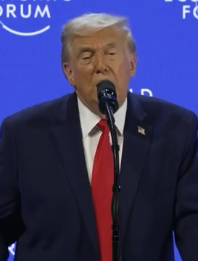
Notes:
As you saw, AI and energy were among the most discussed topics, and our challenge takes on that. Volue gave us access to their energy marked data, and we had to come up with an AI agentic tool to fetch the data and make it more accessible.
Here is what it looks like:

Slide 4
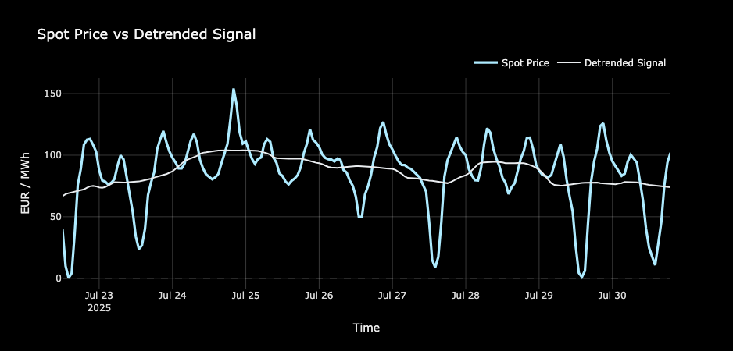
Signal Sesonality Detrending
Notes:
What were the hot topic of this WEF, except the geopolitical tensions? I think the best thing is to ask the special guest directly:

Slide 5
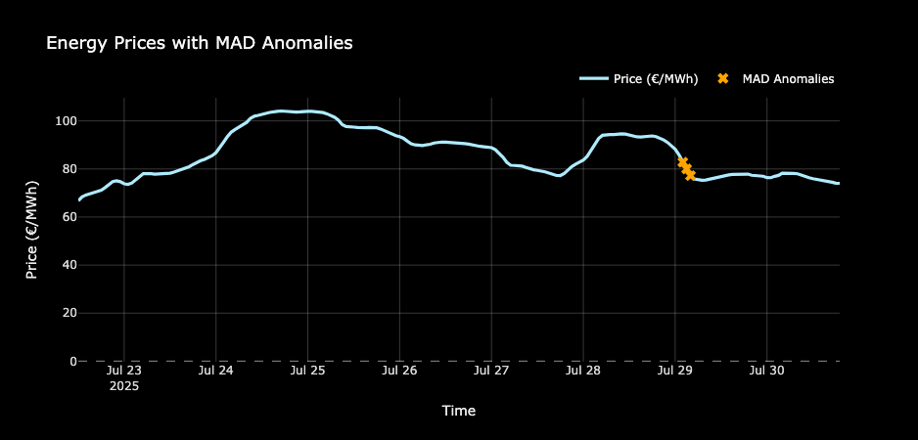
Anomalies Detection
Notes:
What were the hot topic of this WEF, except the geopolitical tensions? I think the best thing is to ask the special guest directly:

Slide 6
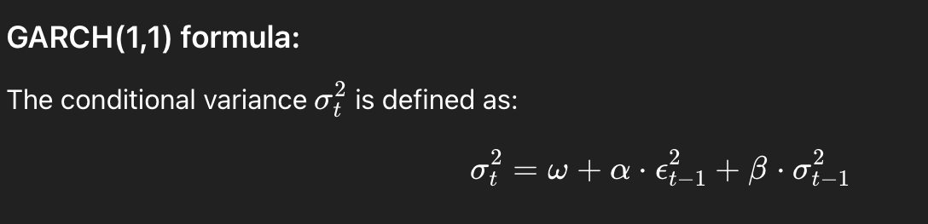
Volatility Estimate
Notes:
What were the hot topic of this WEF, except the geopolitical tensions? I think the best thing is to ask the special guest directly:

Slide 7
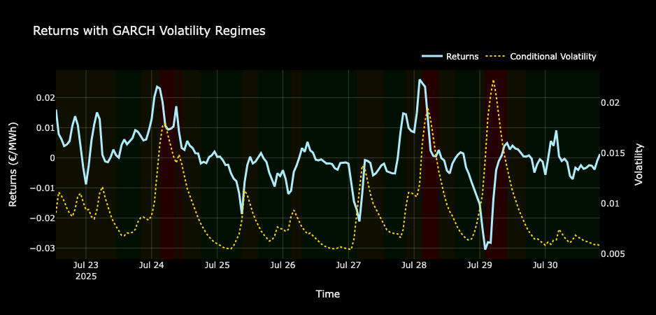
Volatility Estimate
Notes:
What were the hot topic of this WEF, except the geopolitical tensions? I think the best thing is to ask the special guest directly:

Slide 8
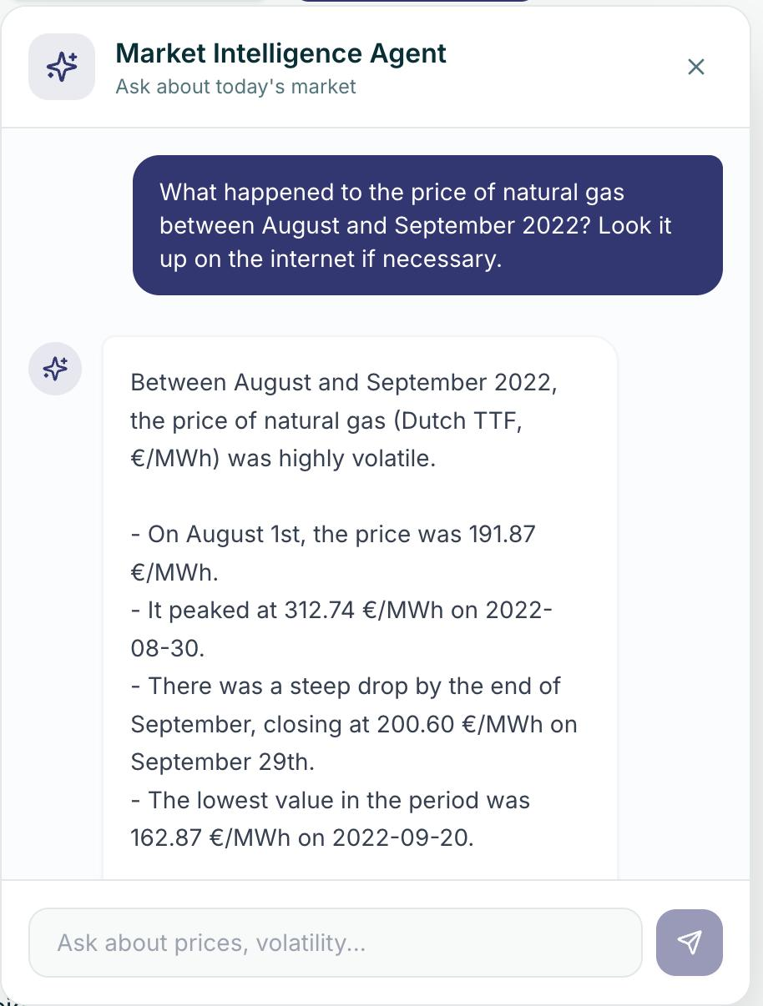
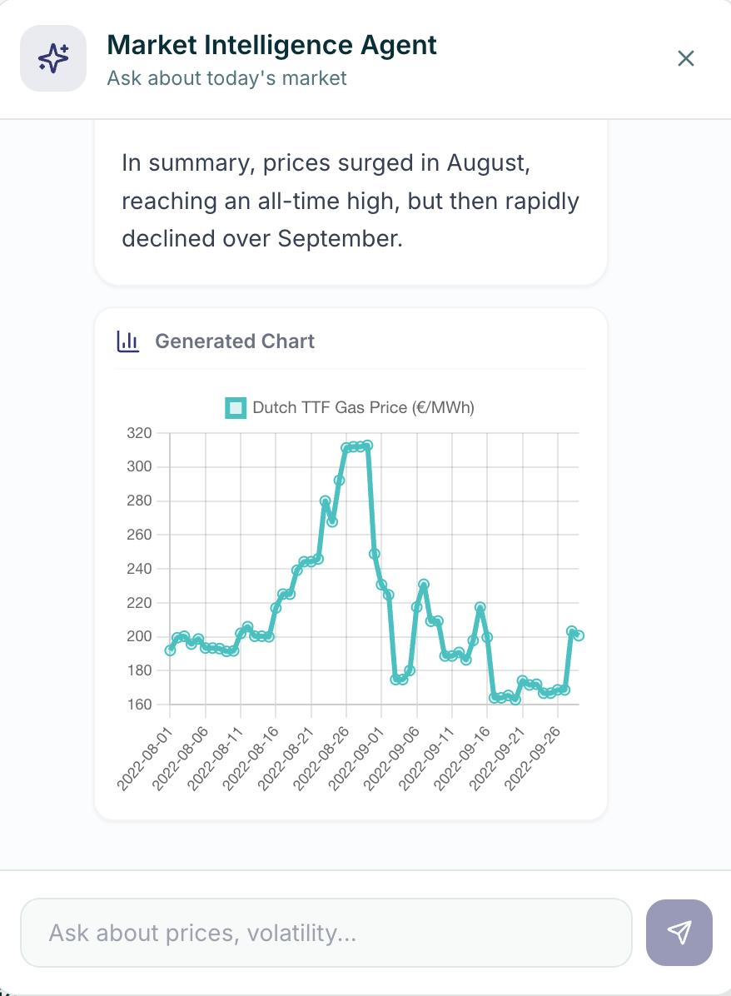
Ask Me Anything AI Agent
Notes:
What were the hot topic of this WEF, except the geopolitical tensions? I think the best thing is to ask the special guest directly:

Slide 9
But… Hot topics of this WEF?
Notes:
What were the hot topic of this WEF, except the geopolitical tensions? I think the best thing is to ask the special guest directly:

Slide 10
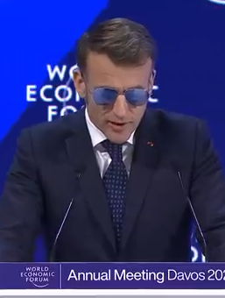
Notes:
As you saw, AI and energy were among the most discussed topics, and our challenge takes on that. Volue gave us access to their energy marked data, and we had to come up with an AI agentic tool to fetch the data and make it more accessible.
Here is what it looks like:

Slide 11
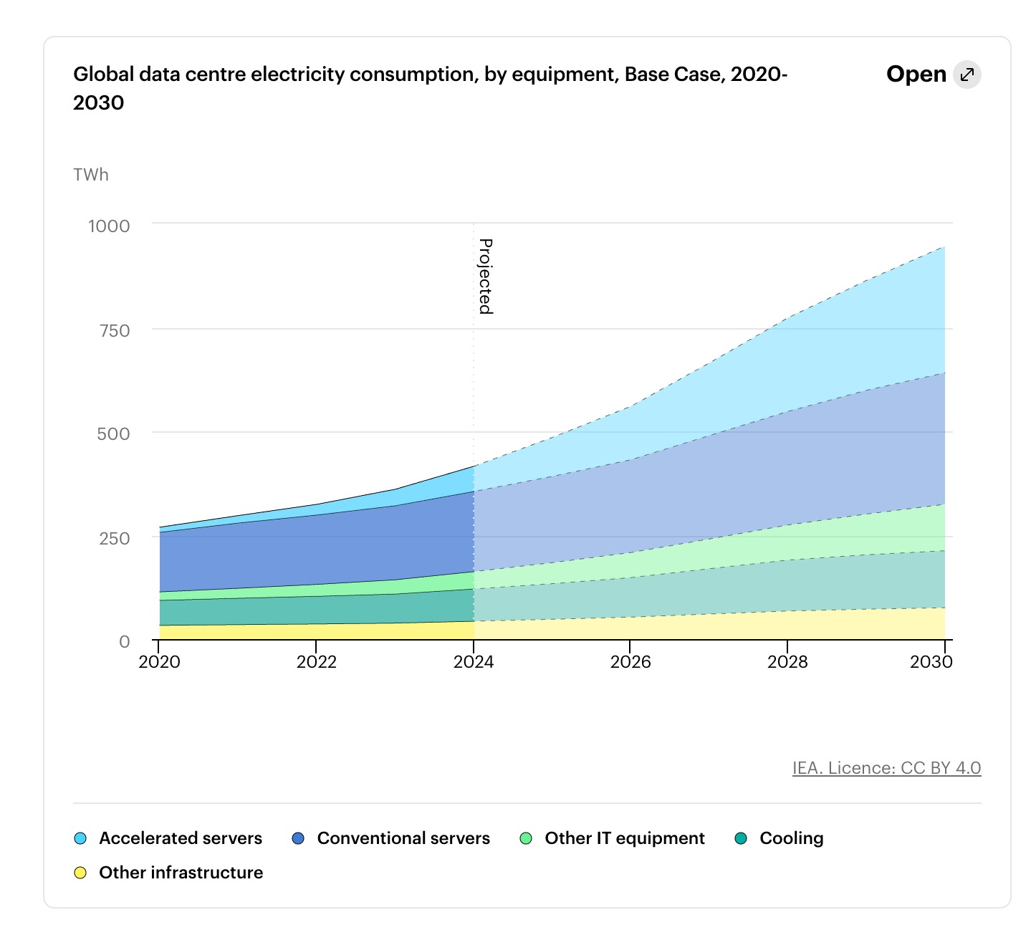
Energy Consumption Trends
Notes:
What were the hot topic of this WEF, except the geopolitical tensions? I think the best thing is to ask the special guest directly:

Slide 12
Energy Consumption Trends
72%
28%​
Cloud
On-Premise
Notes:
What were the hot topic of this WEF, except the geopolitical tensions? I think the best thing is to ask the special guest directly:

