Slide 1
Título
LOGO
Nome da equipe

Slide 2
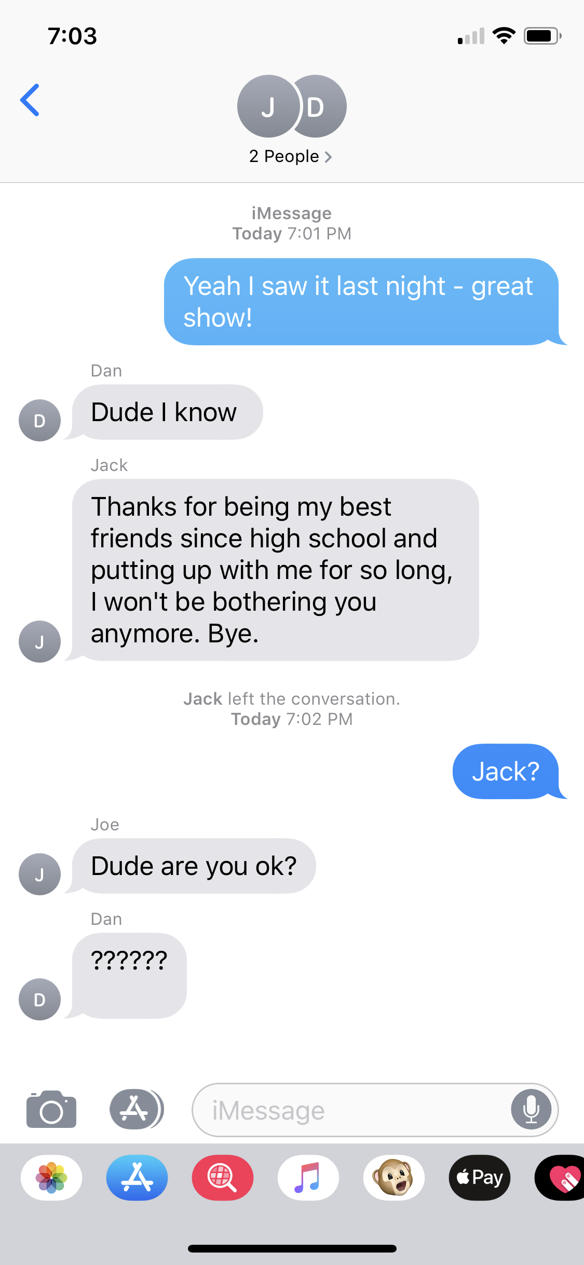
Persona

Slide 3
Need Statement - Definição do problema

Slide 4
Problema e solução
Long Waits for a Counselor
Limited Options
$$$
Real-Time Help
Choice
Access
Notes:
https://namiswwa.org/dangerous-wait-colleges-cant-meet-soaring-student-needs-mental-health-care/

Slide 5

Descrição

Slide 6

MVP
Notes:
Video Walkthrough coming up
Anonymity
Filtering
Matching
Legitimacy of members (all .edu)
First Aid Aspect
Free of cost to user
Connects to resources at university

Slide 7
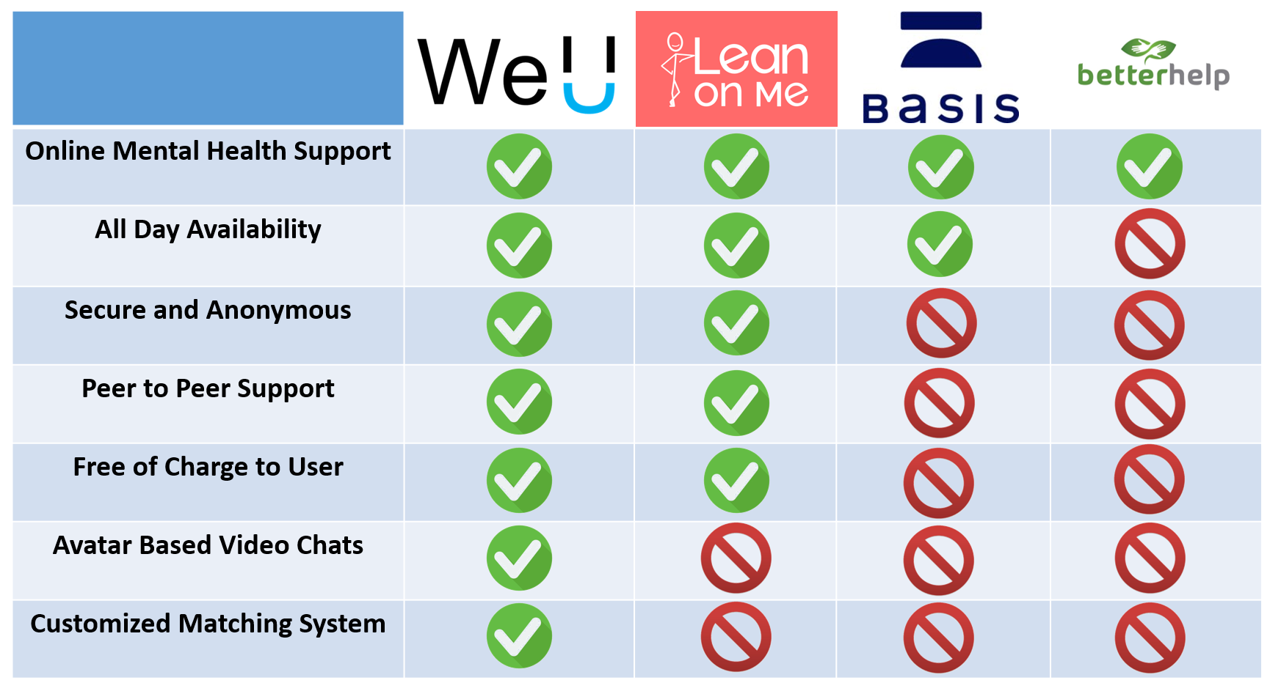
Benchmarking
Notes:
Basis (voice or video sessions with mental health specialists for $35 per 45-minute session)
Weaknesses: Cost $$$
BetterHelp (private paid online counseling from licensed therapists, $35 to $70 per week)
Weaknesses: Cost, Ethical issues (privacy and safety)
7 Cups of Tea (online therapy & free counseling via online listeners)
Weaknesses: Broad, can be anybody, lack of screening, difficult to use, cluttered, not user-friendly
iPrevail (https://www.iprevail.com) ($9.99/month online peer counseling & therapy)
Weaknesses: Broad, can be anybody, lack of screening, only chat

Slide 8
Modelo de Negocio
$3
$35M
600K
Avg. University Cost Per Enrolled Student
Similar to the pricing of an existing student health product
Students
Based off of a 5% market share
Annual Revenue
Notes:
Infographic consistency

Slide 9
Stakeholders
Student
Retention
Mitigation of Adverse Events
Supplemental Resource
Notes:
Adoption? How are we going to get universities & students onboard?
Leverage on-campus organizations, students, alumni
Orientation
First Aid - stats about schools that already do this
Supply/demand?
Mandatory for residential advisors or orientation leaders or first-year seminar leaders or staff?
Peer-to-peer
For people who want to help, they can select that they have previously experienced depressive symptoms/episodes and have overcome it
Clarify: patients who are currently experiencing symptoms will be paired with peers who have experienced this in the past
EAP adopted into University system?

Slide 10

Equipe
Thank You!

