Slide 1
Hype&Vibe
a collaboration based project by kistehén team
Simófi Levente Moroșanu Norbert
Vajda Lehel-Barna
Kiss Krisztián

Slide 2
Wanna know where the best parties take place?
Wanna find contributors or participants to your party?
Come join us and find out about parties! Post your own event!
Events organized BY users FOR users.
→ crowfunding

Slide 3
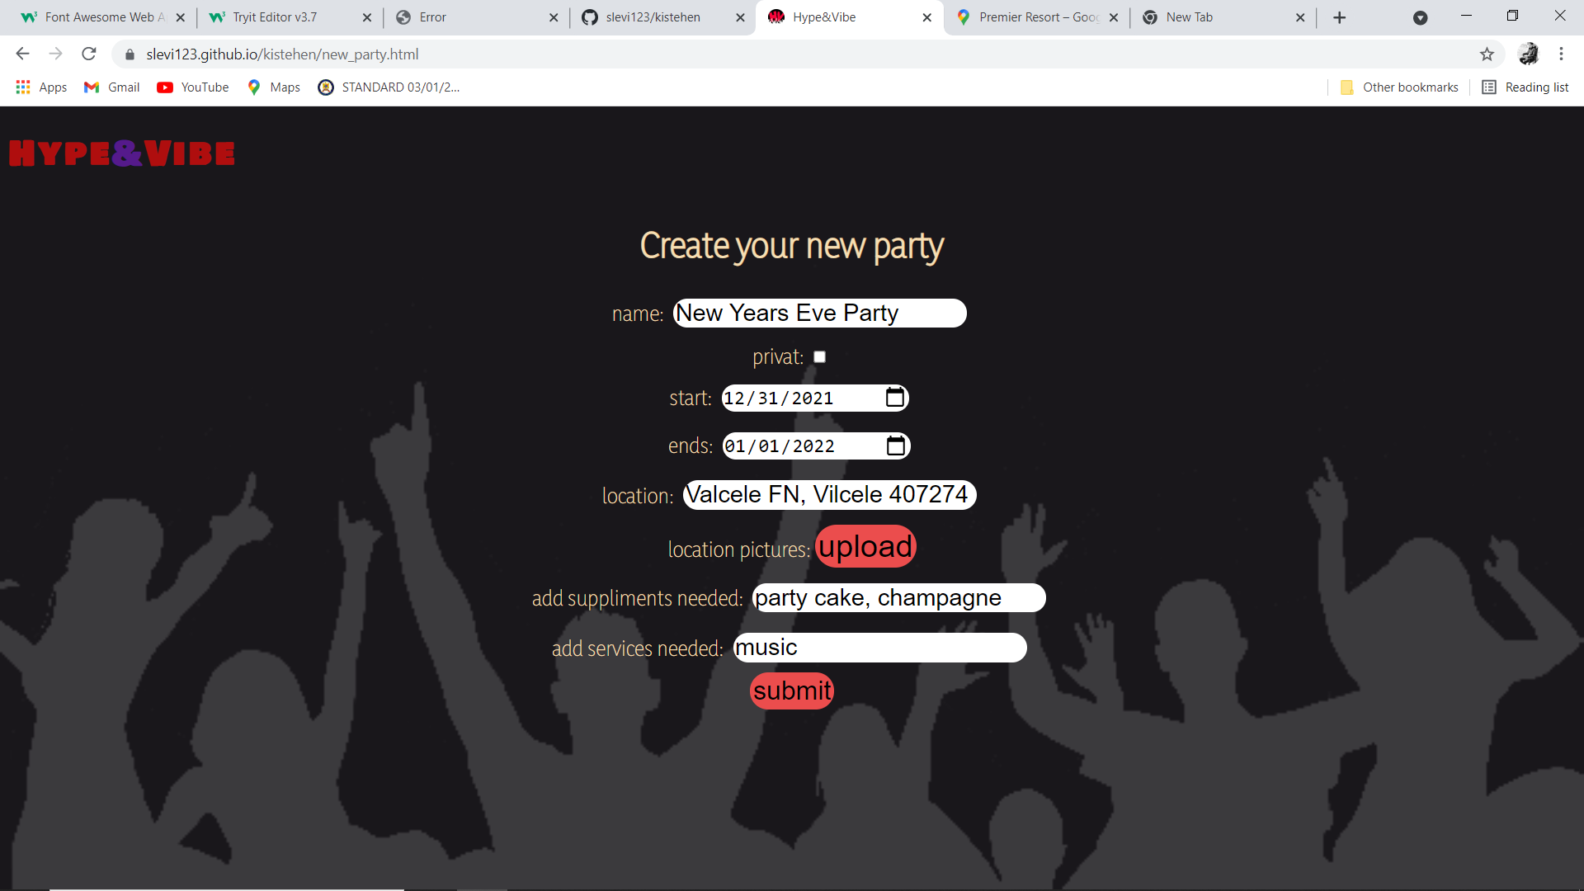

Slide 4
The qualities of users
Organizer | Contributor | Participant
add new events | volunteer for bringing supplies | marks that they are willing to take place at a party
request supplies
ex. Music, drink needed

Slide 5
Features
registration system
email, username, password
gender, age
CNP

Slide 6
rating system
organizers can rate:
contributors (ghosting)
their participants, in general
participants can rate:
parties -> the organizers

Slide 7
Future plans
friends list
private/public parties
customer service
android, iOS & web application
premium version

Slide 8
Premium version
possibility for paying for the app
ad-free version
your parties will be highlighted
as a participant, you can see who else will participate

Slide 9
Now the demo…

