Slide 1
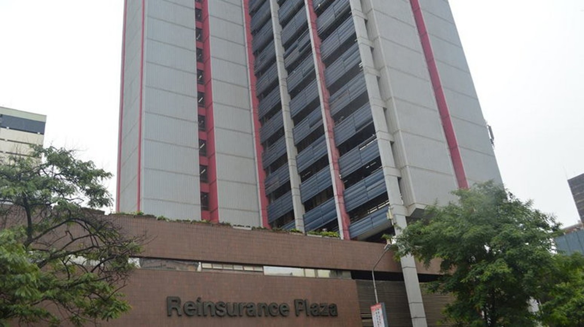
TrueClaim AI
Presented By
The Hacknovators
1

Slide 2

PROBLEM
Claims Processing and Fraud Detection Using AI
Current State | Desired State
Too much reliance on manual data entry and verification. Slow processing times. Fraudulent claims often slip through undetected. Frustrated Stakeholders | Automated document processing. Faster claim settlement. Free staff for higher value tasks Enhanced customer experience with quicker solutions.
2

Slide 3

STAKEHOLDERS
People or organizations that can be affected or can benefit from this system.
Insurers
Reinsurers
Insured
Regulators
Staff and Rating Agencies
3

Slide 4
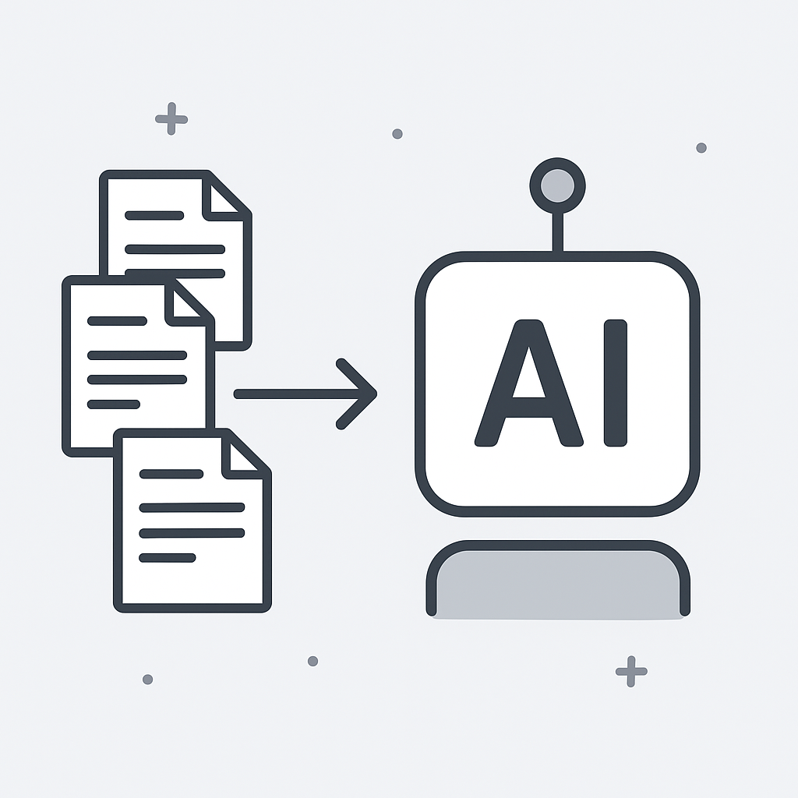
DATA SOURCES
Treaty Slips
OCR Bordereau
Claims Notifications
Cash Call Reports
SICS Treaty Details
4

Slide 5
WORKFLOW
In this slide, the whole process the AI will go through is explained with aid of a flow chart included in the GitHub Repository.
5

Slide 6

WHAT ARE SOME OF THE BENEFITS?
Real-time settlements
Lower loss ratios
Better Customer Service
Resource Optimization
6

Slide 7


