Slide 1
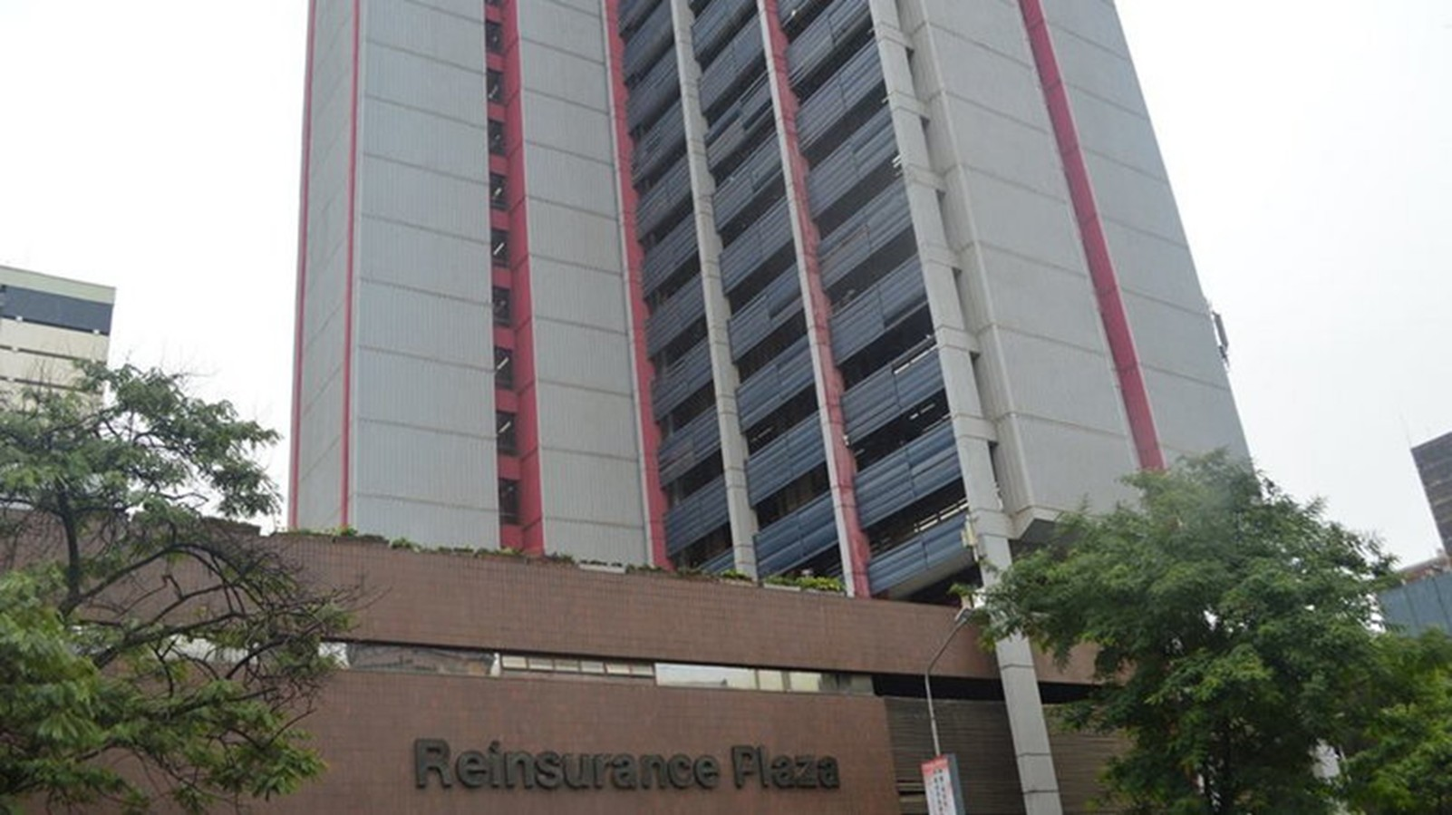
TrueClaim AI
Presented By
The Hacknovators
1

Slide 2

PROBLEM
Claims Processing and Fraud Detection Using AI
Current State | Desired State
Too much reliance on manual data entry and verification. Slow processing times. Fraudulent claims often slip through undetected. Frustrated Stakeholders | Automated document processing. Faster claim settlement. Free staff for higher value tasks Enhanced customer experience with quicker solutions.
2

Slide 3

STAKEHOLDERS
People or organizations that can be affected or can benefit from this system.
Insurers
Reinsurers
Insured
Regulators
Staff and Rating Agencies
3

Slide 4


Slide 6


Slide 7


