Slide 1
Cortex-M0+ Exceptions and Interrupts

Slide 2
Overview
Exception and Interrupt Concepts
Entering an Exception Handler
Exiting an Exception Handler
Cortex-M0+ Interrupts
Using Port Module and External Interrupts
Timing Analysis
Program Design with Interrupts
Sharing Data Safely Between ISRs and Other Threads
Sources
Cortex M0+ Device Generic User Guide - DUI0662
Cortex M0+ Technical Reference Manual - DUI0484
Notes:
Exceptions and interrupts are critical tools for making an embedded system responsive while supporting concurrent operation of hardware and software. They provide a simple task-scheduling and communication mechanism which is quite fast.

Slide 3
Exception and Interrupt Concepts

Slide 4
Example System with Interrupt
Goal: Change color of RGB LED when switch is pressed
Will explain details of interfacing with switch and LEDs in GPIO module later
Need to add external switch
Notes:
Here is an example of an embedded system which we build using an interrupt. We want the color of the light to change when the switch is pressed.

Slide 5
How to Detect Switch is Pressed?
Polling - use software to check it
Slow - need to explicitly check to see if switch is pressed
Wasteful of CPU time - the faster a response we need, the more often we need to check
Scales badly - difficult to build system with many activities which can respond quickly. Response time depends on all other processing.
Interrupt - use special hardware in MCU to detect event, run specific code (interrupt service routine - ISR) in response
Efficient - code runs only when necessary
Fast - hardware mechanism
Scales well
ISR response time doesn’t depend on most other processing.
Code modules can be developed independently

Slide 6
Interrupt or Exception Processing Sequence
Main Code (Background)
Hardwired CPU response activities
ISR (Foreground)
Other code (background) is running
Interrupt trigger occurs
Processor does hard-wired processing
Processor executes ISR (foreground)
Processor does hard-wired processing
Processor resumes other code

Slide 7
Interrupts
Hardware-triggered asynchronous software routine
Triggered by hardware signal from peripheral or external device
Asynchronous - can happen anywhere in the program (unless interrupt is disabled)
Software routine - Interrupt service routine runs in response to interrupt
Fundamental mechanism of microcontrollers
Provides efficient event-based processing rather than polling
Provides quick response to events regardless* of program state, complexity, location
Allows many multithreaded embedded systems to be responsive without an operating system (specifically task scheduler)

Slide 8
Example Program Requirements & Design
RGB LED
ISR
Main
SW
count
(does initialization,
then updates LED based on count)
ISR
Task
Global Variable
Req1: When Switch SW is pressed, ISR will increment count variable
Req2: Main code will light LEDs according to count value in binary sequence (Blue: 4, Green: 2, Red: 1)
Req3: Main code will toggle its debug line each time it executes
Req4: ISR will raise its debug line whenever it is executing

Slide 9
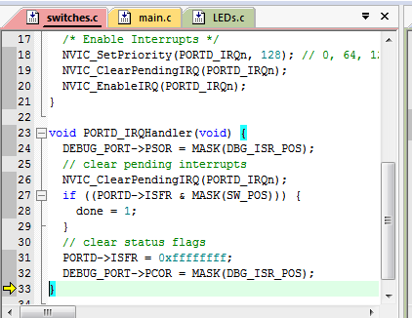
Example Exception Handler
We will examine processor’s response to exception in detail
Notes:
Here is an example of an exception handler for an interrupt request.

Slide 10
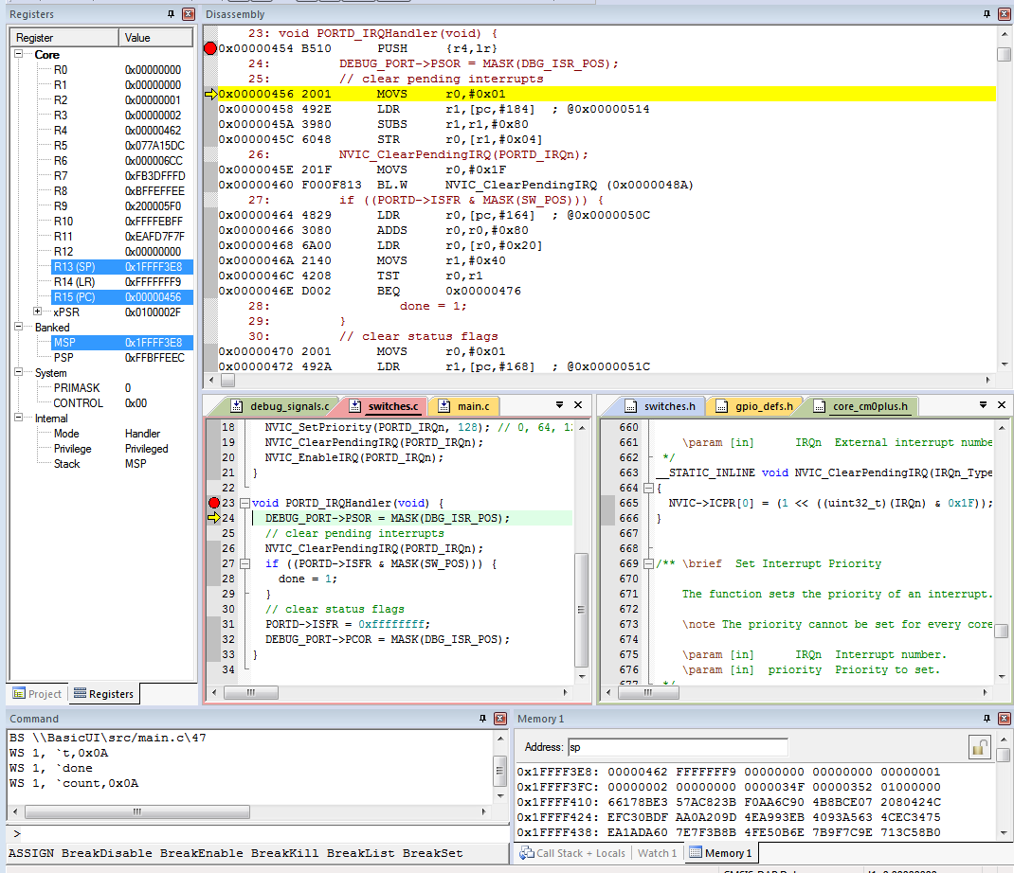
Use Debugger for Detailed Processor View
Can see registers, stack, source code, dissassembly (object code)
Note: Compiler may generate code for function entry (see address 0x0000_0454)
Place breakpoint on Handler function declaration line in source code (23), not at first line of function code (24)

Slide 11
Entering an Exception Handler

Slide 12
CPU’s Hardwired Exception Processing
Finish current instruction (except for lengthy instructions)
Push context (8 32-bit words) onto current stack (MSP or PSP)
xPSR, Return address, LR (R14), R12, R3, R2, R1, R0
Switch to handler/privileged mode, use MSP
Load PC with address of exception handler
Load LR with EXC_RETURN code
Load IPSR with exception number
Start executing code of exception handler
Usually 16 cycles from exception request to execution of first instruction in handler
Notes:
The CPU performs certain processing automatically in hardware to respond to an exception request. Since this is not in software, it executes quite quickly.

Slide 13
1. Finish Current Instruction
Most instructions are short and finish quickly
Some instructions may take many cycles to execute
Load Multiple (LDM), Store Multiple (STM), Push, Pop, MULS (32 cycles for some CPU core implementations)
This will delay interrupt response significantly
If one of these is executing when the interrupt is requested, the processor:
abandons the instruction
responds to the interrupt
executes the ISR
returns from interrupt
restarts the abandoned instruction

Slide 14
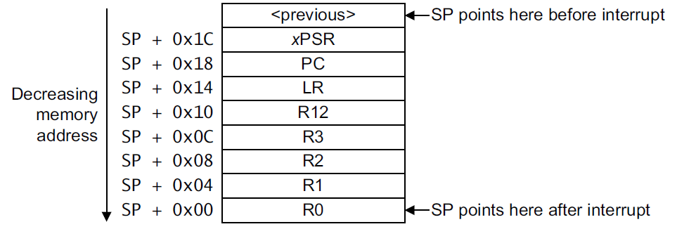
2. Push Context onto Current Stack
SP points here upon entering ISR
Two SPs: Main (MSP), process (PSP)
Which is active depends on operating mode, CONTROL register bit 1
Stack grows toward smaller addresses

Slide 15
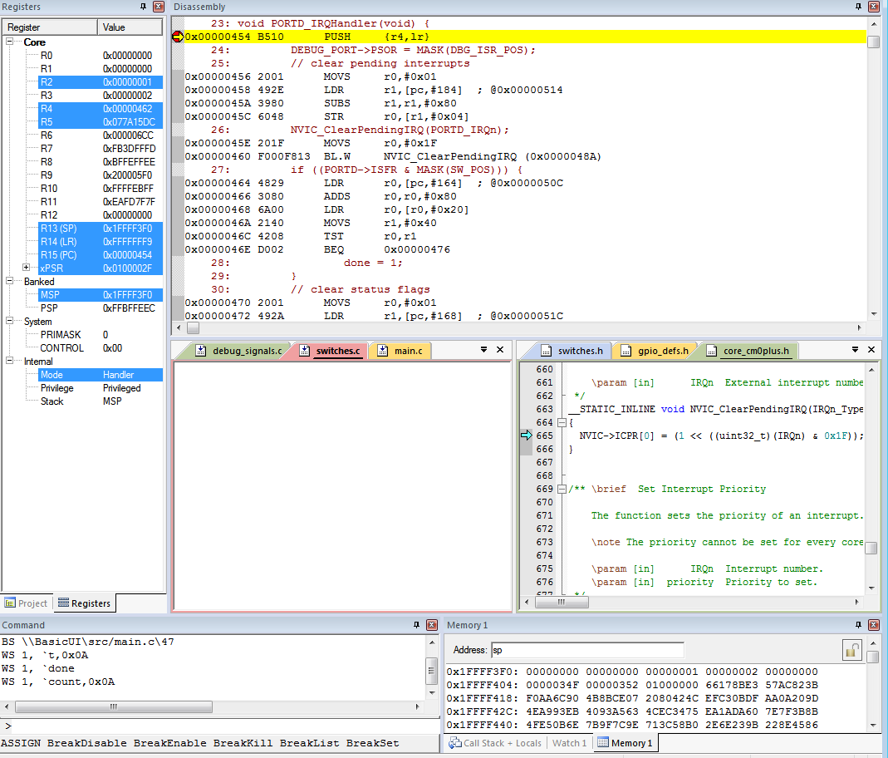
Context Saved on Stack
SP value is reduced since registers have been pushed onto stack
Saved R0
Saved R1
Saved R2
Saved R3
Saved R12
Saved LR
Saved PC
Saved xPSR
Notes:
Here we use the debugger to examine the processor state, including memory and registers. Some register values are covered over with yellow rectangles here because they haven’t happened yet: Step 2 just pushes the context onto the stack.

Slide 16
3. Switch to Handler/Privileged Mode
Reset
Thread
Mode. MSP or PSP.
Handler mode always uses Main SP
Exception Processing
Completed
Starting Exception Processing
Handler Mode
MSP
Notes:
The exception handler executes in Handler/Privileged mode, so it uses the main stack pointer (MSP).

Slide 17
Handler and Privileged Mode
Mode changed to Handler. Was already using MSP and in Privileged mode
Notes:
Now we see that the mode has changed to handler.

Slide 18
Update IPSR with Exception Number
PORTD_IRQ is Exception number 0x2F (interrupt number + 0x10)
Notes:
Now IPSR has been updated with the number of the exception.

Slide 19
4. Load PC With Address Of Exception Handler
Reset Interrupt Service Routine
start
Port D ISR
PORTD_IRQHandler
Port A ISR
PORTA_IRQHandler
Non-maskable Interrupt Service Routine
NMI_IRQHandler
Port D Interrupt Vector
Port A Interrupt Vector
0x0000_00BC
PORTD_IRQHandler
0x0000_00B8
PORTA_IRQHandler
Non-Maskable Interrupt Vector
0x0000_0008
NMI_IRQHandler
Reset Interrupt Vector
0x0000_0004
start
Notes:
Next the PC will be loaded with the starting address of the right exception handler. This diagram shows the program as laid out in memory. At the bottom of the figure is the vector table, which holds the starting address of each exception handler.

Slide 20
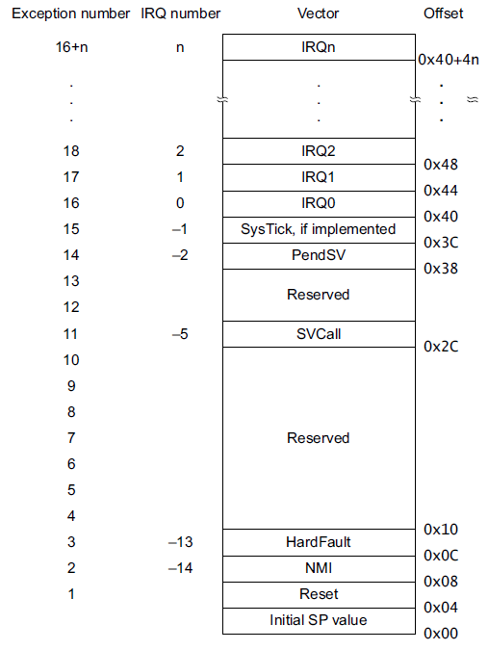
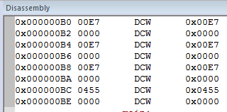
Can Examine Vector Table With Debugger
PORTD ISR is IRQ #31 (0x1F), so vector to handler begins at 0x40+4*0x1F = 0xBC
Why is the vector odd? 0x0000_0455
LSB of address indicates that handler uses Thumb code
Notes:
Here we can see the addresses stored in the vector table. Note that the table and the disassembly window are in opposite order.

Slide 21
Upon Entry to Handler
PC has been loaded with start address of handler
Notes:
We can now see that the PC has now been loaded with the handler address.

Slide 22
5. Load LR With EXC_RETURN Code
EXC_RETURN | Return Mode | Return Stack | Description
0xFFFF_FFF1 | 0 (Handler) | 0 (MSP) | Return to exception handler
0xFFFF_FFF9 | 1 (Thread) | 0 (MSP) | Return to thread with MSP
0xFFFF_FFFD | 1 (Thread) | 1 (PSP) | Return to thread with PSP
EXC_RETURN value generated by CPU to provide information on how to return
Which SP to restore registers from? MSP (0) or PSP (1)
Previous value of SPSEL
Which mode to return to? Handler (0) or Thread (1)
Another exception handler may have been running when this exception was requested

Slide 23
Updated LR With EXC_RETURN Code
Notes:
Now the LR is updated with the exception return code.

Slide 24
6. Start Executing Exception Handler
Exception handler starts running, unless preempted by a higher-priority exception
Exception handler may save additional registers on stack
E.g. if handler may call a subroutine, LR and R4 must be saved
Notes:
And finally our handler code starts running. The first thing this code does is to save some additional registers. Other handlers may not do this.

Slide 25
After Handler Has Saved More Context
SP value reduced since registers have been pushed onto stack
Saved R4
Saved LR
Saved R0
Saved R1
Saved R2
Saved R3
Saved R12
Saved LR
Saved PC
Saved xPSR

Slide 26
Continue Executing Exception Handler
Execute user code in handler
Notes:
We can continue stepping through the execution of the handler until it is ready to exit.

Slide 27
Exiting an Exception Handler

Slide 28
Exiting an Exception Handler
Execute instruction triggering exception return processing
Select return stack, restore context from that stack
Resume execution of code at restored address

Slide 29
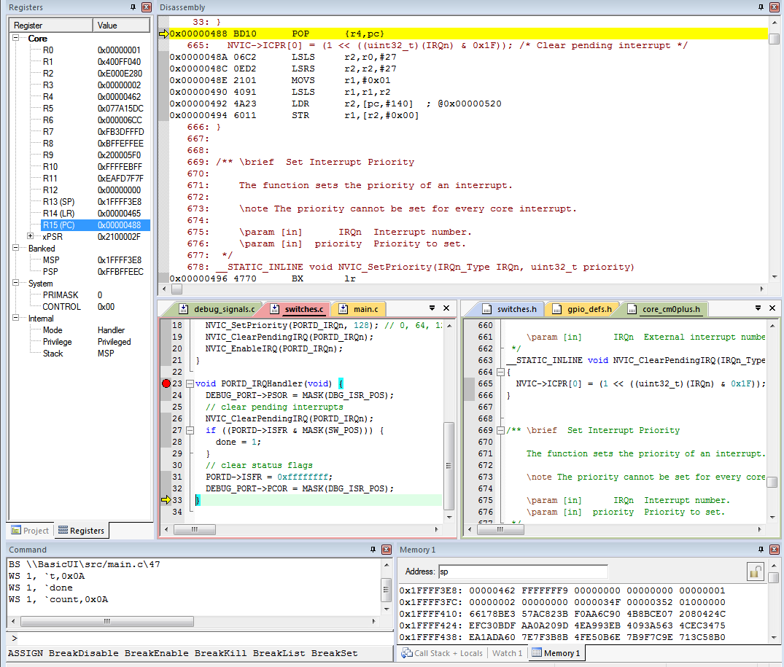
1. Execute Instruction for Exception Return
No “return from interrupt” instruction
Use regular instruction instead
BX LR - Branch to address in LR by loading PC with LR contents
POP …, PC - Pop address from stack into PC
… with a special value EXC_RETURN loaded into the PC to trigger exception handling processing
BX LR used if EXC_RETURN is still in LR
If EXC_RETURN has been saved on stack, then use POP

Slide 30
What Will Be Popped from Stack?
R4: 0x0000_0462
PC: 0xFFFF_FFF9
Saved R4
Saved LR
Saved R0
Saved R1
Saved R2
Saved R3
Saved R12
Saved LR
Saved PC
Saved xPSR

Slide 31
2. Select Stack, Restore Context
Check EXC_RETURN (bit 2) to determine from which SP to pop the context
Pop the registers from that stack
EXC_RETURN | Return Stack | Description
0xFFFF_FFF1 | 0 (MSP) | Return to exception handler with MSP
0xFFFF_FFF9 | 0 (MSP) | Return to thread with MSP
0xFFFF_FFFD | 1 (PSP) | Return to thread with PSP
SP points here after handler
SP points here during handler

Slide 32
Example
PC=0xFFFF_FFF9, so return to thread mode with main stack pointer
Pop exception stack frame from stack back into registers
Saved R0
Saved R1
Saved R2
Saved R3
Saved R12
Saved LR
Saved PC
Saved xPSR

Slide 33
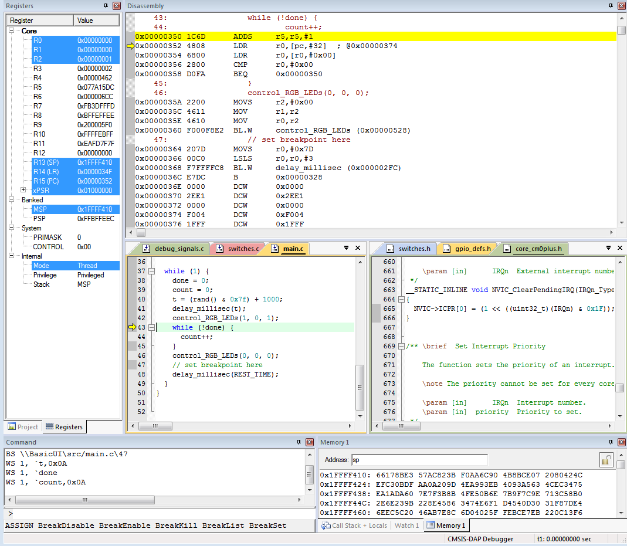
Resume Executing Previous Main Thread Code
Exception handling registers have been restored: R0, R1, R2, R3, R12, LR, PC, xPSR
SP is back to previous value
Back in thread mode
Next instruction to execute is at 0x0000_0352

Slide 34
Cortex-M0+ Interrupts

Slide 35
Microcontroller Interrupts
Types of interrupts
Hardware interrupts
Asynchronous: not related to what code the processor is currently executing
Examples: interrupt is asserted, character is received on serial port, or ADC converter finishes conversion
Exceptions, Faults, software interrupts
Synchronous: are the result of specific instructions executing
Examples: undefined instructions, overflow occurs for a given instruction
We can enable and disable (mask) most interrupts as needed (maskable), others are non-maskable
Interrupt service routine (ISR)
Subroutine which processor is forced to execute to respond to a specific event
After ISR completes, MCU goes back to previously executing code

Slide 36
Nested Vectored Interrupt Controller
Port Module
ARM Cortex M0+ Core
Next Module
NVIC
Another Module
NVIC manages and prioritizes external interrupts for Cortex-M0+
Interrupts are types of exceptions
Exceptions 16 through 16+N
Modes
Thread Mode: entered on Reset
Handler Mode: entered on executing an exception
Privilege level
Stack pointers
Main Stack Pointer, MSP
Process Stack Pointer, PSP
Exception states: Inactive, Pending, Active, A&P

Slide 37
Some Interrupt Sources (Partial)
Vector Start Address | Vector # | IRQ | Source | Description
0x0000_0004 | 1 |  | ARM Core | Initial program counter
0x0000_0008 | 2 |  | ARM Core | Non-maskable interrupt
0x0000_0040-4C | 16-19 | 0-3 | Direct Memory Access Controller | Transfer complete or error
0x0000_0058 | 22 | 6 | Power Management Controller | Low voltage detection
0x0000_0060-64 | 24-25 | 8-9 | I²C Modules | Status and error
0x0000_0068-6C | 26-27 | 10-11 | SPI Modules | Status and error
0x0000_0070-78 | 28-30 | 12-14 | UART Modules | Status and error
0x0000_00B8 | 46 | 30 | Port Control Module | Port A Pin Detect
0x0000_00BC | 47 | 31 | Port Control Module | Port D Pin Detect
Up to 32 non-core vectors, 16 core vectors
From KL25 Sub-Family Reference Manual, Table 3-6
Notes:
The MCU has many different types of interrupt sources – some are listed here. Full details are in the manual.

Slide 38
NVIC Registers and State
Bits | 31:30 | 29:24 | 23:22 | 21:16 | 15:14 | 13:8 | 7:6 | 5:0
IPR0 | IRQ3 | reserved | IRQ2 | reserved | IRQ1 | reserved | IRQ0 | reserved
IPR1 | IRQ7 | reserved | IRQ6 | reserved | IRQ5 | reserved | IRQ4 | reserved
IPR2 | IRQ11 | reserved | IRQ10 | reserved | IRQ9 | reserved | IRQ8 | reserved
IPR3 | IRQ15 | reserved | IRQ14 | reserved | IRQ13 | reserved | IRQ12 | reserved
IPR4 | IRQ19 | reserved | IRQ18 | reserved | IRQ17 | reserved | IRQ16 | reserved
IPR5 | IRQ23 | reserved | IRQ22 | reserved | IRQ21 | reserved | IRQ20 | reserved
IPR6 | IRQ27 | reserved | IRQ26 | reserved | IRQ25 | reserved | IRQ24 | reserved
IPR7 | IRQ31 | reserved | IRQ30 | reserved | IRQ29 | reserved | IRQ28 | reserved
Priority - allows program to prioritize response if both interrupts are requested simultaneously
IPR0-7 registers: two bits per interrupt source, four interrupt sources per register
Set priority to 0 (highest priority), 1, 2 or 3 (lowest)
CMSIS: NVIC_SetPriority(IRQnum, priority)
Notes:
The NVIC allows us to prioritize some interrupts over others, providing better control of system response.

Slide 39
NVIC Registers and State
Enable - Allows interrupt to be recognized
Accessed through two registers (set bits for interrupts)
Set enable with NVIC_ISER, clear enable with NVIC_ICER
CMSIS Interface: NVIC_EnableIRQ(IRQnum), NVIC_DisableIRQ(IRQnum)
Pending - Interrupt has been requested but is not yet serviced
CMSIS: NVIC_SetPendingIRQ(IRQnum), NVIC_ClearPendingIRQ(IRQnum)

Slide 40
Core Exception Mask Register
Similar to “Global interrupt disable” bit in other MCUs
PRIMASK - Exception mask register (CPU core)
Bit 0: PM Flag
Set to 1 to prevent activation of all exceptions with configurable priority
Clear to 0 to allow activation of all exceptions. 0 is value after CPU reset.
Access using CPS, MSR and MRS instructions
Use to prevent data race conditions with code needing atomicity
CMSIS-CORE API
void __enable_irq() - clears PM flag
void __disable_irq() - sets PM flag
uint32_t __get_PRIMASK() - returns value of PRIMASK
void __set_PRIMASK(uint32_t x) - sets PRIMASK to x

Slide 41
Prioritization
Exceptions are prioritized to order the response simultaneous requests (smaller number = higher priority)
Priorities of some exceptions are fixed
Reset: -3, highest priority
NMI: -2
Hard Fault: -1
Priorities of other (peripheral) exceptions are adjustable
Value is stored in the interrupt priority register (IPR0-7)
0x00
0x40
0x80
0xC0

Slide 42
Special Cases of Prioritization
Simultaneous exception requests?
Lowest exception type number is serviced first
New exception requested while a handler is executing?
New priority higher than current priority?
New exception handler preempts current exception handler
New priority lower than or equal to current priority?
New exception held in pending state
Current handler continues and completes execution
Previous priority level restored
New exception handled if priority level allows

Slide 43
Example Using Port Module and External Interrupts

Slide 44
Refresher: Program Requirements & Design
RGB LED
ISR
Main
SW
count
(does initialization,
then updates LED based on count)
ISR
Task
Global Variable
Req1: When Switch SW is pressed, ISR will increment count variable
Req2: Main code will light LEDs according to count value in binary sequence (Blue: 4, Green: 2, Red: 1)
Req3: Main code will toggle its debug line DBG_MAIN each time it executes
Req4: ISR will raise its debug line DBG_ISR (and lower main’s debug line DBG_MAIN) whenever it is executing

Slide 45
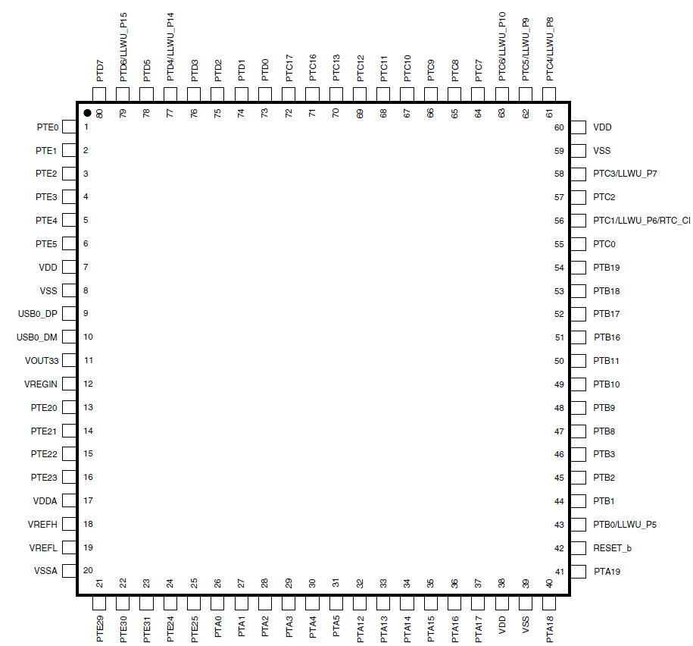
KL25Z GPIO Ports with Interrupts
Port A (PTA) through Port E (PTE)
Not all port bits are available (package-dependent)
Ports A and D support interrupts

Slide 46
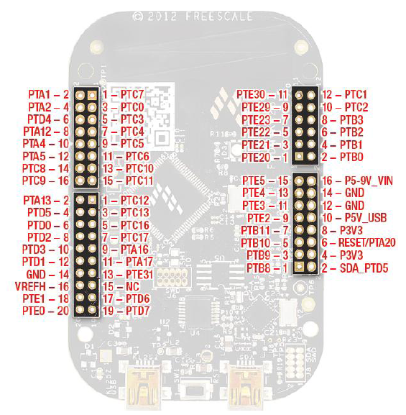
FREEDOM KL25Z Physical Set-up
DBG_Main
DBG_ISR
Ground
Switch Input

Slide 47
Building a Program – Break into Pieces
First break into threads, then break thread into steps
Main thread:
First initialize system
initialize switch: configure the port connected to the switches to be input
initialize LEDs: configure the ports connected to the LEDs to be outputs
initialize interrupts: initialize the interrupt controller
Then repeat
Update LEDs based on count
Switch Interrupt thread:
Update count
Determine which variables ISRs will share with main thread
This is how ISR will send information to main thread
Mark these shared variables as volatile (more details ahead)
Ensure access to the shared variables is atomic (more details ahead)

Slide 48
Where Do the Pieces Go?
main
top level of main thread code
switches
#defines for switch connections
declaration of count variable
Code to initialize switch and interrupt hardware
ISR for switch
LEDs
#defines for LED connections
Code to initialize and light LEDs
debug_signals
#defines for debug signal locations
Code to initialize and control debug lines

Slide 49
Configure MCU to Respond to the Interrupt
Set up peripheral module to generate interrupt
We’ll use Port Module in this example
Set up NVIC
Set global interrupt enable
Use CMSIS Macro __enable_irq();
This flag does not enable all interrupts; instead, it is an easy way to disable interrupts
Could also be called “don’t disable all interrupts”

Slide 50
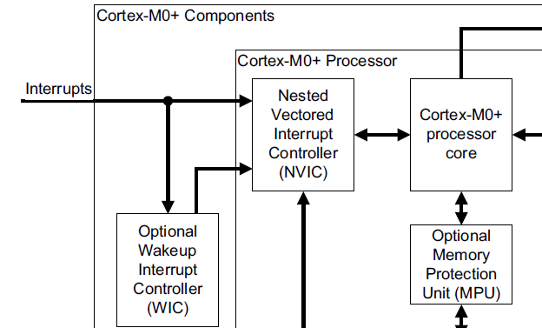
Port Module
Port Module
Port Module connects external pins to NVIC (and other devices)
Relevant registers
PCR - Pin control register (32 per port)
Each register corresponds to an input pin
ISFR - Interrupt status flag register (one per port)
Each bit corresponds to an input pin
Bit is set to 1 if an interrupt has been detected

Slide 51
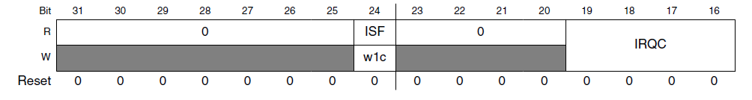
Pin Control Register
ISF indicates if interrupt has been detected - different way to access same data as ISFR
IRQC field of PCR defines behavior for external hardware interrupts
Can also trigger direct memory access (not covered here)
IRQC | Configuration
0000 | Interrupt Disabled
…. | DMA, reserved
1000 | Interrupt when logic zero
1001 | Interrupt on rising edge
1010 | Interrupt on falling edge
1011 | Interrupt on either edge
1100 | Interrupt when logic one
… | reserved
Notes:
The PCR allows us to configure a pin on the MCU to trigger an interrupt under a particular condition.

Slide 52
CMSIS C Support for PCR
MKL25Z4.h defines PORT_Type structure with a PCR field (array of 32 integers)
/** PORT - Register Layout Typedef */
typedef struct {
__IO uint32_t PCR[32]; /** Pin Control Register n, array offset: 0x0, array step: 0x4 */
__O uint32_t GPCLR; /** Global Pin Control Low Register, offset: 0x80 */
__O uint32_t GPCHR; /** Global Pin Control High Register, offset: 0x84 */
uint8_t RESERVED_0[24];
__IO uint32_t ISFR; /** Interrupt Status Flag Register, offset: 0xA0 */
} PORT_Type;
Notes:
CMSIS provides data structures for accessing the PCR. We will use this later in an example.

Slide 53
CMSIS C Support for PCR
Header file defines pointers to PORT_Type registers
/* PORT - Peripheral instance base addresses */
/** Peripheral PORTA base address */
#define PORTA_BASE (0x40049000u)
/** Peripheral PORTA base pointer */
#define PORTA ((PORT_Type *)PORTA_BASE)
Also defines macros and constants
#define PORT_PCR_MUX_MASK 0x700u
#define PORT_PCR_MUX_SHIFT 8
#define PORT_PCR_MUX(x) (((uint32_t)(((uint32_t)(x))<<PORT_PCR_MUX_SHIFT)) &PORT_PCR_MUX_MASK)
Notes:
CMSIS provides symbolic names and macros for accessing the port’s PCR. We will use this later in an example.

Slide 54
Switch Interrupt Initialization
void init_switch(void) {
/* enable clock for port D */
SIM->SCGC5 |= SIM_SCGC5_PORTD_MASK;
/* Select GPIO and enable pull-up resistors and
interrupts on falling edges for pin connected to switch */
PORTD->PCR[SW_POS] = PORT_PCR_MUX(1) |
PORT_PCR_PS_MASK | PORT_PCR_PE_MASK | PORT_PCR_IRQC(0x0a);
/* Set port D switch bit to inputs */
PTD->PDDR &= ~MASK(SW_POS);
/* Enable Interrupts */
NVIC_SetPriority(PORTD_IRQn, 2);
NVIC_ClearPendingIRQ(PORTD_IRQn);
NVIC_EnableIRQ(PORTD_IRQn);
}

Slide 55
Main Function
int main (void) {
init_switch();
init_RGB_LEDs();
init_debug_signals();
__enable_irq();
while (1) {
DEBUG_PORT->PTOR = MASK(DBG_MAIN_POS);
control_RGB_LEDs(count&1, count&2, count&4);
__wfi(); // sleep now, wait for interrupt
}
}

Slide 56
Write Interrupt Service Routine
No arguments or return values – void is only valid type
Keep it short and simple
Much easier to debug
Improves system response time
Name the ISR according to CMSIS-CORE system exception names
PORTD_IRQHandler, RTC_IRQHandler, etc.
The linker will load the vector table with this handler rather than the default handler
Read interrupt status flag register to determine source of interrupt
Clear interrupt status flag register by writing to PORTD->ISFR

Slide 57
ISR
void PORTD_IRQHandler(void) {
DEBUG_PORT->PSOR = MASK(DBG_ISR_POS);
if ((PORTD->ISFR & MASK(SW_POS))) {
count++;
}
// clear status flags
PORTD->ISFR = 0xffffffff;
DEBUG_PORT->PCOR = MASK(DBG_ISR_POS);
}

Slide 58
Evaluate Basic Operation
Build program
Load onto development board
Start debugger
Run
Press switch, verify LED changes color

Slide 59
Examine Saved State in ISR
Set breakpoint in ISR
Run program
Press switch, verify debugger stops at breakpoint
Examine stack and registers

Slide 60
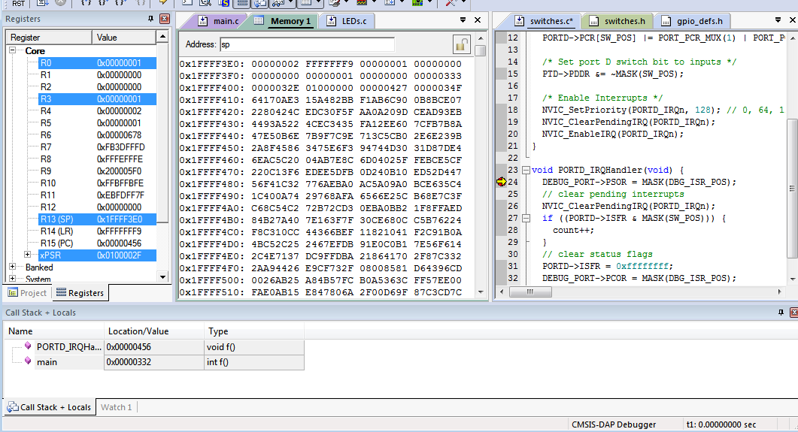
At Start of ISR
Examine memory
What is SP’s value? See processor registers window

Slide 61
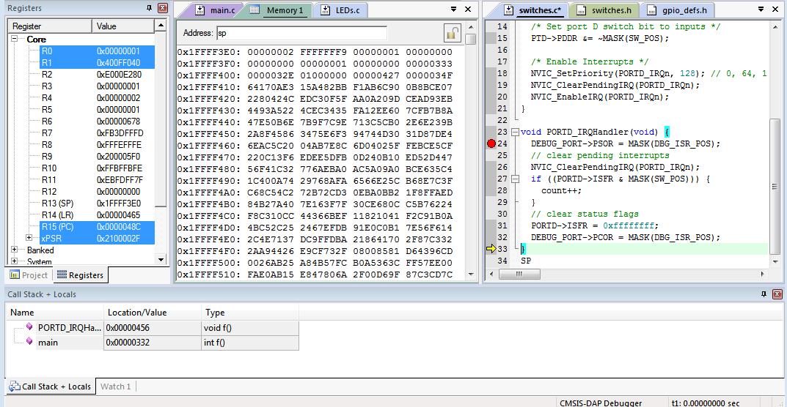
Step through ISR to End
PC = 0x0000_048C
Return address stored on stack: 0x0000_0333

Slide 62
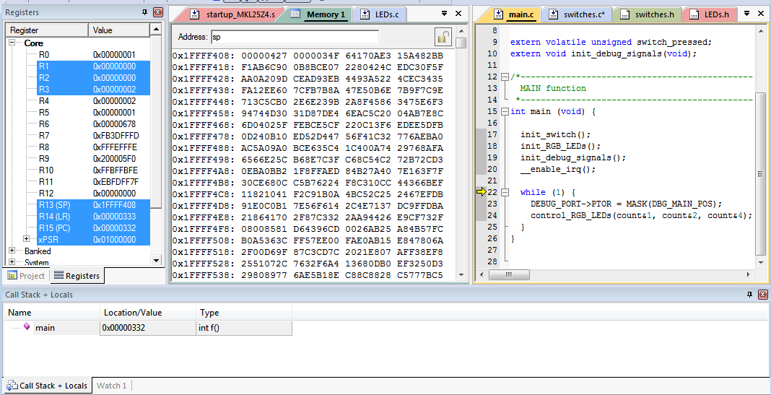
Return from Interrupt to Main function
PC = 0x0000_0332

Slide 63
Timing Analysis

Slide 64
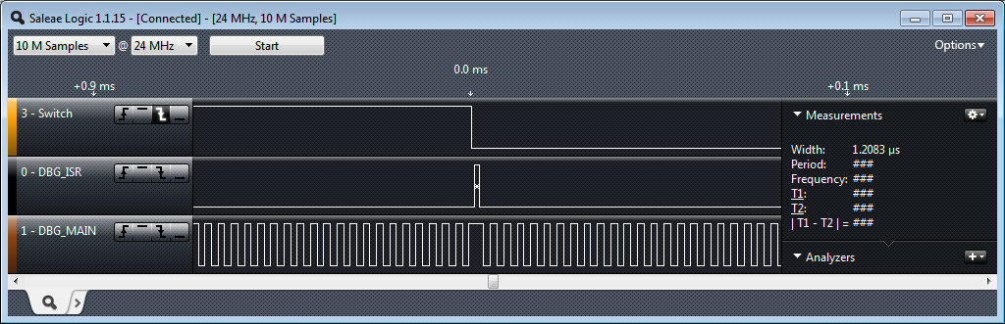
Visualizing the Timing of Processor Activities
Indicate CPU activity by controlling debug output signals (GPIO)
Monitor these with a logic analyzer (e.g. http://www.saleae.com/logic) or oscilloscope
Notes:
We often need to see the timing activity of the program. This can be critical to understanding why a system works or doesn’t work.

Slide 65
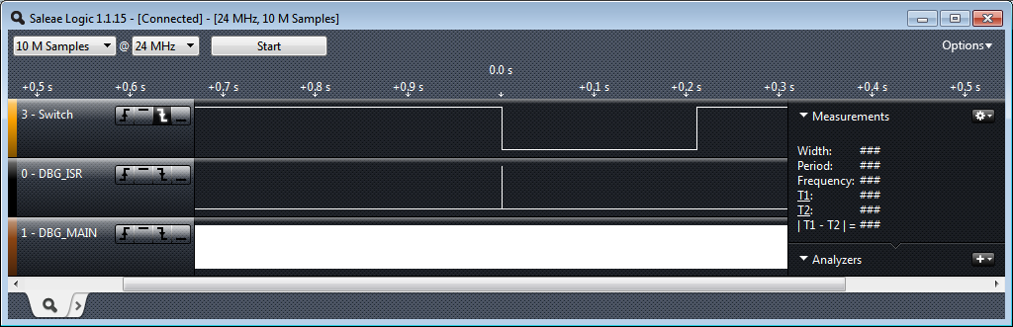
Big Picture Timing Behavior
Switch was pressed for about 0.21 s
ISR runs in response to switch signal’s falling edge
Main seems to be running continuously (signal toggles between 1 and 0)
Does it really? You will investigate this in the lab exercise.
Notes:
Timing analysis lets us see the “Big Picture” timing, how external events relate to processor activities. For example, here we see how long the switch was pressed, and what the MCU did in response.

Slide 66
Interrupt Response Latency
Latency = time delay
Why do we care?
This is overhead which wastes time, and increases as the interrupt rate rises
This delays our response to external events, which may or may not be acceptable for the application, such as sampling an analog waveform
How long does it take?
Finish executing the current instruction or abandon it
Push various registers on to the stack, fetch vector
C_{IntResponseOvhd}: Overhead for responding to each interrupt)
If we have external memory with wait states, this takes longer

Slide 67
Maximum Interrupt Rate
We can only handle so many interrupts per second
F_{Max_Int}: maximum interrupt frequency
F_{CPU}: CPU clock frequency
C_{ISR}: Number of cycles ISR takes to execute
C_{Overhead:} Number of cycles of overhead for saving state, vectoring, restoring state, etc.
F_{Max_Int} = F_{CPU}/(C_{ISR+} C_{Overhead})
Note that model applies only when there is one interrupt in the system
When processor is responding to interrupts, it isn’t executing our other code
U_{Int}: Utilization (fraction of processor time) consumed by interrupt processing
U_{Int} = 100%*F_{Int}* (C_{ISR}+C_{Overhead})/ F_{CPU}
CPU looks like it’s running the other code with CPU clock speed of (1-U_{Int})*F_{CPU}

Slide 68
Program Design with INterrupts

Slide 69
Program Design with Interrupts
How much work to do in ISR?
Should ISRs re-enable interrupts?
How to communicate between ISR and other threads?
Data buffering
Data integrity and race conditions

Slide 70
How Much Work Is Done in ISR?
Trade-off: Faster response for ISR code will delay completion of other code
In system with multiple ISRs with short deadlines, perform critical work in ISR and buffer partial results for later processing

Slide 71
Sharing Data Safely between ISRs and other Threads

Slide 72
Overview
Volatile data – can be updated outside of the program’s immediate control
Non-atomic shared data – can be interrupted partway through read or write, is vulnerable to race conditions

Slide 73
Volatile Data
Compilers assume that variables in memory do not change spontaneously, and optimize based on that belief
Don’t reload a variable from memory if current function hasn’t changed it
Read variable from memory into register (faster access)
Write back to memory at end of the procedure, or before a procedure call, or when compiler runs out of free registers
This optimization can fail
Example: reading from input port, polling for key press
while (SW_0) ; will read from SW_0 once and reuse that value
Will generate an infinite loop triggered by SW_0 being true
Variables for which it fails
Memory-mapped peripheral register – register changes on its own
Global variables modified by an ISR – ISR changes the variable
Global variables in a multithreaded application – another thread or ISR changes the variable

Slide 74
The Volatile Directive
Need to tell compiler which variables may change outside of its control
Use volatile keyword to force compiler to reload these vars from memory for each use
volatile unsigned int num_ints;
Pointer to a volatile int
volatile int * var; // or
int volatile * var;
Now each C source read of a variable (e.g. status register) will result in an assembly language LDR instruction
Good explanation in Nigel Jones’ “Volatile,” Embedded Systems Programming July 2001

Slide 75
Non-Atomic Shared Data
void GetDateTime(DateTimeType * DT){
DT->day = TimerVal.day;
DT->hour = TimerVal.hour;
DT->minute = TimerVal.minute;
DT->second = TimerVal.second;
}
Want to keep track of current time and date
Use 1 Hz interrupt from timer
System
TimerVal structure tracks time and days since some reference event
TimerVal’s fields are updated by periodic 1 Hz timer ISR
void DateTimeISR(void){
TimerVal.second++;
if (TimerVal.second > 59){
TimerVal.second = 0;
TimerVal.minute++;
if (TimerVal.minute > 59) {
TimerVal.minute = 0;
TimerVal.hour++;
if (TimerVal.hour > 23) {
TimerVal.hour = 0;
TimerVal.day++;
… etc.
}

Slide 76
Example: Checking the Time
Problem
An interrupt at the wrong time will lead to half-updated data in DT
Failure Case
TimerVal is {10, 23, 59, 59} (10th day, 23:59:59)
Task code calls GetDateTime(), which starts copying the TimerVal fields to DT: day = 10, hour = 23
A timer interrupt occurs, which updates TimerVal to {11, 0, 0, 0}
GetDateTime() resumes executing, copying the remaining TimerVal fields to DT: minute = 0, second = 0
DT now has a time stamp of {10, 23, 0, 0}.
The system thinks time just jumped backwards one hour!
Fundamental problem – “race condition”
Preemption enables ISR to interrupt other code and possibly overwrite data
Must ensure atomic (indivisible) access to the object
Native atomic object size depends on processor’s instruction set and word size.
Is 32 bits for ARM

Slide 77
Examining the Problem More Closely
Must protect any data object which both
(1) requires multiple instructions to read or write (non-atomic access),
and
(2) is potentially written by an ISR
How many tasks/ISRs can write to the data object?
One? Then we have one-way communication
Must ensure the data isn’t overwritten partway through being read
Writer and reader don’t interrupt each other
More than one?
Must ensure the data isn’t overwritten partway through being read
Writer and reader don’t interrupt each other
Must ensure the data isn’t overwritten partway through being written
Writers don’t interrupt each other

Slide 78
Definitions
Race condition: Anomalous behavior due to unexpected critical dependence on the relative timing of events. Result of example code depends on the relative timing of the read and write operations.
Critical section: A section of code which creates a possible race condition. The code section can only be executed by one process at a time. Some synchronization mechanism is required at the entry and exit of the critical section to ensure exclusive use.

Slide 79
Solution: Briefly Disable Preemption
void GetDateTime(DateTimeType * DT){
uint32_t m;
m = __get_PRIMASK();
__disable_irq();
DT->day = TimerVal.day;
DT->hour = TimerVal.hour;
DT->minute = TimerVal.minute;
DT->second = TimerVal.second;
__set_PRIMASK(m);
}
Prevent preemption within critical section
If an ISR can write to the shared data object, need to disable interrupts
save current interrupt masking state in m
disable interrupts
Restore previous state afterwards (interrupts may have already been disabled for another reason)
Use CMSIS-CORE to save, control and restore interrupt masking state
Avoid if possible
Disabling interrupts delays response to all other processing requests
Make this time as short as possible (e.g. a few instructions)

Slide 80
Summary for Sharing Data
In thread/ISR diagram, identify shared data
Determine which shared data is too large to be handled atomically by default
This needs to be protected from preemption (e.g. disable interrupt(s), use an RTOS synchronization mechanism)
Declare (and initialize) shared variables as volatile in main file (or globals.c)
volatile int my_shared_var=0;
Update extern.h to make these variables available to functions in other files
volatile extern int my_shared_var;
#include “extern.h” in every file which uses these shared variables
When using long (non-atomic) shared data, save, disable and restore interrupt masking status
CMSIS-CORE interface: __disable_irq(), __get_PRIMASK(), __set_PRIMASK()

