Slide 1

DDT Tool Overview: FSISEC
--Hari Sankar Sahasranaman

Slide 2

CONTENTS
Purpose of Security
Customer Secure Access
Symmetric Cryptography
Asymmetric Cryptography
DDT Tool Setup
Tool demo

Slide 3


Why is security needed in ECU
To restrict the access of confidential data
To restrict the write/upload of confidential information
Improper usage can damage the ECU
Risk the vehicle’s compliance to safety and security standard
3
Internal | RBEI/ESD | 08/04/2014 | © Robert Bosch Engineering and Business Solutions Limited 2014. All rights reserved, also regarding any disposal, exploitation, reproduction, editing, distribution, as well as in the event of applications for industrial property rights.

Slide 4
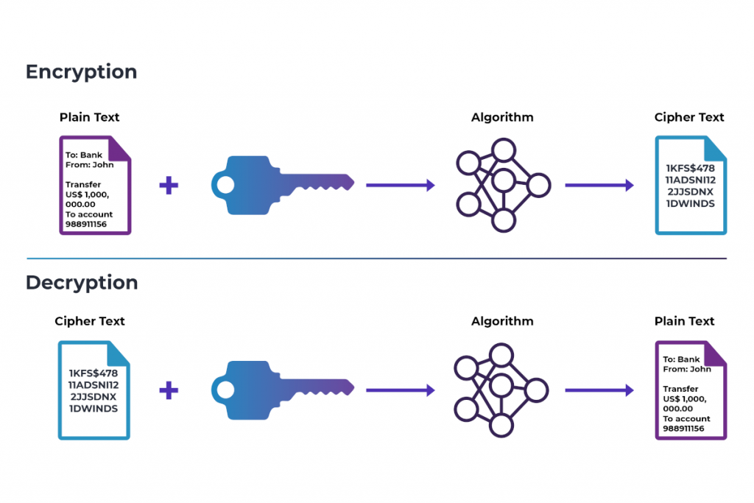
Customer Secure Access
FSISEC

Slide 5
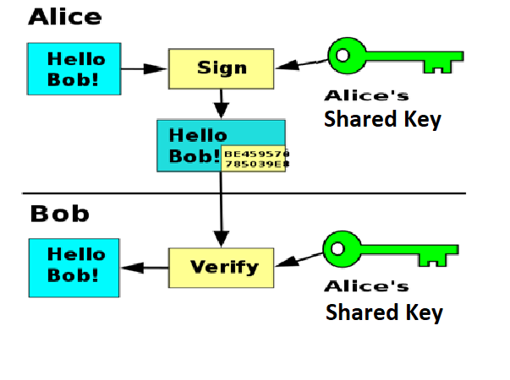
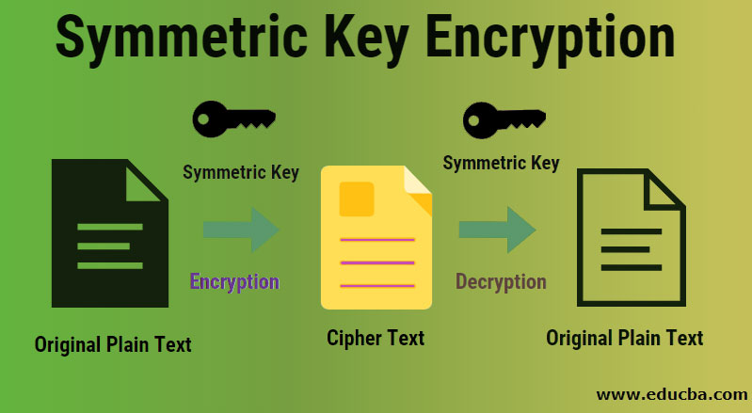
Customer Secure Access
FSISEC
Symmetric Cryptography

Slide 6
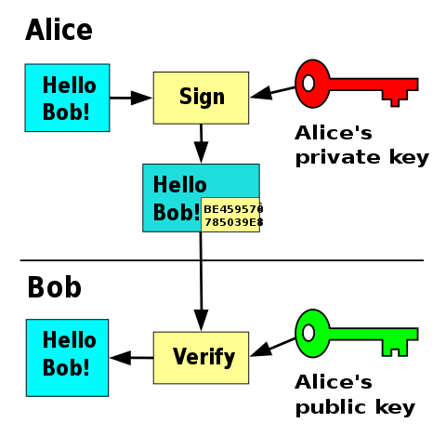
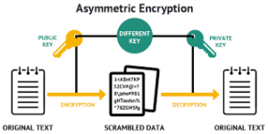
Customer Secure Access
FSISEC
Asymmetric Cryptography

Slide 7
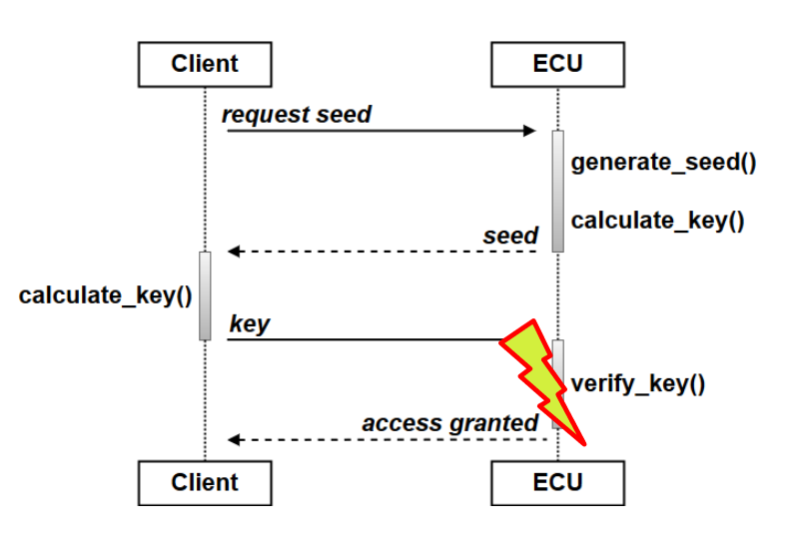
Customer Secure Access
FSISEC

Slide 8
Customer Secure Access
FSISEC
Steps:
Request Seed- 27 01
Calculate key using key calculation algorithm
(The secret used by the key calculation algorithm should be protected!)
Send Key: 27 02 xx (xx = n bytes key )
ECU validate the results
Security mode can be dummy or normal

Slide 9
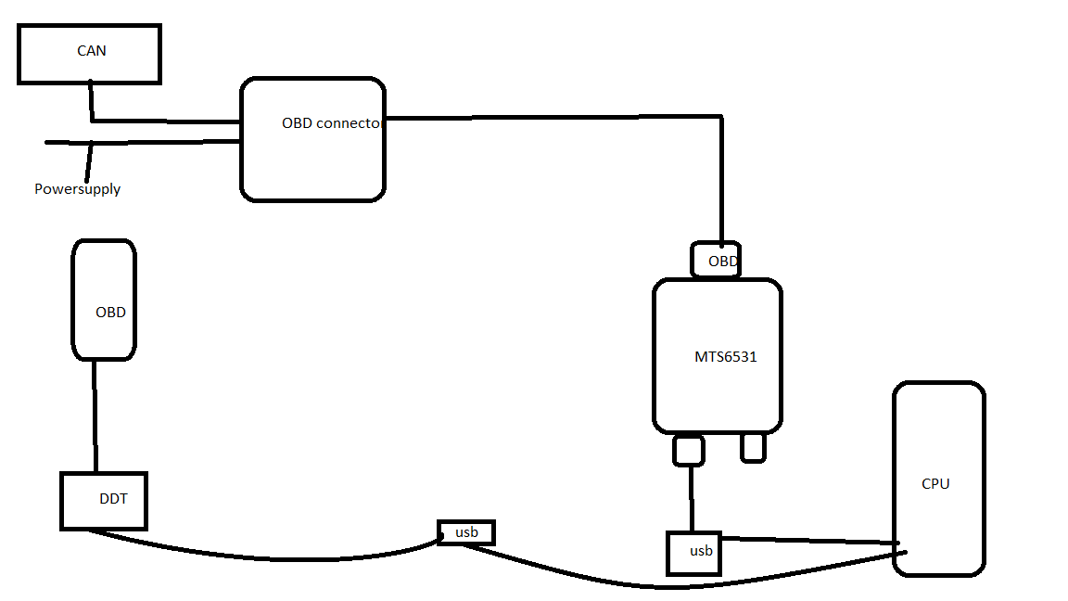
Connection Diagram
DDT TOOL FSISEC Tests

Slide 10
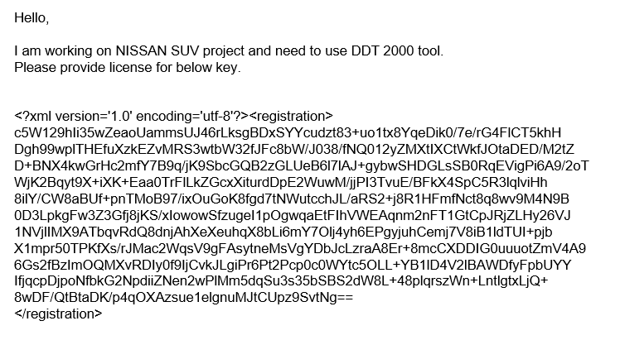
DDT TOOL:FSISEC Tests
License Request
- Request licnese for DDT by generating the Key from DDT tool home page and mail to respective team with the below format and send it to list.DDT2000-Support@renault.com

Slide 11
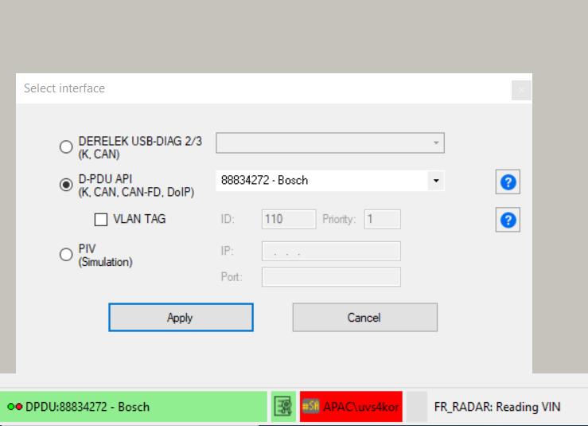
DDT TOOL FSISEC Tests
Vehicle Communication Interface
DDT needs to have an interface to communicate with the vehicle /ECU
D-PDU API VCI used is MTS6531.
It allows to communicate with K-Line, DoCAN, DoCAN-FD and DoIP ECU

Slide 12
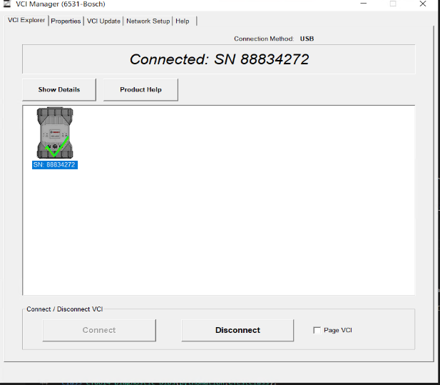
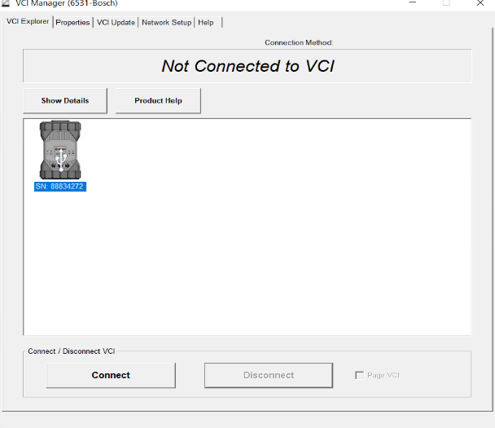
Steps to connect to DDT 1.Close DDT2000 if its opened. 2.Open VCI Manager Bosch (type VCI in search tab in windows) 3.Click on MTS6531 →connect(green tick will be displayed)→ Then disconnect
DDT TOOL FSISEC Tests

Slide 13
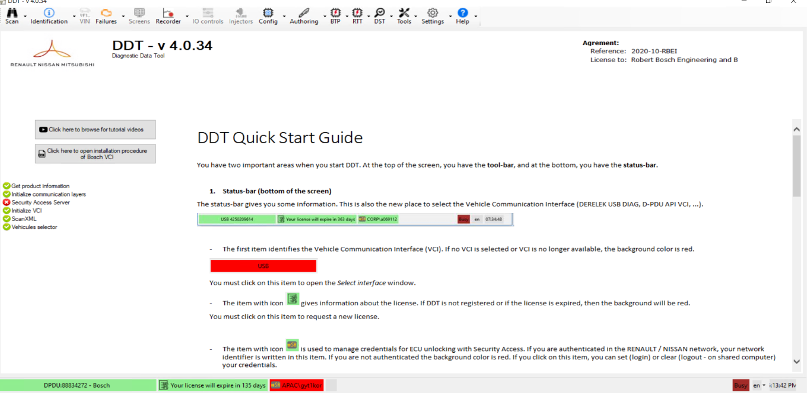
Steps to connect to DDT Once the Setup is done DDT home page will look like this
DDT TOOL FSISEC Tests

Slide 14
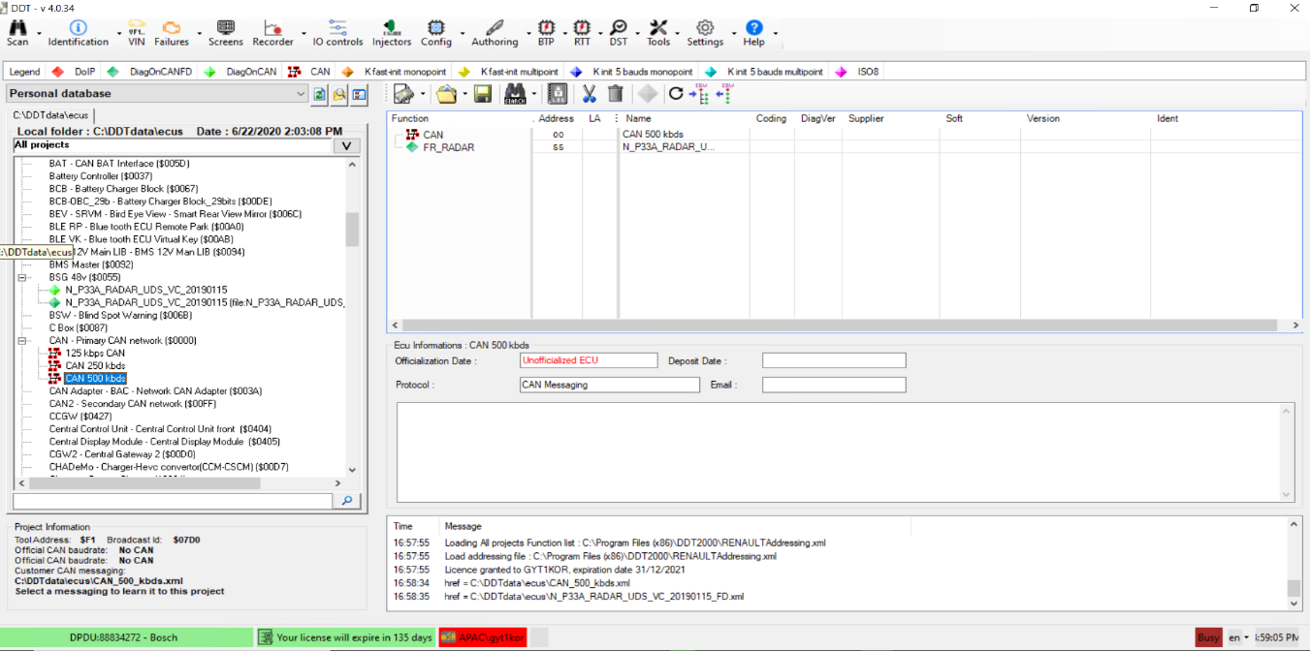
DDT TOOL FSISEC Tests
Before running a scan, it is necessary to prepare the diagnosis by selecting the
working database.
As PER the project choice, CAN baud rate have to be selected

Slide 15
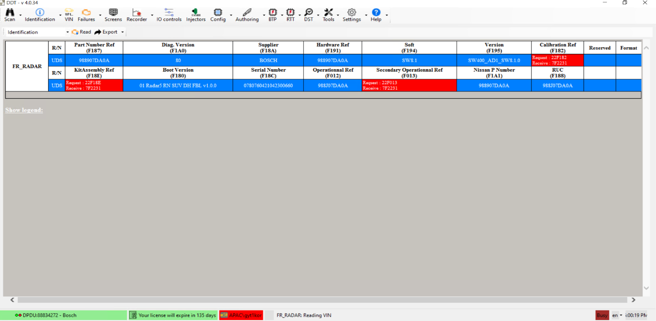
DDT TOOL FSISEC Tests
Identification
The goal of this function is to obtain the ECU features:

Slide 16
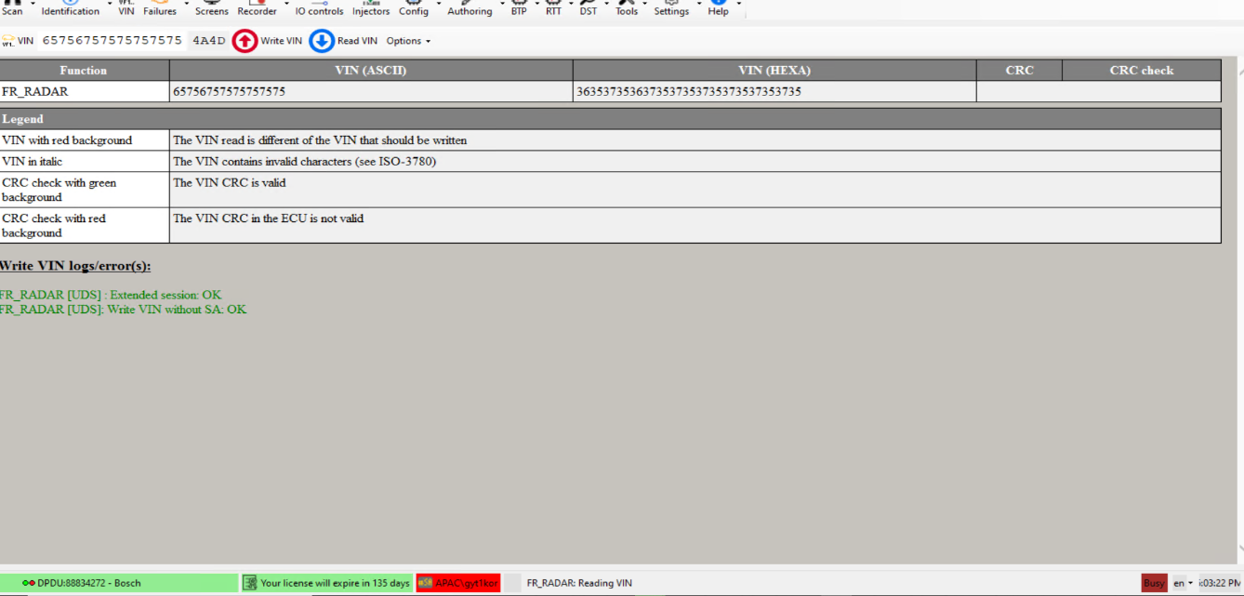
DDT TOOL FSISEC Tests
Security tests can be performed by unlocking security using VIN tab
When NRC 33 is received, DDT will send the sequence for security unlock automatically if the setting is enabled

Slide 17
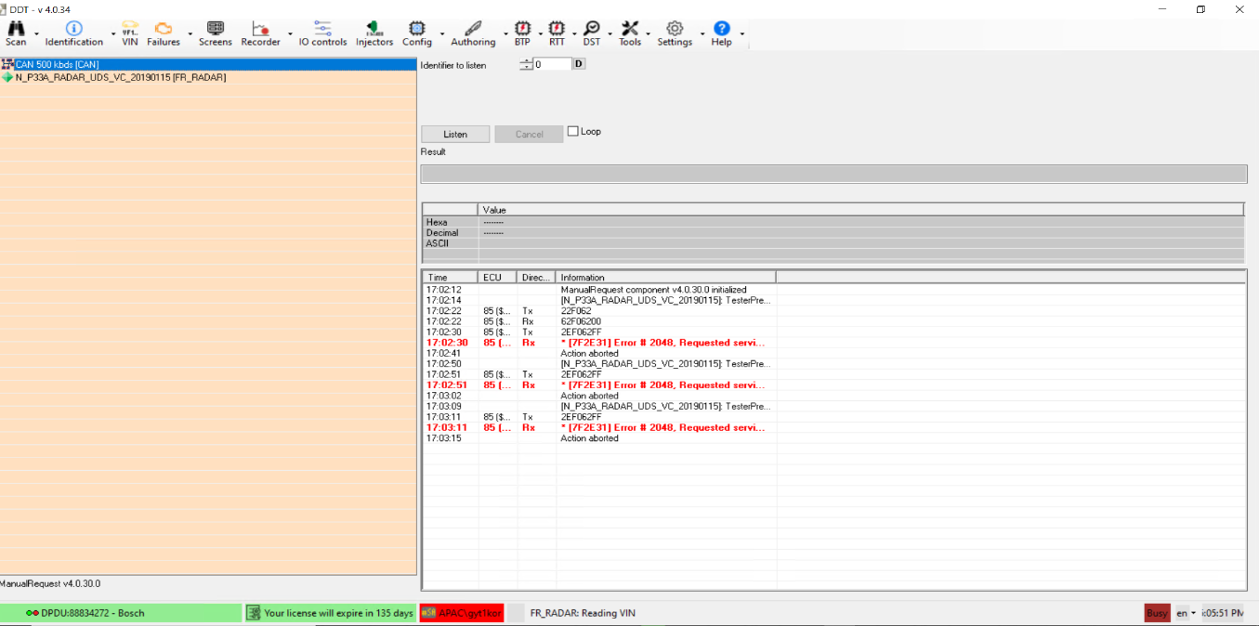
DDT TOOL FSISEC Tests
Manual Diagnostics request and response tests also can be done → Tools → Manual requests

Slide 18
DDT TOOL FSISEC Tests
Tool demo

