Slide 1
Decision Tree
Supervised Learning,
Information Theory,
Scalable,
Human Comprehensible
Allen Grimm
3/16/2016
allen@GrimmScience.com
@GrimmScientist

Slide 2
Supervised Learning (Black Box)
Inputs
Outputs

Slide 3
Black Box
Inputs
Outputs

Slide 4
Black Box
Inputs
Outputs

Slide 5
Black Box
Inputs
Outputs

Slide 6
Introducing: Fisher's Iris Data
shape of data: (150, 4)
iv names: ['sepal length (cm)', 'sepal width (cm)', 'petal length (cm)', 'petal width (cm)']
shape of labels: (150,)
label names: ['setosa' 'versicolor' 'virginica']
Picking 15 samples, with labels:
  [ 5.1 3.5 1.4 0.2] 0
  [ 5.7 4.4 1.5 0.4] 0
  [ 4.8 3.1 1.6 0.2] 0
  [ 4.8 3. 1.4 0.3] 0
  [ 5. 2. 3.5 1. ] 1
  [ 6.6 3. 4.4 1.4] 1
  [ 5.5 2.6 4.4 1.2] 1
  [ 7.6 3. 6.6 2.1] 2
  [ 6.9 3.2 5.7 2.3] 2
  [ 7.7 3. 6.1 2.3] 2

Slide 7
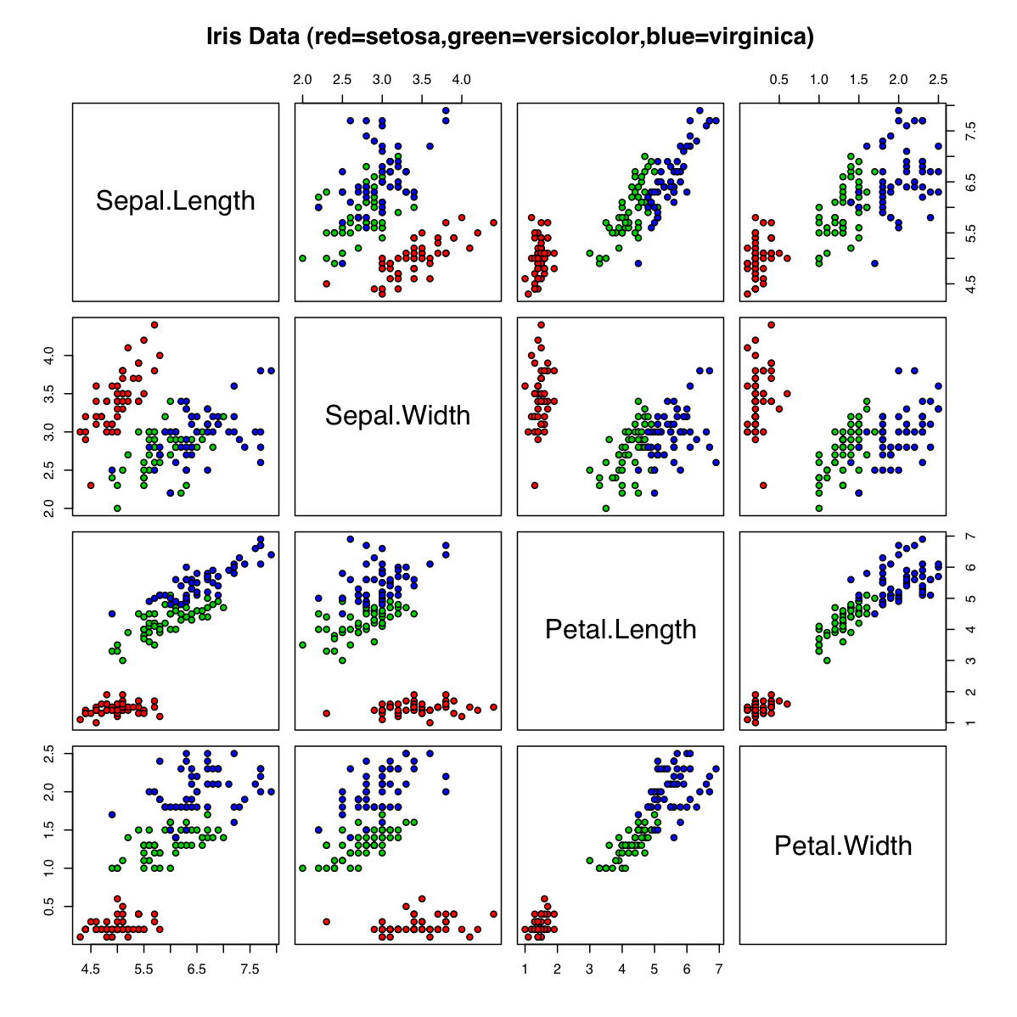

Slide 8
Petal Length
!!!!! (add graph without line)

Slide 9
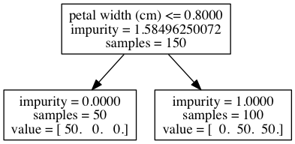
Depth = 1

Slide 10
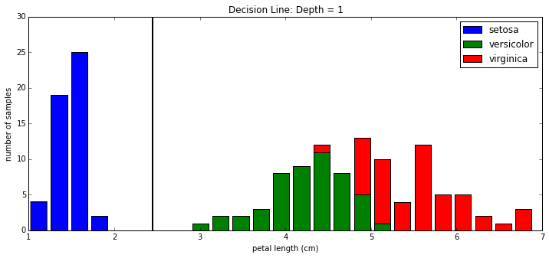
Petal Length, with decision line

Slide 11
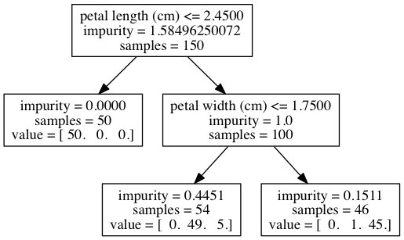
Depth = 2

Slide 12
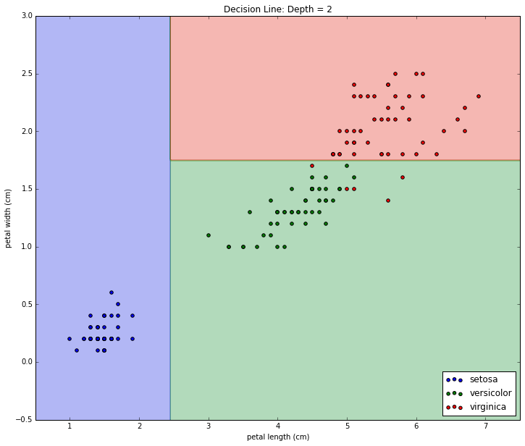
Petal Length and Petal Width. d=2

Slide 13
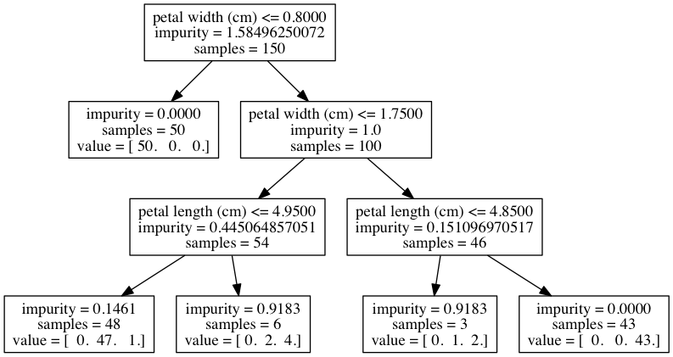
Depth = 3

Slide 14
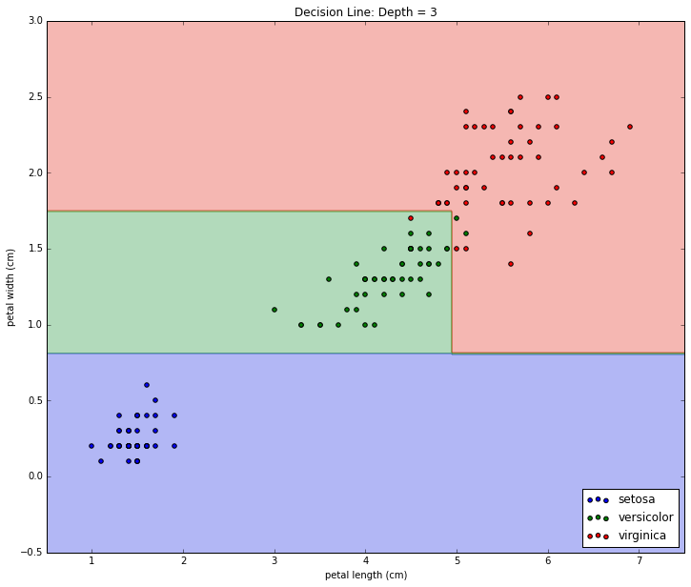
Petal Length and Petal Width. d=3

Slide 15
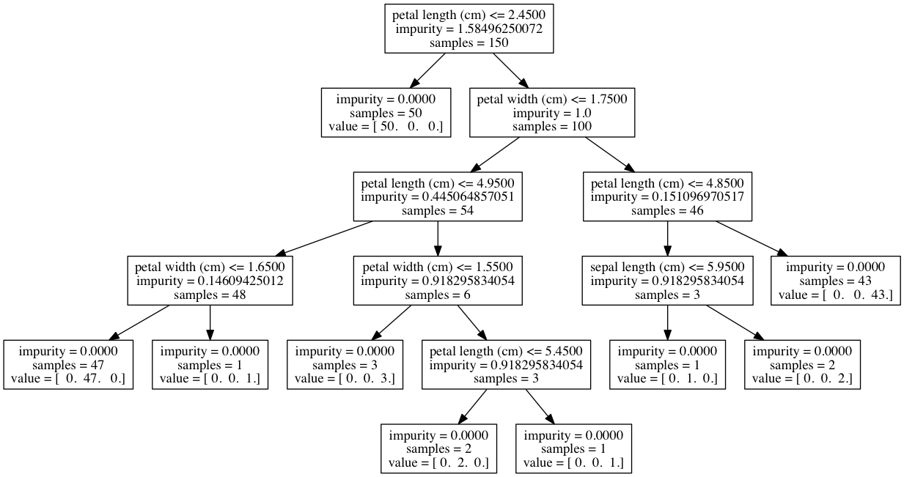
Depth = *

Slide 16
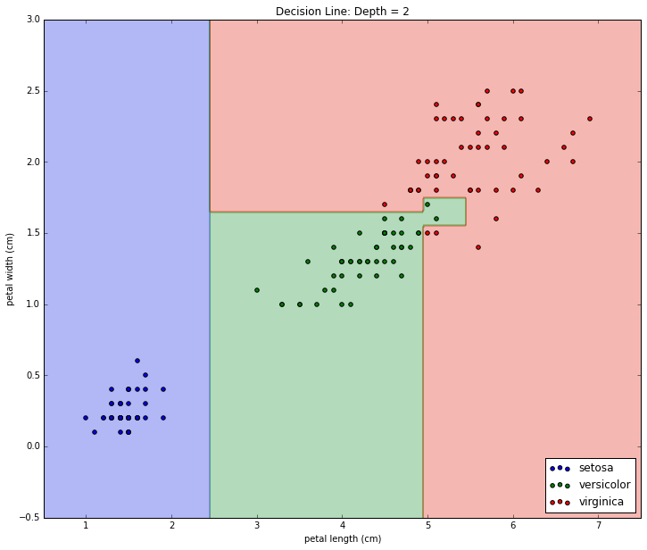
Petal Length and Petal Width. d=*

Slide 17
Entropy
To the notebook!

