Slide 1

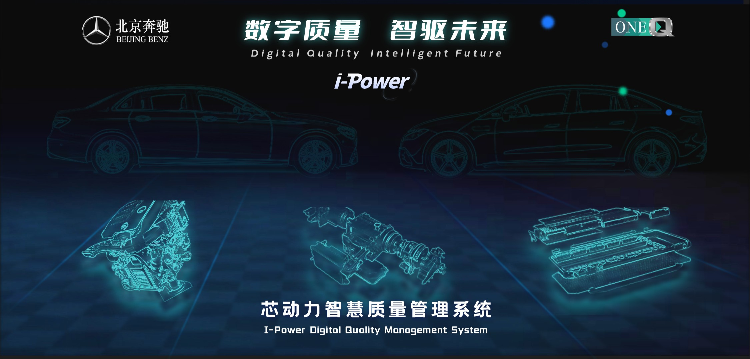
Engine & Battery Q-Loop4 Issue Report
No. | Date | Shift | Plant | Sensor | V-Type | E&B Type | PN | EN/BN | Issue Description | Root Cause | SOMA | Status
{index} | {date} | {shift} | {plant} | {sensor} | {v_type} | {eb_type} | {pn} | {en_bn} | {issue_description} | {root_cause} | {soma} | {status}
{title}
1/5 QM E&B | AFS

