Slide 1
Andrew Just Talks for Nine Hours About Express.js
This slideshow theme is from Microsoft Office 97

Slide 2
Websites
They are a thing
Notes:
Websites! They are a thing.

Slide 3
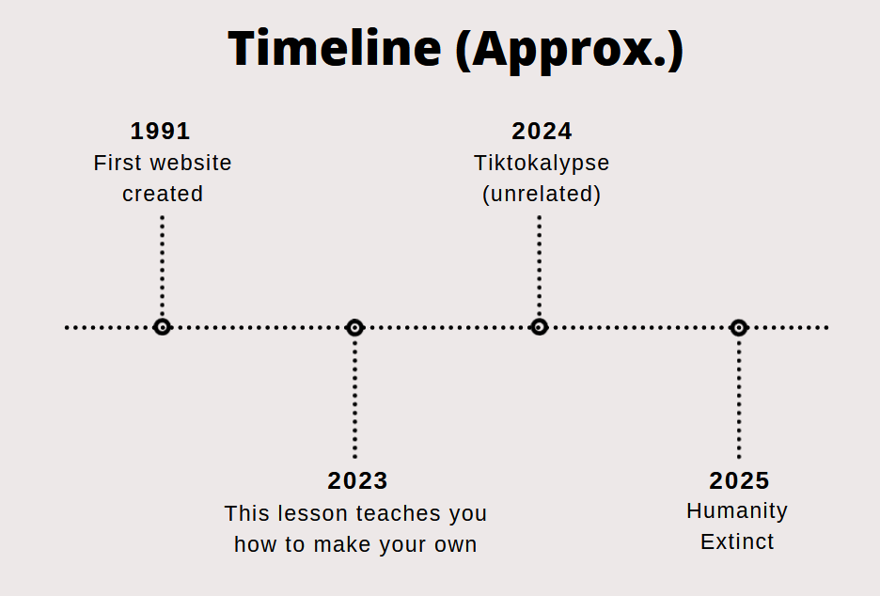
World Wide Web: Evolution
Notes:
at some point, web pages were basically just simple text documents, but now they’re more like miniature programs or apps that get downloaded, installed, and run on your computer as soon as you visit them. back in the day, like when this powerpoint template was initially created, everyone used microsoft excel to turn numbers into charts and stuff, but now you can do basically the same things with google sheets. but there’s one thing that microsoft excel has that google sheets doesn’t: unrestricted access to your hard drive. normal programs can create files and store settings and autosave basically whenever they want, but for numerous obvious safety and security reasons, websites are trapped [next slide] or sometimes it’s called “sandboxed,” inside your browser.

Slide 4





The Problem
Your Program
The Browser
Notes:
or sometimes it’s called “sandboxed,” inside your browser. [] so, sure, one thing you could is write code that asks the browser to store data for you for next time, you can store data in cookies and localStorage, but a) the browser might not feel like doing that, especially if the user has privacy settings turned on and clears their history and stuff; also b) you, the creator of the website, never get to chance to see the data and analyze it [next slide] and sell it to the north korean state;

Slide 5

The Goal
The
Highest
Bidder
You
User
Data
(disclaimer: is a joke)
Notes:
and sell it to the north korean state; [] [next slide]

Slide 6
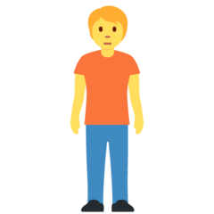




The Problem
Your Program
Other browsers and users
The Browser
Notes:
and c), the data won't be there if the user visits the website with a different browser, like the one on their phone, or if any other user visits the website and wants to see what other people are doing on there. this is why the programs that are responsible for web pages kind of need to be split in half: we need to run half of the program in the user's browser, to respond to stuff they're doing, and half of it on some external computer that stores data and lets you retrieve it from anywhere. that kind of computer is called a web server.

Slide 7
Servers
Server: Centralizes resources (incl. web pages and application data)
Client (browser): Accesses those things
Notes:
a server is just a device that provides resources to a network. every time you view any kind of website, a web server is sending you the html, javascript, images, and et cetera that constitute the page you're looking at, including any data that’s submitted by users or that needs to be able to change over time.

Slide 8
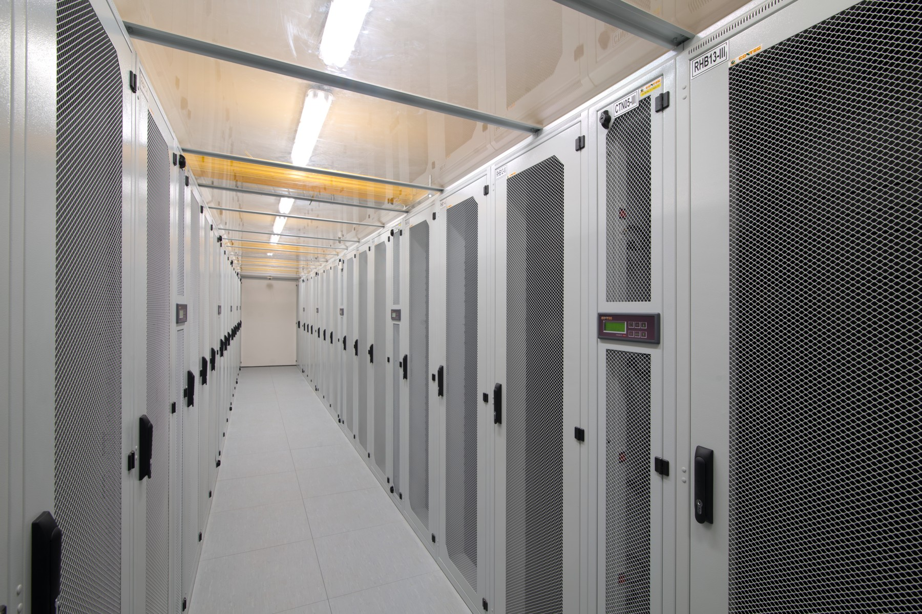
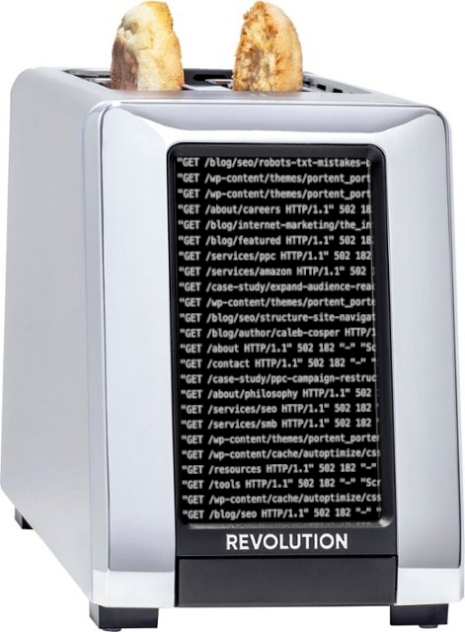
Servers
Notes:
any network device can play the role of a server: a phone can, a desktop computer can, a raspberry pi can; you usually want a server to be a big powerful computer with a good internet connection sitting in a cool basement somewhere, but sometimes you have to work with what you got, and so you're forced to jailbreak and reverse engineer your smart toaster

Slide 9
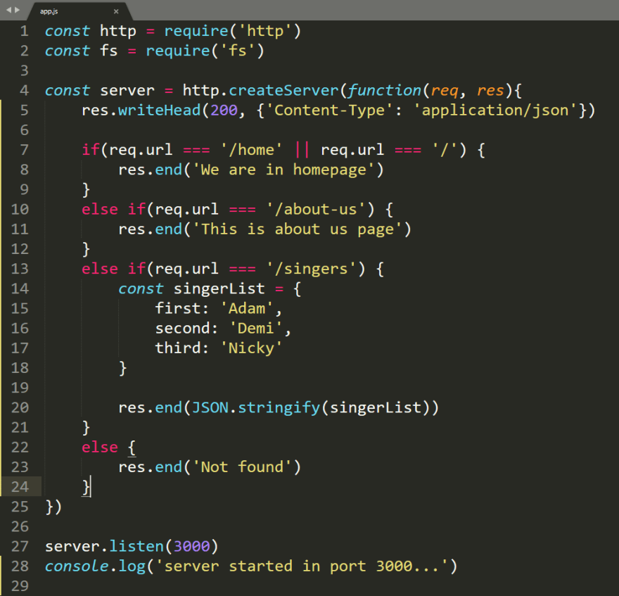
Servers
Notes:
and unfortunately, the term "server" can refer to either a whole computer or just a specific program that is implementing the role of providing resources on a network. so that may sometimes be confusing, sorry. but hopefully it will be possible to use context to figure out what kind of thing i'm talking about.

Slide 10
Choices
Browser languages: CSS/JS/HTML
Front-end frameworks: React, Vue, Angular, jQuery used to be huge
Back-end frameworks:
  Python: Django, Flask, Tornado
  PHP: Laravel, Symfony, CodeIgniter
  Node.js: Express, Fastify, Koa
  plus infinity more for every language you can think of
  also: you need other external programs like databases or video encoders sometimes
Notes:
and, by the way, there is no agreement on the best way to run a server. when you’re just creating the content that the users see, which is called frontend web development, there really aren’t too many options: you have to produce html, css, and javascript, and the main ways to do that are to write programs with react, vue, or angular; frontend web designers [next slide] do not use too many brain cells pinning down their basic tools.

Slide 11


Notes:
do not use too many brain cells pinning down their basic tools. [] but if you're creating a server, which means you're doing what's called backend engineering, you can do anything. you can write your code in any language, using any or multiple of a million frameworks and libraries people have created for you, you can read and write to files, you can integrate with databases, you can run other unrelated programs from inside your program, anything. we're staring [next slide] into the abyss, here.

Slide 12


Notes:
we're staring into the abyss, here. [] we're not trapped in the browser anymore, but we are caught in the prison of having decisions to make.

Slide 13
Choices
Browser languages: HTML/CSS/JS/WASM
Front-end frameworks: React, Vue, Angular (+ jQuery is still out there)
Back-end frameworks:
  Python: Django, Flask, Tornado
  PHP: Laravel, Symfony, CodeIgniter
  Node.js: Express, Fastify, Koa
  plus infinity more for every language you can think of
  also: you need other external programs like databases or video encoders sometimes
Notes:
however: since you have to write frontend (user-facing) stuff in javascript, many people have recently started to write their backend server stuff in javascript as well, to avoid having to learn more than one language. they can do this because a program called node.js will run javascript code for you, outside of its original habitat (the browser.) node could theoretically run any kind of program, but it's mostly used for web servers. there's a very popular library for it called "express" that provides convenience functions that make common web server tasks very easy to accomplish. and this introduction is finally over; we can now try creating our own node.js with express server. was that nine hours?

