Slide 1
HacKSU Spring 2024 :D
Intro to technology stacks

Slide 2
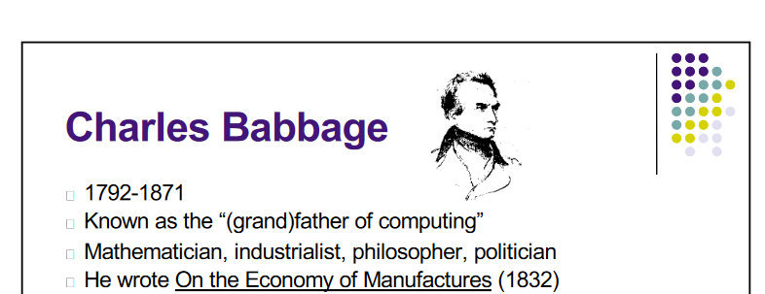
Charles Babbage
Credited with inventing the idea of a digital programmable computer

Slide 3
Charles Babbage
Also waged a lifelong war against street musicians

Slide 4
Charles Babbage
“I have developed…an unenviable celebrity,” Babbage once wrote, “not by anything I have done, but simply by a determined resistance to the tyranny of the lowest mob, whose love, not of music, but of the most discordant noises, is so great that it insists upon enjoying it at all hours in every street.”

Slide 5
Charles Babbage
Corrected poems:
The English mathematician Charles Babbage, who conceived programmable computation, wrote to the young poet Tennyson. "In your otherwise beautiful poem," he said, "one verse reads,
Every moment dies a man, Every moment one is born.
" ... If this were true," he went on, "the population of the world would be at a standstill. In truth, the rate of birth is slightly in excess of that of death. I would suggest [that the next edition of your poem should read]:"
Every moment dies a man, Every moment 1 1/16 is born.

Slide 6
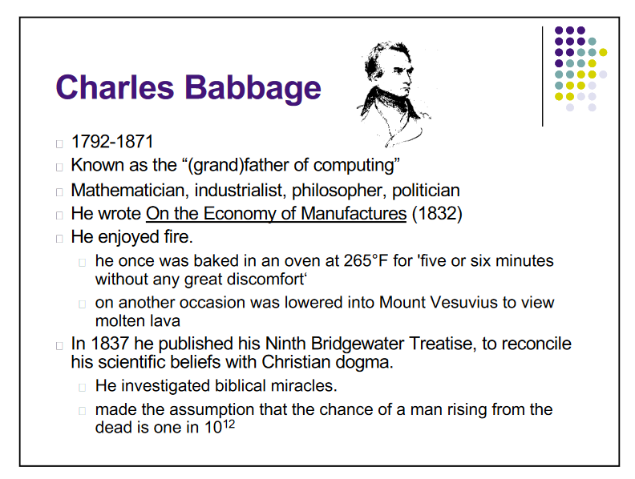
Charles Babbage

Slide 7
Charles Babbage
Ultimately, the street musicians won
“After a painful surgical operation, Babbage was certain that a brass band had conspired to keep him awake with their playing. Being bed-ridden with the band not far outside his window, Babbage said he was ‘compelled passively to submit to my tormentors...’”
Even on his deathbed in 1871, Babbage’s son writes that a guy kept encouraging kids to whack tin pails outside his window.

Slide 8
Charles Babbage
His obituary:
Our obituary column on Saturday contained the name of one of the most active and original of original thinkers, and whose name has been known through the length and breadth of the kingdom for nearly half a century as a practical mathematician—we mean Mr. Charles Babbage. He died at his residence in Dorset-street, Marylebone, at the close of last week, at an age, spite of organ-grinding persecutors, little short of 80 years.

Slide 9
Not Much Has Changed
We’re all still so weird
Let’s take a hard left turn into technology stacks

Slide 10
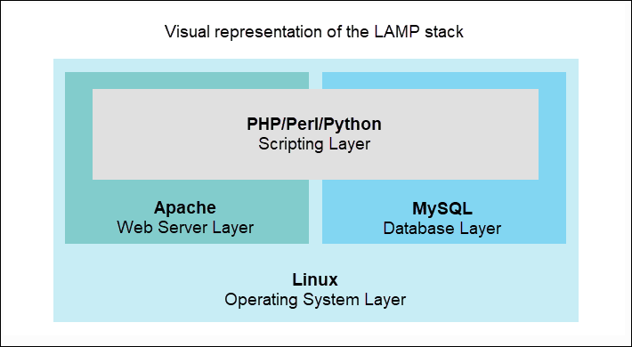
Stacks

Slide 11



Stacks
For C++ Programming:

Slide 12






Stacks
For C++ Programming:

Slide 13
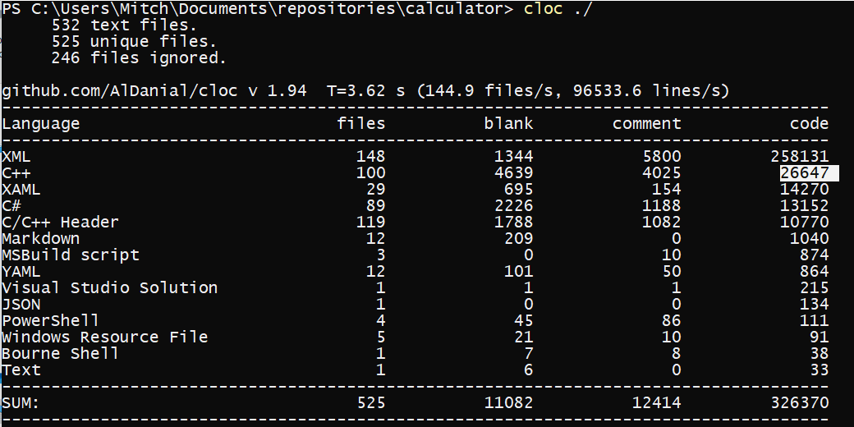





Stacks
For C++ Programming:

Slide 14
Stacks
Web Calculator Stack:
Your Code
JS Interpreter
Browser
OS
CPU

Slide 15
Stacks
Tradeoffs:
Speed

Slide 16
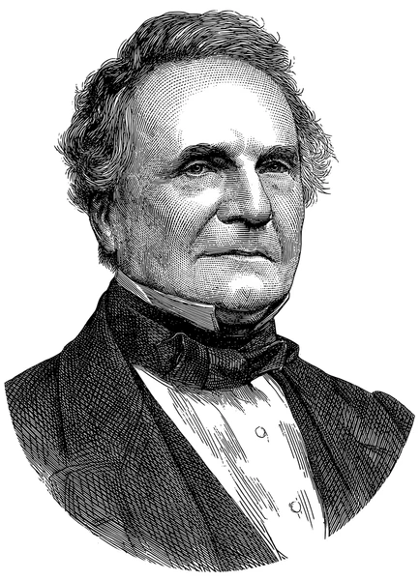
Stacks
Tradeoffs:
Speed
This Guy

Slide 17
Stacks
Tradeoffs:
Speed
This Guy
Making your own systems
vs.
Using systems He created

Slide 18
Stacks
Python Stack:
Your Code
Bytecode Interpreter
Python Interpreter
WebAssembly Interpreter
JS Interpreter
OS
Browser
CPU
OS
CPU

Slide 19
Stacks
Python Stack:
Your Code
Bytecode Interpreter
Python Interpreter
OS
CPU

Slide 20
Stacks
Python Stack:
Your Code
Bytecode Interpreter
Python Interpreter
OS
CPU

Slide 21
Stacks
Python Stack:
Your Code
Bytecode Interpreter
Python Interpreter
OS
CPU

Slide 22
Stacks
Python Stack:
Your Code
Bytecode Interpreter
Python Interpreter
OS
CPU

Slide 23
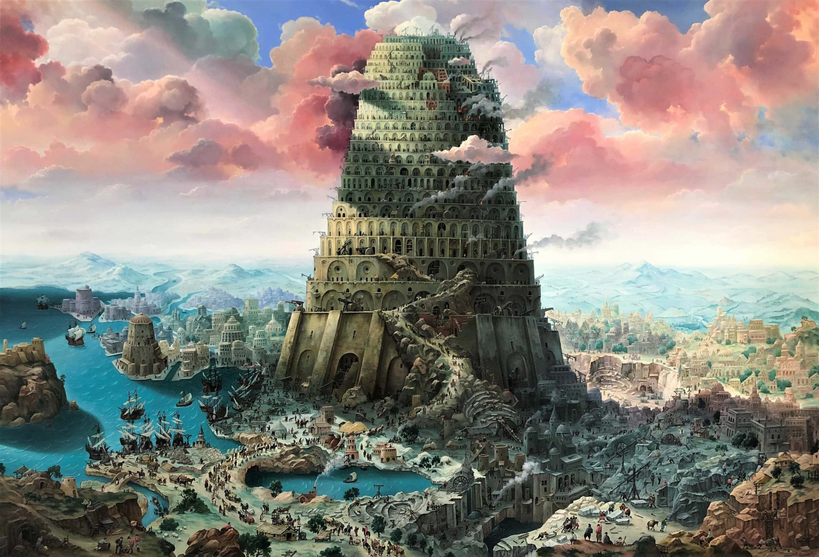
Stacks

Slide 24
Stacks
Human :(

Slide 25
Stacks
God :D
Human :(

