Slide 1

BYTE-BOT AI CHATBOT
Pixel-style AI companion with FastAPI, MongoDB memory, Groq/LangChain, and future RAG tools
Submitted By: Harsh Tiwari
Guided By: Faculty Name
Department / University Name
BYTE-BOT
A practical project presentation

Slide 2
TABLE OF CONTENT
02
Presentation Flow
Introduction
Technologies Used
Problem Statement
Features / Modules
Objectives
Future Enhancements
Solution / Proposed System
Conclusion
System Architecture
Thank You
PLAN
Byte-Bot AI Chatbot Project
Department / University Name

Slide 3
INTRODUCTION
03
Current Gap
Vision
Many chatbot UIs feel plain and do not show personality.
Create a cute pixel companion called Byte-Bot.
Frontend demos often fail when backend memory is added later.
Keep the UI playful while the backend stays practical.
Students need a clear bridge between UI, API, database, and AI model.
Store user sessions and chat memory with MongoDB.
Future tools like voice, document search, and web search need a scalable base.
Grow toward RAG, TTS, STT, and assistant tools step by step.
Byte-Bot AI Chatbot Project
Department / University Name

Slide 4
PROBLEM STATEMENT
04
The main problem this project solves
A chatbot without backend connection cannot become a real product.
Project Need
A chatbot without memory forgets the user after every message.
Byte-Bot combines a friendly interface with a real backend path, so the demo can grow into a usable AI assistant.
A plain interface gives no emotional identity to the assistant.
Manual testing becomes confusing when frontend and backend are separate.
Deployment needs clean configuration, database setup, and documentation.
BOT
Byte-Bot AI Chatbot Project
Department / University Name

Slide 5
OBJECTIVES
05
User Focus
System Focus
Functional Focus
Make the chatbot easy to use, visually friendly, and simple enough for a beginner to understand.
Connect frontend, FastAPI backend, Groq/LangChain, and MongoDB without breaking the UI.
Support chat, registration, login, memory, reset, and a roadmap for future document and voice tools.
Keep the project modular.
Document each major file and workflow.
Prepare the app for hosting and future AI features.
Byte-Bot AI Chatbot Project
Department / University Name

Slide 6
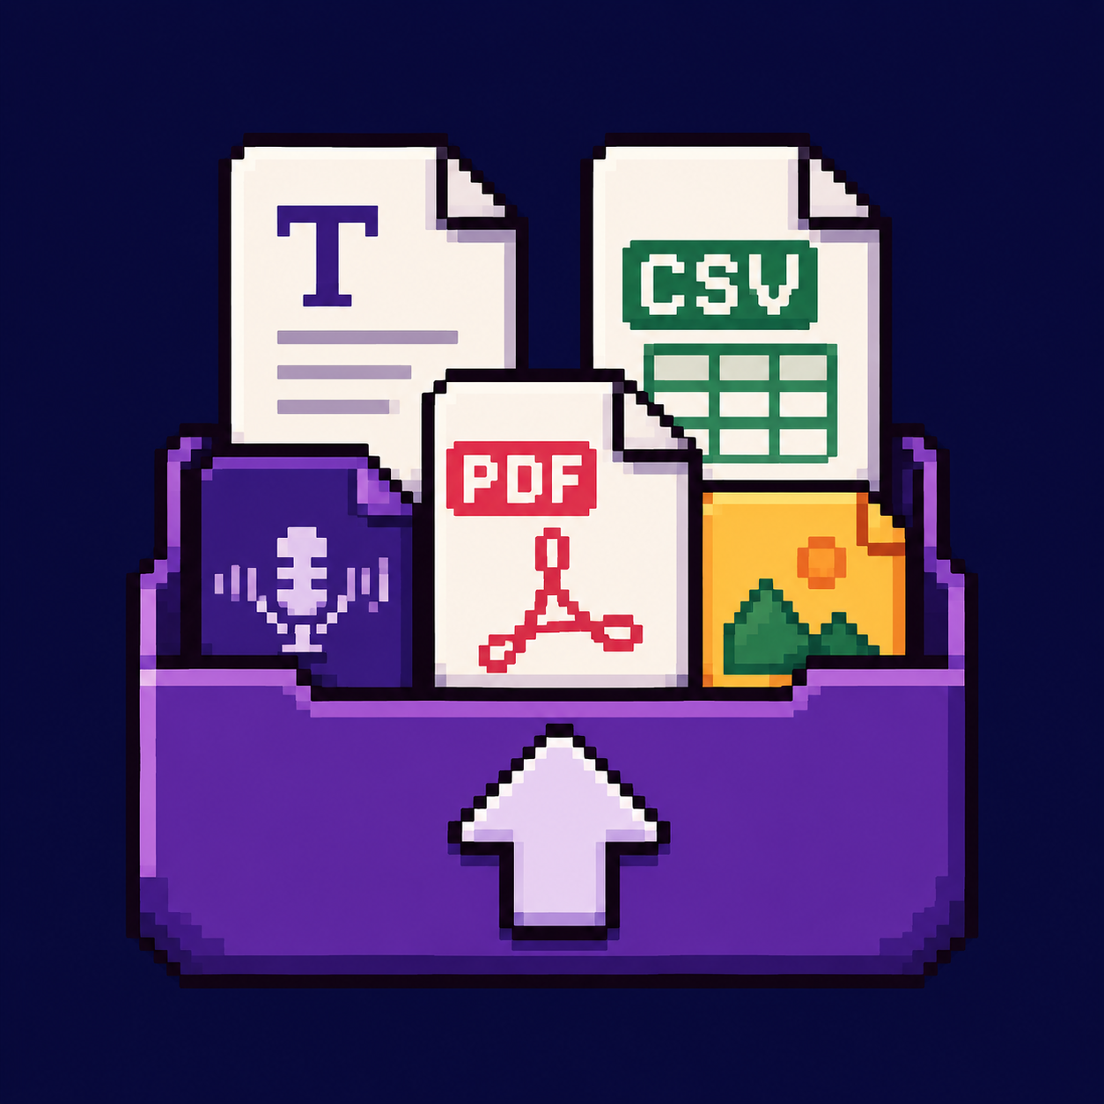
SOLUTION / PROPOSED SYSTEM
06
Byte-Bot proposed system
Pixel Chat UI
Groq + LangChain
A themed chatbot page with mascot animation, status bar, and clean chat controls.
LangChain controls prompt structure while Groq generates fast chatbot responses.
FastAPI Backend
Future Tools
A Python API receives messages, handles routes, and connects the frontend to AI logic.
PDF, image, web search, STT, TTS, and local RAG can be added without rewriting the UI.
MongoDB Memory
Registration and conversation memory can be stored by user/session for persistence.
Byte-Bot AI Chatbot Project
Department / University Name

Slide 7
SYSTEM ARCHITECTURE
07
Architecture Flow
User Input
>
Frontend UI
>
FastAPI Backend
>
LLM + Tools
>
Database
>
Bot Reply
The user interacts with the HTML/CSS/JS interface. The frontend sends JSON requests to FastAPI. FastAPI calls LangChain/Groq and stores or reads user/session data from MongoDB.
User -> Interface -> Processing -> Database / Model -> Output
Byte-Bot AI Chatbot Project
Department / University Name

Slide 8
TECHNOLOGIES USED
08
Frontend
Backend
HTML, CSS, JavaScript
Python, FastAPI, Uvicorn
Database
AI Framework
MongoDB Atlas with SQLite fallback
LangChain prompt orchestration
LLM
Tools
Groq chat model
SerpApi, document loaders, future Whisper STT
STACK
Byte-Bot AI Chatbot Project
Department / University Name

Slide 9
FEATURES / MODULES
09
Login and registration flow connected to backend routes.
Live chat interface that sends messages to FastAPI.
Byte-Bot personality prompt with friendly, short replies.
MongoDB memory for users and chat history.
Reset endpoint that clears frontend and backend memory.
Tool dock prepared for upload, web search, image search, and voice.
Module View
The project is moving from a UI demo into a modular assistant: frontend, backend, auth, memory, tools, and deployment notes.
Byte-Bot AI Chatbot Project
Department / University Name

Slide 10
FUTURE ENHANCEMENTS
10
Next development path
Add RAG over PDF, TXT, CSV, and image notes.
Use embeddings and semantic search for better document answers.
Roadmap Focus
Build one feature at a time: stable chat, stable memory, document search, voice, then deployment polish.
Add speech-to-text input with Whisper or browser speech APIs.
Add text-to-speech so Byte-Bot can speak replies.
Improve long-term memory and user profiles.
Deploy frontend and backend with environment variables safely.
NEXT
Byte-Bot AI Chatbot Project
Department / University Name

Slide 11
CONCLUSION
11
Project Summary
Byte-Bot is a beginner-friendly AI chatbot project with a strong visual identity.
Final Takeaway
The current system connects UI, backend, AI model, and MongoDB memory.
The project now has a real product foundation: a personality-rich frontend, a practical API backend, persistent memory, and a clear future roadmap.
The architecture is simple enough to explain and scalable enough to extend.
The next major milestone is local document RAG with PDF/TXT/CSV support.
Byte-Bot AI Chatbot Project
Department / University Name

Slide 12
THANK YOU
Any Questions?
Byte-Bot AI Chatbot Project
BYE

