Slide 1


BYTE-BOT AI CHATBOT
Project Presentation
Byte-Bot
A Pixel-Style AI Chatbot With Backend Memory, Tools, Voice Roadmap And Deployment Plan
Submitted By: Harsh Tiwari
Guided By: Faculty / Department
Stack: HTML, CSS, JavaScript, FastAPI, LangChain, Groq, MongoDB
Byte-Bot AI Chatbot Project | Frontend + FastAPI + LangChain + MongoDB

Slide 2
TABLE OF CONTENT
1
Introduction
7
Technologies Used
2
Current Gap and Vision
8
Features / Modules
3
Objectives
9
Frontend and Backend Workflow
4
Problem Statement
10
Integration and Deployment
5
Solution / Proposed System
11
Future Enhancements
6
System Architecture
12
Conclusion and Thank You
Byte-Bot AI Chatbot Project | Frontend + FastAPI + LangChain + MongoDB

Slide 3
INTRODUCTION
Background
Why Byte-Bot was built
Many chatbot projects stop at a simple textbox and do not feel interactive or memorable.
Byte-Bot began as a pixel-style frontend UI, then grew into a real AI chatbot connected to a backend.
The goal is to make the bot useful and charming: it can chat, remember sessions, search the web, and later understand user documents.
The project focuses on beginner-readable code, clear documentation, and deployment readiness.
Byte-Bot AI Chatbot Project | Frontend + FastAPI + LangChain + MongoDB

Slide 4
INTRODUCTION
Current Gap and Vision
Current Gap
Vision
Frontend-only chat demos cannot answer intelligently.
Plain LLM wrappers forget previous messages without memory.
Users need search, file understanding, and voice features in one simple interface.
Deployment becomes hard when frontend, backend, database, and API keys are not organized.
Build a scalable AI companion with a polished pixel UI.
Connect the UI to FastAPI, LangChain, Groq, MongoDB, and tool modules.
Support future RAG over PDFs, CSVs, text files, and images.
Keep the project understandable enough to explain in viva or classroom review.
Byte-Bot AI Chatbot Project | Frontend + FastAPI + LangChain + MongoDB

Slide 5
OBJECTIVES
Main Objectives
User Focus
System Focus
Functional Focus
Send messages from a friendly pixel UI.
Receive short, helpful, personality-rich answers.
Use buttons for upload, voice, search, and reset.
Use FastAPI for clean backend endpoints.
Store users, sessions, and memory in MongoDB.
Keep API keys safely in environment variables.
Integrate Groq LLM through LangChain.
Add document search using chunking and retrieval.
Prepare for TTS, STT, hosting, and future tools.
Byte-Bot AI Chatbot Project | Frontend + FastAPI + LangChain + MongoDB

Slide 6
PROBLEM STATEMENT
Problem Statement
A basic chatbot UI is not enough because it cannot preserve memory or call real backend logic.
Without backend organization, login, database storage, and deployment become confusing.
Search results can be messy unless the bot summarizes context first and keeps links separate.
Uploaded files need chunking and retrieval before the bot can answer from PDF/CSV/TXT content.
Voice and assistant tools need a clear roadmap so they do not break the stable chat system.
Core Challenge
Merge many parts into one stable beginner-friendly product without losing the Byte-Bot personality.
Byte-Bot AI Chatbot Project | Frontend + FastAPI + LangChain + MongoDB

Slide 7
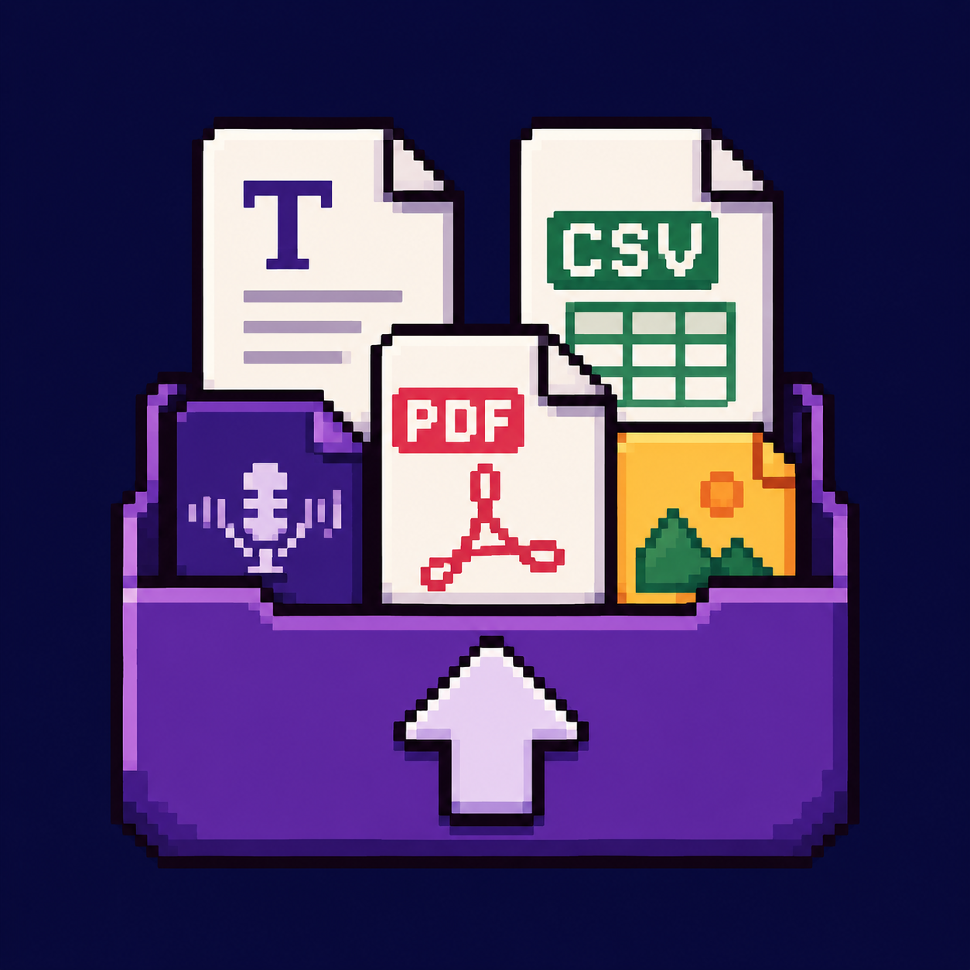


SOLUTION / PROPOSED SYSTEM
Proposed System
Pixel Chat Interface
HTML, CSS, and JavaScript create the visual chat experience.
FastAPI Backend
Python routes receive messages, reset memory, and expose tools.
AI Brain
LangChain sends the prompt and history to Groq.
The base chatbot stays stable first; advanced abilities are added step by step.
Each tool is isolated so one broken feature does not break the whole chat flow.
MongoDB Memory
Registration, login, and chat sessions can be stored in backend database.
Tool Layer
Search, upload, voice, and future assistant tools are added as separate modules.
Byte-Bot AI Chatbot Project | Frontend + FastAPI + LangChain + MongoDB

Slide 8
SYSTEM ARCHITECTURE
Architecture Flow
User
Frontend
FastAPI
LangChain
Groq
MongoDB
Reply
Frontend sends JSON data such as message and session_id using fetch().
FastAPI receives the request, loads memory, adds prompt instructions, and calls the AI model.
MongoDB stores user/login data and can store chat/session data for scalable memory.
The backend returns JSON, and JavaScript renders it inside the pixel chat bubble.
Byte-Bot AI Chatbot Project | Frontend + FastAPI + LangChain + MongoDB

Slide 9
TECHNOLOGIES USED
Tools Used and Why
HTML / CSS / JS
FastAPI
Simple frontend stack, easy to edit, good for learning web basics.
Modern Python framework, fast JSON APIs, automatic docs, cleaner than Flask for API work.
LangChain + Groq
MongoDB Atlas
LangChain organizes prompts and memory; Groq gives fast LLM responses.
Cloud database for registration, login, sessions, and future scalable storage.
SerpApi
Vercel / Render
Search API for web/image results when user asks for current external information.
Free-friendly hosting path: frontend on Vercel, backend on Render/Railway.
Byte-Bot AI Chatbot Project | Frontend + FastAPI + LangChain + MongoDB

Slide 10
FEATURES / MODULES
Current and Planned Modules
Completed / Started
In Progress
Future
Pixel login and chat UI
Backend /chat endpoint
Groq + LangChain reply
MongoDB login connection
Web search and image search
Upload chunking prototype
Cleaner RAG answers
PDF/CSV/TXT semantic retrieval
Better response formatting
Deployment configuration
Teacher-ready documentation
Voice input using Whisper
Voice output using TTS
Assistant tools/actions
Long-term memory
Authentication polish
Production monitoring
Byte-Bot AI Chatbot Project | Frontend + FastAPI + LangChain + MongoDB

Slide 11
WORKFLOW AND INTEGRATION
How Everything Was Merged
Designed the pixel frontend with static HTML, CSS animations, mascot, and chat bubbles.
Added JavaScript event handling for Send, Reset, Upload, Search, and Voice buttons.
Connected fetch() calls to FastAPI routes such as /chat, /reset, and tool endpoints.
Backend loads environment variables, database connection, prompt, memory, and tool modules.
Responses are returned as JSON and rendered back into the chat UI.
Click
JS
Fetch
API
AI/DB
Bubble
Important Integration Rule
Frontend knows the backend URL only. Secrets, AI keys, database logic, and tool logic stay in backend.
Byte-Bot AI Chatbot Project | Frontend + FastAPI + LangChain + MongoDB

Slide 12
FUTURE ENHANCEMENTS
Roadmap
TTS
STT
Browser speechSynthesis first; later ElevenLabs/OpenAI TTS.
Whisper/OpenAI transcription endpoint or browser speech recognition.
RAG
Tools
Upload PDFs, CSVs, TXT files, split into chunks, retrieve relevant context.
Search, calculator, notes, image search, and personal assistant actions.
Deployment
Security
Vercel/Netlify frontend plus Render/Railway backend and MongoDB Atlas.
Hash passwords, add tokens, protect environment variables, rate limit APIs.
Byte-Bot AI Chatbot Project | Frontend + FastAPI + LangChain + MongoDB

Slide 13
CONCLUSION AND THANK YOU
Conclusion
Byte-Bot has moved from a frontend demo toward a real AI assistant project.
The system combines pixel UI, FastAPI backend, AI model calls, memory, search, and upload-tool planning.
The chosen tools are beginner-friendly, scalable, and suitable for local testing and future hosting.
Next focus: stable deployment, better RAG, voice features, and secure authentication.
THANK YOU Any Questions?
Byte-Bot AI Chatbot Project | Frontend + FastAPI + LangChain + MongoDB

