Slide 1

My Career Goal – Cyber
Security Expert
A Journey Towards Protecting the Digital World

Slide 2
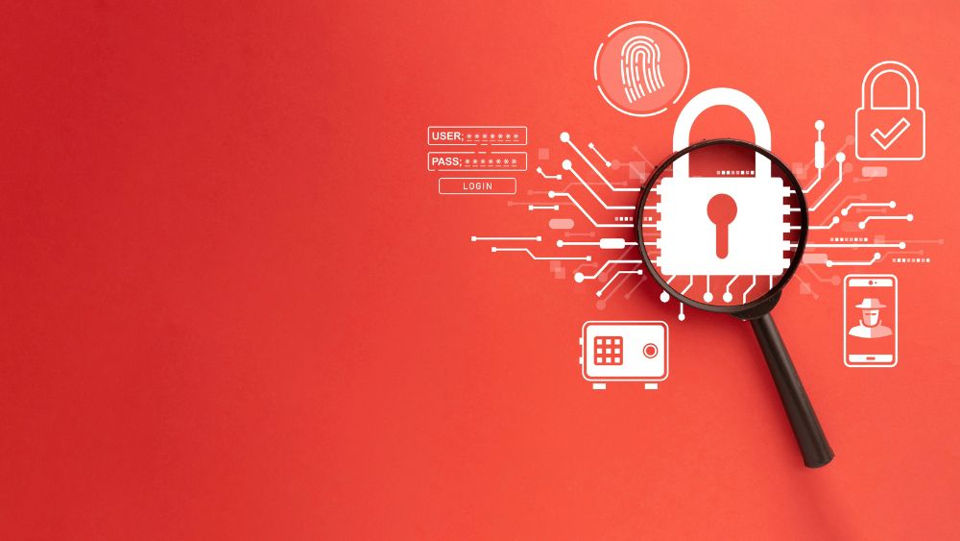
What is Cyber Security?
• Cyber Security means protecting data and systems from digital attacks.
• It ensures safe communication and privacy in the digital world.
• It is a core branch of Computer Science and Engineering.
• Cyber Security covers areas like network protection, cryptography, and digital forensics.
• It’s the digital shield that keeps our online world safe.

Slide 3
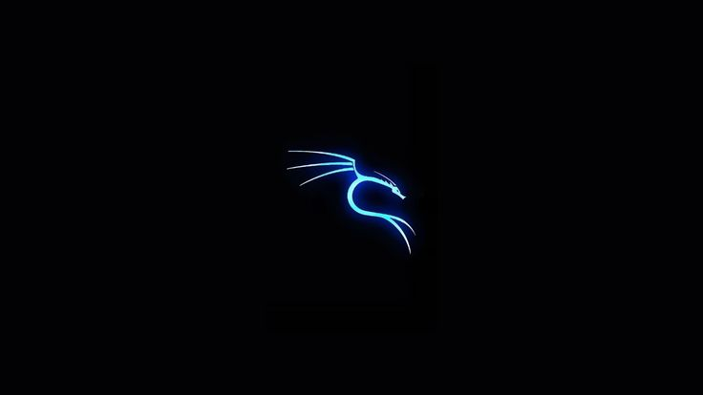
Why I Chose Cyber Security
I am passionate about technology and problem solving.
I want to help protect people and organizations from cybercrimes.
The field offers exciting challenges and career growth.
The idea of fighting cyber threats motivates me every day.
Cyber Security allows me to turn curiosity into contribution.

Slide 4
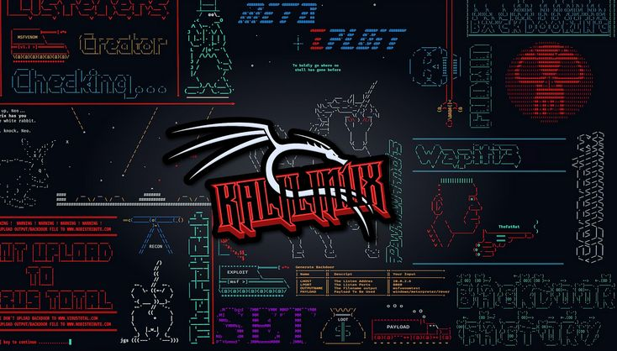
Skills I Want to Learn
• Ethical Hacking & Penetration Testing
• Networking and System Security
• Programming (Python, Java, C)
• Risk Management and Cryptography
• AI-based Threat Detection and Cloud Security
• Strong problem-solving and teamwork skills

Slide 5
My Education & Training Plan
• Pursuing B.Tech in Computer Science & Engineering (CSE).
• I will take certifications like CEH, CompTIA Security+, and CCNA Security.
• I plan to participate in cybersecurity workshops and hackathons for real-world experience.
• Learning from online platforms like Coursera and Udemy will help me stay updated.

Slide 6
My Future Career Goals
• Work as a Cyber Security Analyst in a reputed company.
• Later become a Security Consultant or Ethical Hacker.
• Contribute to building a safer internet for all.
• My short-term goal is to gain industry experience in leading IT companies.
• In the future, I wish to establish my own Cyber Security Training firm.

Slide 7
Conclusion – My Vision
• Technology is growing — so are cyber threats.
• My dream is to protect people from these threats.
• “Cyber Security is not just a job, it’s a responsibility.”
• I believe protecting information is protecting the future.
• My mission is to become a Cyber Guardian for the digital world.
Thank You!

