Slide 1

Silent-Protocol
The Context-Aware Privacy Proxy
OPEN INNOVATION TRACK
Team Members
A next-generation privacy proxy that lets professionals harness the power of public LLMs — without ever exposing sensitive data.
Divya — Frontend
Aum — Backend
Aayush — Core Engine

Slide 2

The Problem
Professionals Need LLMs
Professionals require LLMs to accelerate workflows but possess data too sensitive for public APIs.
Self-Hosting Is Prohibitive
Self-hosted LLMs incur costs exceeding $50k/year and offer inferior generation quality compared to top models.
Redaction Destroys Context
Standard text redaction destroys contextual integrity, rendering LLM outputs useless.
Compliance Failures
Enterprise APIs transmit raw data over the wire, failing strict compliance requirements.

Slide 3
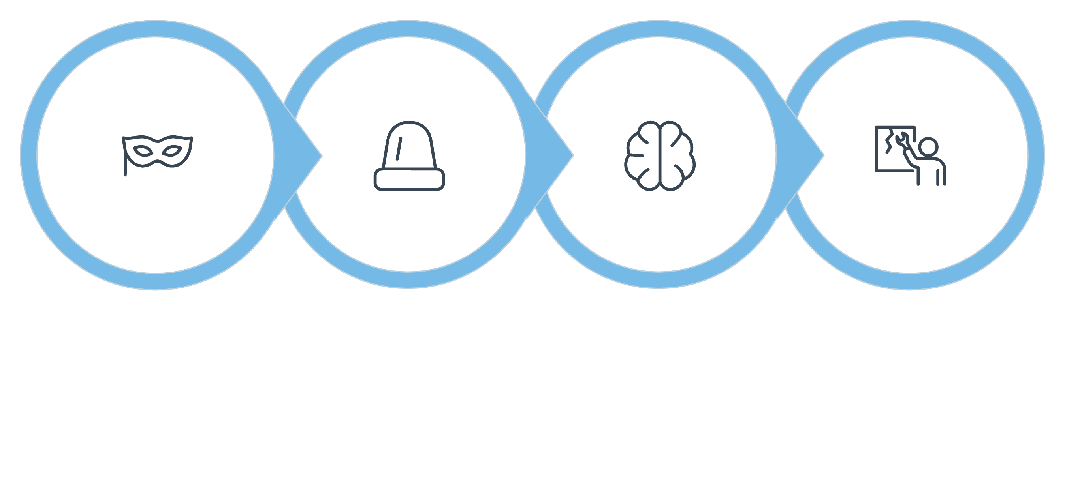

The Solution
Silent-Protocol functions as an intermediary proxy between the user and public LLMs — preserving full context while keeping real data private.
Forward to LLM
Reconstruct Reply
Alias Prompt
LLM Process
The LLM operates without access to real data while delivering a fully contextualized response.

Slide 4
System Architecture
Entity Detection
Alias Manager
The system detects sensitive entities using regex and a GLiNER NER model.
Replaces detected entities with session-consistent fake aliases using the Faker library.
LLM Forwarding
Response Reconstruction
The sanitized prompt is forwarded to the Groq LLM API.
The system reconstructs the final response by mapping aliases back to the original entities.

Slide 5

Core Differentiator: 3-Tier Pipeline
REPLACE
PERTURB
PRESERVE
Executes full substitution with fake data for critical PII.
Introduces minor numerical noise to obscure exact values.
Maintains domain-specific terminology unmodified.
Example: "Dr. Priya Sharma" → "Vikram Patel"
Example: "₹3.5 lakh" → "₹3.9 lakh"
Example: "Metformin 500mg" remains "Metformin 500mg"

Slide 6

Real-World Implementation Example
User Input
Proxied Input Seen by LLM
"Draft an NDA between Apple Inc and Samsung Electronics regarding Project Titan battery technology."
"Draft an NDA between Orion Corp and Vega Industries regarding Project Falcon battery technology."
Output Delivery
The system maps the aliases back to deliver a precise legal document containing the real entity names.

Slide 7
Technical Stack
Frontend
Backend
NER Engine
Constructed using HTML, CSS, and Vanilla JavaScript.
Powered by the FastAPI framework utilizing Python 3.11.
GLiNER zero-shot model implemented for entity detection without retraining.
Data Generation
LLM Integration
Python Faker library deployed to generate realistic, locale-aware aliases.
Groq API utilizing Llama 3.3 70b for rapid inference.

Slide 8




Testing Metrics & Validation
40
394
95%
Real-World Prompts
Entities Detected
HIPAA Safe Harbor
Executed with 0 processing errors.
Across all test cases.
Approximate coverage rate achieved.
Pipeline Distribution
59%
21%
20%
Replaced
Perturbed
Preserved
233 entities fully substituted with fake aliases.
81 entities modified with numerical noise.
80 domain-specific terms kept unmodified.
Real-time Privacy Score: Integrated metric to quantify risk level and identifiers protected per prompt.

