Slide 1
ANTLR(ANother Tool for Language Recognition)
What is ANTLR?
“ANTLR is a powerful parser generator for reading, processing, executing, or translating structured text or binary files. It's widely used to build languages, tools, and frameworks. From a grammar, ANTLR generates a parser that can build and walk parse trees.”
http://www.antlr.org/

Slide 2
Lexers / Parsers
They have a lot in common
  They read symbols of some alphabet from their input.
  They analyse these symbols and try to match them with the grammar of the language they understood.
  They attach semantics (meaning) to the language pieces they find.
  They all produce on their output, a proper sentences of the language they recognize.

Slide 3
Lexers
Lexers attach meaning by classifying lexemes (strings of symbols from the input) as the particular tokens. E.g. All these lexemes: *, ==, <=, ^ will be classified as "operator" token by the C/C++ lexer.
Lexers produce tokens, which are sentences of the regular language they recognize.

Slide 4
Lexers (cont)
Example grammar
fragment DIGIT : [0-9] ; // not a token by itself
NUMBER : DIGIT+ ; // references the DIGIT helper rule
WORD : [a-zA-Z]+ ; // match identifiers
Using lexer designed for this grammar
Input | Output Tokens
code1234hack | WORD NUMBER WORD
1234 567 7 | NUMBER NUMBER NUMBER

Slide 5
Parsers
Parsers attach meaning by classifying an array of tokens and building the parse tree. E.g. all these tokens: [number][operator][number], [id][operator][id], [id][operator][number][operator][number] will be classified as "expression" nonterminal by the C/C++ parser.
Parsers produce syntax trees, which are representations of sentences of the context-free language they recognize.

Slide 6
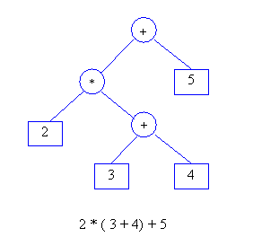
Parsers (cont)
Example of a parse tree of a calculator

Slide 7
Use-Cases
Groovy – A dynamic scripting language that supports Java syntax and borrows featuresfrom other languages like python and ruby
Jython – an implementation of the Python programming language in Java
TTAGG uses it to generate grammars for processing Natural Language for usage in Semantic Search

