Slide 1
Re(Trie)val Tree
- Also called prefix tree
- Usually used to store, but is not limited to, text
- Provides compressed storage over other data structures
- Provides fast look up time for many data structures with extra bonues

Slide 2
Sample Data to store
Joe
John
Johnny
Jane
Jack

Slide 3
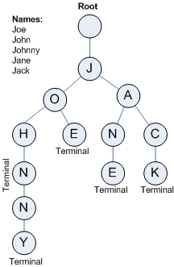
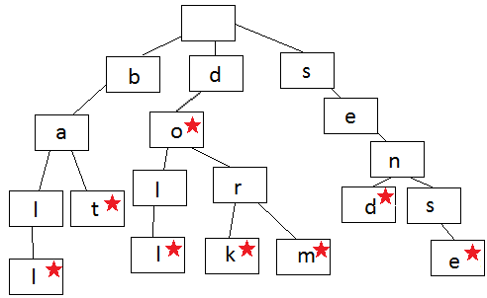
Visual representation

Slide 4
Trie vs Other alternatives
Arrays of Strings
HashSet

Slide 5
Array
a = [“joe” “john” “johnny” “jane” “jack”]
Stores each word as-is
Any duplicate/common prefixes are repeated in data structure (large memory footprint)
O(N) lookup when searching through array, for matching string (slow)
Easy to get All the data back in original state

Slide 6
HashSet
Stores each word as-is
Any duplicate/common prefixes are repeated in data structure (large memory footprint)
A bit of work to get data back in original state
O(1) lookup when searching for matching string (very fast)

Slide 7
Trie
Stores words as characters
Any duplicate/common prefixes are NOT repeated in data structure (small memory footprint)
O(m), where m is the length of the string
Due to tree structure of data you have many interesting applications (listed next page)
A bit of work to get data back in original state

Slide 8
Trie Applications
You could, easily find all words contained in current word, starting from root.
- i.e. “implementation” contains “imp” “implement”
You can easily implement a “suggest word/next letter” feature, or even spell check. (used in mobile phones)
Has one of the fastest known sorting algorithms: Burstsort
Major memory/performance gains when storing large repeating strings like DNA sequences, or loading entire language dictionaries into memory.

