Slide 1
Software Security Primer Adversary Goals in Binary Exploitation
Joseph Parker Diamond
Vice President, HackUTK
Fall 2016

Slide 2
What Exactly is a Binary Executable?
A “binary executable” is a set of instructions in binary format which a computer of the appropriate architecture can read and execute.
Commonly abbreviated as a “binary” or “executable”
Examples: Any of your CS 102, 140, 302, 360 labs.

Slide 3
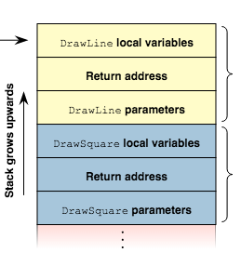
How Do Computers Execute Binaries?
Create a workspace to operate on variables and maintain a sequence of instructions
This workspace consists of “the stack” and registers.
The stack is a region of memory (RAM, not disk)
Source: Wikimedia Commons -- https://upload.wikimedia.org/wikipedia/commons/1/1f/Call-stack-layout.svg

Slide 4
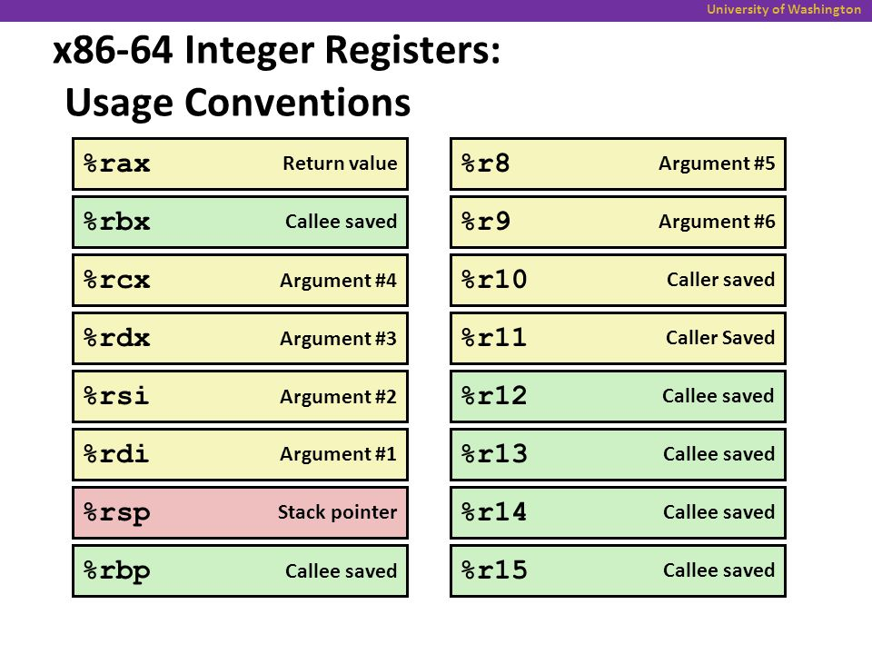
The Stack and Registers
The stack maintains the order of functions calls
Each function call has a “frame” in the stack
Each frame holds local variables and return address info
The registers hold temporary variables and information immediately relevant to the flow of execution
Source: University of Washington --
http://images.slideplayer.com/15/4850754/slides/slide_27.jpg

Slide 5
What is the Goal of the Adversary?
In general, the adversary wants the program to deviate from its expected behavior in a way beneficial to him/her.
How might this happen?
Hijack Control Flow -- “Please call /bin/bash and let me see all your secrets”
Alter Data -- “Transfer $10 $10,000 to my bank account”
Stop the Program -- “Customers will leave if this program is always down!”

Slide 6
How are these Goals Accomplished?
Let’s focus on control flow hijacking first
You may have noticed that the return address is stored on the stack.
Suppose one of the local variables spilled over to that space….
Demo time!
void bar()
{
printf("Hey there, I'm bar!\n");
}
void foo()
{
char input[10];
gets(input);
printf("You typed: %s\n", input);
}
int main()
{
foo();
return 0;
}

Slide 7
Conclusions
This was a contrived example, but it illustrates the concept and serves as a basis for almost the entirety of software security.
The OS and compiler have features which defend against these exploits:
Non-Executable Stack
Stack Smashing Protection
Address Space Layout Randomization
But these countermeasures do not provide complete security either…

Slide 8
Upcoming
Further Down the Rabbit Hole: Binary Protections and their Weaknesses
Thanks for coming out!

