Slide 1







Flow Chart
&
6. show user info
1. access
2. take menu photo
Webfront
Web Server(api)
3. analyze menu photo,
get name
5. info about food
4. send photos
Instagram
Web Crawler
Notes:
User can access React app anytime with web browser with his or her own mobile phone.
User is guided by web browser’s initial view in React
User takes photo of menu board
The photo user took goes to Web Server implemented with Nodejs and Naver Papago api, azure Computer vision api.
Web Server analyzes menu photo and gets name of target food.
If user clicks on one of the recognized names from menu board.
Web Crawler(Python BeautifulSoup) gets photos from Instagram by crawling with the name of target food.
Web Crawler sends back to Web server with information about food.
Web Server sends the target food’s information and frontend shows the new window of the target food.

Slide 2

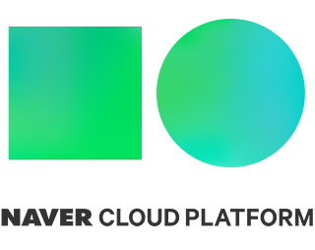




Development Environment
OCR
Translation
Api
FRONTEND
Web Crawler
Crawling from
Database
BACKEND
Notes:
Here’s all the tools used for implementation of ME:NEW.
Frontend : React web app
Api Server : Naver Papago Language Detection, Naver Papago NMT, Azure Computer Vision api
Web Crawler : Flask, Selenium, Python BeautifulSoup
Crawl From : Instagram

Slide 3
B2B - 사업성
1. Associate with Naver Store : Bind with the price tag
2. Associate with Air BnB : Bind with the ‘Experience Category’
3. Associate with Google Map Api : Check prefers through users’ track
//네이버 파파고 번역에 묶기 -> 어디?
네이버 store에 묶기 -> 가격표까지 묶기
여행사에 묶기(air bnb) -> experience랑 엮기
구글맵 api와 연동 -> 사용자의 방문 경로(+긍정, 부정 반응)

Slide 4
B2C - 보상
Restaurant & Recipt Recognition : Check whether overcharged or not
Follow other user : Follow user restaurant list
Food Ranking System : Prefers, Categorized by sex, age.
바가지를 당했는지 안 당했는지 -> 메뉴판에서 음식점까지 인식 : 리뷰
다른 사용자를 팔로우해서 음식점을 볼 수 있도록 함
음식 순위화 – 음식 트렌드 리더(성별, 연령대별)

