Slide 1

KAVIKULGURU INSTITUTE OF TECHNOLOGY AND SCIENCE, RAMTEK-441106
DEPARTMENT OF COMPUTER TECHNOLOGY
Efficient Revocable Multi-Authority
Attribute-Based Encryption for Cloud Storage
Group members
Mr. Jayesh Mirashe (CT19092)
Mr. Nitesh Chawhan (CT19038)
Ms. Pragati Wadibhasme (CT19042)
Mr. Badal Gaidhane (CT19014)
Ms. Pragati Lanjewar (CT19012)
GUIDED BY
Ms. Vaishali Malekar

Slide 2
CONTENTS
Introduction
Problem Statement
Project Objectives
Literature Review
Proposed Approach
System Architecture
Algorithm
Tools and Technologies
References

Slide 3
INTRODUCTION
Cloud storage is an application pattern of cloud computing to store massive data, so more and more individuals and organizations shift their data from local computers to cloud.
the data might be accessed and analyzed by the cloud server providers for illegal or monetary purposes.
attribute-based encryption (ABE) ensures the data owners to enjoy non-interactive and fine-grained control over encrypted data.
many researchers turn to multi-authority attribute-based encryption (MA-ABE), so that secret keys of attributes are issued to data consumers with the corresponding privileges for different attribute authorities respectively

Slide 4
PROBLEM STATEMENT
This project intends to illustrate the Cloud storage is an application pattern of cloud computing to store massive data, so more and more individuals and organizations shift their data from local computers to cloud. However, this new paradigm poses a serious threat to the privacy of their owners, since the data might be accessed and analyzed by the cloud server providers for illegal or monetary purposes

Slide 5
PROJECT OBJECTIVIES
To enhance the security of user data and privacy of the user by hiding the access policy.
The storage overhead of this scheme is reduced by generating constant size ciphertext.
The identification and prevention from insider attack is achieved by utilizing the short signature scheme.
for secure fine-grained access control system that also prevents insider attacks.

Slide 6
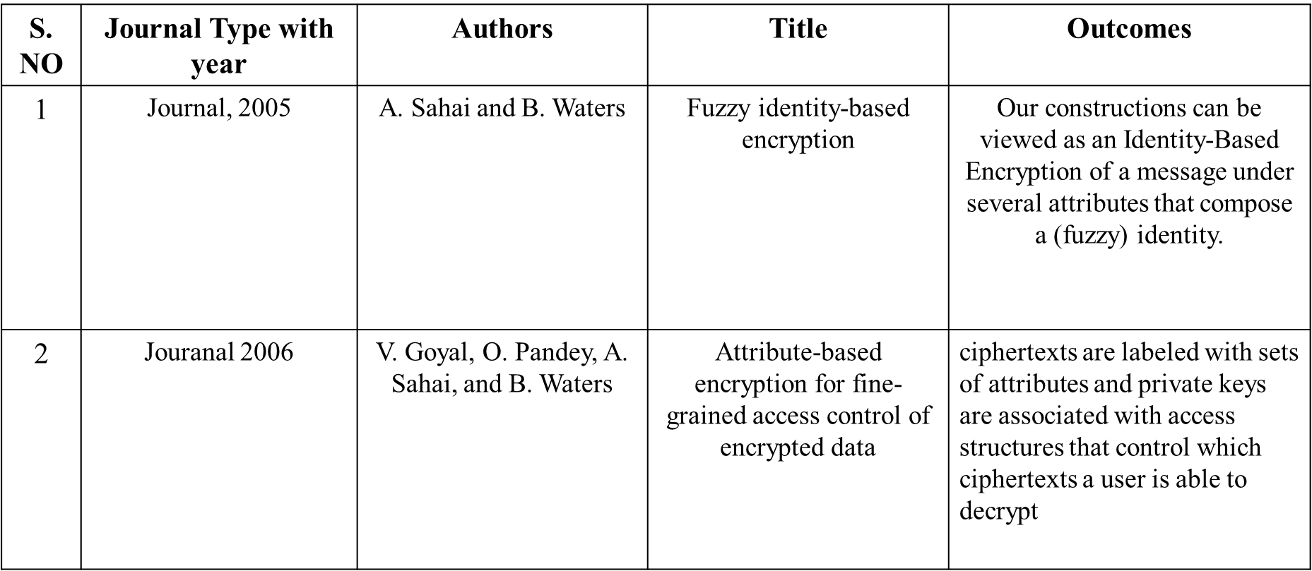
LITERATURE REVIEW

Slide 7
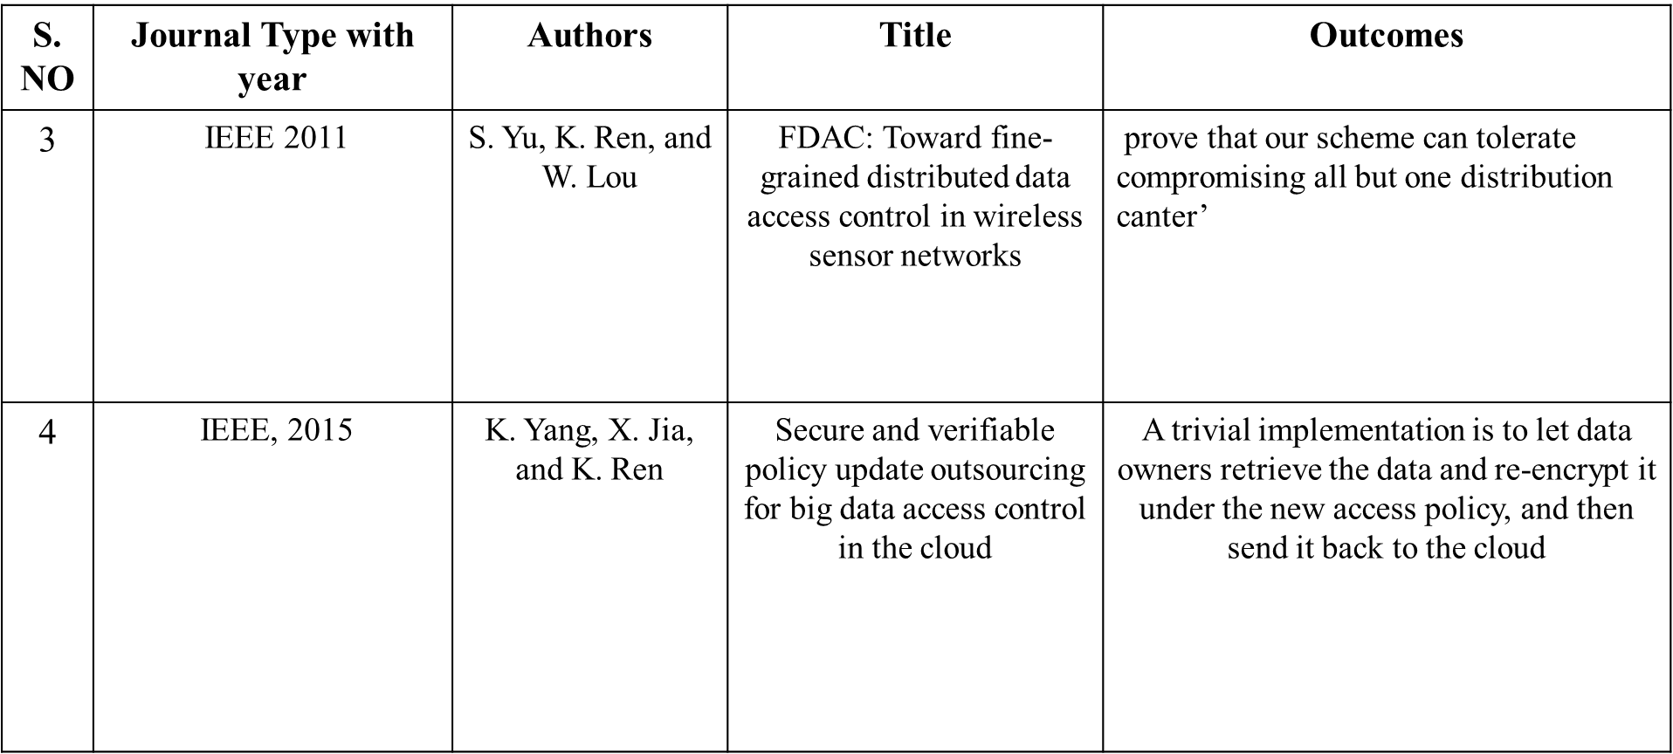
LITERATURE REVIEW

Slide 8
PROPOSED APPROACH
We propose efficient revocable multi-authority attribute-based encryption (RMA-ABE) scheme for cloud storage.
The security analysis indicates that the proposed scheme satisfies indistinguishable under adaptive chosen plaintext attack assuming hardness of the decisional Diffie-Hellman problem

Slide 9
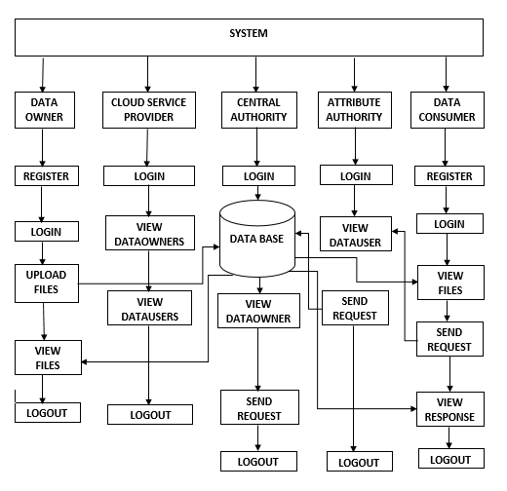
SYSTEM ARCHITECTURE

Slide 10
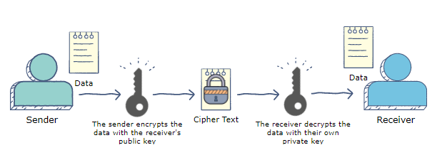
ALGORITHMS
RSA ALGORITHM:
The RSA algorithm is an asymmetric cryptography algorithm; this means that it uses a public key and a private key (i.e two different, mathematically linked keys). As their names suggest, a public key is shared publicly, while a private key is secret and must not be shared with anyone.

Slide 11
DATA ENCRYPTION:
Data encryption translates data into another form, or code, so that only people with access to a secret key (formally called a decryption key) or password can read it. Encrypted data is commonly referred to as ciphertext, while unencrypted data is called plaintext..
DATA DECRYPTION:
Decryption is the process of transforming data that has been rendered unreadable through encryption back to its unencrypted form. In decryption, the system extracts and converts the garbled data and transforms it to texts and images that are easily understandable not only by the reader but also by the system.

Slide 12
HARDWARE AND SOFTWARE REQUIREMENTS
H/W Configuration:
Processor - I3/Intel Processor
Hard Disk - 160GB
RAM - 8GB

Slide 13
HARDWARE AND SOFTWARE REQUIREMENTS
S/W Configuration:
Operating System : Windows 7/8/10
Server side Script : HTML, CSS & JS
IDE : Pycharm
Libraries Used :Numpy, IO, OS, Pandas
Technology : Python 3.6+
Framework : Django.

Slide 14
REFERENCES
[1]A. Sahai and B. Waters, ‘‘Fuzzy identity-based encryption,’’ in Advancesin Cryptology–(EUROCRYPT). Berlin, Germany: Springer, Jan. 2005,pp. 457–473
[2] V. Goyal, O. Pandey, A. Sahai, and B. Waters, ‘‘Attribute-based encryption for fine-grained access control of encrypted data,’’ in Proc. 13th ACM Conf. Comput. Commun. Secur. (CCS), 2006, pp. 89–98.
[3] S. Yu, K. Ren, and W. Lou, ‘‘FDAC: Toward fine-grained distributed data access control in wireless sensor networks,’’ IEEE Trans. Parallel Distrib. Syst., vol. 22, no. 4, pp. 673–686, Apr. 2011.
[4] K. Yang, X. Jia, and K. Ren, ‘‘Secure and verifiable policy update outsourcing for big data access control in the cloud,’’ IEEE Trans. Parallel Distrib. Syst., vol. 26, no. 12, pp. 3461–3470, Dec. 2015.
[5] J. Li, X. Lin, Y. Zhang, and J. Han, ‘‘KSF-OABE: Outsourced attribute based encryption with keyword search function for cloud storage,’’ IEEE Trans. Services Compute., vol. 10, no. 5, pp. 715–725, Sep. 2017

Slide 15
THANK YOU

