Slide 1

SPECZ
AI-Powered Laptop Buying Assistant for Nepal
Browser extension that helps Nepali shoppers compare laptops, normalize confusing specs, and get AI-driven buying advice — fast, local, and trustworthy.
Specz
1

Slide 2
TEAM : SNACK OVERFLOW
Team Members:
Bikash Chaudhary
Priya Dangol
Reshma Shrestha
Teaongsi Angdembe
Specz
2

Slide 3




The Problem
Buying a laptop in Nepal today is guesswork, not decision-making.
Prices vary wildly
Inconsistent titles
The same laptop can differ drastically in price across Nepali stores.
Confusing, non-standard product names make listings hard to trust.
Specs, not comparable
Hidden issues ignored
Users can't easily compare specs side-by-side to judge value.
Thermal performance and battery health rarely get flagged upfront.
Specz
3

Slide 4


The Solution
Seamlessly integrates in the browser to detect products, normalize specs with AI, and show side‑by‑side comparisons across Nepali stores with actionable buying guidance.
Auto-detects product
Recognizes the laptop you're viewing on any store page instantly.
Compares prices across stores
Pulls prices from multiple Nepali retailers for a real comparison.
Specz
Gives smart buying advice
Delivers an AI-backend recommendation on real value for money.
Browser Extension
Specz
4

Slide 5
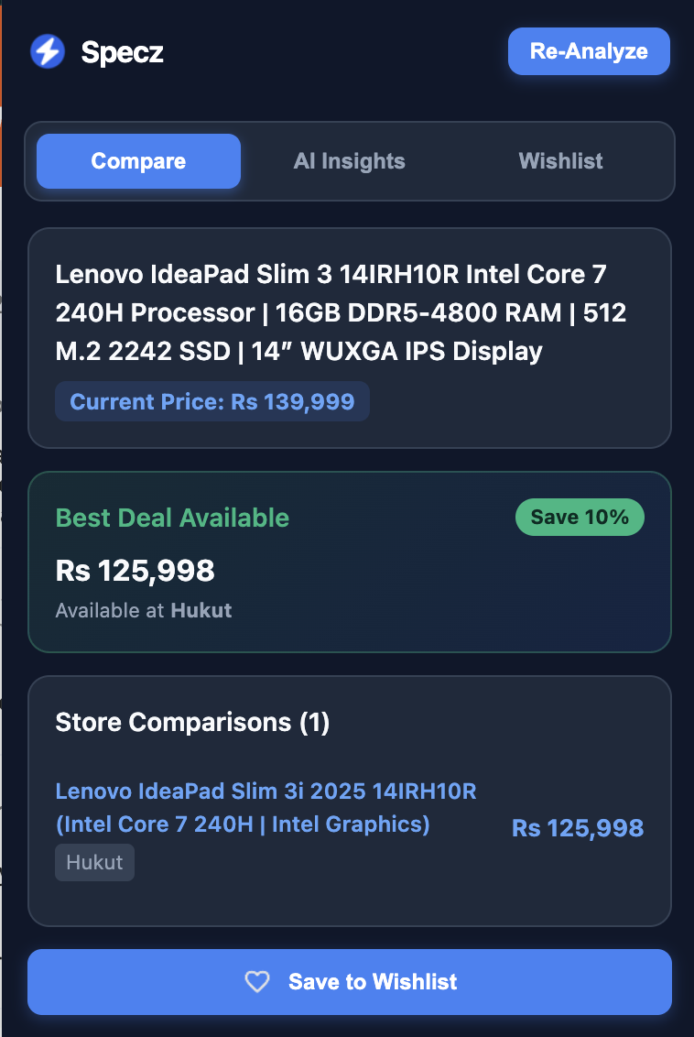
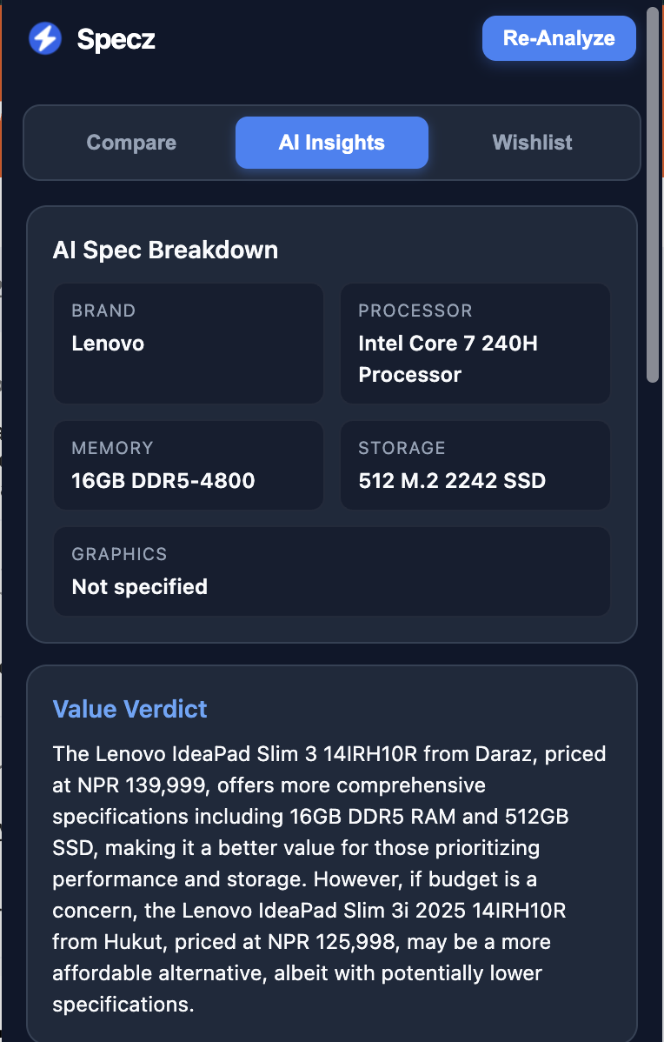
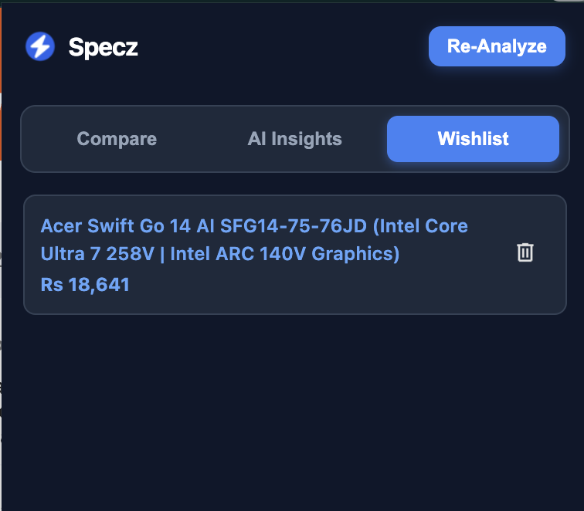
Product Demo
The extension popup at work on a live product page
Specz
5

Slide 6



Key Features
AI Smart Matcher
Cheapest Price Detection
Value Analysis
Wishlist
Matches identical products across listings and stores.
Surfaces the lowest verified price automatically.
Scores value for money for laptops.
Track laptops and get notified when prices drop.
Specz
6

Slide 7





How It Works
From page load to purchase decision in five steps.
1
2
3
4
5
Extract
Normalize
Match
Analyze
Display
Pull product data from the page
Clean specs
Find it across stores
Score real value
Show clear insights
Behind the scenes: lightweight client-side extraction + secure API calls to AI and store-matching services — optimized for speed and privacy.
Specz
7

Slide 8






Tech Stack
Lightweight, modern, and built to ship fast.
Chrome Extension
Groq API
Playwright and Chromium Scraping
Built on Manifest V3 for speed and security.
Powers spec normalization and AI recommendations.
Automated web data extraction from e-commerce websites
HTML, CSS
chrome.storage
Node.JS
Structure and interface styling
Persists wishlist and user preferences locally.
JavaScript runtime for backend development
Specz
8

Slide 9


Market Impact
Nepali Tech Buyers
Multi-Store Coverage
Real Transparency
Directly targets a fast-growing, price-conscious market segment.
Works across Daraz, ITTI, Evostore and Hukut from a single popup.
Solves a genuine trust and information gap in local e-commerce.
Specz
9

Slide 10



Future Scope
Best time to Buy
Price History Tracking
Should I buy now or when?
Show trends so buyers know when a price is genuinely good.
Affiliate Monetization
Mobile App Version
Sustainable revenue through store partnerships.
Bring the same insights to on-the-go shoppers.
Specz
10

Slide 11
“Don’t just buy cheaper.
Buy smarter.”
Specz — AI-Powered Laptop Buying Assistant for Nepal
Specz
11

