Slide 1
CV-MAKER
MINI-PROJECT PRESENTATION
B.Tech CSIT 3rd sem

Slide 2
TEAM MEMBERS::
Sushank Pathak(1900270110055)
Subhdeep Kushwah(1900270110051)

Slide 3
DESCRIPTION::
This project is for generating a Professional CV in PDF format.
The user needs to enter all the details as required by the software and also select the destination for saving the generated CV
CV will be generated and saved automatically.

Slide 4
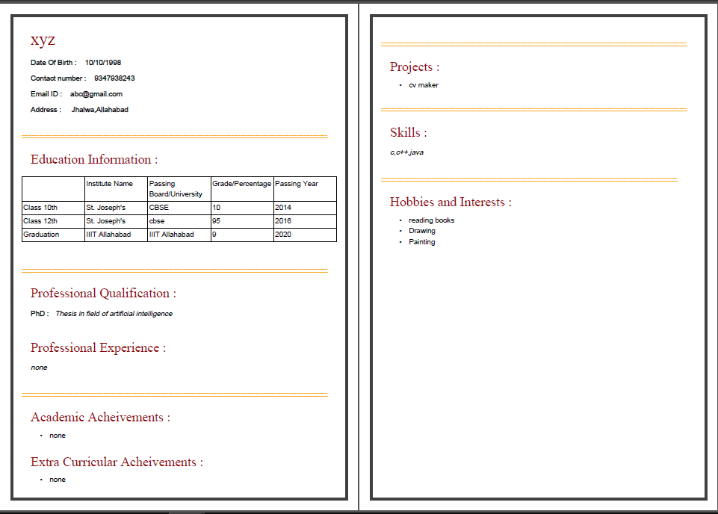

Slide 5
CLASSES
Personal class
Input class
Education class
Professional class
Achievement class
Project class
Hobbies class

Slide 6
STEP-WISE DESIGNING OF CV MAKER

Slide 7
About and Help
About menu option contains information about the software and its developers.
Help menu option tells the format of entering text in the tab opened currently. Help menu is different for different tabs.
Every next Tab is enabled when SUBMIT button of previous tab is clicked which in turn is enabled when all compulsory fields are filled. Once a tab is enabled it can be revisited anytime and information can be altered by submitting it again.

Slide 8
Personal Information
The user need to enter all
the details in required
format. Submit button will not be enabled until all fields are filled.

Slide 9
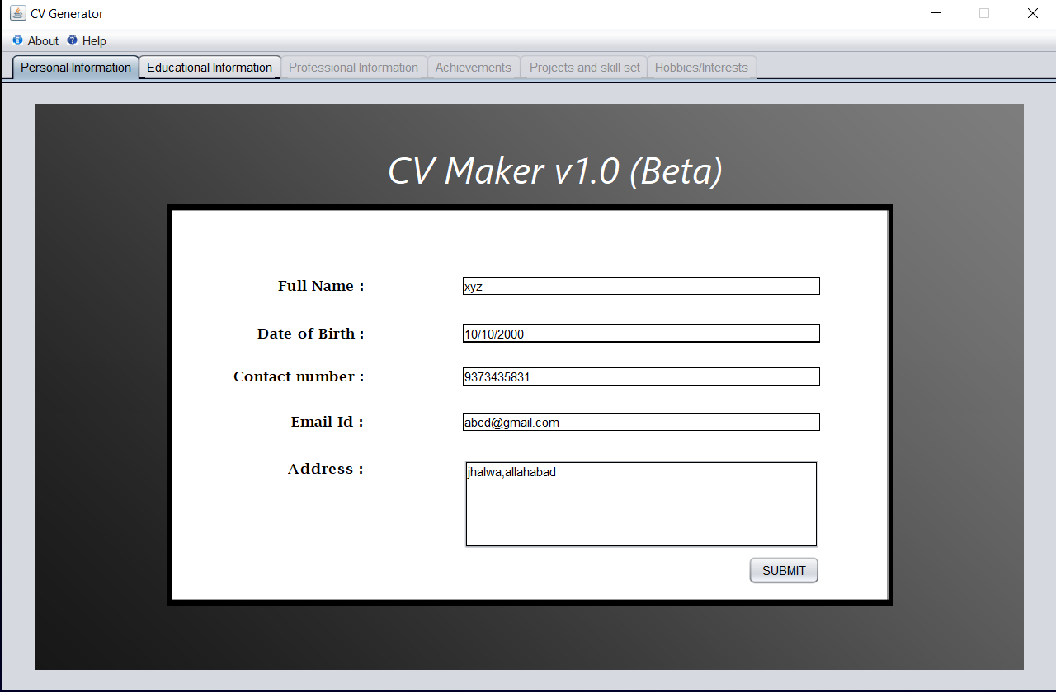

Slide 10
Educational Info
This field is mandatory and user needs to input correct details of educational qualification.

Slide 11
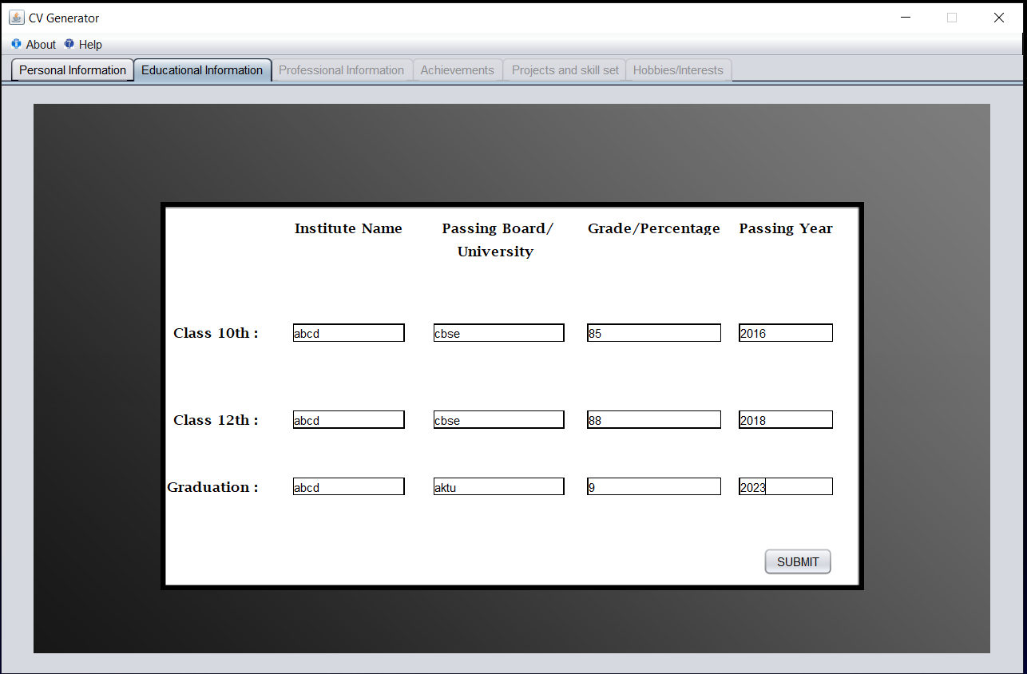

Slide 12
Professional Education and Experience(optional)
This field is optional and asks for any specialization course and professional experience.

Slide 13
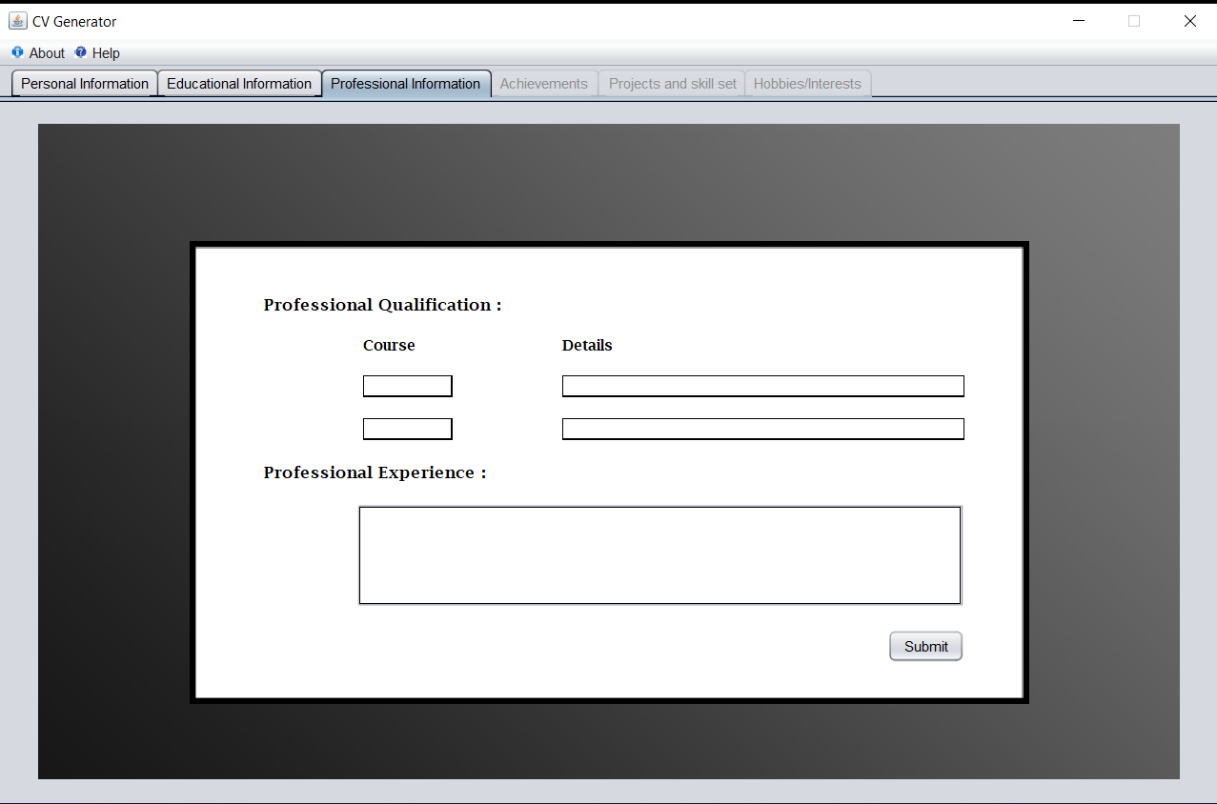

Slide 14
Achievements
This field asks for academic and extra curriculum achievements if any. This is also not mandatory.

Slide 15
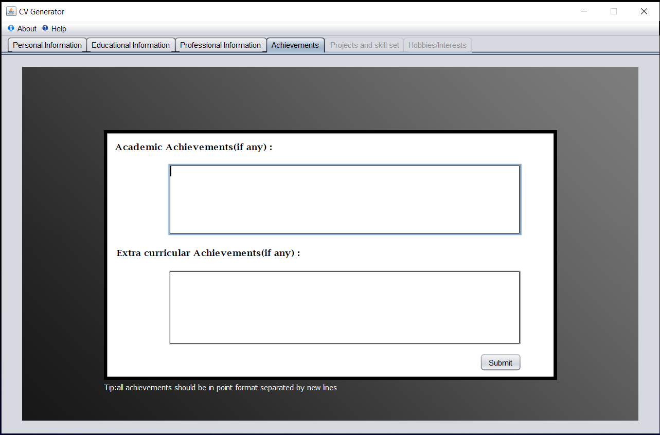

Slide 16
Projects and Skill Set
Projects field is again not mandatory but field for skill set is compulsory to move to next step.

Slide 17
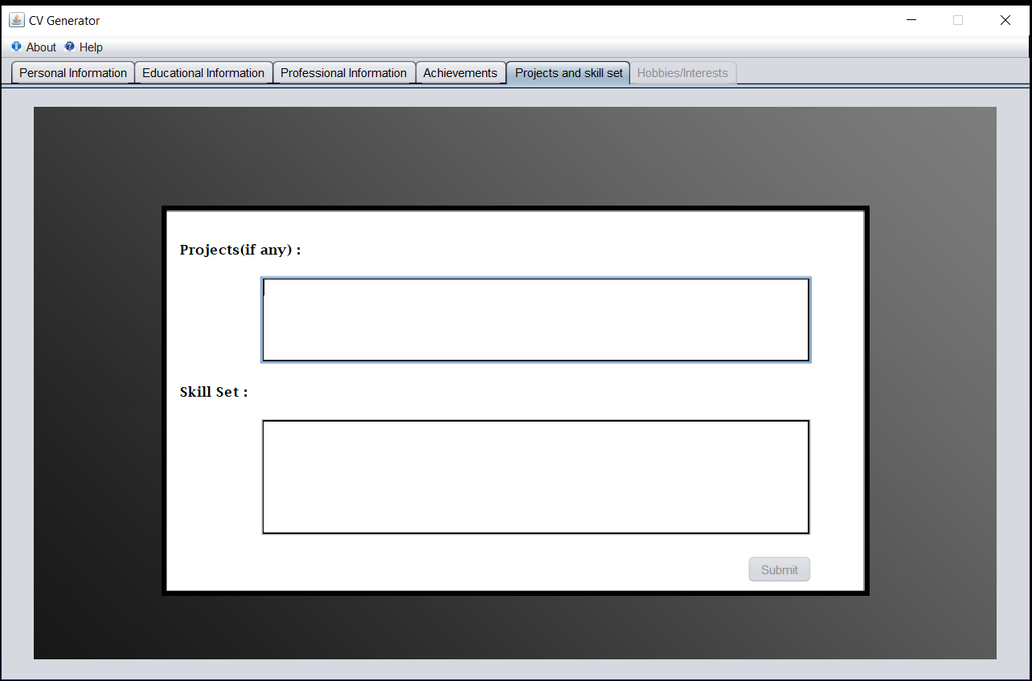

Slide 18
Hobbies and Interests
This field is compulsory, User has to enter his hobbies and fields of interests.

Slide 19
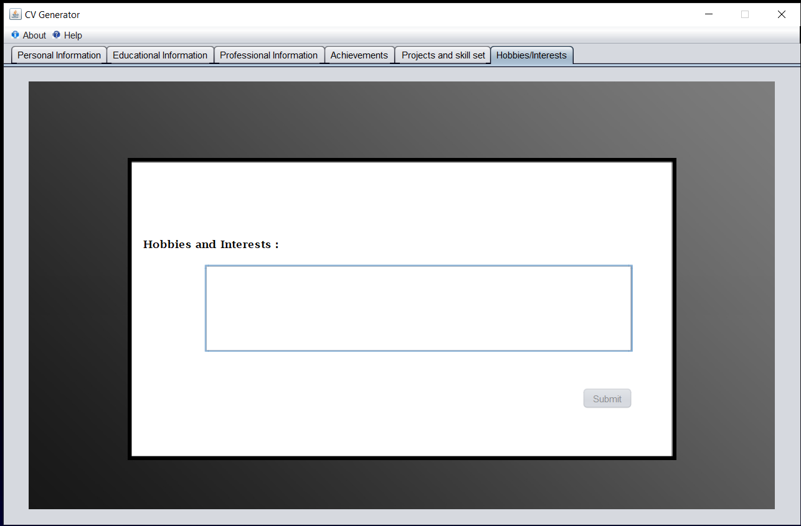

Slide 20
Choosing Destination
Finally choose the destination where the CV generated by the software has to be saved.

Slide 21
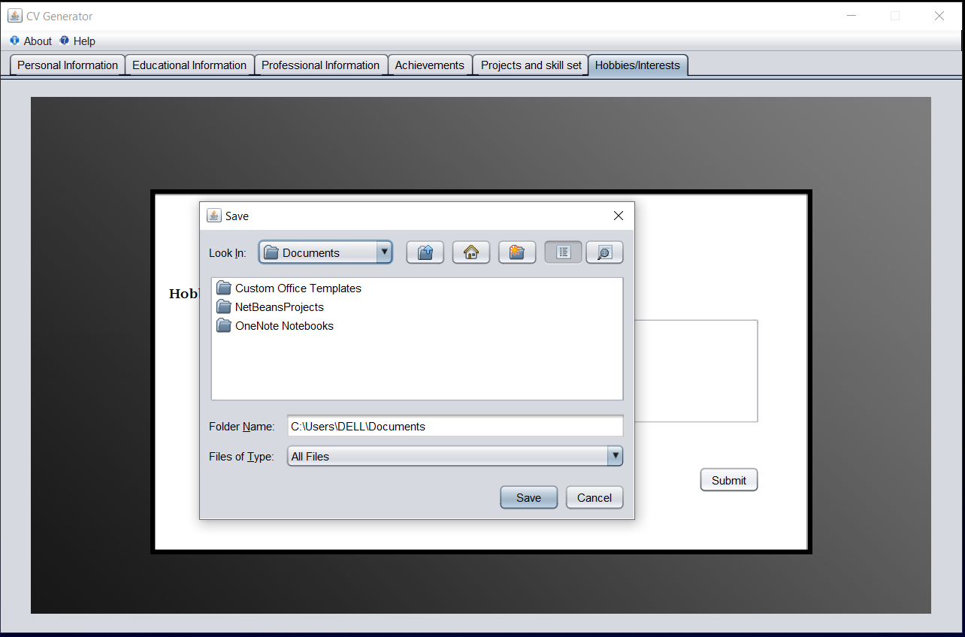

Slide 22
THANK YOU!

