Slide 1
PyFlight
A simple flight simulator
By Henry Cooney
hacoo36@gmail.com

Slide 2
How do you play it??
Must have pyOpenGL and GLUT installed for the python version you are using
To run it: python3.3 pyflight.py (I haven't tested it with older python versions)
Use the mouse and keyboard to control the airplane (see slides)
Try not to crash

Slide 3
Flight basics
PyFlight makes more sense if you know a little about how airplanes work. This presentation assumes you know nothing at all. If you already know about this, skip to page 9.
The basic rules of flight: airspeed and altitude are your friends. Gravity is not.
Lift is a function of angle of attack (AoA) and airspeed. To stay airborne, keep AoA low and airspeed high (more later).

Slide 4
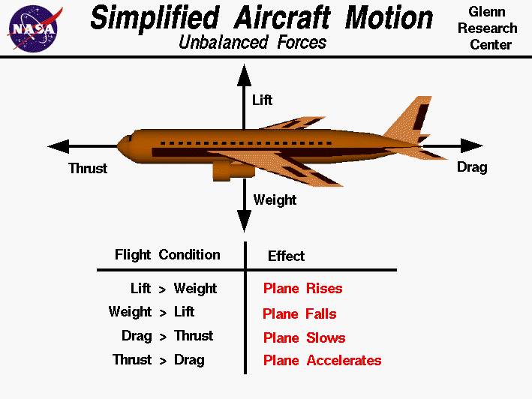
Airplanes: Four Forces
There are 4 main forces acting on a plane at all times: lift, gravity, thrust, and drag.
Image source: NASA (https://www.grc.nasa.gov/www/k-12/airplane/smotion.html)

Slide 5
Airplanes: Aerodynamics
Gravity, thrust, and drag are all pretty simple. Lift is a little more complicated.
Lift is closely related to Angle of Attack (AoA). This is the angle between where the plane is pointed (the nose vector) and where is actually going (the velocity vector).
Thus, AoA corresponds to the direction of air flowing over the wings.

Slide 6
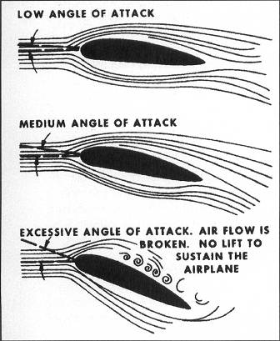
Airplanes: AoA
This image illustrates Angle of Attack:
Low AoA – straight and level
or descending
Medium AoA – turning
or climbing
High AoA – oh s$%t
Image source:Microsoft Flight Simulator Handbook (http://www.flightsimbooks.com/
flightsimhandbook/CHAPTER_02_16_Basic_Aerodynamics.php)

Slide 7
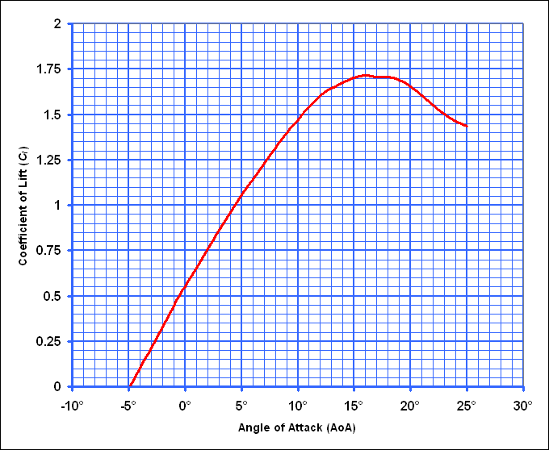
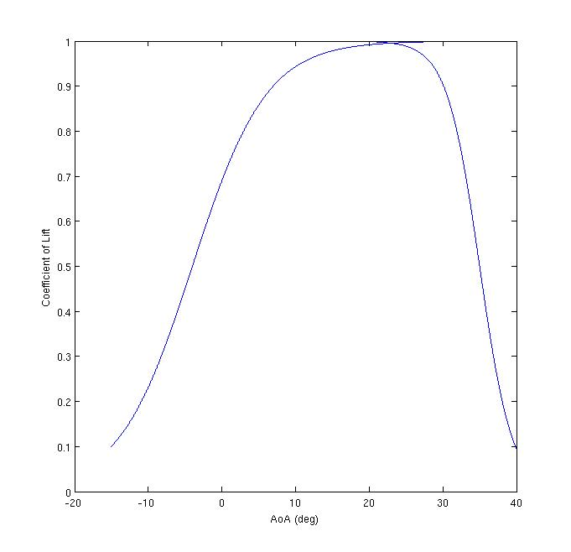
Airplanes: CoL Curve
Angle of attack affects each airfoil differently, but here are some curves:
This is a typical curve
This is the curve I used in my sim
Image source: Wikipedia (http://upload.wikimedia.org/wikipedia/commons/4/42/LiftCurve.gif)

Slide 8
What does this mean for the pilot?
In this sim, peak lift occurs around 20 deg. AoA. If you go above this, lift will rapidly decrease. If AoA gets too high, you will lose lift almost completely, and the plane will stall – you will lose control and fall towards the ground.
This usually occurs if you try to turn too hard, so the plane's nose rotates faster than its velocity can keep up.
To recover from a stall, you must regain airspeed by pointing the plane towards the ground. Once AoA has decreased, gently pull up.
You need altitude to recover from a stall – stalling at low altitudes may be un-recoverable!

Slide 9
How-To: Controls
So how exactly do you play PyFlight?
The mouse imitates a joystick.
Centering the mouse in the middle of the screen is like centering the stick.
Move the mouse right/left to roll the plane. Move the mouse up and down to pitch.
Keyboard: the A and D keys control the rudder. Press A to yaw left, and D to yaw right.

Slide 10
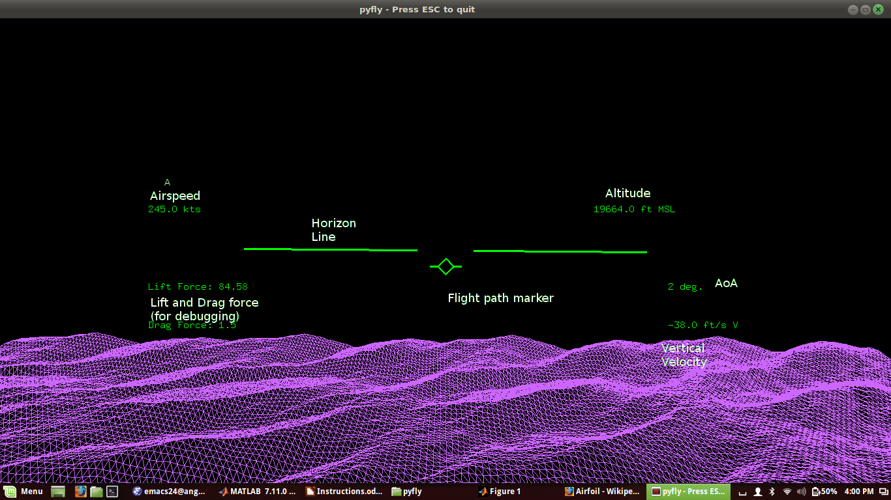
How-To: The HUD

Slide 11
How-To: Interpreting the HUD
The Flight-Path Marker (FPM) shows you the planes velocity vector (actual direction of travel).
The gap in the center of the horizon line is the nose. So if the FPM is in the gap, AoA is 0 degrees.
The VVI (vertical velocity indicator) tells you if you're climbing or descending, and how fast.

Slide 12
How-To: Avoiding Crashes
PyFlight is somewhat tricky. If you don't pay attention to your AoA and FPM, you can easily stall.
Make smooth, gentle inputs. Pulling too hard on the stick will usually cause a nasty stall.
Try to “follow” the FPM with your nose. This will keep AoA low.
In addition to the stick, use the rudder to bring the nose towards the FPM when turning. This is called “coordinating the turn”.

Slide 13
How does it work?
Without going into too much detail: the plane is modeled as a single rigid body. With a few modifications, this code could be used to simulate something like falling blocks (though you would also need to write code handling collisions)
Right now, it uses Euler integration. I implemented RK4, but there's something wrong with it and I haven't fixed it yet.

Slide 14
Rigid Body Simulation
The rigid body represents the plane as a center of mass (P) and a set of vectors, which can point to any arbitrary spot in the rigid body.
These vectors are multiplied by a rotation matrix R in order to rotate the body
The inertial tensor, I, represents the distribution of mass in the body. This makes it more or less difficult to spin around different axes.
Each force contributes to the overall linear momentum (this is simple – F = ma)
Forces acting on point other than the center contribute to overall torque. Torque is the derivative of angular momentum; angular momentum can be converted to angular velocity, which is the derivative of R.

Slide 15
Simulating the Plane
The rigid body (rigidbody.py) handles an arbitrary rigid body with forces acting on it. Airplane.py decides what forces should act on the body.
I tried my best to model lift, thrust, drag, and gravity, and their relationships to velocity and AoA. The current model is reasonable, but still feels too unforgiving, and also too draggy.
Controls work by adjusting the amount of lift at various parts of the plane (much as in a real airplane)
There's also a weak stabilizer force that tries to drag the nose in line with the velocity vector. Adding this force made the plane feel more realistic, and much easier to fly. I suspect real airplanes are engineered to have similar forces that keep them stable.

Slide 16
Thanks for playing!

