Slide 1
Chessmaster
By Trịnh Thế Thái Hòa

Slide 2
Table of Contents
01
02
03
04
Creator’s introduction
About me
Web’s information
Overall information about the web
Demo
Web’s demonstration
Strengths and weaknesses
The good points and the bad points of the web

Slide 3
01
Creator’s introduction
About me

Slide 4
About me
Trịnh Thế Thái Hòa
Thị Trấn Dương Minh Châu Secondary school
Name
Age
School
hobbies
14 years old
Playing chess, reading comics

Slide 5
02
web’s information
Overall information about the web

Slide 6
About the web
Reason
What can it do?
Chessmaster is created to contain grandmasters’ informations
-Gives the user the grandmaster’s information
-Let the user write their blogs
What does it have?
The coding languages that I use
- Grandmasters’ information
- Sign in/Sign up pages
- Ranking page
- Shop page
- News page
-blogs page
-review section
Html, Css, Javascript

Slide 7
03
Demo
Web’s demonstration

Slide 8
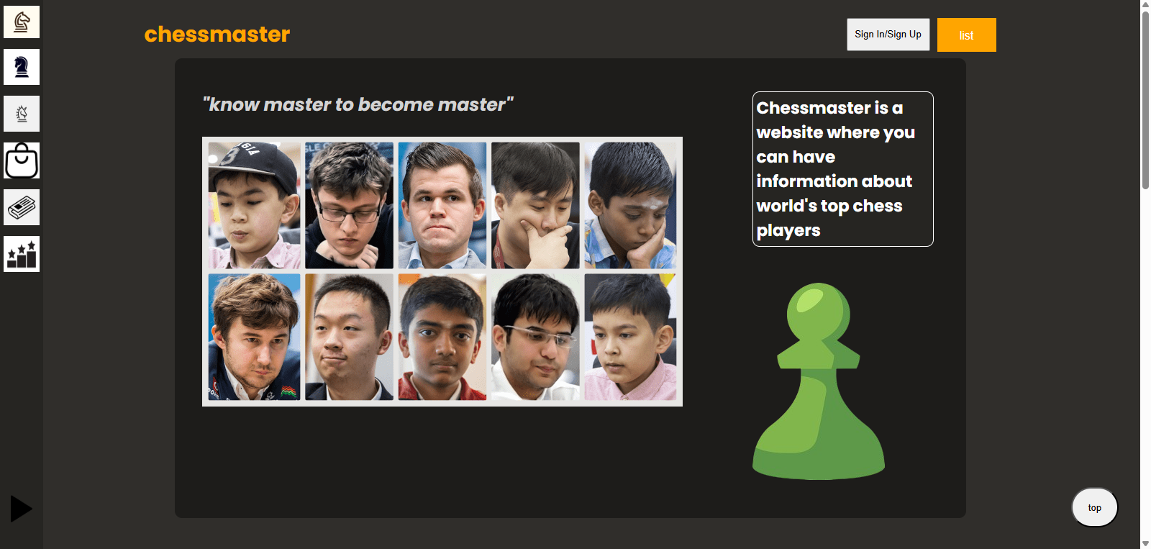
Demo

Slide 9
04
Strengths and weaknesses
The good points and the bad points of the web

Slide 10
Strengths and weaknesses
01
02
Strengths
weaknesses
- Easy to use
- Bad design
- Lack of sensors
- Some small weaknesses

Slide 11
Thanks
Thank you for listening to my presentation

