Slide 1
Network Servers
Notes:
1

Slide 2
This presentation will demystify essential network servers, their functions, and their critical roles in modern IT infrastructure.
01
02
Introduction to Servers
Proxy Servers
Laying the groundwork for understanding server roles.
Exploring intermediary functions for security and performance.
03
04
Web Servers
Mail Servers
How web content is delivered and managed.
The backbone of email communication.
05
06
SNMP: Network Management
Key Takeaways
Monitoring and managing devices across the network.
Summarizing core concepts and next steps.
Notes:
3

Slide 3
Proxy Server
A proxy server acts as middle man between client and servers. It provides functionalities like privacy, security, load balancing ,caching and filtering. It acts as firewall and web filter and provide shared network connections and cache data to speed up common requests.
Types of Proxy Server:
Forward Proxy: For internal network users to access external resources. Eg: Virtual Private Network (VPN) and Web Content filters.
Reverse Proxy: For external clients to access internal servers securely.
Open Proxy: That is accessible by Internet users. Eg: https://www.stayinvisible.com/
Notes:
4

Slide 4





Why Use a Proxy Server?
Proxy servers offer significant benefits, from bolstering security to optimizing network performance and user experience.
Security
Privacy
Caching
Acts as a firewall, protecting internal resources from external threats and controlling access.
Masks client IP addresses, enhancing anonymity and preventing tracking.
Stores frequently accessed content, reducing bandwidth usage and speeding up access times.
Filtering
Load Balancing
Blocks access to undesirable websites or content, enforcing organizational policies.
Distributes network traffic across multiple servers to prevent overload and ensure availability.
Notes:
5

Slide 5
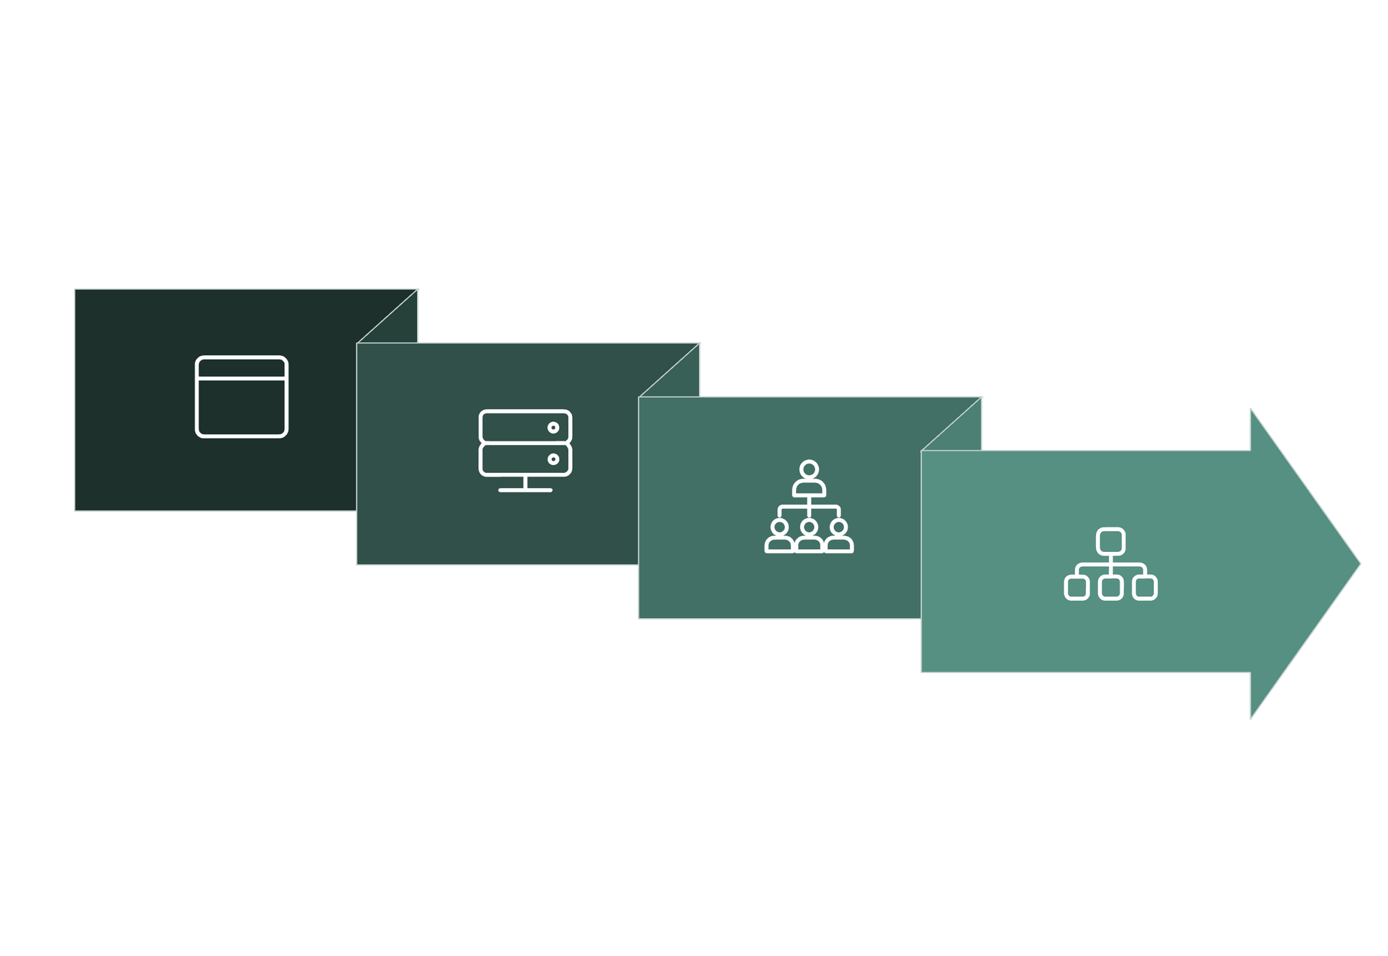




Web Servers: The Foundation of the Internet
Web servers are specialized computers that store website content and deliver it to users' web browsers upon request. They use HTTP/HTTPS protocols for communication, forming the backbone of how we access information online.
Web servers manage both static and dynamic content. Static content, like HTML, CSS, and JavaScript files, is delivered as-is. Dynamic content, however, is generated on the fly by server-side scripting languages.
Server Processing
Browser Rendering
Browser Request
Response
Notes:
6

Slide 6
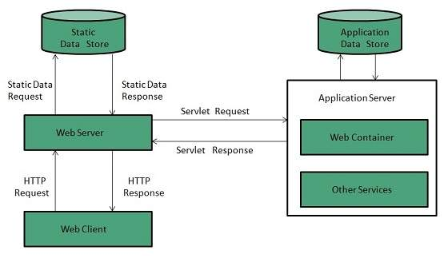
Web Server Working Mechanism:
Notes:
7

Slide 7
Mail Servers: The Post Office of the Internet
Mail servers is also known as Mail Transfer Agent MTA. They are responsible for sending, receiving, and storing emails for users. It provides Spam Filtering , Mail boxes and Authentication. Eg: Gmail, Outlook.
Sending Emails (SMTP)
1
The Simple Mail Transfer Protocol (SMTP) is used for sending outgoing emails..
Receiving Emails (POP3/IMAP)
Post Office Protocol 3 (POP3) downloads emails to your local device, often deleting them from the server. Internet Message Access Protocol (IMAP) allows you to access and manage emails directly on the server, synchronizing changes across all your devices.
2
Notes:
8

Slide 8
SNMP: Network Management Protocol
The Simple Network Management Protocol (SNMP) is a standard protocol used for monitoring and managing network devices. It allows network administrators to centrally oversee the health and performance of their entire network infrastructure.
1
2
3
Manager
Agent
MIB (Management Information Base)
The console or software used by administrators to monitor and control network devices.
Software running on network devices that collects and sends data to the Manager.
A hierarchical database defining the properties of managed devices that can be monitored or controlled.
Notes:
10

Slide 9
SNMP Functions and Use Cases
SNMP facilitates various operations essential for proactive network management and troubleshooting.
Key Functions
Applications
GET: Retrieves specific information from an agent (e.g., current CPU usage).
Performance monitoring (bandwidth, latency, uptime)
Fault management (detecting and alerting on device failures)
SET: Modifies configuration parameters on a device (e.g., resetting a router interface).
Configuration management (remote device setup)
TRAP: An alert sent by an agent to the manager when a significant event occurs (e.g., a device goes offline).
Security auditing (logging access and changes)
Notes:
11

