Slide 1
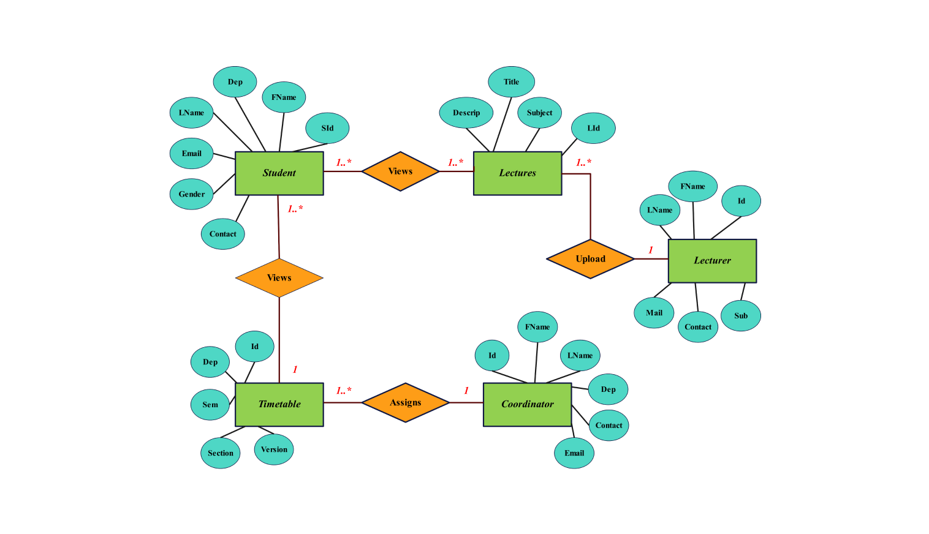
Data Modeling Using Entity-Relational Model
By:
Anshu Hada
Hrikesh Aran
Sangam Adhikari

Slide 2
ER Diagram
An Entity-Relationship (ER) diagram is a visual representation of a database's structure, showing how entities ( like people, objects, or concepts) are related to each other.
It is used to design and visualize databases, making it easier to understand how data is organized and how different parts of the data relate to each other.
Its components are:
  Rectangles representing entity sets.
  Ellipses representing attributes.
  Diamonds representing relationship sets.
  Lines linking attributes to entity sets and entity sets to relationship sets.

Slide 3
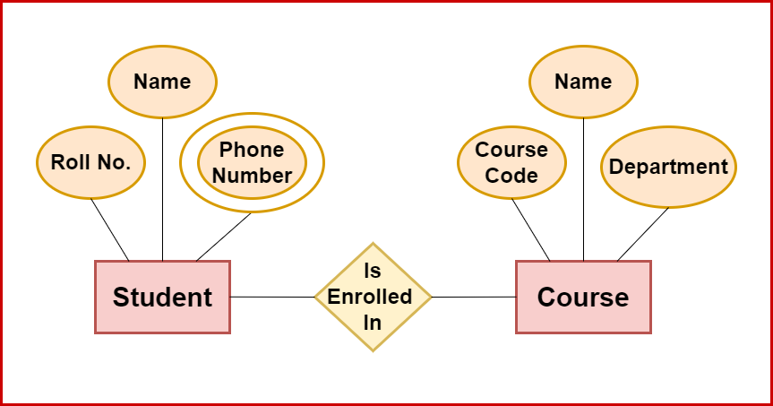
Fig : ER Diagram

Slide 4
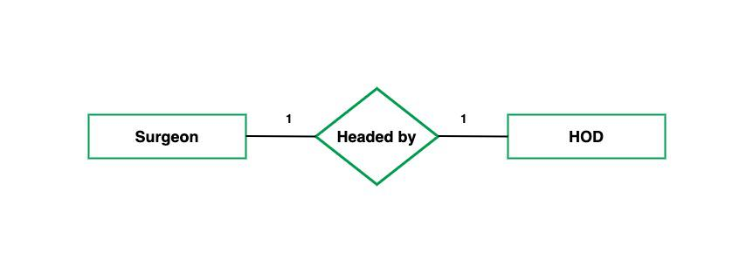
Cardinality in er model
One-to-On
e: When each entity in each entity set can take part only once in the relationship, the cardinality is one-to-one.

Slide 5
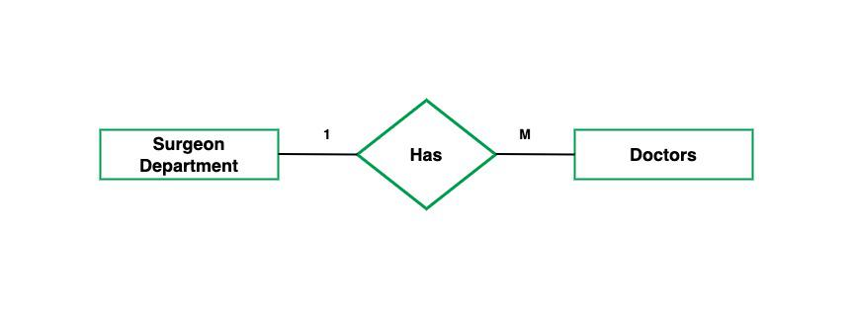
One-to-Many: In one-to-many mapping as well where each entity can be related to more than one entity. Let us assume that one surgeon department can accommodate many doctors. So the Cardinality will be 1 to M. It means one department has many Doctors.

Slide 6
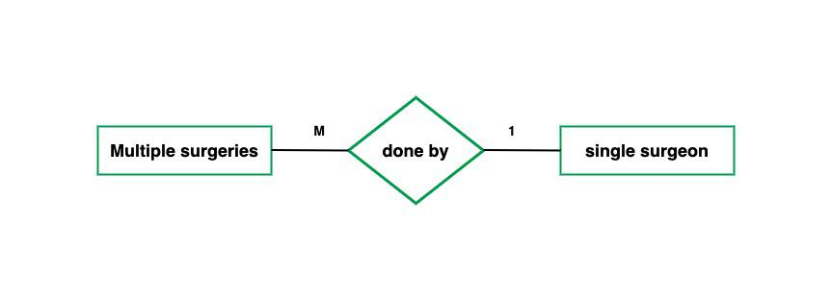
Many-to-One: When entities in one entity set can take part only once in the relationship set and entities in other entity sets can take part more than once in the relationship set, cardinality is many to one.

Slide 7
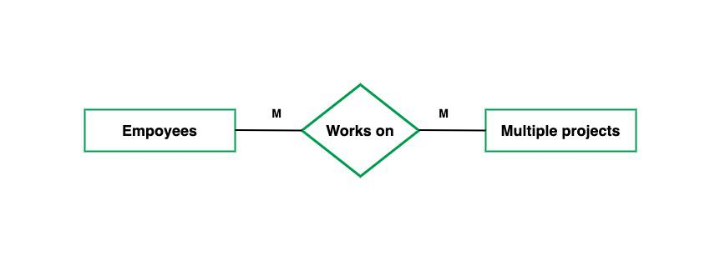
Many-to-Many: When entities in all entity sets can take part more than once in the relationship cardinality is many to many.

Slide 8
Naming Conventions
Entity Names:
  Use singular nouns (e.g., Student, Course)
  Use TitleCase (capitalize each word)
  Should be meaningful and clear
  Example Customer, Order, Employee
Attribute Names:
  Use camelCase (e.g., studentID, birthDate)
  Should describe the data clearly
  Avoid using vague or generic names
  Example: emailAddress, phoneNumber, totalMarks

Slide 9
Primary Key Attributes:
  Prefix with entity name for clarity
  Should be unique within the entity
  Example: studentID, orderID, employeeID
Relationship Names:
  Use verbs or verb phrases
  Describe the action or connection clearly
  Example: EnrolledIn, AssignedTo, PlacedBy
Weak Entities & Identifying Relationships:
  Weak entities: use meaningful names with double rectangle
  Identifying relationships: describe the dependency clearly
  Example: Weak Entity: Dependent
  Identifying Relationship: IsDependentOn

Slide 10
Design Issues in ER Modeling
Use of Entity vs. Attribute
Use of Entity vs. Relationship
Follow proper Naming Conventions
Avoid Redundancy
Decide the Degree of Relationship
Use Generalization and Specialization

Slide 11

Types of Higher Degree Relationship
When the degree is 3 or more, it is called a higher-degree relationship.
1) Binary Relationships:
    Involves two entity types
    Most common type in ER modeling.
    Example: Student and Id

Slide 12
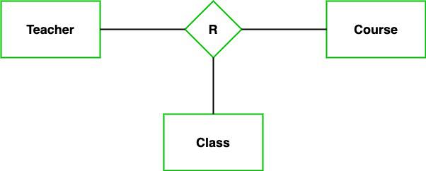
2) Ternary Relationship (Degree 3):
  Involves three diffentity sets
  .
  Example: A Teacher teaches a Student in a particular Course.

Slide 13
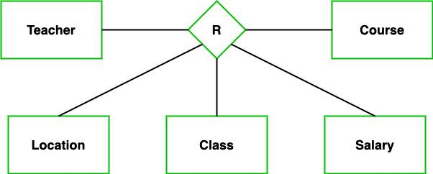
3) n-ary Relationship (Degree n):
Involves n entities, where n ≥ 3
Used when more than two entities participate together in a single activity or association

Slide 14
Superclass and subclass
Superclass:
A general entity that holds common attributes shared by all related entities.
Example: Person with attributes PersonID, Name, Birthdate.
Subclass:
A specialized entity that inherits from the superclass and contains additional attributes specific to that subclass.
Example: Student (inherits from Person) with attributes Major, GPA; Teacher with Subject, Salary.

