Slide 1

File Systems: FAT and NTFS
Presented by: Anshu Hada
CSIT 4th SEM
Section- A

Slide 2
File Systems
A file system is a method employed by operating systems to store, organise, and facilitate access to data on storage devices. It acts as the backbone for how information is managed on your computer.
Core Functionality
Key Examples
File systems assign names to files, store critical metadata (like creation date and size), and efficiently manage available storage space.
FAT (File Allocation Table)
NTFS (New Technology File System)
exFAT (Extended File Allocation Table)
ext3/ext4 (Third/Fourth Extended File System)
1

Slide 3
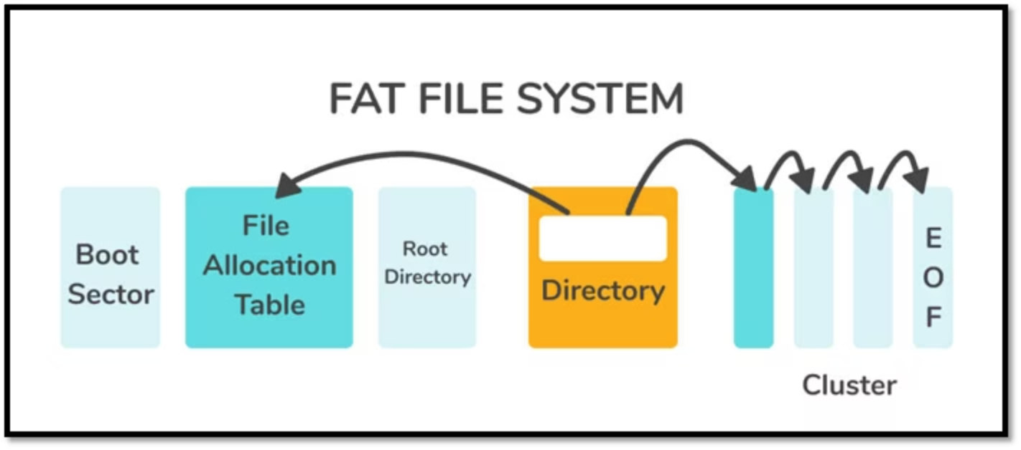
Introduction to FAT (File Allocation Table)
The File Allocation Table (FAT) is one of the earliest file systems, developed by Microsoft in 1977. It's known for its simplicity and widespread compatibility.
Widespread Use
Key Variants
FAT remains common in:
Over the years, FAT has evolved:
USB drives
FAT12 (earliest, for small volumes)
SD cards
Older floppy disks
FAT16 (improved, larger volumes)
Cross-platform data exchange
FAT32 (most common, larger volumes and files)
2

Slide 4
FAT Architecture: Cluster Chains and Fragmentation
1
Cluster Allocation
2
Directory Entries
3
Non-Contiguous Storage
Files are stored in one or more clusters. If a file is larger than a single cluster, it's broken into pieces and stored in a chain of clusters.
Each directory entry contains crucial file information: filename, timestamps (creation, modification), and the starting cluster of the file.
A key characteristic is that a file's clusters do not need to be contiguous on the disk. This can lead to fragmentation but allows for flexible storage.
4
3

Slide 5
FAT Variants: Capacity Limitations
Each FAT variant has specific limitations regarding the maximum volume size and maximum file size it can handle. Understanding these limits is crucial for choosing the right file system for a given storage device.
Type
Max Volume Size
Max File Size
FAT12
32 MB
32 MB
FAT16
2 GB (DOS)
2 GB
FAT32
2 TB (Windows)
4 GB
FAT32's 4 GB file size limit is a significant constraint for modern applications dealing with large media files or databases.
4

Slide 6
FAT: Advantages and Disadvantages
While FAT offers broad compatibility, its simplicity comes with certain trade-offs, particularly in modern computing environments.
Advantages
Disadvantages
Simple and easy to implement, reducing overhead.
No built-in file security or permissions, making it less suitable for shared or sensitive data.
Universally supported by nearly all operating systems (Windows, macOS, Linux).
Maximum file size limit (4 GB for FAT32) restricts its use for large files.
Excellent for removable drives due to its broad compatibility.
No journaling feature, increasing the risk of data loss or corruption during system crashes.
6
5

Slide 7
Numerical Example: FAT32 Internal Fragmentation
Let's illustrate how storage is allocated and potential waste (internal fragmentation) occurs within a FAT32 system.
Question: A file of 18 KB is to be stored in a FAT32 system. The cluster size is 4 KB.
Find:
Number of clusters used
Internal fragmentation (wasted space)
6

Slide 8

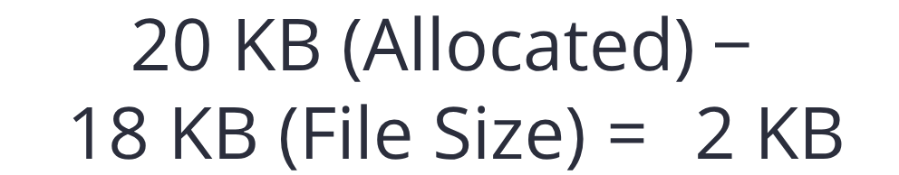
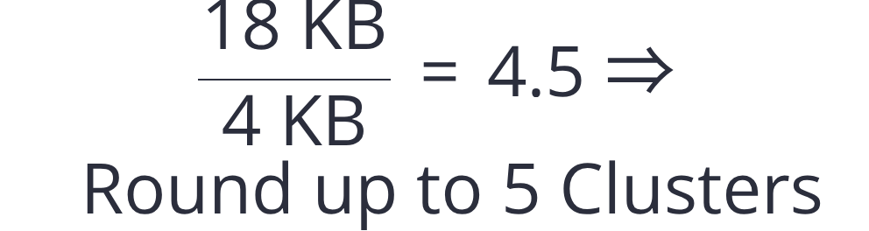
FAT Numerical Solution (Step-by-Step)
Step 3: Internal Fragmentation
Step 2: Total Allocated Size
Step 1: Clusters Needed
This is the total disk space reserved for the 18 KB file.
This 2 KB is wasted space within the last allocated cluster, demonstrating internal fragmentation.
Since clusters are allocated as whole units, 4.5 clusters means 5 clusters are required.
7

Slide 9
Summary of FAT Numerical Example
This table summarises the calculation, clearly showing how internal fragmentation arises in a FAT32 system when a file does not perfectly fill its allocated clusters.
Parameter
Value
File Size
18 KB
Cluster Size
4 KB
Clusters Used
5
Allocated Space
20 KB
Internal Fragmentation
2 KB
8

Slide 10
Introduction to NTFS (New Technology File System)
NTFS is Microsoft's advanced file system, designed for robustness, security, and efficiency in modern operating systems, particularly Windows NT and its successors.
Enhanced Capabilities
Advanced Security
Data Integrity
NTFS supports significantly larger files and volumes compared to FAT, along with rich metadata capabilities.
Key features include Access Control Lists (ACLs), allowing granular permissions for files and folders.
Journaling ensures file system consistency, even after power failures or system crashes, by logging changes before applying them.
9

Slide 11




NTFS Architecture
The core of NTFS is the Master File Table (MFT), a comprehensive database that stores all metadata for every file and directory on the volume.
File Compression
File Encryption (EFS)
Efficiently reduces file sizes to maximise available disk space.
Provides robust, integrated file-level security for sensitive data.
Disk Quotas
Journaling
Enables administrators to set limits on disk space usage per user.
Logs all changes to ensure data integrity and prevent corruption.
10

Slide 12
FAT vs NTFS: A Feature Comparison
Understanding the key differences between FAT32 and NTFS is essential for choosing the appropriate file system for various storage needs and operating environments.
Feature
FAT32
NTFS
Max File Size
4 GB
~16 EB (Exabytes)
Security
None
Yes (Access Control Lists)
Journaling
No
Yes
OS Compatibility
Universal
Mostly Windows
File Compression
No
Yes
While FAT32 offers broader compatibility, NTFS excels in modern environments with its superior capacity, security features, and data integrity.
11

Slide 13
Where are FAT and NTFS Used?
FAT
NTFS
USB drives
Windows internal storage
SD cards
Servers
Legacy devices
Secure enterprise systems
12

Slide 14



Conclusion
Our exploration of file systems highlights the distinct characteristics and applications of FAT and NTFS, alongside the practical implications of their designs.
FAT: Simple, Yet Outdated
NTFS: Robust & Secure
Fragmentation Inefficiency
FAT's straightforward design ensures broad compatibility, making it ideal for smaller, removable media. However, its lack of modern features and security limitations render it unsuitable for large, critical systems.
NTFS stands out with its advanced capabilities, including journaling for data integrity, comprehensive security through Access Control Lists (ACLs), and efficient management of metadata for enhanced reliability.
Numerical illustrations underscore a key drawback of FAT: internal fragmentation. This inherent inefficiency leads to wasted disk space, especially noticeable with smaller files on larger clusters.
13

Slide 15
Thank You!!

