Slide 1

DriveEase
Car Rental System
A complete web-based platform for managing
car rentals, bookings, payments, and overdue tracking.
PHP • MySQL • HTML/CSS
By : Anshu Hada
CSIT 5th Sem

Slide 2
Introduction
DriveEase
- Car Rental System
The Car Rental System is a web-based application designed to simplify the process of renting vehicles. It allows users to browse available cars, book rentals, and manage reservations efficiently. The system enables administrators to manage car listings, bookings, and customer records.
This system provides:
Customer registration & login
Car browsing and booking
Admin dashboard for management
Database storage using MySQL
It ensures efficient handling of rental operations and improves service quality.

Slide 3
System Architecture
Frontend Layer
Backend Layer
Database Layer
HTML, CSS, PHP Views
User Interface & Forms
PHP Logic & Controllers
Session, Auth, Routing
MySQL — driveease DB
users, cars, bookings
System Roles
Admin:
Full system control — manage cars, users, bookings, overdue & reports
Customer:
Register, search cars, book, pay, view history & cancel bookings

Slide 4
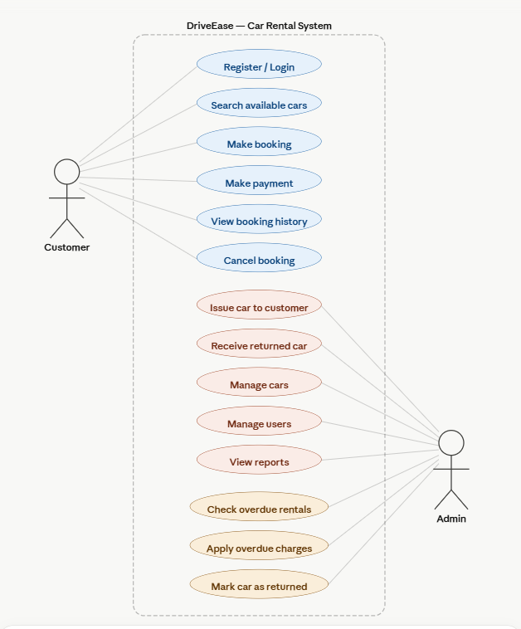
Use Case Diagram

Slide 5
Key Features
User Authentication
Car Management
Secure register & login with bcrypt password hashing and role-based access (Admin / Customer)
Admin can add, edit, delete cars with images, pricing, and availability status
Booking System
Payment Tracking
Customers search available cars by date and create bookings with total price calculation
Admin marks bookings as paid or unpaid. Supports cash and online payment methods
Overdue Management
Reports & Dashboard
Auto-detects overdue rentals past end date, calculates extra charges, and marks car returned
Admin dashboard with stats — total bookings, revenue, active rentals and car status overview

Slide 6
Future Enhancements
1
GPS Car Tracking
2
Email & SMS Notifications
Auto-send booking confirmations, reminders, and overdue alerts to customers
Real-time location tracking of rented vehicles via Google Maps API integration
Mobile App
4
Customer Reviews
3
Build a React Native or Flutter app for customers to book cars on their phones
Allow customers to rate and review cars after returning them to improve trust
05

Slide 7
Conclusion
DriveEase is a fully functional car rental management system
Covers the full rental lifecycle from booking to return
Overdue detection and charge calculation built-in
Secure role-based access for Admin and Customers
Clean, responsive UI built with PHP and MySQL

Slide 8
Thank You!!!

