Slide 1
TECHNICAL PARTNERSHIP PITCH
NEUROMORPHIC VIO
Drones that see where GPS can't reach — at a fraction of the power.
Prepared for a potential technical co-founder
July 2026

Slide 2
01 — THE PROBLEM
GPS-denied navigation is the hard problem
autonomy hasn't solved
— Any jammer or tunnel blinds a GPS-only drone: no signal means no position, and no position means no mission.
— Two existing fixes, both wrong for small drones: classical vision is cheap but breaks on low light, motion blur, and texture-less scenes; GPU-class learned vision is robust but needs 5–15W a small airframe can't spare.
— This isn't hypothetical: in April 2026 the U.S. Army paid AeroVironment $17.6M for Red Dragon, a 400km strike drone whose GPS-denied navigation runs on onboard vision and digital scene matching.
400 km
flown GPS-denied — Red Dragon, U.S. Army contract, Apr 2026
$3.1B
Pentagon counter-drone budget — the money is already moving
NEUROMORPHIC VIO — CONFIDENTIAL
02 / 12

Slide 3
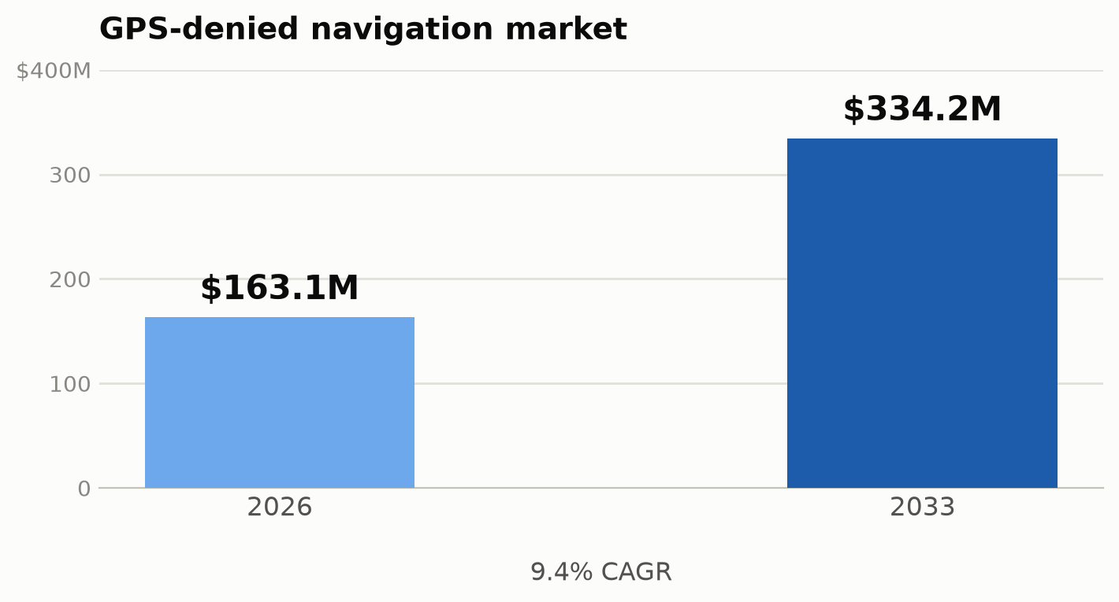
02 — WHY THE MARKET IS READY
This isn't speculative demand — it's already being funded
— GPS-denied navigation market: $163.1M (2026) → $334.2M (2033), a 9.4% CAGR.
— Defense tech VC funding: $17.9B in 2025 — more than double 2024's $7.3B.
— DARPA OPTIMA program: $78M committed specifically to compute-in-memory accelerators.
— Pentagon counter-drone budget: $3.1B allocated and growing.
Sources: defense-tech funding reports and GPS-denied navigation market sizing, 2025–2026.
NEUROMORPHIC VIO — CONFIDENTIAL
03 / 12

Slide 4
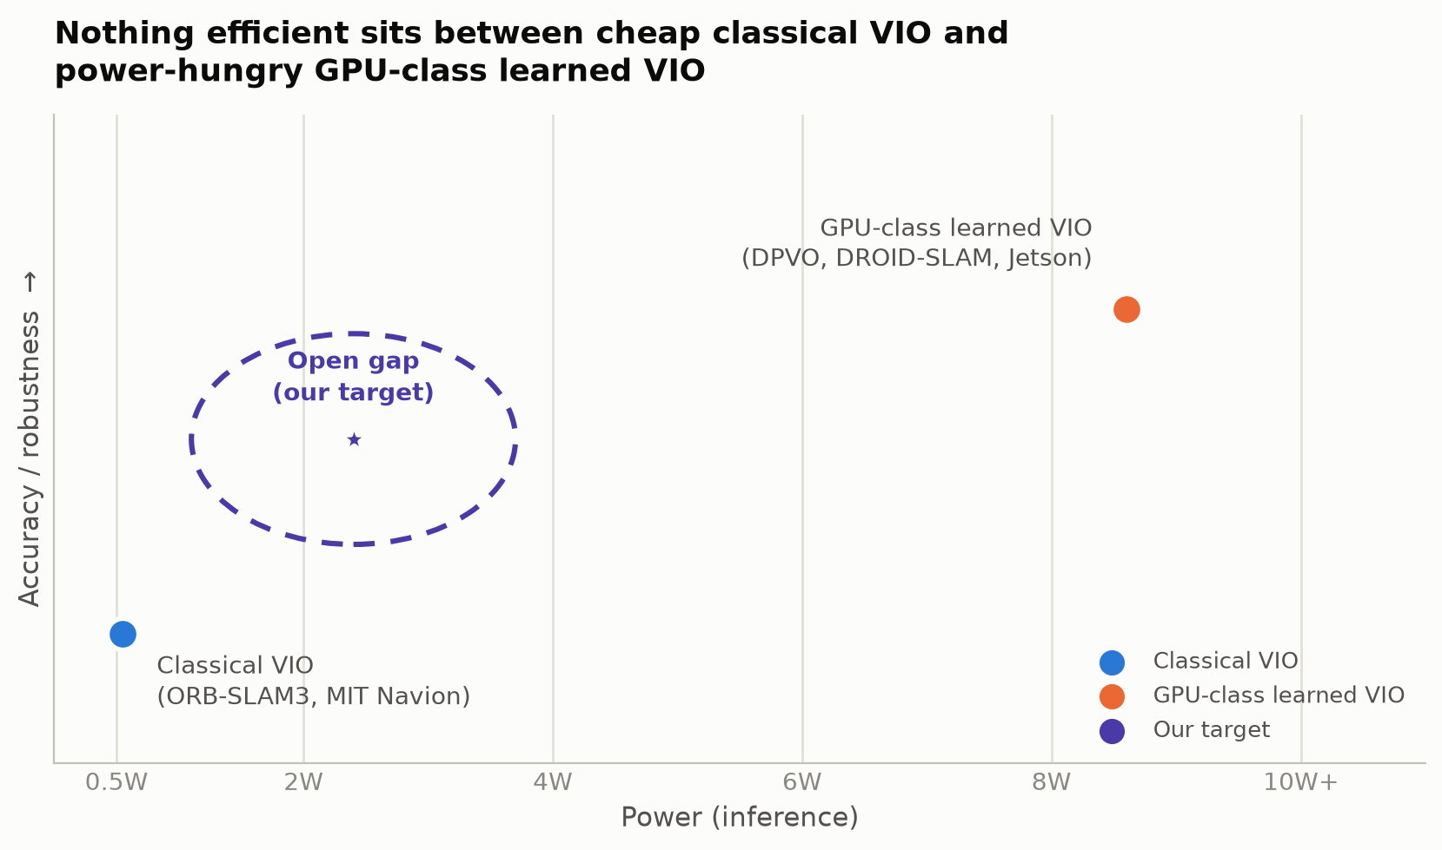
03 — THE OPEN GAP
Nothing efficient sits between ‘cheap but brittle’
and ‘accurate but power-hungry’
— Classical VIO (ORB-SLAM3, MIT Navion): milliwatt-class power, but fails on low light, motion blur, texture-less scenes.
— Learned VIO (DPVO, DROID-SLAM): handles the hard cases, but needs 5–15W of GPU — 100–1000x a small drone's budget.
— We scanned every neuromorphic and edge-AI chip on the market — Qualcomm, NVIDIA, Hailo, BrainChip, SynSense, Intel Loihi — none closes this gap for VIO.
NEUROMORPHIC VIO — CONFIDENTIAL
04 / 12

Slide 5
04 — OUR APPROACH
Sparse sensing, sparse compute — a spiking front-end,
a classical back-end
— Event cameras report only pixel changes — 100–1000x less data than a frame camera.
— SNNs compute only when a spike arrives — no wasted cycles on static pixels, the same sparsity all the way through.
— We pair that with a classical EKF back-end — learned flexibility where it helps, guaranteed correctness where it must.
Event
Camera
SNN Front-End
(feature / motion
extraction)
Sparse Feature /
Motion
Representation
Classical EKF
Back-End
(sensor fusion)
Pose Output
200Hz+, <5ms
<200 mW
<5 ms
200 Hz+
1280×720
power budget
pose latency
output rate
event resolution
NEUROMORPHIC VIO — CONFIDENTIAL
05 / 12

Slide 6
05 — WHY NOW
Three things just became true at the same time
01
02
03
Event cameras shipped
SNN tooling matured
A power proof point landed
Prophesee and iniVation sensors are commercially available now — not lab prototypes.
snnTorch and SpikingJelly train on commodity GPUs and export to INT8/ONNX — the missing PyTorch-equivalent finally exists.
TinyDEVO (CVPR 2026) just showed a learned event-VO pipeline running at 86mW on a RISC-V MCU — the sub-500mW gap is closing, right now.
And defense demand is accelerating under all three — this is a closing window, not an open-ended one.
NEUROMORPHIC VIO — CONFIDENTIAL
06 / 12

Slide 7
06 — COMPETITIVE LANDSCAPE
We checked every neuromorphic and edge-AI player.
Zero target this gap.
Player | Power | Can do full VIO? | Threat
SynSense Speck | <5 mW | No — 128×128 resolution ceiling | Low
BrainChip AKD1500 | <300 mW | No — wrong architecture (counter-drone) | Low
Intel Loihi 3 | ~1.2 W | Research only, targets healthcare/AV | None
Hailo-8 / 15 | 1.5–2.5 W | Partial — CNN only | Medium
Qualcomm RB5 / NVIDIA Orin | 5–15 W | Yes, full — but that's the power gap | High — the wedge
MIT Navion (academic) | 2 mW | Yes — proved feasibility, never shipped | Validates market
HYFIX (new, 2026) | — | No — RTK/GNSS correction, not vision | Adjacent
Zero new VIO-accelerator competitors emerged across six months of tracking (Jan→Jul 2026). The gap is wide, and it isn't closing on its own.
NEUROMORPHIC VIO — CONFIDENTIAL
07 / 12

Slide 8
07 — TRACTION
Already in motion — not just a slide deck
— 25+ sources synthesized into technical architecture, competitive landscape, and risk-assessment research.
— Working SNN demos built and running (N-MNIST, DVS Gesture) on snnTorch.
— Classical VIO feature tracker implemented, with an EuRoC benchmark dataset pipeline wired up.
— Hardware path selected and priced: AMD Kria KV260 + Prophesee CCAM5 + BMI088 IMU — ~$800 prototype BOM.
— Architecture grounded in a literature maturity assessment: classical VIO 10/10 proven, SNN ego-motion 4/10, full end-to-end SNN VIO 2/10 — hence a hybrid, not a moonshot.
NEUROMORPHIC VIO — CONFIDENTIAL
08 / 12

Slide 9
08 — ROADMAP
A staged path that de-risks the hardest part last
PHASE 1
PHASE 2
PHASE 3
PHASE 4
Months 0–3
Months 3–9
Months 9–12
Months 12–30
Software SNN demos +
algorithm development
Classical VIO front-end
on FPGA (Kria KV260)
Event camera integration
(Prophesee CCAM5, MIPI)
SNN front-end replaces
classical feature tracking
status: demos running
proven techniques first
sensor + hardware fusion
full neuromorphic pipeline
NEUROMORPHIC VIO — CONFIDENTIAL
09 / 12

Slide 10
09 — WHY A TECHNICAL CO-FOUNDER
I can design the silicon. I need a partner
to build the system around it.
WHAT I BRING
WHAT'S MISSING
— Logic-design background — FPGA/ASIC architecture, RTL, hardware roadmap.
— Deep technical research already done — 25+ sources, architecture decisions grounded in literature.
— The compute model for the accelerator and the priced hardware BOM.
— Production ML engineering — SNN training methodology, dataset pipelines.
— Real-time embedded software — MIPI/driver integration, event-stream processing.
— The software architecture that turns a chip into a usable product.
This isn't “write some scripts.” It's owning half the technical direction of a company
at its earliest, most malleable point.
NEUROMORPHIC VIO — CONFIDENTIAL
10 / 12

Slide 11
10 — THE OFFER
Technical co-founder — equal footing, from here
— Equity co-founder role, not a contractor and not a later hire.
— Shared ownership of technical direction: the training framework, the software architecture, and the build-vs-buy calls are joint decisions from day one.
— Ground floor on a validated gap in an accelerating market — $163M → $334M by 2033, with defense demand already funding it.
— Specific equity split and terms: open — that's exactly what the next conversation is for.
NEUROMORPHIC VIO — CONFIDENTIAL
11 / 12

Slide 12
LET'S TALK
Let's build the thing that doesn't exist yet
Gap
Demand
Progress
Roadmap
proven and wide open
funded and accelerating
real demos, not just research
staged and de-risked
Next step: let's spend a few sessions scoping the software architecture together — no commitment, just seeing if this is a problem you want to spend the next few years solving with me.
Ofir Hadad
ofir.hadad3@gmail.com
NEUROMORPHIC VIO — CONFIDENTIAL
12 / 12

