Slide 1
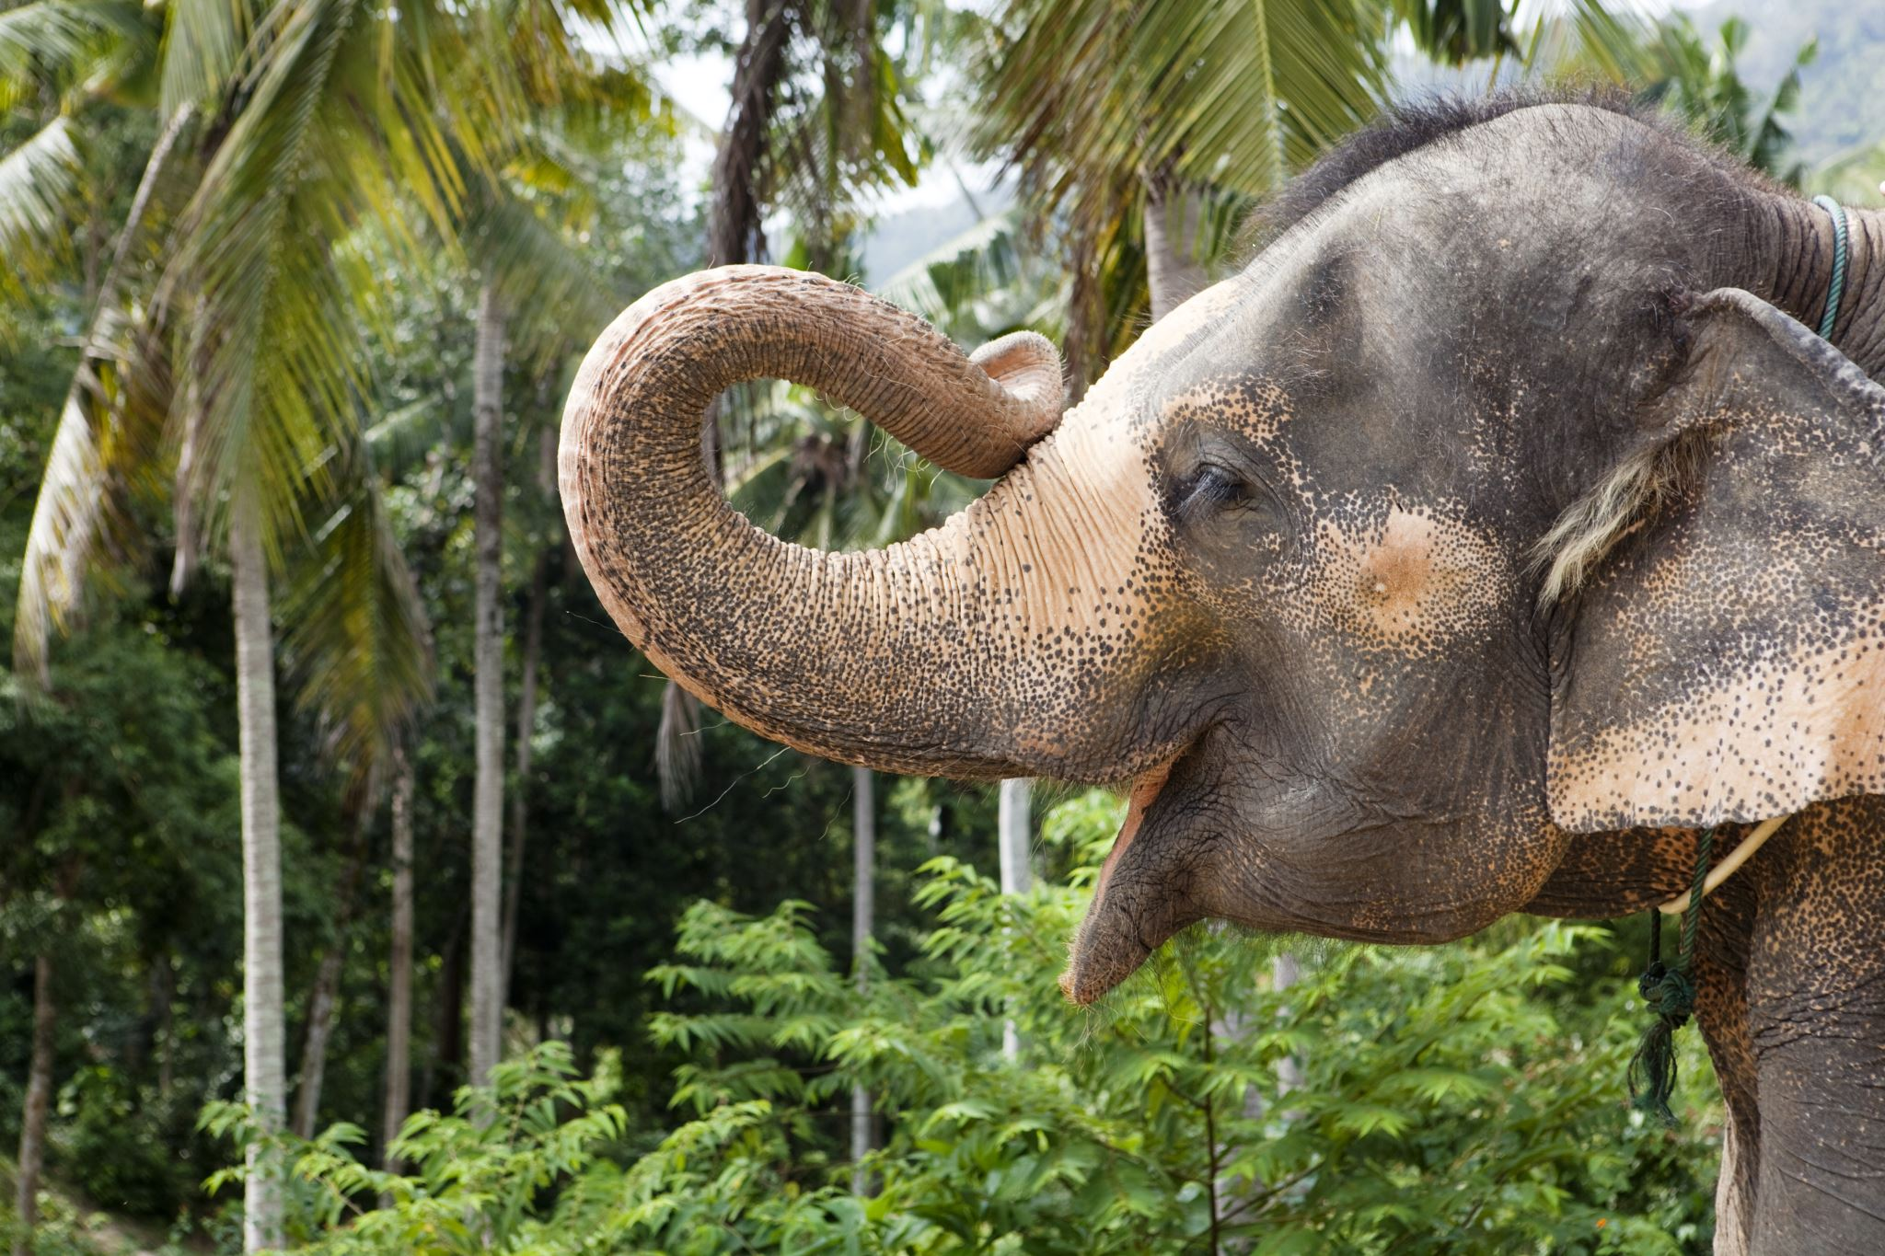
Comparative Analysis of Vision Transformer (VIT) vs. Convolutional Neural Network (CNN) on African vs. Asian Elephants Dataset
Ariel Lulinsky and Hadar Hai

Slide 2
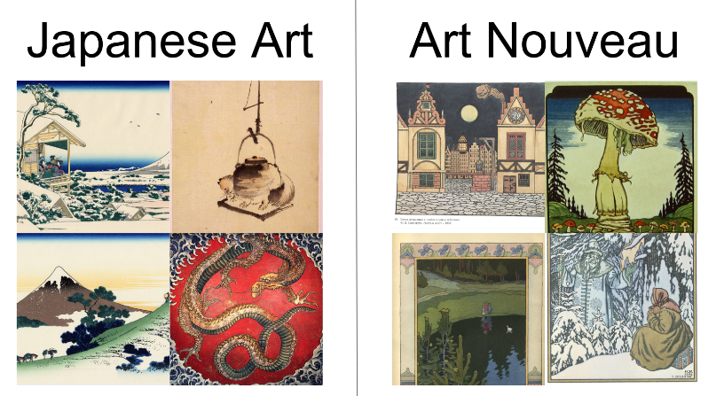
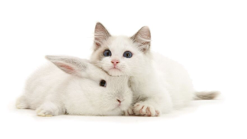
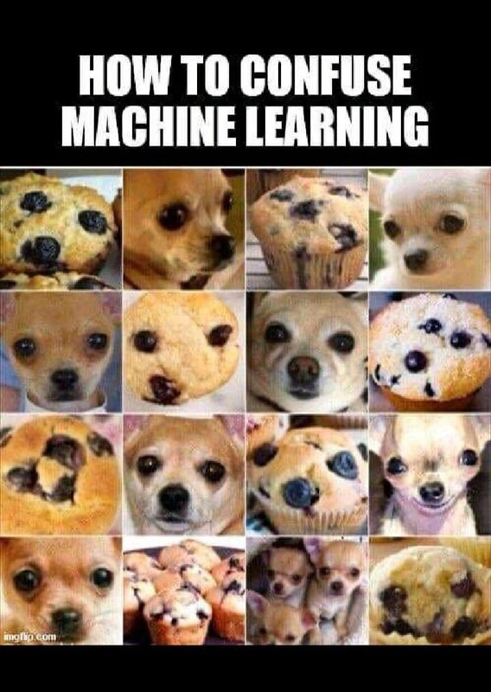
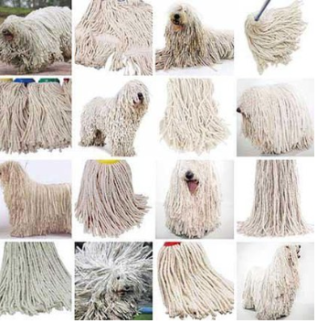
Introduction
82.3%*
This project aims to compare the effectiveness of Convolutional Neural Networks (CNN) and Vision Transformers (ViT) in binary image classification, particularly in distinguishing between Asian and African elephants, visually similar classes.
This issue is also found in other datasets, such as Japanese art vs. art Nouveau, cats vs. rabbits, sheepdogs and mops, muffins vs. chihuahuas, and more…
This type of classification task poses a significant challenge, even for humans to accomplish.
* https://www.kaggle.com/code/luthei/vit-vs-cnn-on-wikiart

Slide 3


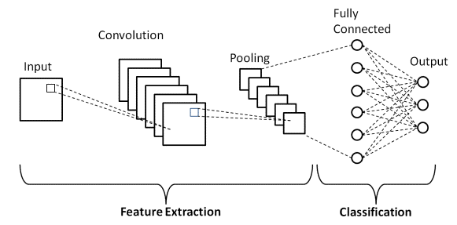


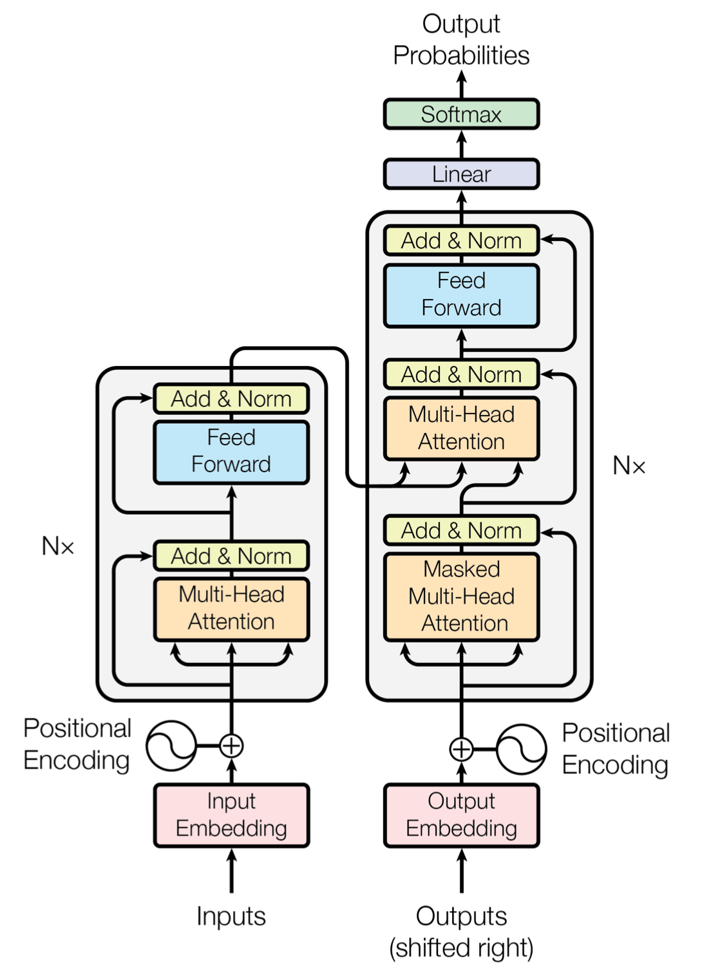
Efficient Image Processing
Limited Global Context
Excels at processing images efficiently through convolutional layers.
Processes local regions, leading to limited global context understanding.
Hierarchical Feature Learning
Heavy Parameter Footprint
CNN
Learns hierarchical representations for robust feature extraction.
Requires many parameters, leading to increased memory usage and longer training times.
State-of-the-Art Performance
Achieves remarkable success in various computer vision benchmarks.
https://www.upgrad.com/blog/basic-cnn-architecture/
Global Context Understanding
High Computational Cost
Processes the entire image, capturing long-range dependencies and global context.
Training can be computationally expensive due to a large number of parameters and self-attention mechanisms.
Self-Attention Mechanism
Data Efficiency
ViT
Utilizes self-attention mechanisms for focusing on relevant parts of the image.
Requires substantial amounts of data for effective training, limiting performance on smaller datasets.
Transferability and Pretraining
Can be pretrained on large-scale datasets and fine-tuned for various vision tasks.
Vaswani, Ashish & Shazeer, Noam & Parmar, Niki & Uszkoreit, Jakob & Jones, Llion & Gomez, Aidan & Kaiser, Lukasz & Polosukhin, Illia, “Attention is all you need” , 2017.
Notes:
© Copyright PresentationGO.com – The free PowerPoint and Google Slides template library

Slide 4

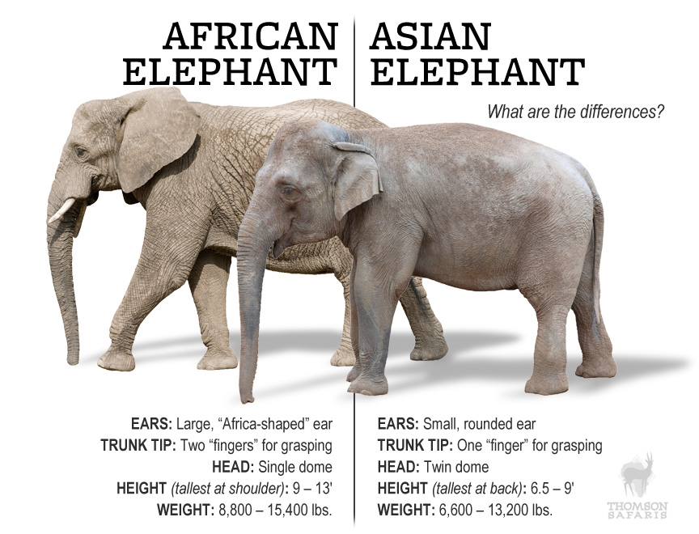
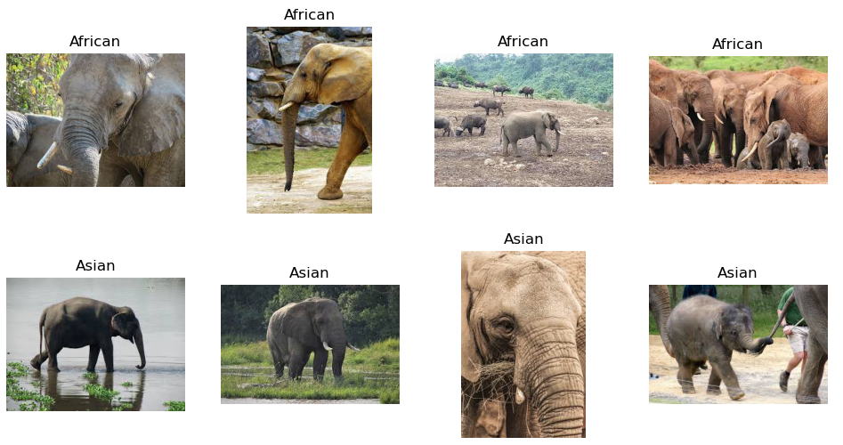
Dataset Description
Dataset of 1028 images
% of total | Asian | African
70 % | 369 | 369 | Train
10 % | 51 | 51 | Validation
20 % | 91 | 97 | Test
https://thomsonsafaris.com/blog/difference-african-asian-elephant/

Slide 5
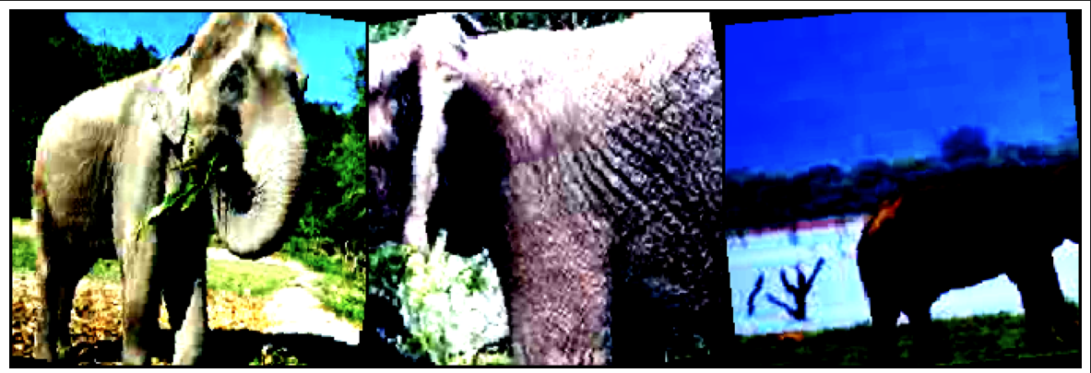

Data Preprocessing – augmentation using Kornia
Random resize and crop to 224 x 224
Random rotation -10:10 degrees
Random horizontal flip
Random affine, zoom 10%
Normalize with mean and std of Imagenet
Methodology

Slide 6
Methodology
SGD optimizer with learning rate of 0.001 and momentum of 0.9
Cross entropy loss function
Find the best CNN checkpoint
Checkpoint | Pretrained Model Name | Batch Size | Epochs | FE/FT | Use LoRA/ DoRA | Validation Accuracy | Time [sec] | Why
1 | Mobilenet V2 | 32 | 20 | FE | No | 71% | 355
2 | Mobilenet V3 Small | 32 | 20 | FE | No | 75% | 346
3 | Mobilenet V3 Small | 64 | 20 | FE | No | 75% | 332
4 | Mobilenet V3 Small | 128 | 20 | FE | No | 73% | 335
5 | Mobilenet V3 Large | 32 | 20 | FE | No | 77% | 339
6 | RESNET50 | 128 | 20 | FE | No | 68% | 357 | Same network as for Wikiart *
7 | Mobilenet V3 Large | 32 | 20 | FE | LoRA | 73% | 342 | The best so far using FE
8 | Mobilenet V3 Large | 32 | 20 | FE | DoRA | 76% | 333 | The best so far using FE
9 | Mobilenet V3 Large | 32 | 20 | FT | No | 74% | 361 | The best so far using FE, LoRA or DoRA didn’t make an improvement
* https://www.kaggle.com/code/luthei/vit-vs-cnn-on-wikiart

Slide 7
Results
Present the performance metrics of both VIT and CNN on the African vs. Asian elephants dataset.
Include metrics such as accuracy, precision, recall, and F1 score.
Visualize any significant differences in performance between the two models.

Slide 8
Discussion & Conclusion
Discussion
Interpret the results and discuss the strengths and weaknesses of each model.
Analyze factors contributing to the performance gap (if any) between VIT and CNN.
Discuss potential improvements or future directions.
Conclusion
Summarize the key findings of the comparative analysis.
Reiterate the importance of choosing appropriate models for image classification tasks.
Mention any implications for wildlife conservation or further research.

Slide 9
Thank you!
Q&A

