Slide 1
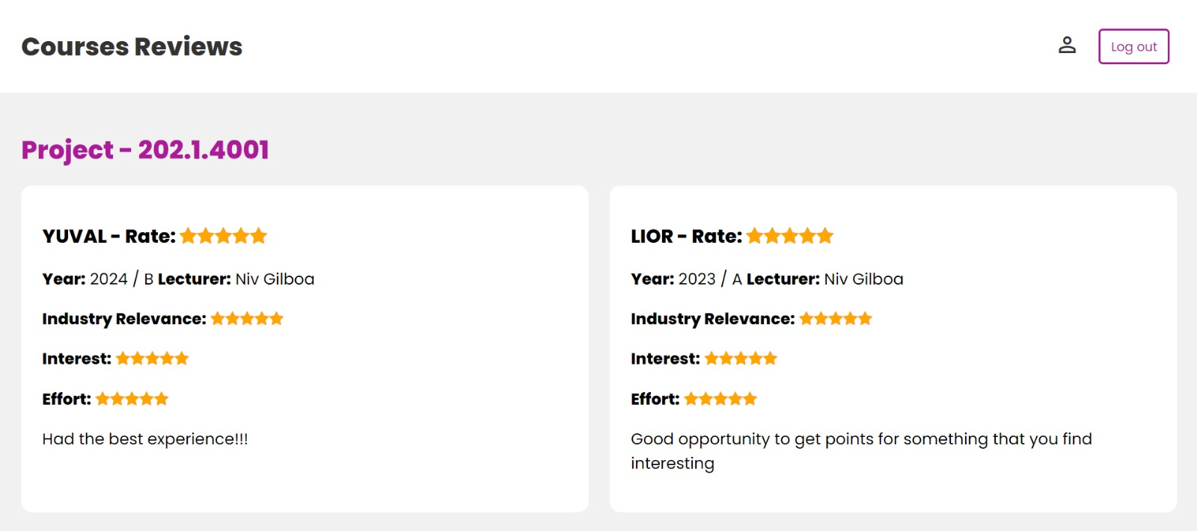
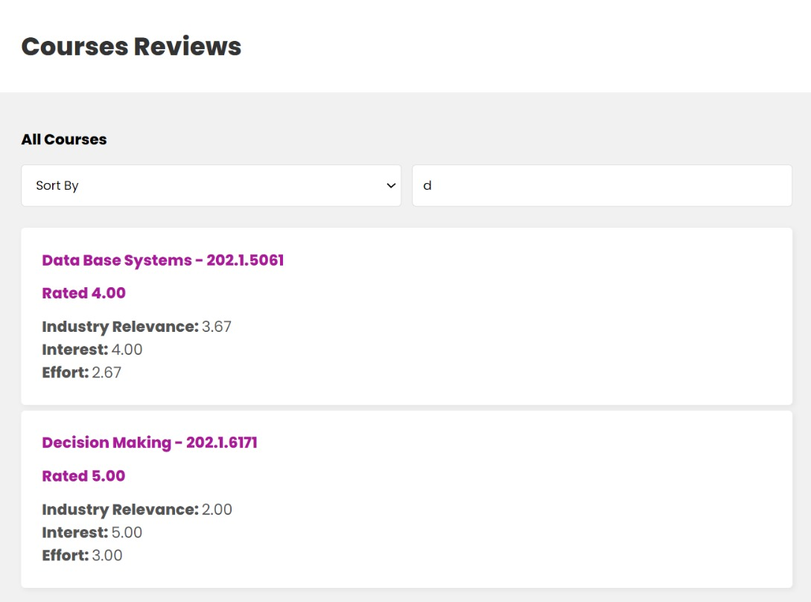
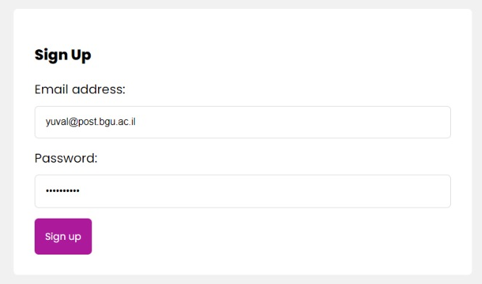
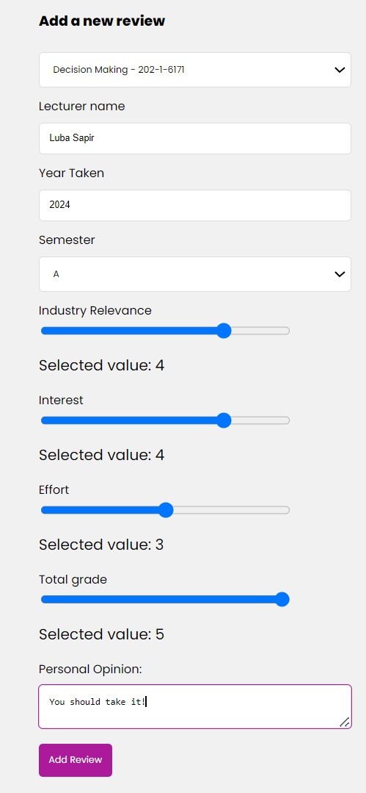
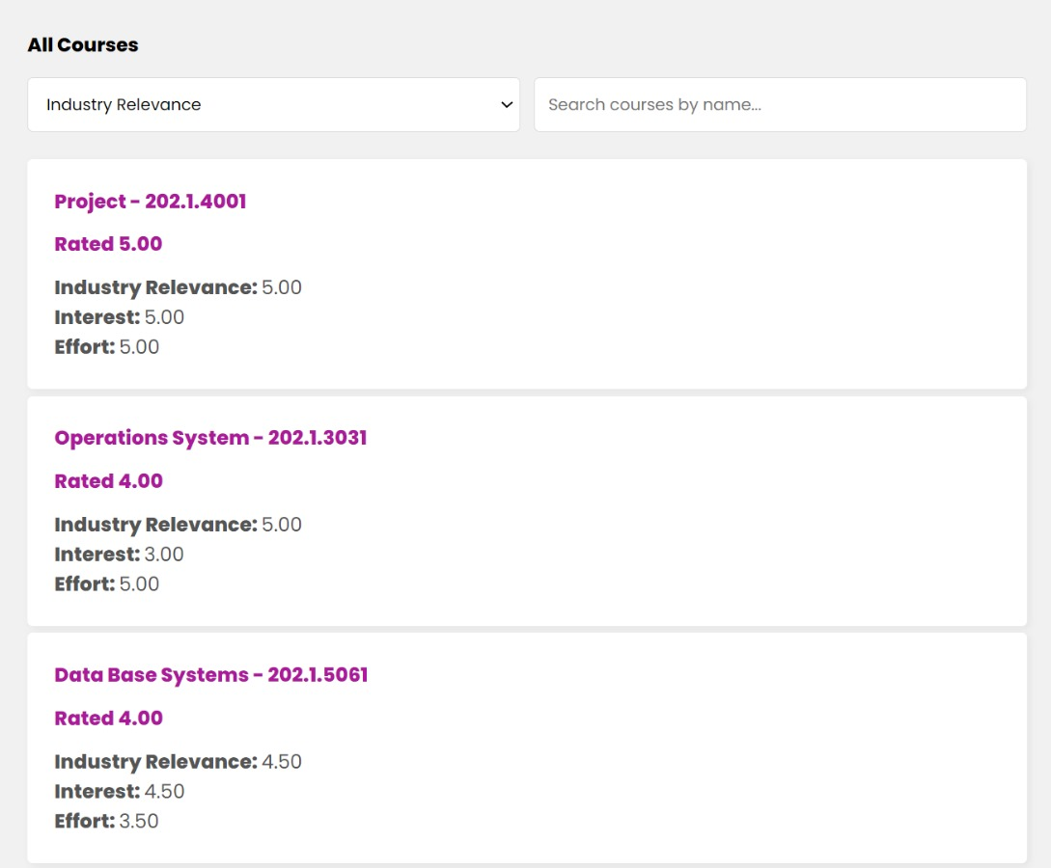
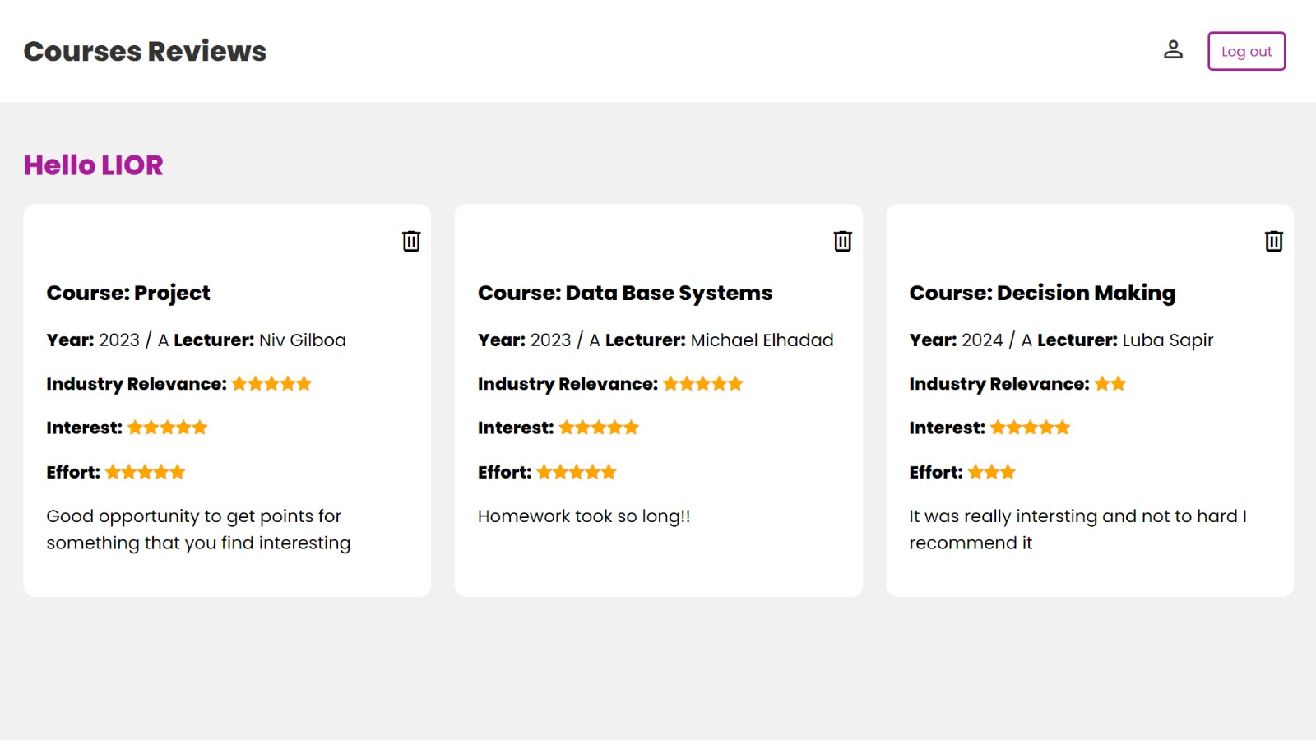


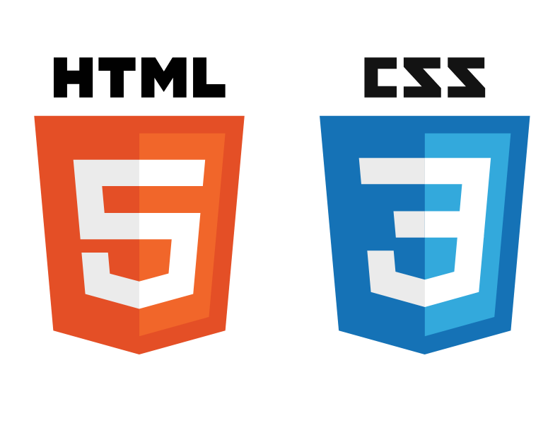



הפקולטה למדעי הטבע
המחלקה למדעי המחשב
Courses Reviews - A System For Rating Courses
Lior Soffer, Yuval Liman, Michal Regev, Shir Gordon
Advisor: Dr. Niv Gilboa
Main Goals
Motivation
Enhanced Decision-Making
Improved Course Selection Experience
Community and Engagement
Challenges Faced by Students:
Limited Information: Students often rely on brief course descriptions and syllabus, which may not provide enough insight into the effort required, the difficulty level, and the course's relevance to industry standards.
Lack of Peer Reviews: While some students may have informal conversations with peers about elective courses, there is no centralized platform to access diversity reviews.
Difficulty in Decision Making: The absence of detailed reviews and ratings makes it challenging for students to compare courses and decide which ones align best with their interests and career goals.
DataBase Relations
Review
User name
Course number
Course name
Lecturer
Year
Semester
Effort level
Interest level
Relevance to industry
User
Email
Password
course
Course number
Course name
Average rates
Reviews counter
Features of the system
View Course Reviews
Display reviews for specific courses using the relationships between database tables.
Security
Protected Pages - Only logged-in users can access system pages,
Registration is restricted to users with a university email address to verify affiliation.
Searching
On type search by course name
Adding review
Single Comment
Limitation:
Each user is restricted to
one comment per
course to ensure
reliable feedback, Dynamic Average
Grades:
Average grades are
Automatically updated
with each new review.
Managing my reviews
Track my Reviews: Display all reviews posted by the logged-in user,
Delete Review: Users have the option to delete their specific reviews if needed.
sorting
Sort courses by average rate based on selected category.

