Slide 1
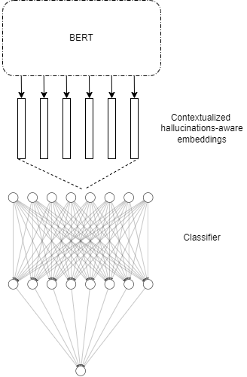
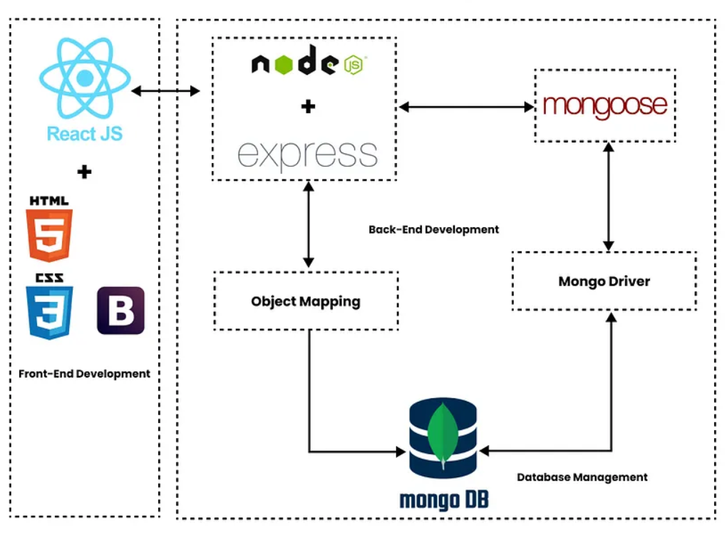
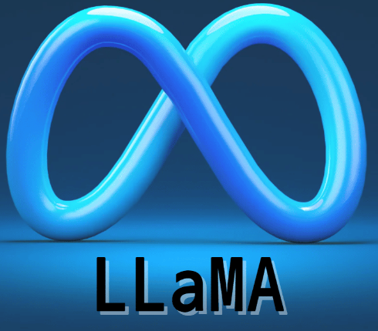




הפקולטה למדעי הטבע
המחלקה למדעי המחשב
Looking into LLM Hallucinations
Yuval Assif, Yoav Kor, Ohad Carmel, Yuval Reuveni
Instructors: Dr. Yuval Pinter, Mr. Nitay Calderon, Mr. Itzik Fradkin
Background
These days many people rely on language models for various tasks.
However, many language models provide incorrect answers with full confidence and without any disclaimers.
Even when a model uses hedging, it is not always directly correlated to the hallucination of the model.
Currently, there is no method that allow the user to estimate the reliability of the answer that the model provides.
Goals
Experiment goal – evaluate user trust in a Generative AI model by analyzing their betting behavior regarding the correctness of statements related to AI-generated photo description.
Our part in the experiment:
Generate the data from visual language model (Llava) for both the experiment and the model training + evaluation.
Build a model that aims to predict the hallucinations of the language model.
Create experimental setup - the toolset and the interface.
Model
We aim to find a way to detect the model’s hallucinations.
Our goal is to determine for each word (each token, actually) if it is a hallucination or not.
We propose to fine-tune a pre-trained BERT model with auxiliary classification feed forward neural network head.
We add an additional dimension into the embeddings vectors encoded by BERT which correspond to the logits that were given to the original word (token) By the model
Experimental setup
Cross-platform web application for experiments - using React, NodeJS, MongoDB.
Online experiments - tracking participant responses, reaction times, and facilitating comprehensive data analysis.
Tools

