Slide 1

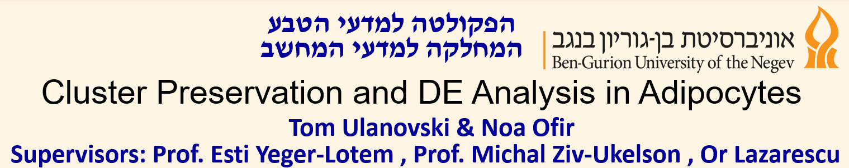

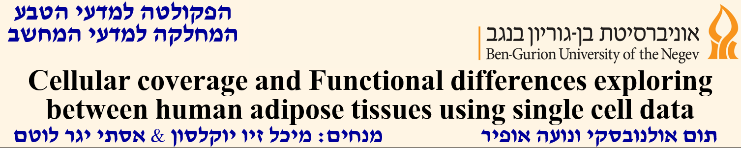
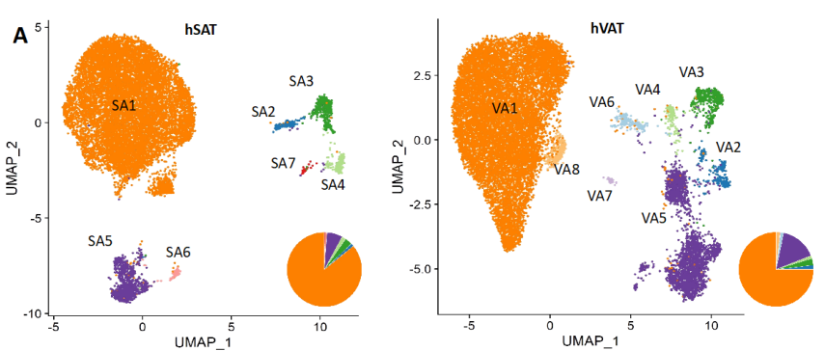
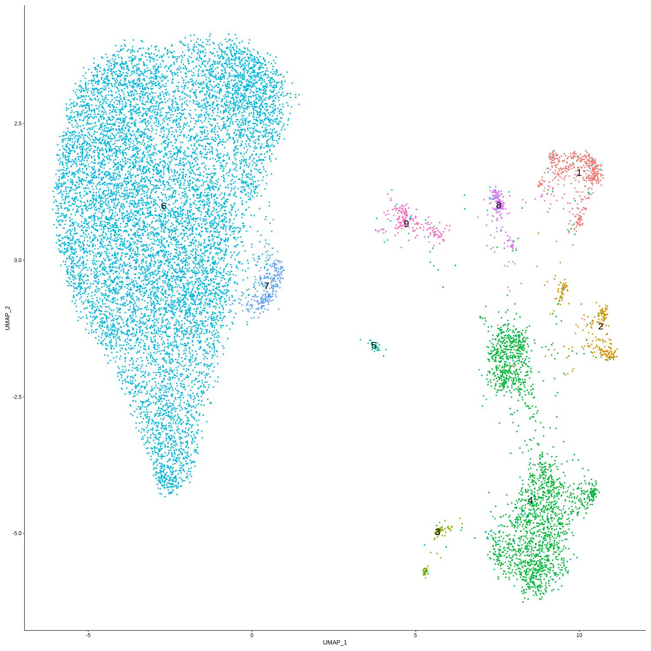
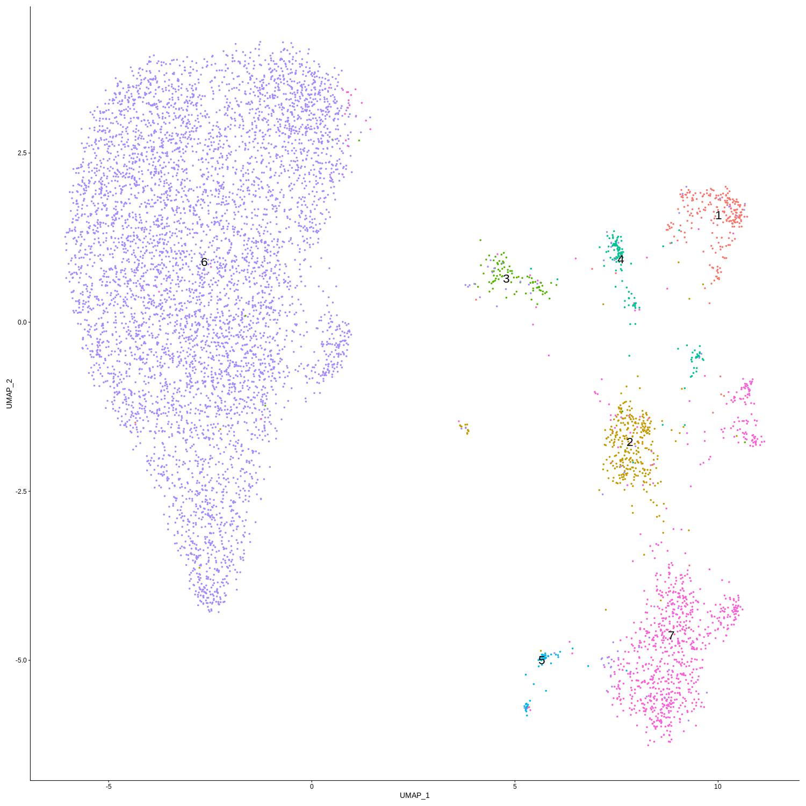
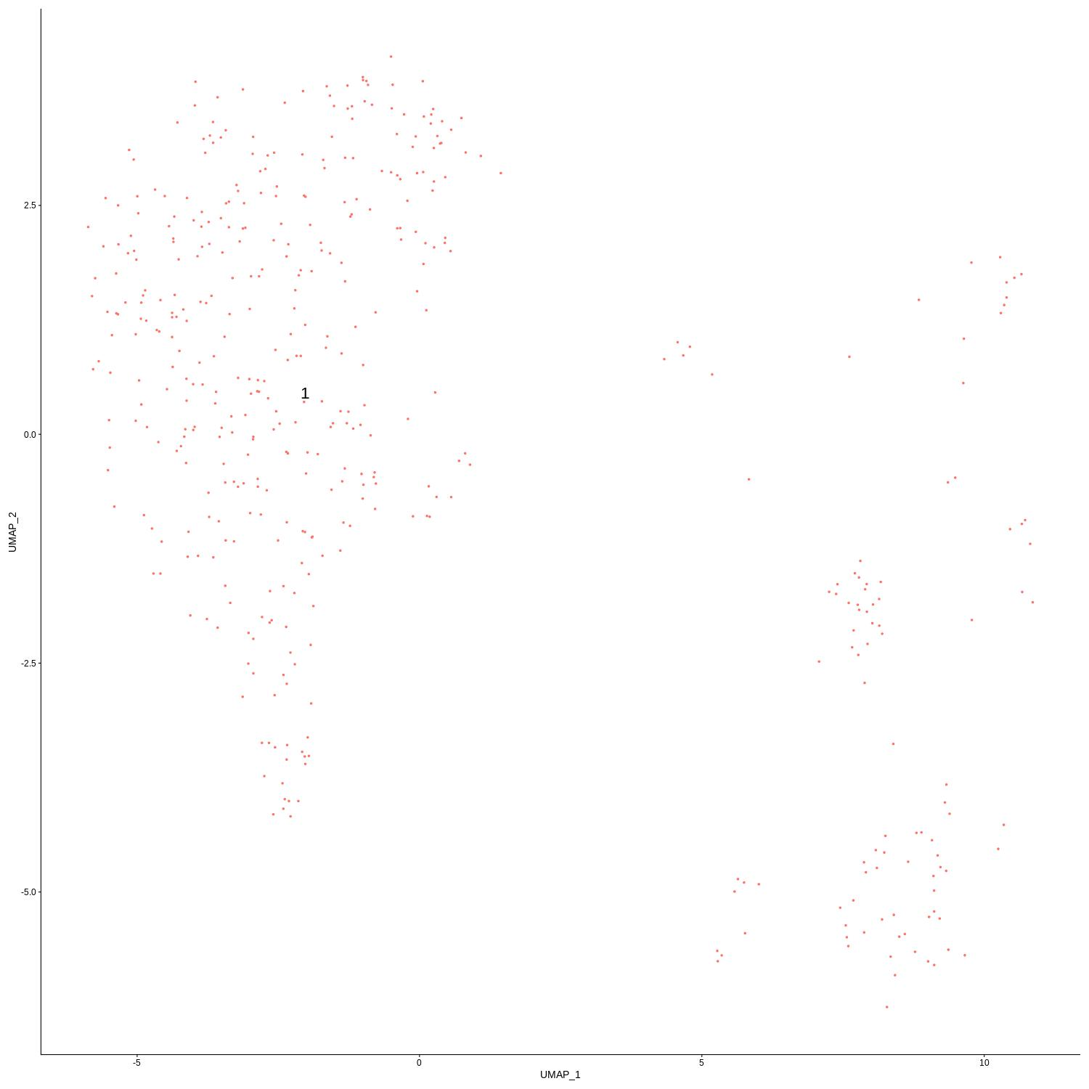
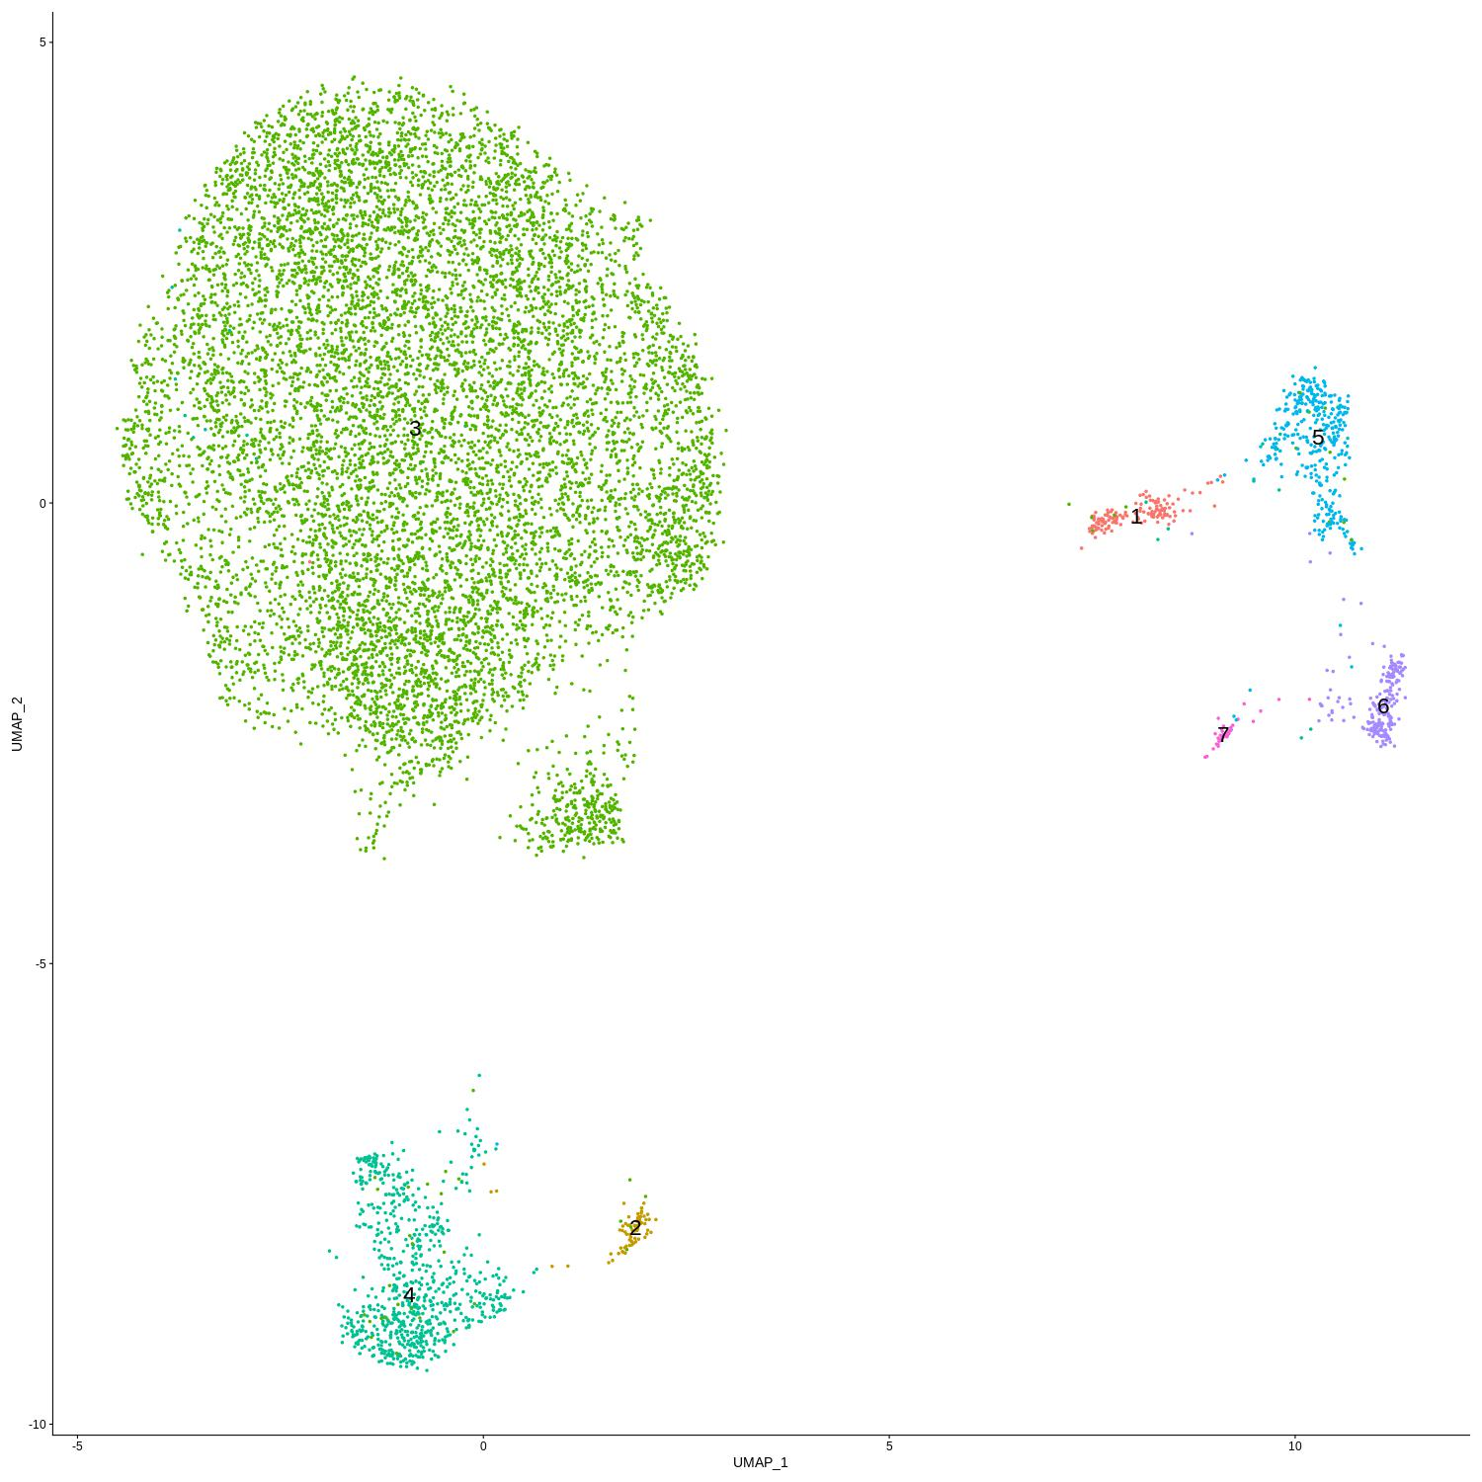
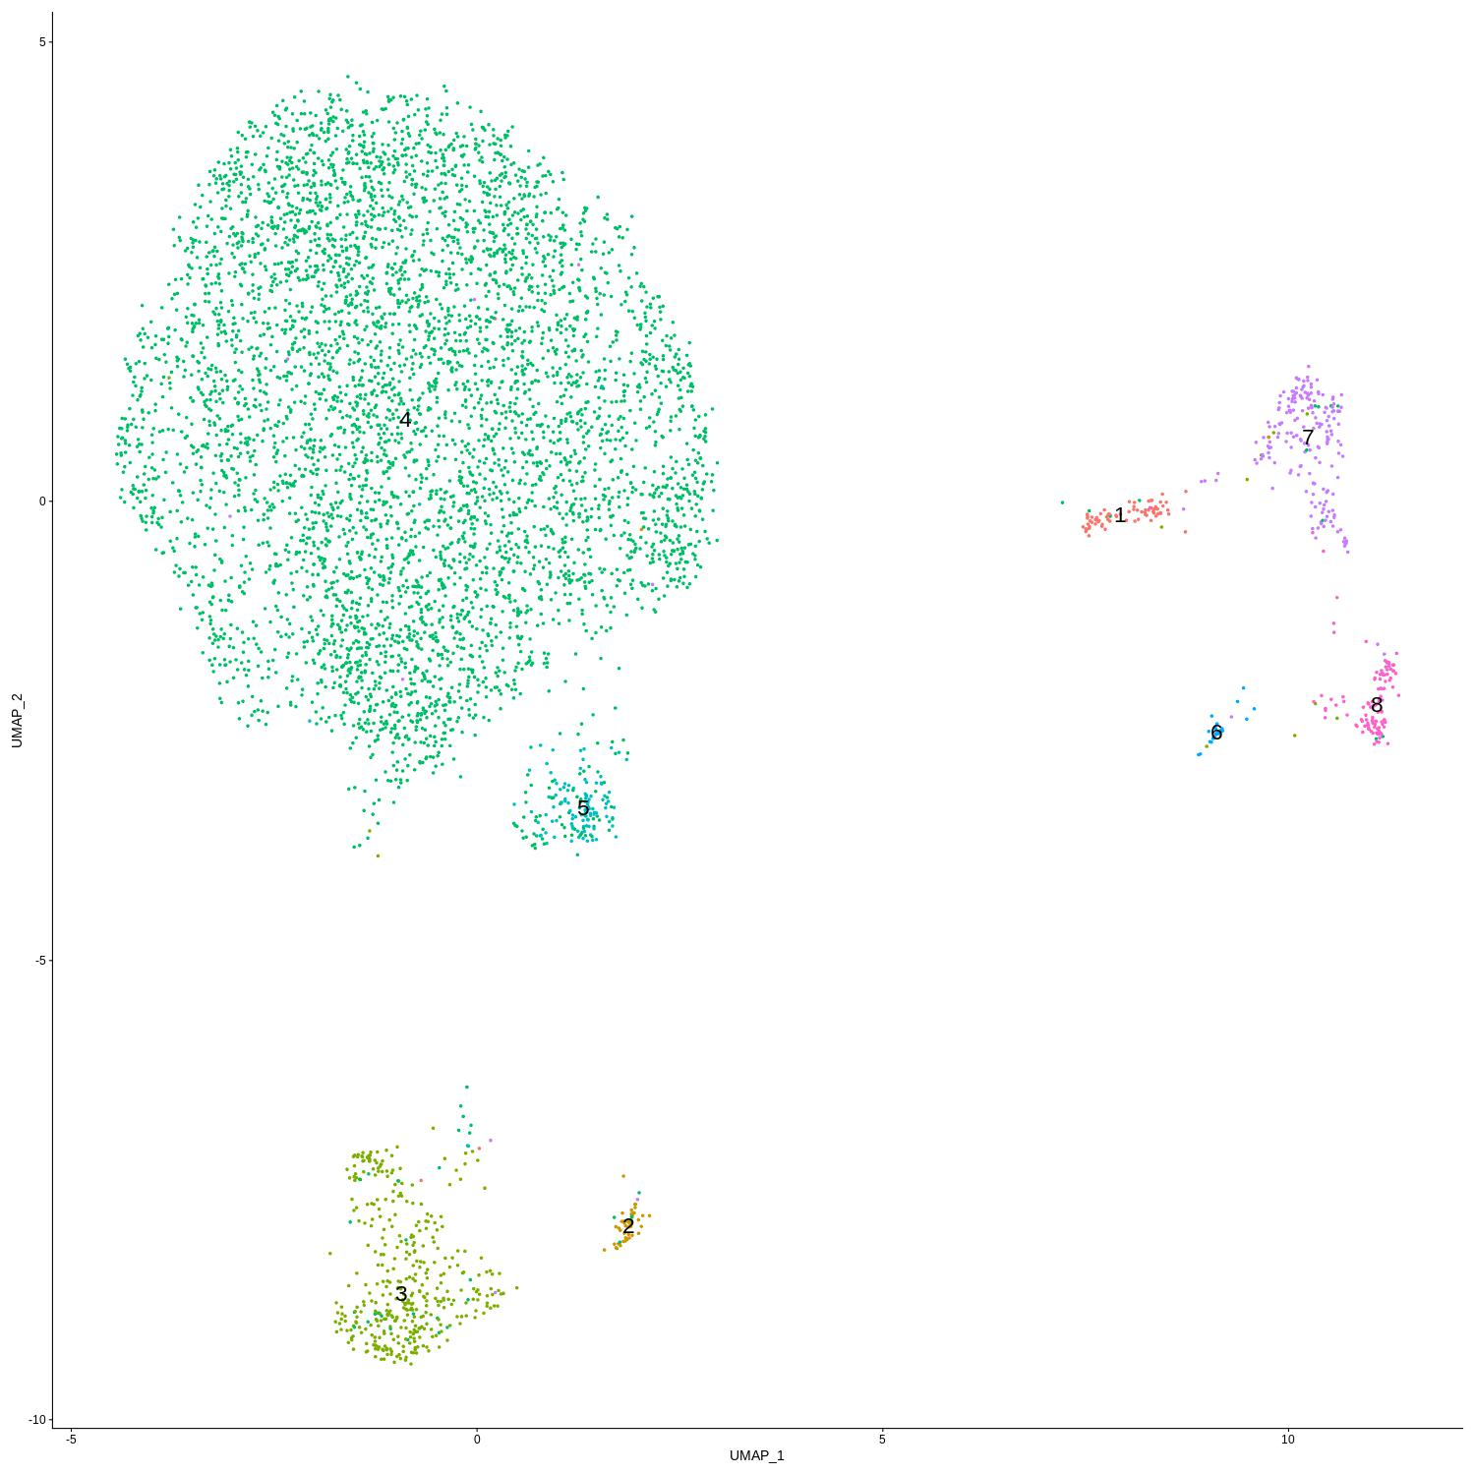
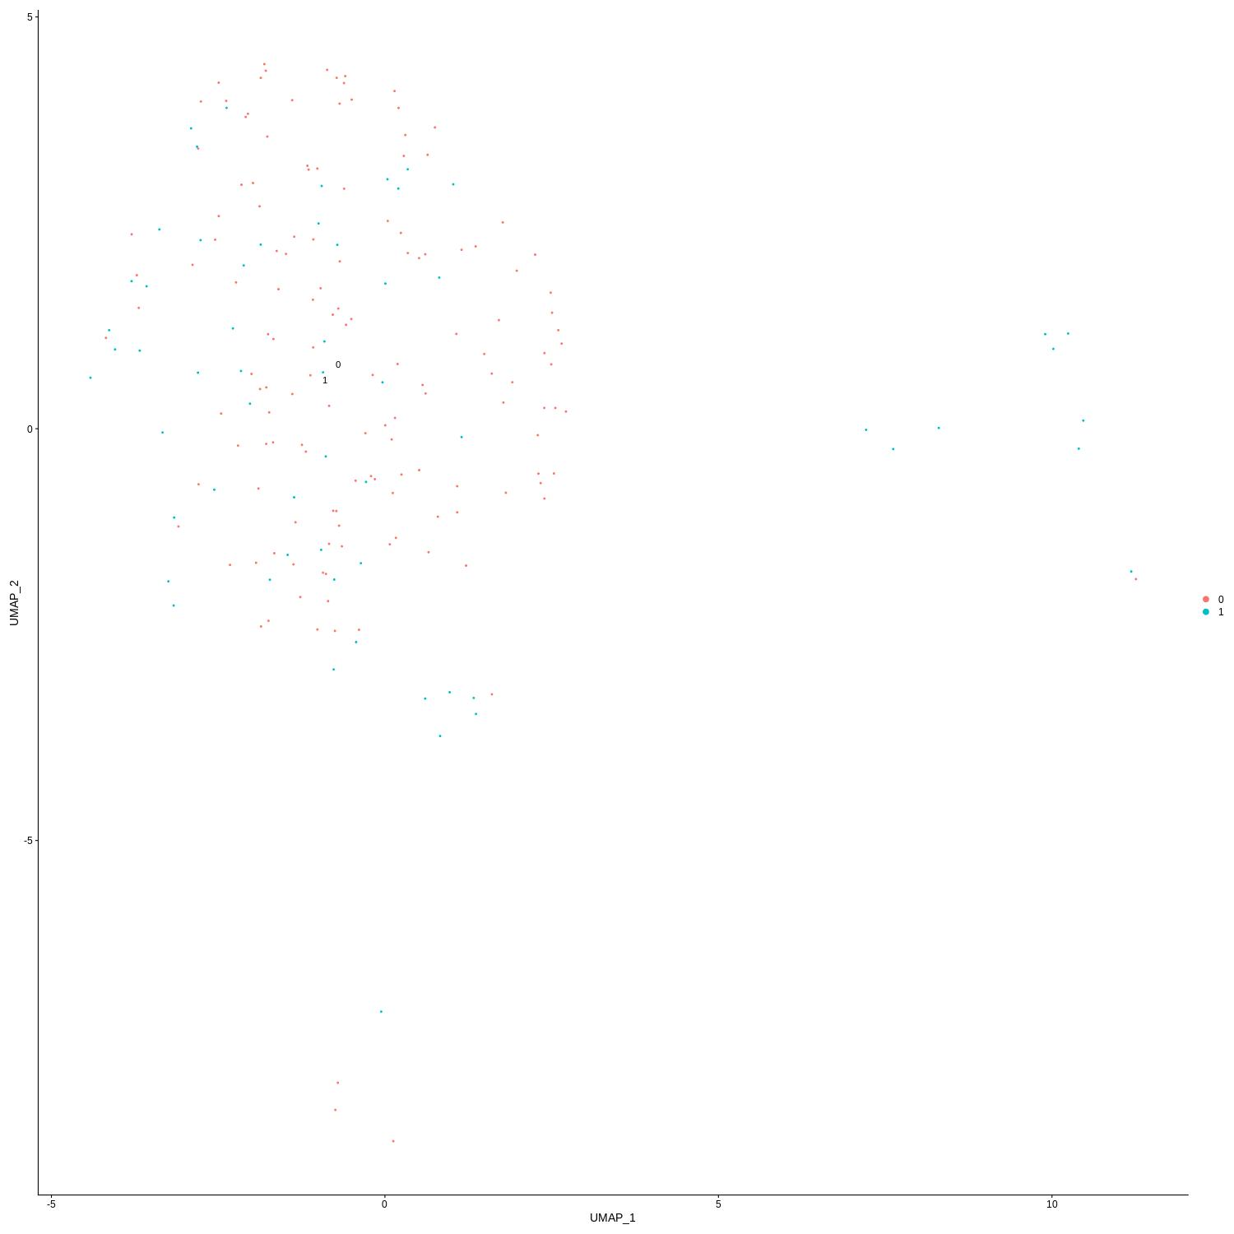
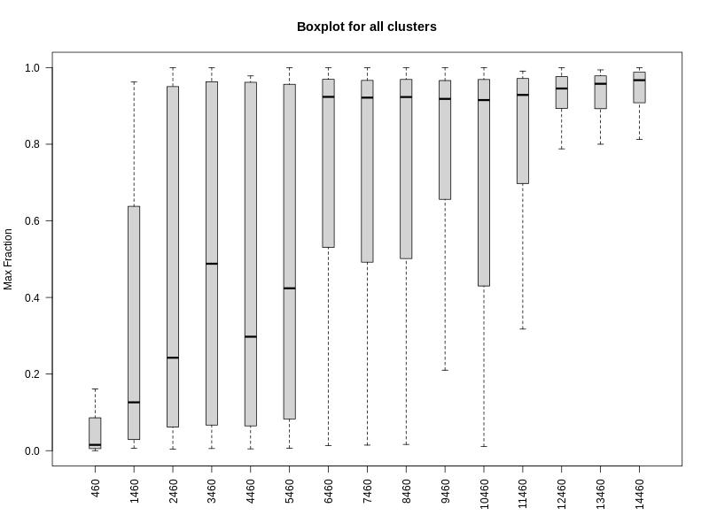
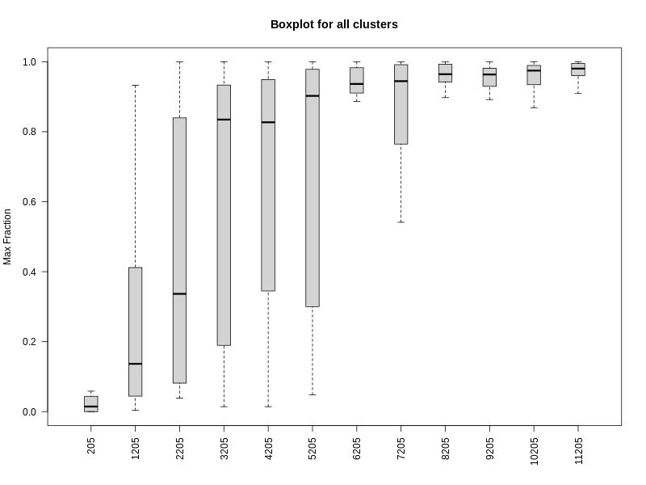
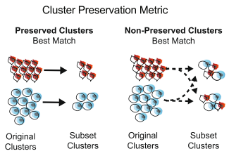
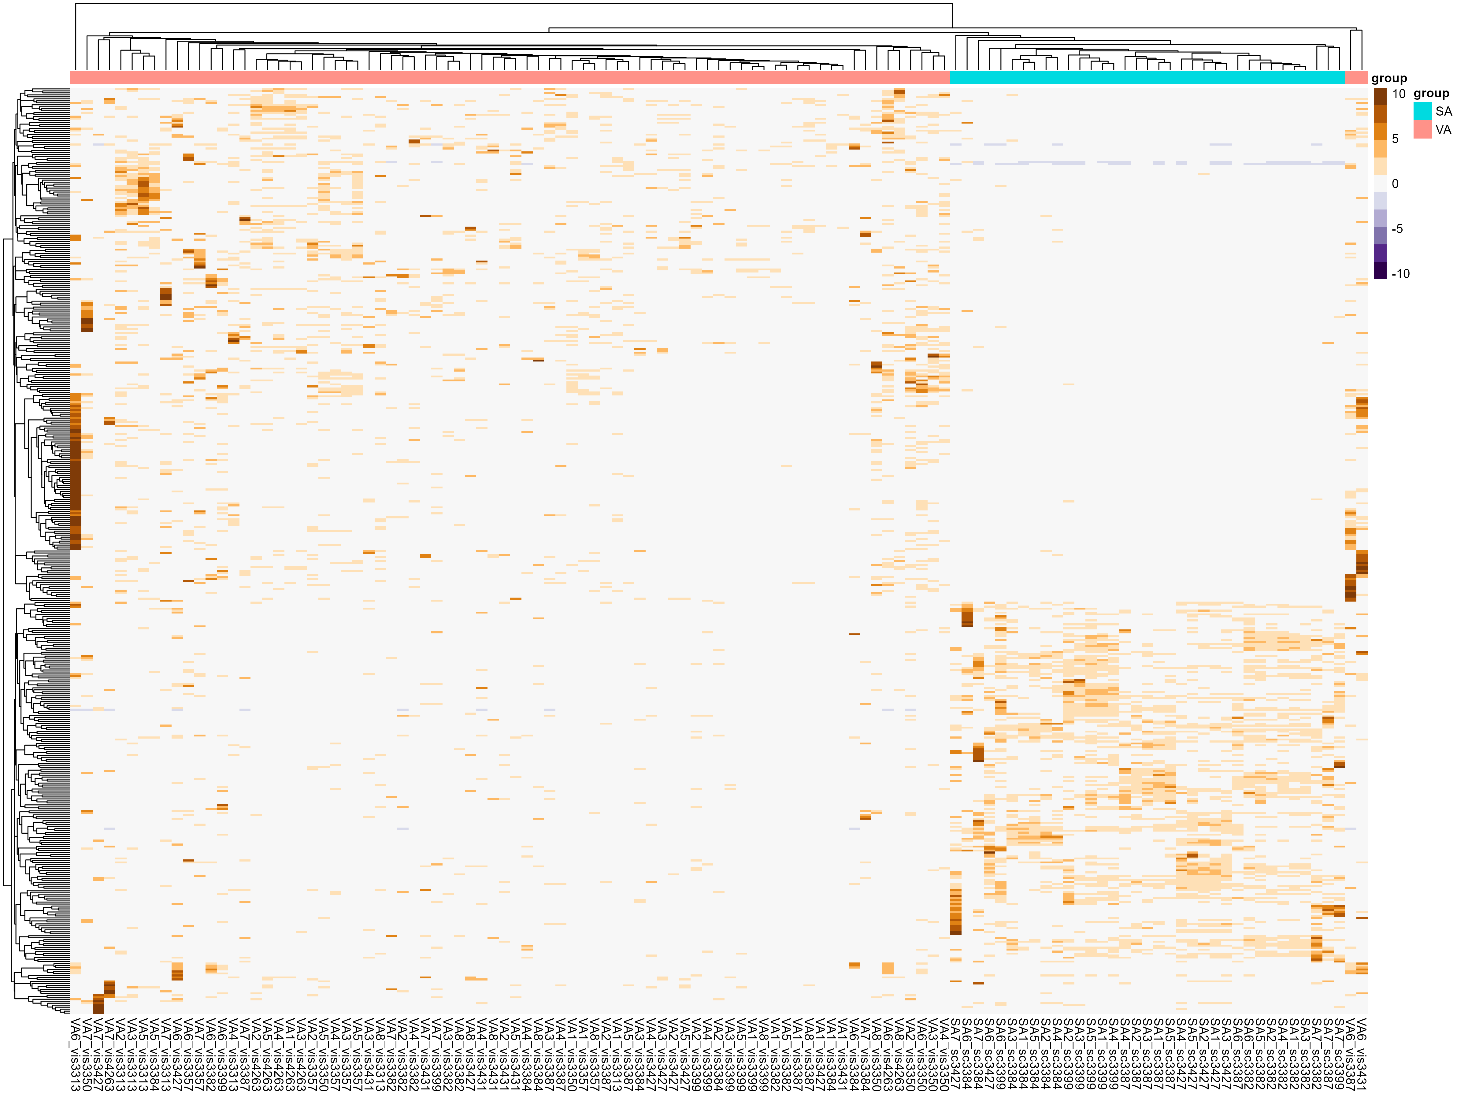
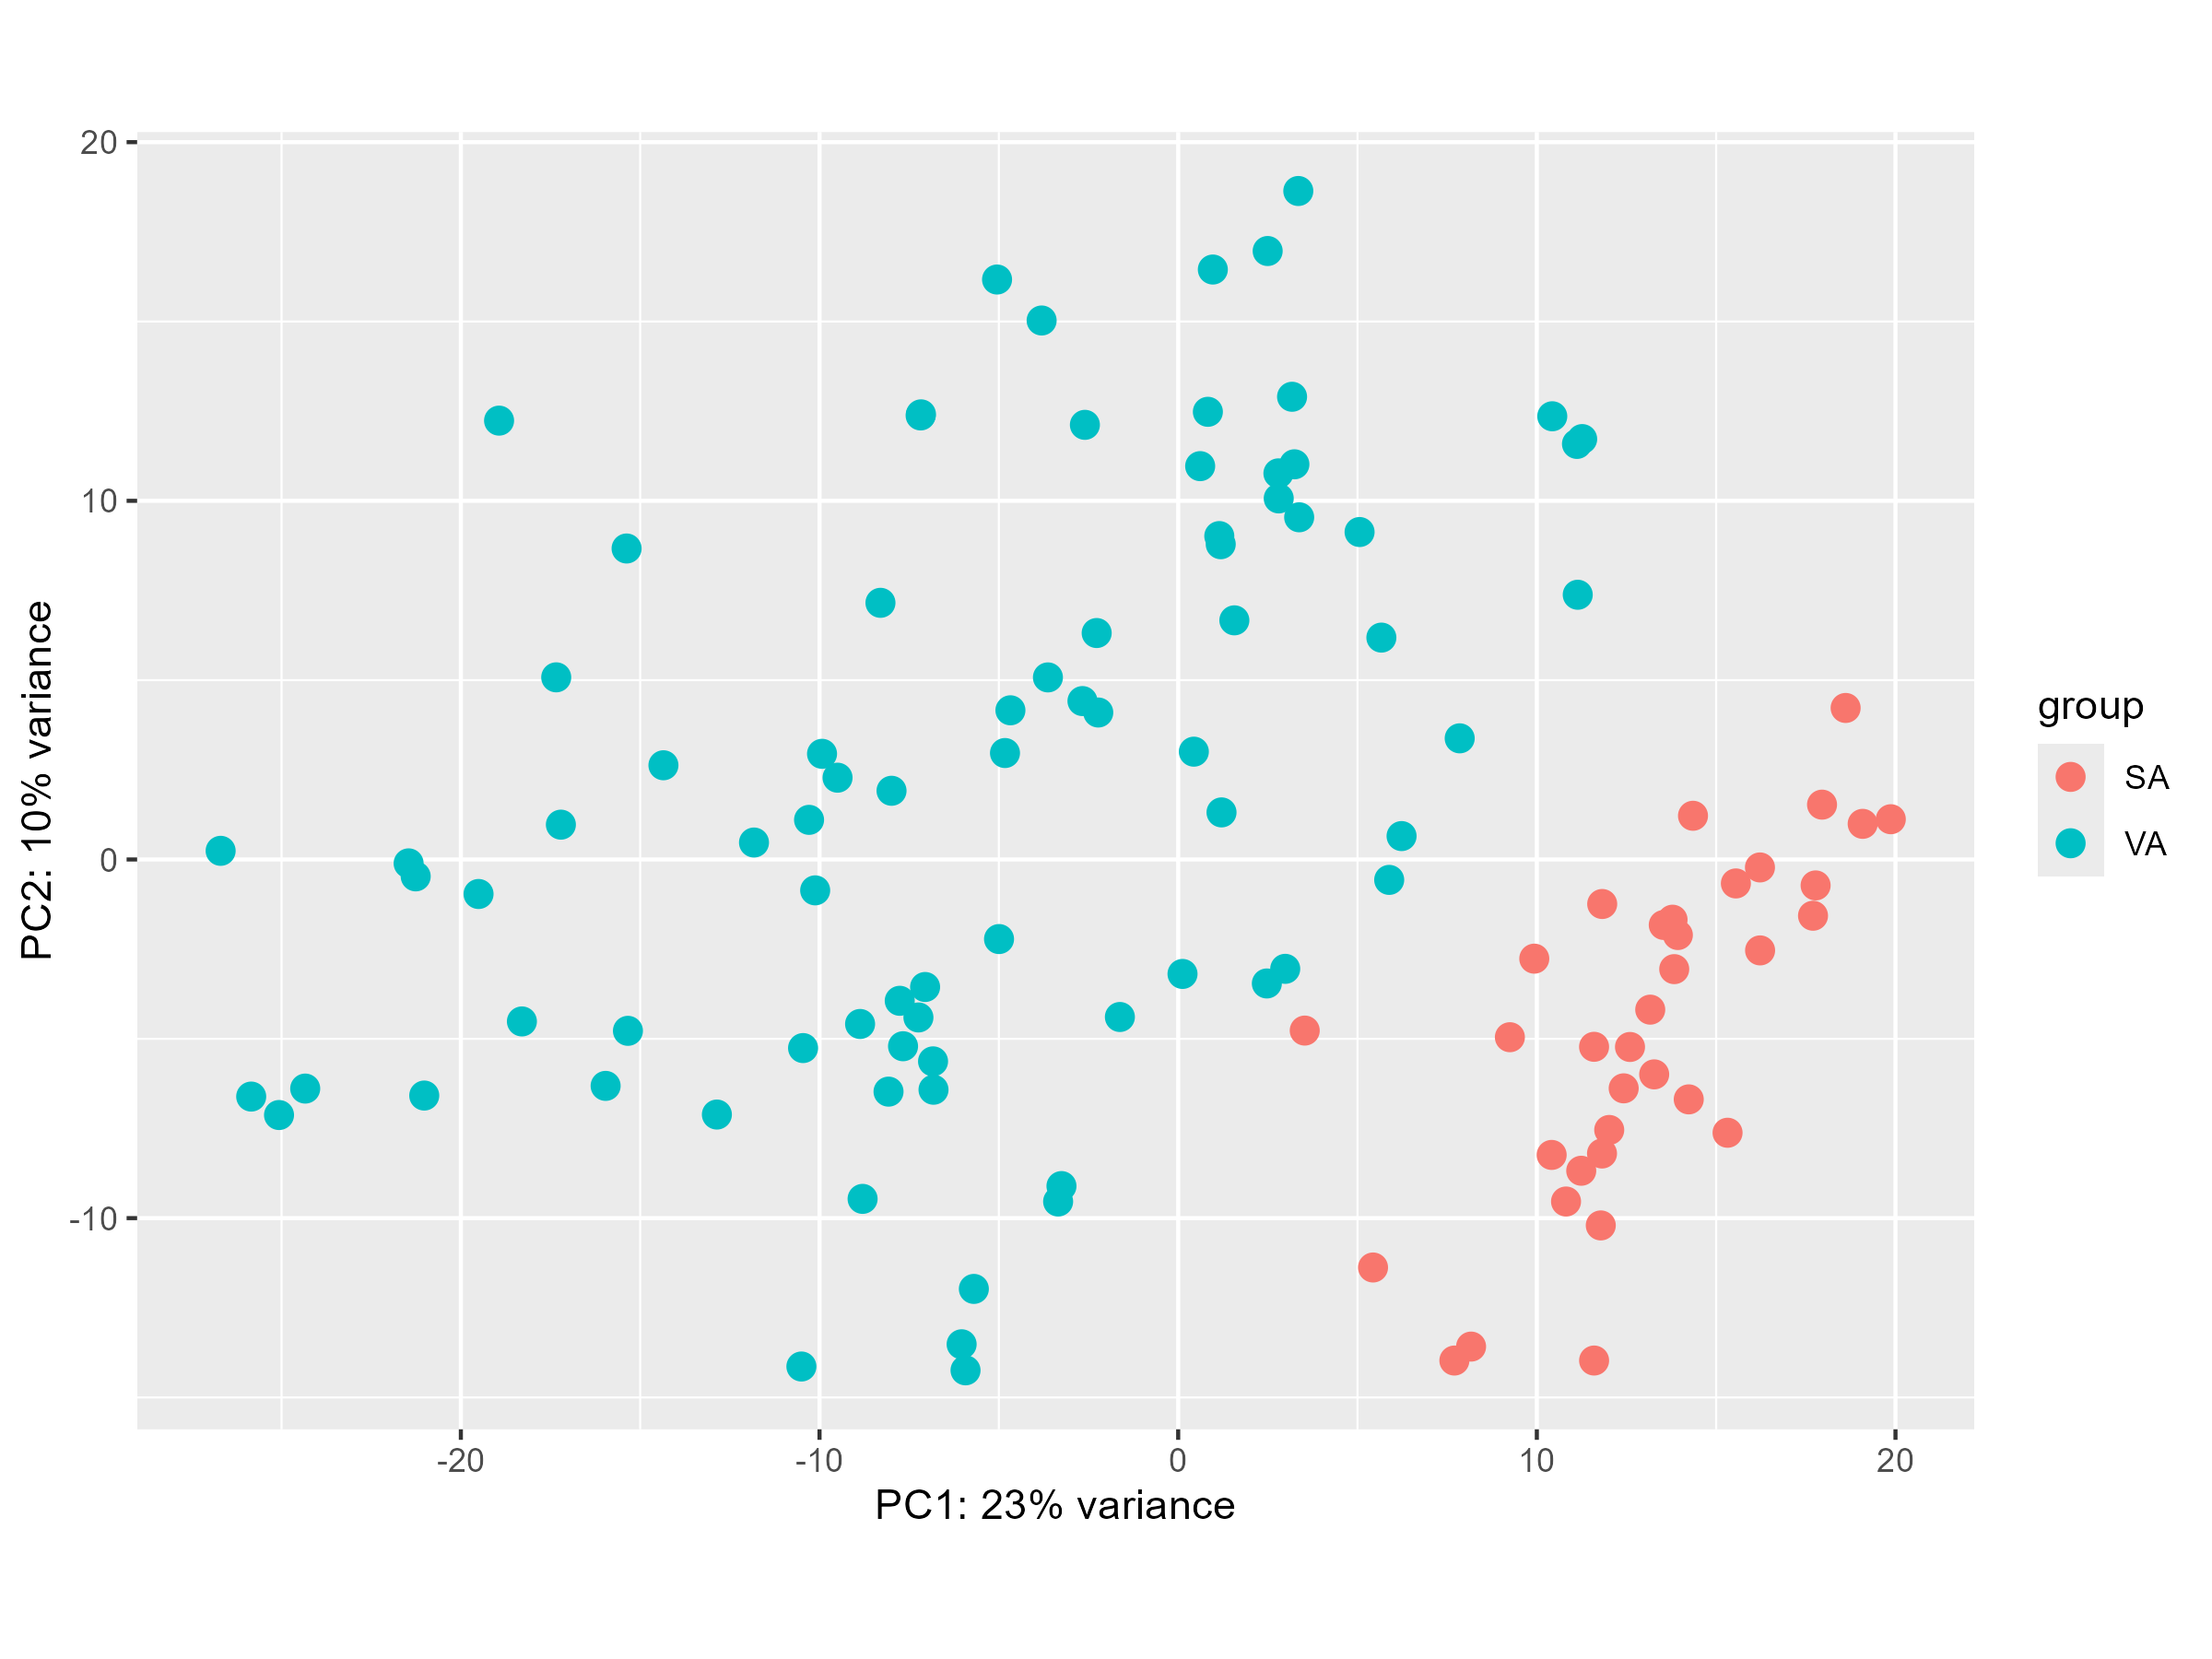
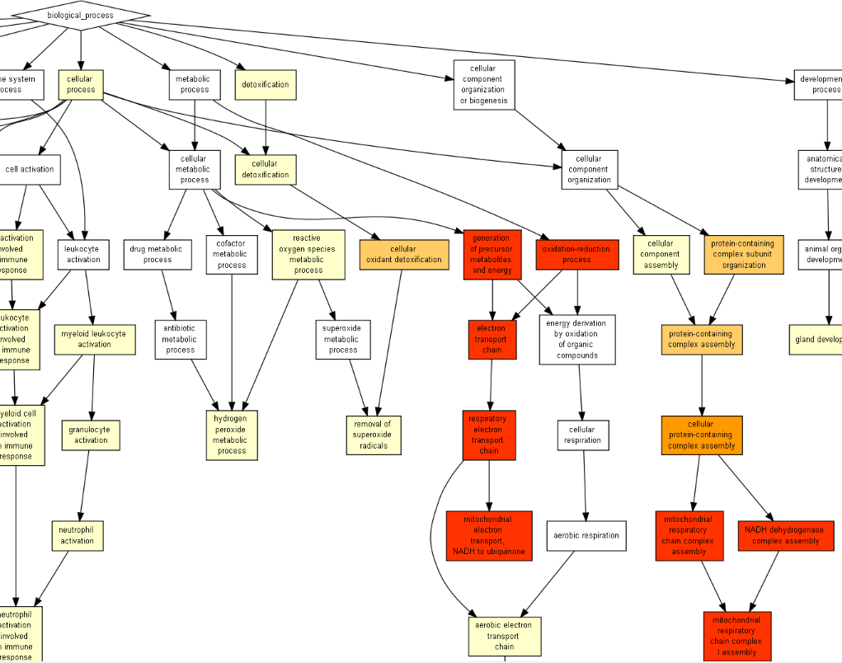
Abstract
Human adipose depots are functionally distinct. Yet, recent single-nucleus RNA-sequencing (snRNA-seq) analyses uncovered similar cellular landscapes. To illuminate this similarity-difference gap, the Yeger-Lotem, Rudich, and additional labs performed snRNA-seq of human subcutaneous and visceral adipose tissue (hSAT and hVAT, respectively). Most adipocytes in both depots were ‘classical‘, namely enriched in lipid metabolism pathways, yet they also observed for the first time ‘specialized‘ adipocyte subtypes that were enriched in immune-related, extracellular matrix deposition (fibrosis), vascularization/angiogenesis, or ribosomal processes. Our project aimed to (i) determine if the snRNA-seq dataset was large enough to reveal most adipocyte subtypes, and (ii) explore functional differences between hSAT and hVAT adipocytes. For the first aim, we implemented a cluster preservation analysis algorithm, which randomly excludes nuclei and checks whether subtyped were preserved. For the second aim, we aggregated nuclei sequencing data per tissue, applied differential gene expression analysis between tissues, followed by functional enrichment analysis. The cluster preservation analysis indicated that the dataset had reached saturation, confirming sufficient sampling. The functional analysis revealed significant differences in metabolic and immune-related genes, with hVAT showing higher enrichment in these pathways.
Introduction
hVAT
Aim1 results
12,205 nuclei
15,460 nuclei
First iteration
Middle iteration
Last decrease
hSAT
UMAP representations of human hSAT and hVAT adipocyte atlases, and pie charts showing the relative abundance of adipocyte subtypes.
The Yeger-Lotem, Ruding, and additional labs profiled 5 and 10 samples of human XX tissues,
respectively (Lazaescu, Ziv-Agam, et al, bioRxiv 2023, [1])
They found 8 and 7 clusters which represent different adipocytes subtypes with unique functionalities in visceral and
subcutaneous depots, respectively
Project aims
Aim1 - Assess whether sufficient sampling was preformed to identify all adipocyte subtypes.
Aim2 – Explore functional differences between the adipose tissues.
Visualization of the re-clustering. Re-clustering process of cells in the hVAT and hSAT depots, the first, middle and last decreases of a total of 15 random decreases of 1000 nuclei in visceral and 12 random decreases in subcutaneous. As we can see, in lower number of nuclei, there is a decrease in the number of clusters found.
hVAT
hSAT
Methods
Aim1-
We implemented a cluster preservation analysis algorithm based on Bhaduri et al., BMC Biology (2018) [2]
The algorithm assessed whether the numbers of sequenced nuclei allowed to reveal all major adipocyte subtypes in the tissues [1]
Cluster preservation algorithm steps pe iteration
460
1460
2460
3460
4460
5460
6460
7460
8460
9460
10460
12460
14460
11460
13460
205
1205
2205
3205
4205
5205
6205
7205
8205
9205
10205
11205
Division of the dataset into random subgroups of decreasing sizes.
Normalization, scaling, PCA and harmony integration, followed by clustering.
Assessing clustering by building a cluster tree and evaluating nodes in the tree, calculating the out-of-bag (OOB) error rate for each node.
Merging nodes with an OOB error rate greater than 0.05, indicating poor cluster separation.
Cluster preservation calculation+ visualization
Cluster Preservation. The cluster preservation analysis, as depicted in the boxplot, indicates that the cluster preservation value increases with sample size. The distribution of the cluster preservation value becomes more consistent and stabilized as the sample size grows, particularly from cluster sizes of 6000 and above. This trend is evident in both hSAT and hVAT datasets.
We decreased 1000 randomly-selected nuclei in each iteration of the algorithm to produce smaller subgroups. We stopped decreasing when we reached less than 1000 nuclei in a subgroup
10 repetitions were done and gone through the cluster preservation analysis algorithm
The final cluster preservation results is the integration of all the repetitions
Aim 2-
We preprocessed the data for easier analysis. Then we refined an algorithm for Pseudo-Bulk differential expression analysis based on HBCTRaining (2024) [3]
In the last step we used multiple gene enrichment analysis functions to identify which biological processes, pathways, or functions are enriched among the genes found in the differential expression analysis step
Aim2 steps
A
Aim2 Results
B
Data preprocessing including merging and samples names giving
Pseudo-Bulk profile building: Aggregation of data at the sample level and integration with metadata
Quality control steps – PCA and Heatmap plots to explore similarity/differences between samples
Differential expression analysis using DESeq2.
Gene Enrichment Analysis using gseGO , enrichGO and GOrilla for visualization
Aim1 results:
Increasing the sample size improves cluster preservation until it plateaus
Preservation plateaus at around 6000 nuclei in both visceral and subcutaneous datasets
The actual sample size, more than double the plateau number, indicates more than adequate sampling, suggesting fewer nuclei could still achieve comprehensive adipocyte subtype representation
Aim2 results:
hVAT and hSAT adipocytes differ in functionalities
hVAT adipocytes are enriched for mitochondrial processes compared to hSAT adipocytes
Reinforces single-cell differential expression analysis by providing an additional perspective.
Pseudo-Bulk Differential Expression Results for hVAT vs hSAT. A. The heatmap of the significant genes- adjusted probability value<0.05 and absolute value of log2 fold change >2.
B. The PCA plot of the differential gene expression between hVAT and hSAT.
These analyses clearly demonstrate distinct gene expression profiles between hVAT and hSAT, highlighting the physiological differences between the two tissue types
We can see in the PCA a separation on PC1 by our condition of interest, and it suggests that the main source of variation in our dataset is the condition of interest(hVAT vs hSAT)
Conclusions
References
[1] Or Lazarescu, Maya Ziv-Agam, Yulia Haim, Idan Hekselman, Juman Jubran, Ariel Shneyour, Danny Kitsberg, Liron Levin, Idit F Liberty, Uri Yoel, Oleg Dukhno, Miriam Adam, Antje K¨orner, Rinki Murphy, Matthias Bl¨uher, Naomi Habib, Assaf Rudich, and Esti. Yeger-Lotem. subcutaneous and visceral adipocyte atlases uncover classical and specialized adipocytes and depot-specific patterns. BioRxiv, 2023.
[2] A. Bhaduri, T.J. Nowakowski, A.A. Pollen, and A.R. Krieg stein. Identification of cell types in a mouse brain single-cell atlas using low sampling coverage. BMC Biology, 16(1):113, 2018
[3] HBCTRaining. Pseudo bulk deseq2 for single-cell rna-seq. https://hbctraining. github.io/scRNA-seq_online/lessons/pseudobulk_DESeq2_scrnaseq.html, 2024. Accessed: 2024-05-26.
[4] Yu G, Wang L, Han Y, He Q (2012). “clusterProfiler: an R package for comparing biological themes among gene clusters.” OMICS: A Journal of Integrative Biology, 16(5), 284-287. doi:10.1089/omi.2011.0118.
Gene Set Enrichment analysis. Enriched metabolic related pathways in the hVAT depot. The enriched pathways are colored in red.
Pseudo-bulk analysis facilitates Gene Set Enrichment Analysis by aggregating single-cell data into bulk-like profiles, enabling the identification of enriched biological pathways and processes.
From this analysis, we observed that hVAT adipocytes were enriched for mitochondrial processes, underscoring their unique metabolic functions. The figure above that was taken from Gorilla shows

