Slide 1
ML6 CHALLENGE
Machine Failure Classification from Sensor Data
A proof of concept for labeling 1,560 unlabeled failures using only 40 labeled examples.
1,600
20
3
failure events
sensors each
failure types
Hadar Eliyahu
Notes:
Introduce the problem: many machine failure events, very few expert labels, and a need to make the unlabeled data useful.

Slide 2
Problem & Goal
ML6 CHALLENGE
01
Dataset: 1,600 machine failure events, each represented by 20 sensor measurements.
Only 40 failures are labeled; the remaining 1,560 are unlabeled.
Known label space in the labeled set: 3 machine failure types.
Goal: assign labels to the unlabeled failures and surface a high-confidence subset for expert review.
Success criterion for the PoC: a useful review workflow, not perfect classification.
Notes:
This is a low-label problem. The goal is not perfect automation, but a useful workflow for failure review.

Slide 3
Approach Overview
ML6 CHALLENGE
02
1
Explore the data
Start with unsupervised clustering to check whether failure types naturally separate.
↓
2
Use the available labels
When clustering proved weak, evaluate label-guided approaches using the 40 expert-labeled failures.
↓
3
Improve the representation
Reduce the feature space by selecting the most discriminative sensors.
↓
4
Challenge the assumption
Compare supervised and semi-supervised models on the selected features using the same LOO evaluation.
↓
5
Select the final solution
Choose the best-performing model and apply it to classify the unlabeled failures.
Notes:
Walk through the analysis flow: explore with clustering, use the labels, improve the representation with feature selection, challenge the semi-supervised assumption against supervised models, then select the final model.

Slide 4
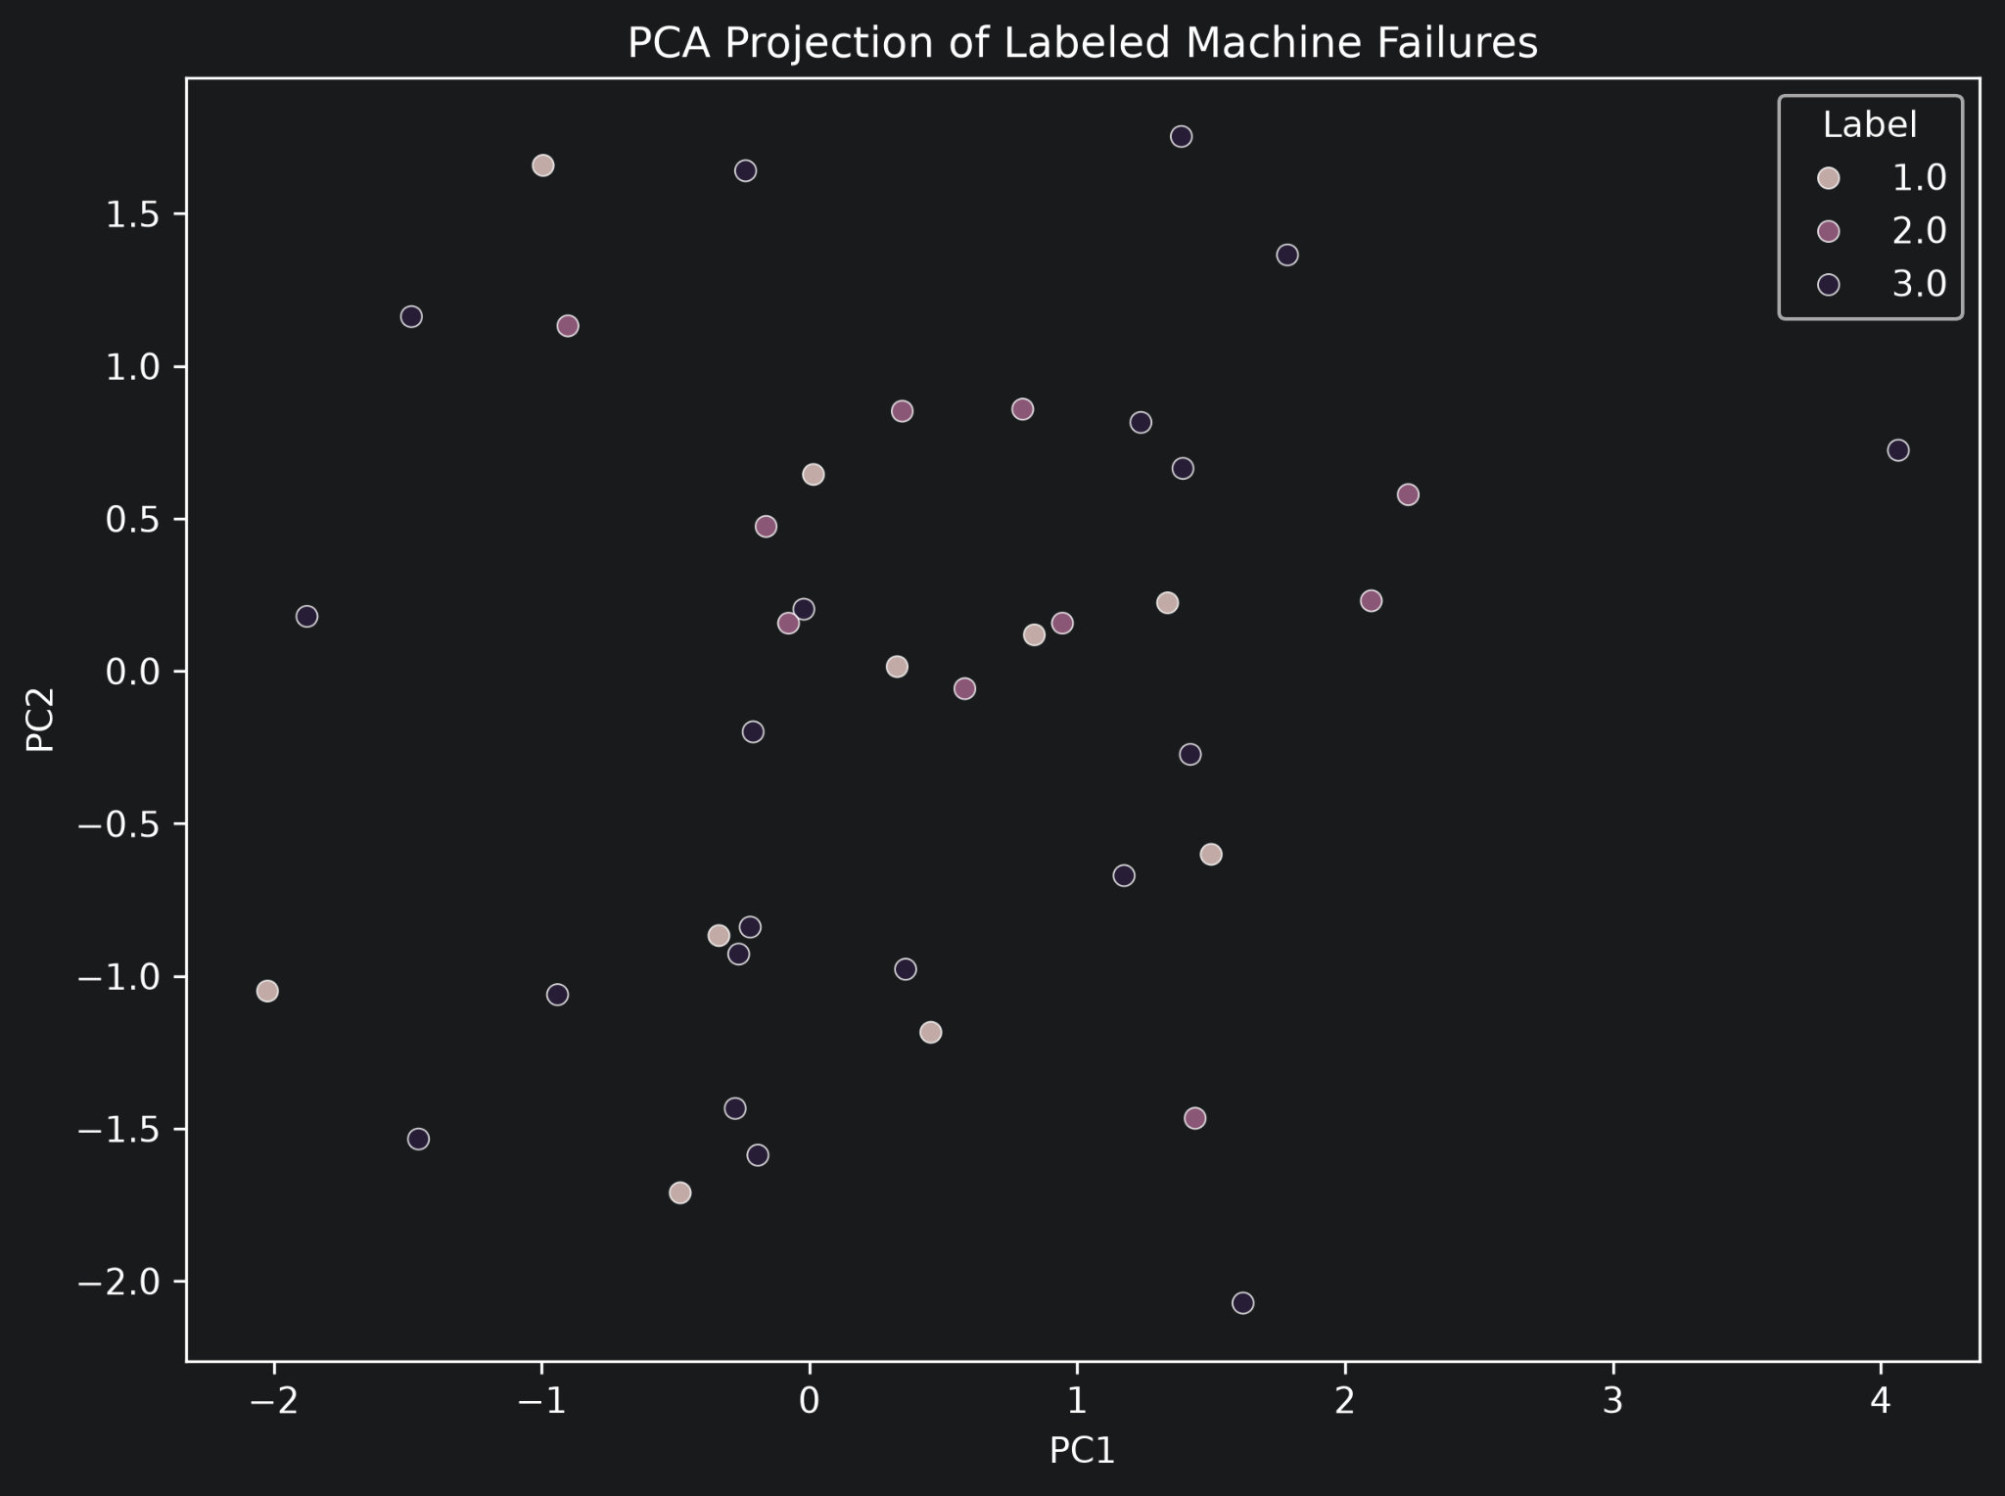
Raw Clustering Was Weak
ML6 CHALLENGE
03
PCA on the labeled failures shows no clean separation between the 3 labels.
Unsupervised baselines gave very low silhouette scores: KMeans 0.035, Agglomerative 0.012, GMM 0.028.
Conclusion: the raw 20-sensor space is not naturally separable with pure clustering.
Silhouette scores near 0 indicate the data does not split into distinct clusters in the original sensor space.
Notes:
PCA is exploratory, not proof by itself. Combined with weak clustering scores, it suggests pure clustering is not enough.

Slide 5
Label-Guided Baselines
ML6 CHALLENGE
04
I used the 40 labeled failures to evaluate label-guided models.
LEAVE-ONE-OUT ACCURACY · 40 LABELED FAILURES
kNN
0.23
None of the models reached satisfactory performance — all scored below 0.5.
Centroid-based
0.33
Label Spreading
0.425
Hypothesis: some sensors may add noise rather than useful information.
Weighted kNN
0.45
Notes:
Even stronger models are only moderate on all 20 sensors, so the feature space itself is probably noisy.

Slide 6
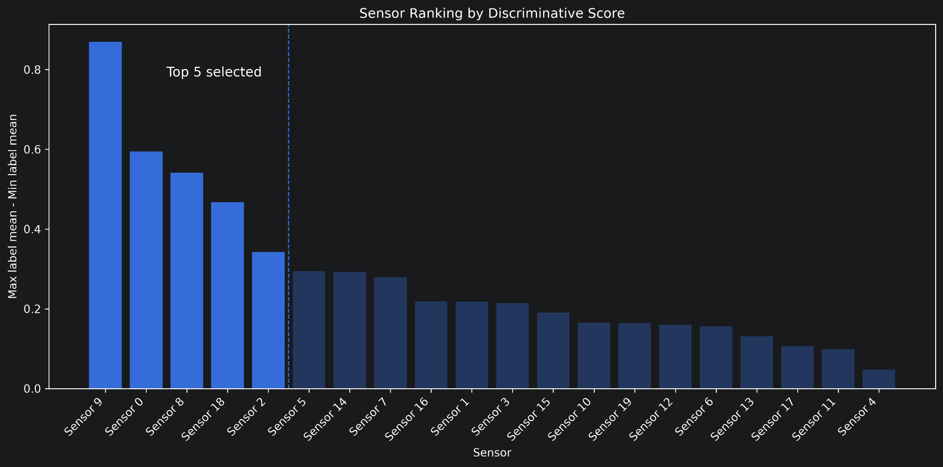
Feature Selection
ML6 CHALLENGE
05
I ranked sensors by how much their mean values differ across the known labels.
Top 5 sensors: Sensor 9, Sensor 0, Sensor 8, Sensor 18, Sensor 2.
Idea: reduce noise and keep the sensors with the strongest label signal.
Notes:
For each sensor I measured how far apart the class means are on the labeled data, then took the top 5.

Slide 7
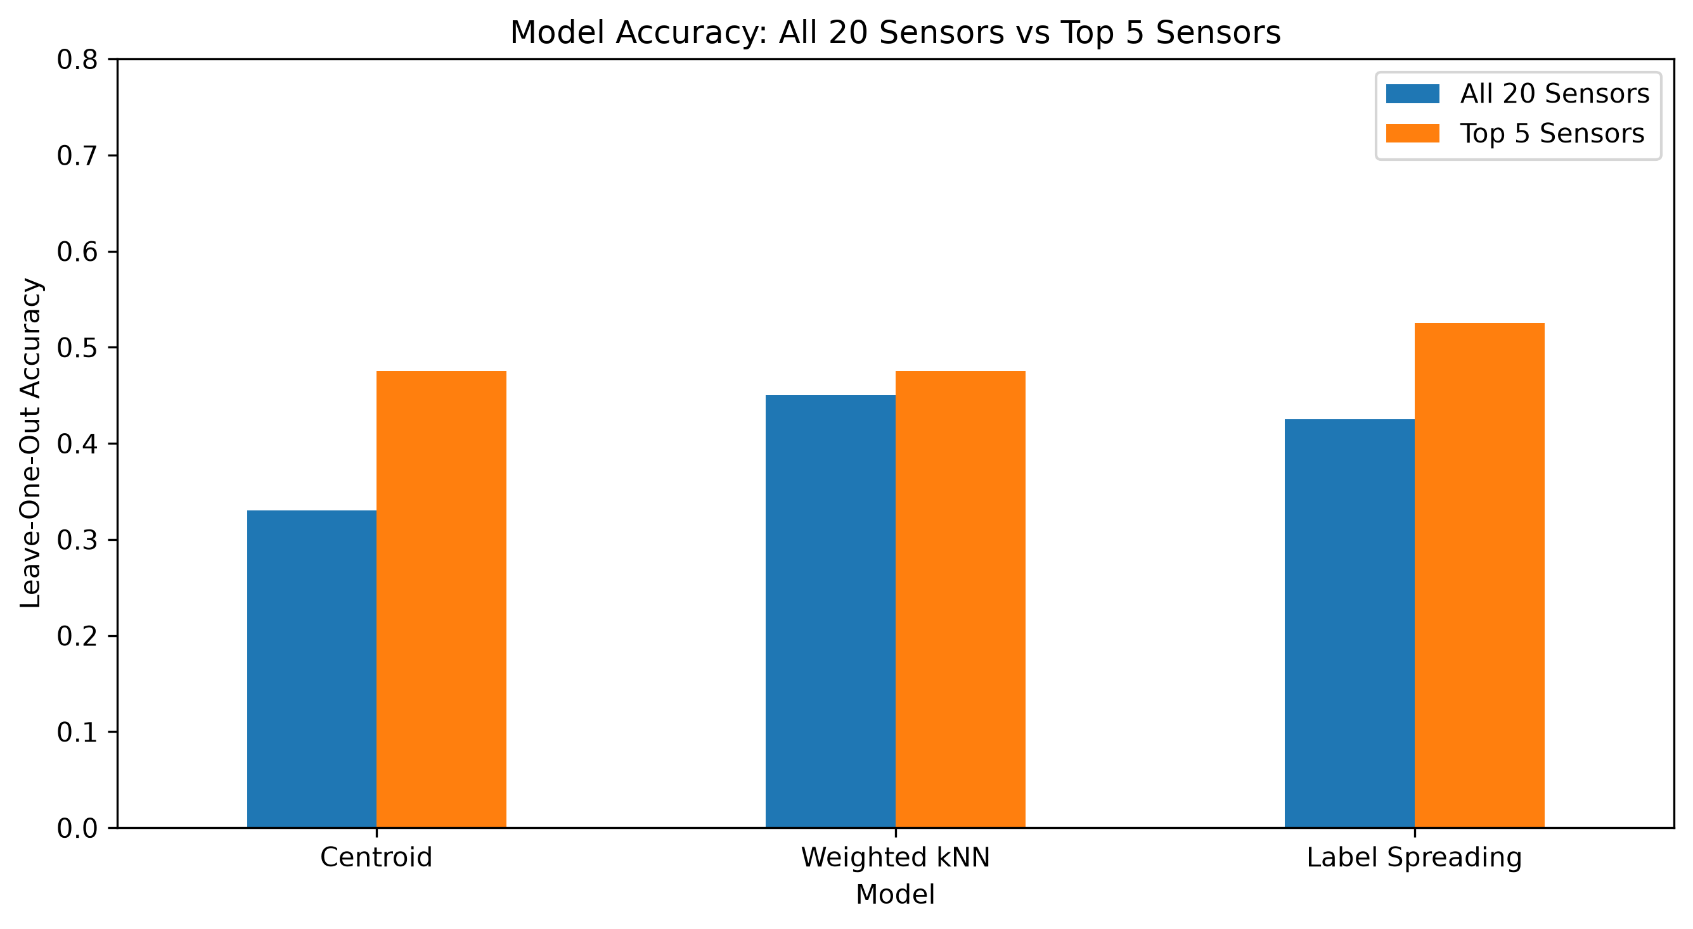
Model Comparison
ALL 20 vs TOP 5 SENSORS
06
Feature selection improved all three model families.
Centroid: 0.33 → 0.475
Weighted kNN: 0.45 → 0.475
Label Spreading: 0.425 → 0.525
Best semi-supervised model: Label Spreading (0.525) — supervised baselines tested next.
Notes:
Feature selection clearly helps across all model families. We have not yet tested a fully supervised classifier — does the semi-supervised approach add value?

Slide 8
Supervised Baselines
THE MISSING COMPARISON
07
Before finalizing model selection, I tested fully supervised classifiers on the top-5 sensors using the same leave-one-out protocol.
MODEL
ACCURACY
BALANCED ACC.
MACRO F1
Logistic Regression
0.600
0.550
0.564
Random Forest SELECTED
0.725
0.717
0.723
Both outperformed Label Spreading (0.525) on every metric.
Random Forest achieved the strongest observed LOO performance and was selected as the final model.
Notes:
Random Forest trained on 39 samples per LOO fold outperforms Label Spreading trained on all 1,600. The semi-supervised framing was not necessary; the top-5 sensors are discriminative enough.

Slide 9
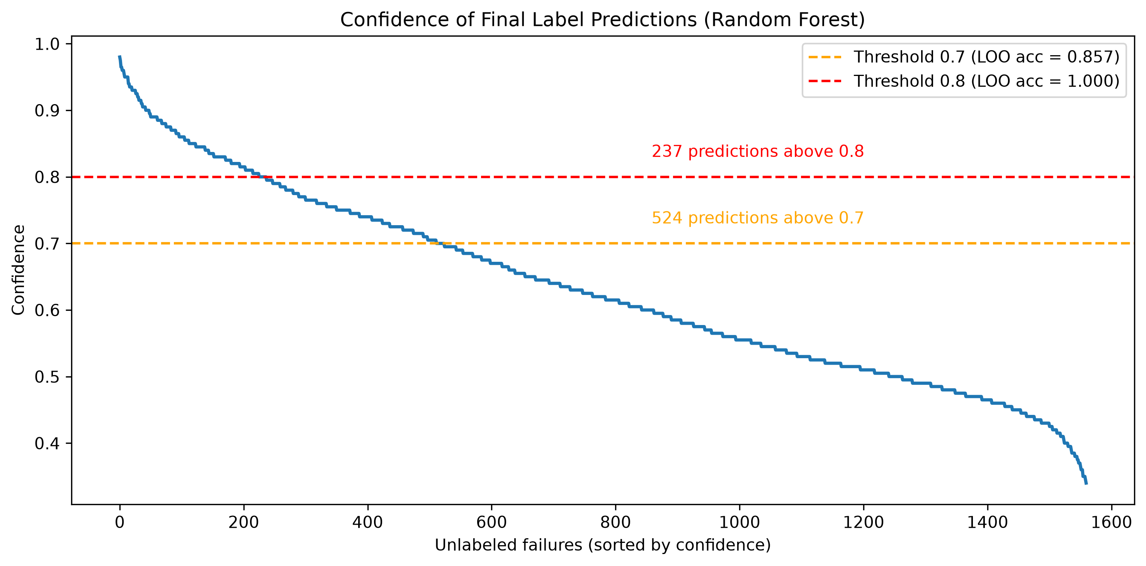
Final Output
1,560 UNLABELED FAILURES
08
Final model: Random Forest trained on 40 labeled failures (top 5 sensors).
Assigned labels to all 1,560 unlabeled failures.
524 high-confidence predictions (confidence ≥ 0.7).
LOO validation showed that higher confidence corresponded to higher accuracy (e.g., confidence ≥ 0.8 achieved 100% accuracy on test set).
Experts can choose the confidence threshold based on the desired trade-off between coverage and accuracy.
Notes:
Random Forest gives both labels and calibrated confidence. The 0.7 threshold surfaces 524 predictions at 85.7% LOO accuracy; 0.8 gives 237 at 100%. Indicative until validated on more labels.

Slide 10
Value for the Customer
ML6 CHALLENGE
09
Example customer: a manufacturer with many machine failure logs and limited expert review capacity.
The model can suggest a likely failure type for each new machine breakdown.
High-confidence cases can be handled faster, while uncertain cases go to experts.
Experts do not need to manually review every failure from scratch.
Over time, reviewed cases become new labels and improve the model.
Notes:
Frame the solution as a decision-support tool for failure analysis teams: faster review, more consistent labeling, gradual improvement.

Slide 11
Roadmap
ML6 CHALLENGE
10
PHASE 1
PHASE 2
PHASE 3
Validate the PoC
Pilot in a Real Workflow
Productionize & Improve
Review a sample of predicted labels with domain experts.
Score incoming failures regularly and present predictions to experts.
Retrain periodically with the expanded labeled set.
Confirm whether the 0.7–0.8 confidence threshold is appropriate.
Track expert agreement, review time, and confidence distribution.
Integrate with the customer's maintenance / failure analysis workflow.
Finalize the feature set and reporting format.
Collect corrected labels from expert feedback.
Notes:
Validate the PoC, run a pilot with experts in the loop, then productionize and monitor.

Slide 12
Caveats & Next Steps
ML6 CHALLENGE
11
CAVEATS
NEXT STEPS
The labeled set is very small: only 40 examples, with class counts 20 / 10 / 10 .
Validate predicted labels with experts.
Collect more labels to grow the training set.
The leave-one-out result should be treated as a useful but limited validation check.
Re-evaluate the model with a stronger validation setup.
A majority-class baseline would already reach 50% accuracy on the labeled subset.
Notes:
Don't over-claim 72.5%. Treat it as a promising signal, not a production-ready metric. A majority-class baseline already reaches 50%.

Slide 13
Summary
ML6 CHALLENGE
12
Pure clustering was weak — the raw sensor space does not separate the failure types.
Using the labeled failures helped, but performance improved most after feature selection.
Random Forest on the top 5 sensors was the best model.
The final model produced 524 high-confidence predictions (confidence ≥ 0.7) for expert review.
Best framed as a practical review workflow that improves as more labels are collected.
Notes:
Random Forest on the top-5 sensors delivered the best accuracy and best confidence calibration — a practical workflow for failure triage that improves as more labels are collected.

