Slide 1
Machine Failure Classification from Sensor Data
ML6 challenge — Hadar Eliyahu
PoC for labeling 1,560 unlabeled failures using 40 labeled examples
Notes:
Introduce the problem: many machine failure events, very few expert labels, and a need to make the unlabeled data useful.

Slide 2
1. Problem & Goal
Dataset: 1,600 machine failure events represented by 20 sensor measurements
Only 40 failures are labeled; 1,560 failures are unlabeled
Known label space in the labeled set: 3 machine failure types
Goal: assign labels to the unlabeled failures and surface a high-confidence subset for expert review
Success criterion for the PoC: a useful review workflow, not perfect classification
Notes:
Main point: this is a low-label problem. The goal is not perfect automation, but a useful workflow for failure review.

Slide 3
2. Approach Overview
Start with unsupervised clustering to test whether the failure types naturally separate in raw sensor space
Move to label-guided methods once clustering quality looks weak
Use leave-one-out evaluation on the 40 labeled failures as a limited but useful validation check
Compare models both on all 20 sensors and on a reduced set of the most informative sensors
Test fully supervised baselines (Logistic Regression, Random Forest) to verify whether the semi-supervised approach is necessary
Train the best-performing model (Random Forest) on the full dataset and assign labels to the 1,560 unlabeled failures
Notes:
Walk through the analysis flow from raw clustering to label-guided models, feature selection, model comparison, and final predictions.

Slide 4
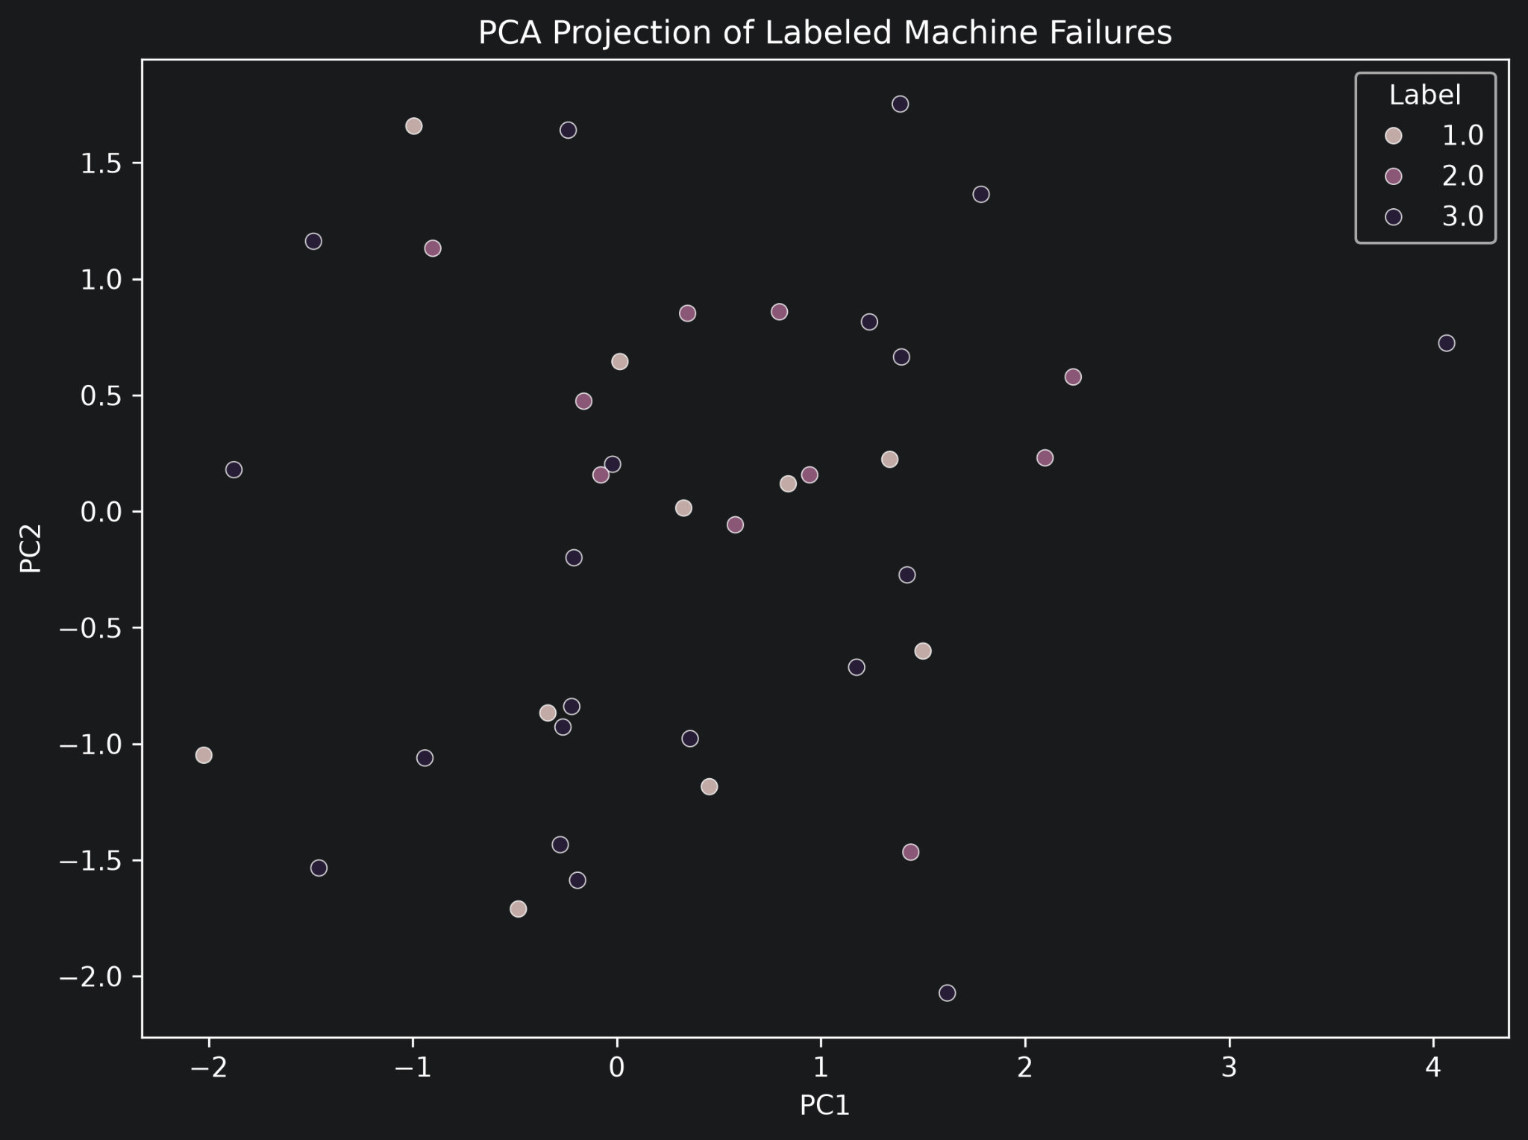
3. Raw Clustering Was Weak
PCA on the labeled failures does not show a clean separation between the 3 labels.
Unsupervised clustering baselines also produced very low silhouette scores
Conclusion: the raw 20-sensor space is not naturally separable with pure clustering
Method: | Silhouette score*:
KMeans | 0.035
Agglomerative | 0.012
GMM | 0.028
*Silhouette scores close to 0 indicate that the data does not naturally separate into distinct clusters in the original sensor space.
Notes:
Explain that PCA is exploratory, not proof by itself. Combined with weak clustering scores, it suggests that pure clustering is not enough.

Slide 5
4. Label-Guided Baselines on All 20 Sensors
I then used the 40 labeled failures to evaluate label-guided models
Leave-one-out accuracy on the labeled subset:
kNN on all 20 sensors: 0.23
Centroid-based classification on all 20 sensors: 0.33
Weighted kNN on all 20 sensors: 0.45
Label Spreading on all 20 sensors: 0.425
These results suggest that the full 20-sensor space is noisy
Notes:
Key message: even stronger models are only moderate on all 20 sensors, so the feature space itself is probably noisy.

Slide 6
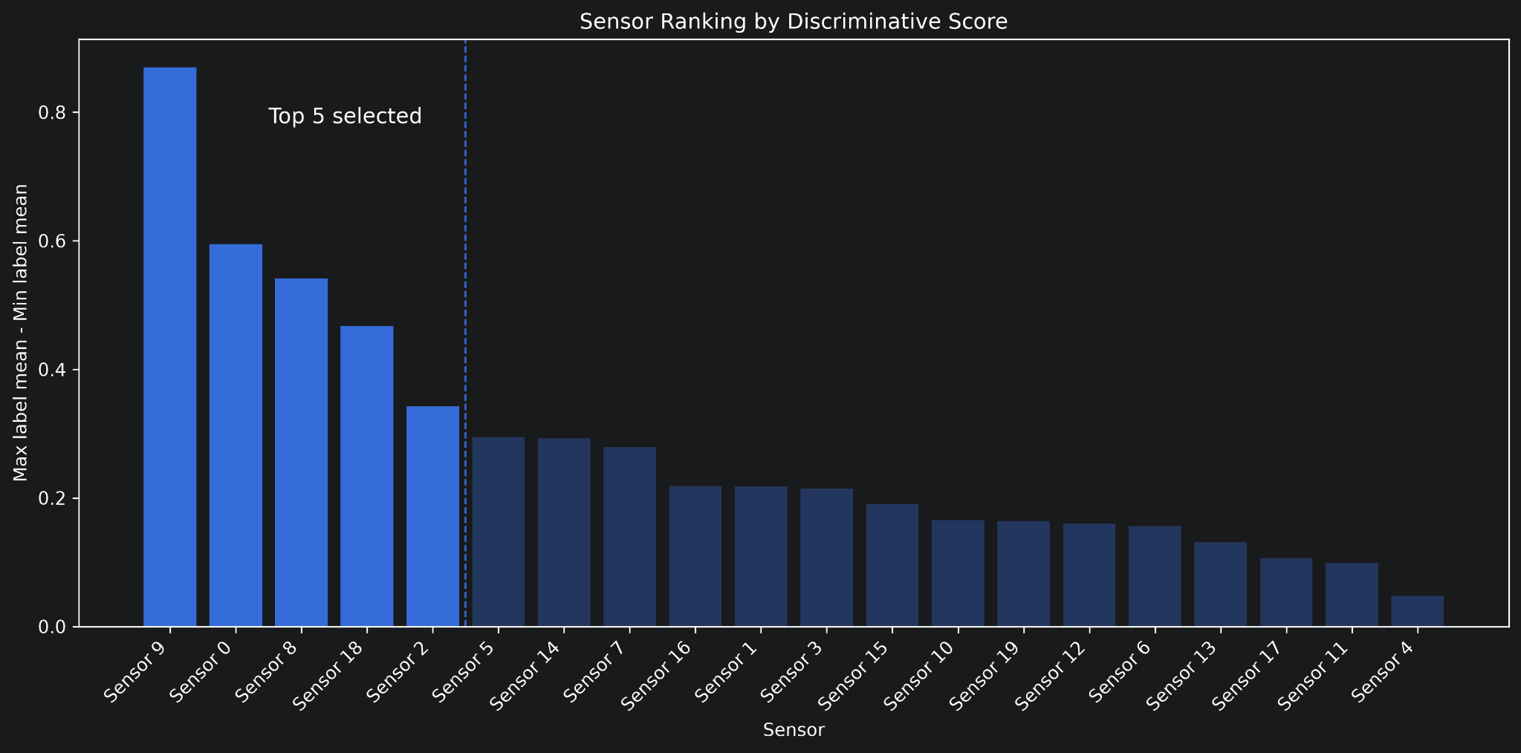
5. Feature Selection
I ranked sensors by how much their mean values differ across the known labels
Top 5 sensors: Sensor 9, Sensor 0, Sensor 8, Sensor 18, Sensor 2
Idea: reduce noise and keep the sensors that show the strongest label signal
Notes:
Explain the ranking simply: for each sensor, I measured how far apart the class means are on the labeled data. Then I took the top 5.

Slide 7
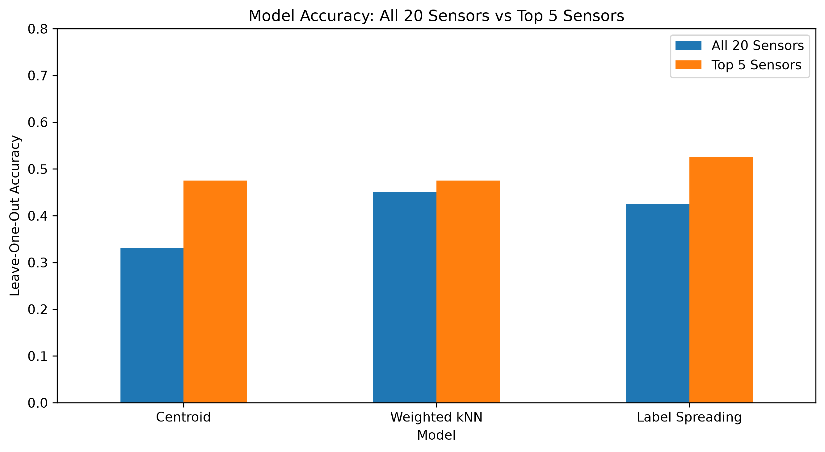
6. Model Comparison: All 20 Sensors vs Top 5 Sensors
Feature selection improved all three model families
Centroid: 0.33 → 0.475
Weighted kNN: 0.45 → 0.475
Label Spreading: 0.425 → 0.525
Best semi-supervised model: Label Spreading (0.525) — supervised baselines tested next
Notes:
Walk through the corrected LOO numbers (leakage-free). Feature selection clearly helps across all model families. Set up the key question for the next slide: we have not yet tested a fully supervised classifier — does the semi-supervised approach actually add value?

Slide 8
7. Supervised Baselines: The Missing Comparison
Before finalizing model selection, I tested fully supervised classifiers on the top-5 sensors using the same LOO protocol as Section 4
Logistic Regression: accuracy 0.600 | balanced acc. 0.550 | macro F1 0.564
Random Forest: accuracy 0.725 | balanced acc. 0.717 | macro F1 0.723
Both outperformed Label Spreading (0.525) on every metric
Random Forest confidence well-calibrated: 100% LOO accuracy at 0.8 threshold (25% of labeled set)
The 1,560 unlabeled samples did not improve over supervised training on 40 labeled failures alone
→ Random Forest is selected as the final model
Notes:
Key finding: Random Forest trained on 39 samples per LOO fold outperforms Label Spreading which trains on all 1,600 samples. The semi-supervised framing was not necessary — the top-5 sensors are discriminative enough for a supervised model. This result changes the model selection to Random Forest.

Slide 9
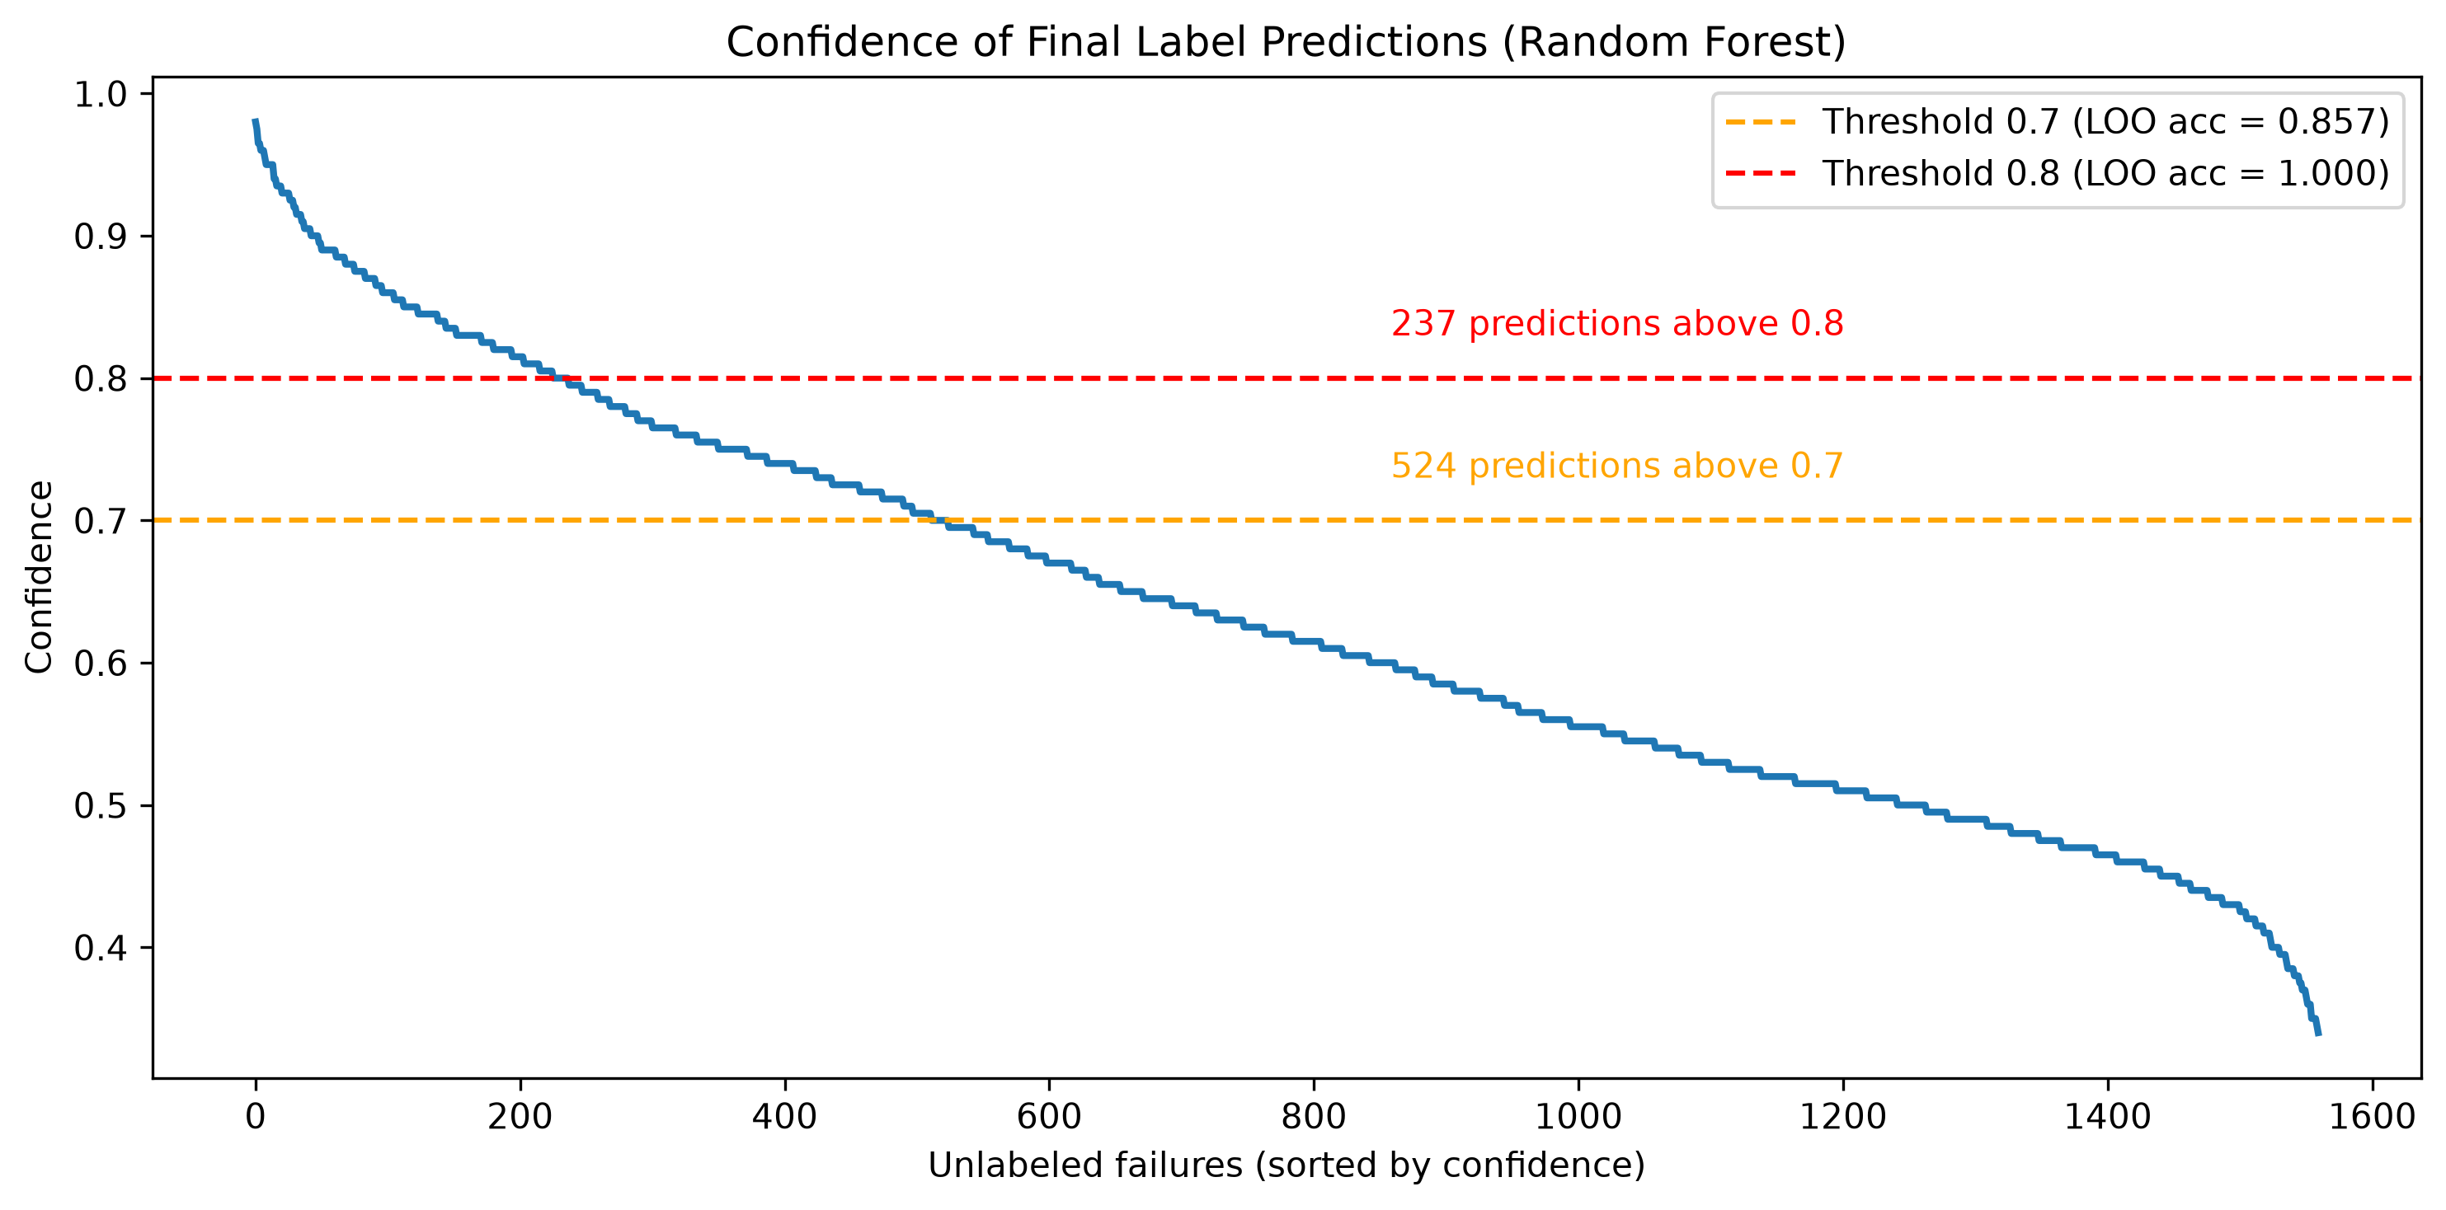
8. Final Output on the 1,560 Unlabeled Failures
Final model: Random Forest trained on all 40 labeled failures using the top 5 sensors
The model produced predictions for all 1,560 unlabeled failures
524 predictions had confidence ≥ 0.7 (LOO-validated: 85.7% accuracy on that subset)
Predicted label counts: 633 / 489 / 438
Notes:
Random Forest gives both labels and calibrated confidence. The 0.7 threshold surfaces 524 predictions with 85.7% LOO accuracy. Stricter 0.8 threshold gives 237 predictions with 100% LOO accuracy on 25% of the labeled set. Frame as indicative until validated on more labeled data.

Slide 10
9. How This Creates Value for an Industrial Customer
Example customer: a manufacturer with many machine failure logs and limited expert review capacity
The model can suggest a likely failure type for each new machine breakdown
High-confidence cases can be handled faster, while uncertain cases go to experts
Experts do not need to manually review every failure from scratch
Over time, reviewed cases become new labels and improve the model
Notes:
Frame the solution as a decision-support tool for failure analysis teams. The value is faster review, more consistent labeling, and gradual improvement over time.

Slide 11
10. High-Level Roadmap
Phase 1 — Validate the PoC
Review a sample of predicted labels with domain experts
Confirm whether the 0.7–0.8 confidence threshold is appropriate
Finalize the feature set and reporting format
Phase 2 — Pilot in a Real Workflow
Score incoming failures regularly and present predictions to experts
Track expert agreement, review time, and confidence distribution
Collect corrected labels from expert feedback
Phase 3 — Productionize and Improve
Retrain periodically with the expanded labeled set
Monitor data drift and confidence changes
Integrate with the customer’s maintenance / failure analysis workflow
Notes:
This is the roadmap I would present to a client: validate the PoC, run a pilot with experts in the loop, then productionize and monitor.

Slide 12
11. Caveats & Next Steps
The labeled set is very small: only 40 examples, with class counts 20 / 10 / 10
The leave-one-out result should be treated as a useful but limited validation check
A majority-class baseline would already reach 50% accuracy on the labeled subset
Next steps: validate predicted labels with experts, collect more labels, and re-evaluate the model with a stronger validation setup
Notes:
Be careful not to over-claim the 72.5% number. Random Forest achieved 0.725 LOO accuracy. Treat it as a promising signal, not a production-ready metric.

Slide 13
12. Summary
Pure clustering was weak on the raw 20-sensor space
Using the labeled failures helped, but performance improved most after feature selection
Random Forest on the top 5 sensors was the best model
The final model produced 524 high-confidence predictions for expert review (confidence ≥ 0.7)
The solution is best framed as a practical review workflow that can improve as more labels are collected
Notes:
Close with the main message: Random Forest on the top-5 sensors delivered the best accuracy and best confidence calibration. A practical workflow for failure triage that improves as more labels are collected.

