Slide 1
Chapter 1: Introduction

Slide 2
Introduction to the Course
Operating systems – essential part of any computer system
Course discusses:
What they are
What they do
How they are designed and structures
Common features
Processes, Threads, CPU-scheduling, Synchronization, Deadlocks, Memory Management, Virtual Memory, File system interface
Book:
Silberschatz, Galvin and Gagne, Operating System Concepts – 10th Edition

Slide 3
Main Themes
Topic | #
Introduction | 1
Operating System Structures | 2
Processes | 3
Threads | 4
CPU Scheduling | 5
Process Synchronization | 6
Deadlocks | 7
Memory Management | 8
Virtual Memory | 9
File-System Interface | 10
File-System Implementation | 11
Windows / Unix | 12

Slide 4
Movie
We’re goanna watch the movie “to the kernel and beyond”
Purpose: see how much background you have…
https://www.youtube.com/watch?v=Qqg95y56Bxk

Slide 5
Chapter 1: Objectives
To provide a grand tour of the major operating systems components
To provide coverage of basic computer system organization

Slide 6
What is an Operating System?
A program that acts as an intermediary between a user of a computer and the computer hardware
Operating system goals:
Execute user programs and make solving user problems easier
Make the computer system convenient to use
Use the computer hardware in an efficient manner

Slide 7
Example – MS-Paint over Windows
Assume we are using MS-Paint over Windows - when do we need to access the OS?
Loading the application / terminating the application
Interrupts Management
Memory allocation / management (e.g., paging)
Access to IO devices – keyboard, mouse, printer, monitor
CPU allocation
Copy / Paste (inter-process communication)

Slide 8
Operating System Design & Goals
Each OS has different goals and design:
Mainframe – maximize HW utilization/efficiency
PC – maximum support to user applications
Handheld – convenient interface for running applications, performance per amount of battery life
efficiency
convenience
performance,
resource utilization
ease of use

Slide 9
Mainframe, PC, Handheld
Supercomputer - computer at the frontline of current processing capacity, particularly speed of calculation
Mainframe – powerful computers used mainly by large organizations for critical applications (the term originally referred to the large cabinets that housed the central processing unit and main memory of early computers. Later the term was used to distinguish high-end commercial machines from less powerful units)
Personal Computer (PC) - any general-purpose computer whose size, capabilities, and original sales price make it useful for individuals (and which is intended to be operated directly by an end-user with no intervening computer operator)
Handheld - pocket-sized computing device, typically having a display screen with touch input and/or a miniature keyboard.
Of course, one generation's "supercomputer" is the next generation's "mainframe"

Slide 10
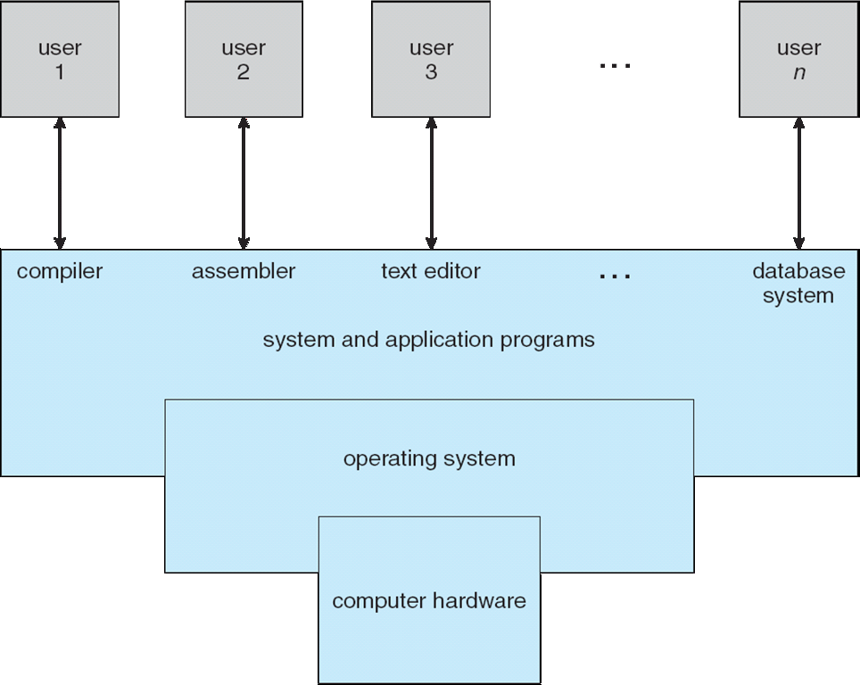
Computer System Structure
Computer system can be divided into four components
Hardware – provides basic computing resources
CPU, memory, I/O devices, file storage space
Operating system
Controls and coordinates use of hardware among various applications and users
Application programs – define the ways in which the system resources are used to solve the computing problems of the users
Word processors, compilers, web browsers, database systems, video games
Users
People, machines (e.g., embedded), other computers

Slide 11
Four Components of a Computer System

Slide 12
Operating System Definition
OS is a resource allocator
Manages all resources (OS as a government allegory)
Decides between conflicting requests for efficient and fair resource use
OS is a control program
Controls execution of programs to prevent errors and improper use of the computer
Resource allocation and control is especially important when having several users connected to the same mainframe or microcomputer

Slide 13
Operating System Definition (Cont)
No universally accepted definition
“Everything a vendor ships when you order an operating system” is good approximation
But varies wildly
“The one program running at all times on the computer” is the kernel. Everything else is either a system program (ships with the operating system) or an application program
The matter of what constitutes an operating system is important! In 1998 this was the essence of a suit filed by the United State Department of Justice against Microsoft
(even though today most mobile OS include much functionality)

Slide 14
Computer Startup
bootstrap program is loaded at power-up or reboot
Typically stored in ROM or EPROM, generally known as firmware
Initializes all aspects of system (CPU registers, device controllers, memory contents, etc.)
Loads operating system kernel and starts execution
OS initializes, starts its first process and waits for an event…
Notes:
EPROM = erasable programmable ROM

Slide 15
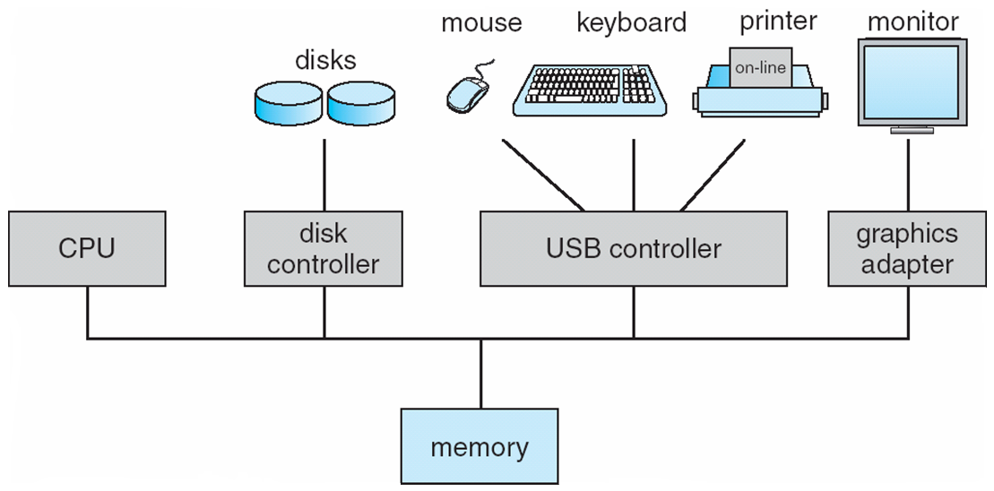
Computer System Organization
Computer-system operation
One or more CPUs, device controllers connect through common bus providing access to shared memory (bus movie)
Concurrent execution of CPUs and devices competing for memory cycles (through memory controller)

Slide 16
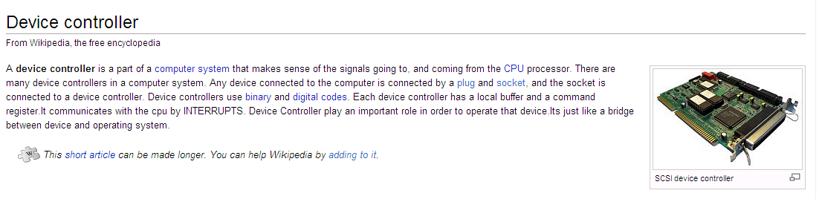
Device Controller
Each device controller is in charge of a particular device type (thus competing on memory cycles)
Each device controller has a local buffer
CPU moves data from/to main memory to/from local buffers
I/O is from the device to local buffer of controller
Device controller informs CPU that it has finished its operation by causing an interrupt

Slide 17
Common Functions of Interrupts
Interrupt transfers control to the interrupt service routine generally, through the interrupt vector, which contains the addresses of all the service routines
Interrupt architecture must save the address of the interrupted instruction
A trap or exception is a software-generated interrupt caused either by an error or a user request
An operating system is interrupt driven

Slide 18
Interrupt Handling
The operating system preserves the state of the CPU by storing registers and the program counter
Determines which type of interrupt has occurred:
polling
vectored interrupt system
Separate segments of code determine what action should be taken for each type of interrupt
Ideally, we would have used a generic code for analyzing the interrupt information and deciding what code to run, however speed is critical here…

Slide 19
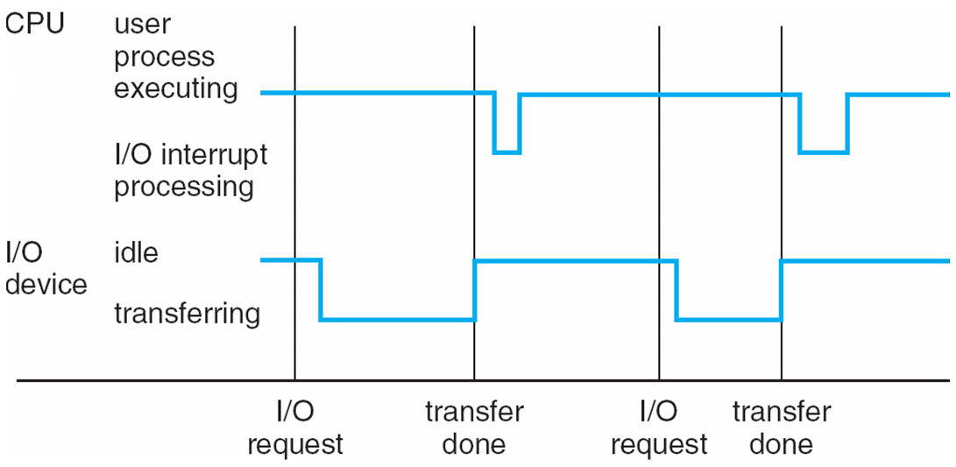
Interrupt Timeline

Slide 20
I/O Structure
After I/O starts, control returns to user program only upon I/O completion
Wait instruction idles the CPU until the next interrupt
Wait loop (contention for memory access)
At most one I/O request is outstanding at a time, no simultaneous I/O processing
After I/O starts, control returns to user program without waiting for I/O completion
System call – request to the operating system to allow user to wait for I/O completion
Device-status table contains entry for each I/O device indicating its type, address, and state
Operating system indexes into I/O device table to determine device status and to modify table entry to include interrupt
Synchronous
Asynchronous

Slide 21
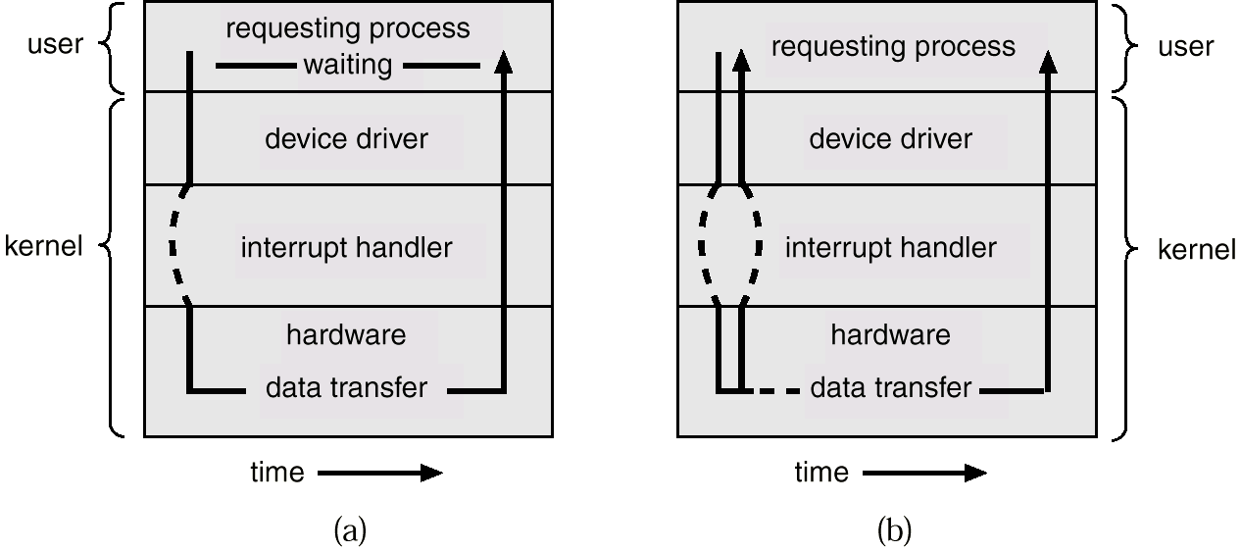
Two I/O Methods
Synchronous
Asynchronous

Slide 22
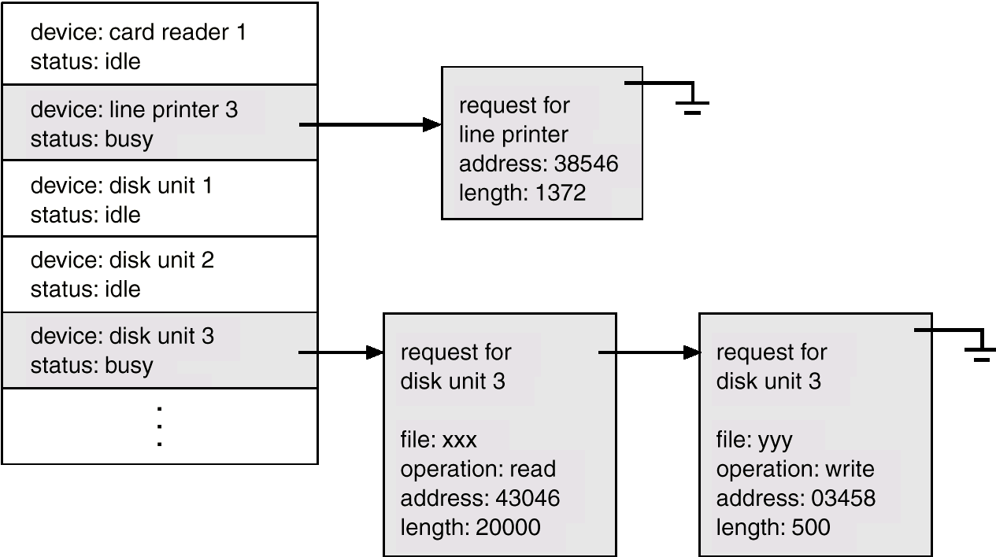
Device-Status Table

Slide 23
Storage Definitions and Notation Review
The basic unit of computer storage is the bit. A bit can contain one of two values, 0 and 1. All other storage in a computer is based on collections of bits. Given enough bits, it is amazing how many things a computer can represent: numbers, letters, images, movies, sounds, documents, and programs, to name a few. A byte is 8 bits, and on most computers it is the smallest convenient chunk of storage. For example, most computers don’t have an instruction to move a bit but do have one to move a byte. A less common term is word, which is a given computer architecture’s native unit of data. A word is made up of one or more bytes. For example, a computer that has 64-bit registers and 64-bit memory addressing typically has 64-bit (8-byte) words. A computer executes many operations in its native word size rather than a byte at a time.
Computer storage, along with most computer throughput, is generally measured and manipulated in bytes and collections of bytes.
A kilobyte, or KB, is 1,024 bytes
a megabyte, or MB, is 1,024² bytes
a gigabyte, or GB, is 1,024³ bytes
a terabyte, or TB, is 1,024⁴ bytes
a petabyte, or PB, is 1,024⁵ bytes
Computer manufacturers often round off these numbers and say that a megabyte is 1 million bytes and a gigabyte is 1 billion bytes. Networking measurements are an exception to this general rule; they are given in bits (because networks move data a bit at a time).

Slide 24
Storage Structure
Main memory – only large storage media that the CPU can access directly
Random access
Typically volatile
Secondary storage – extension of main memory that provides large nonvolatile storage capacity
Hard disks – rigid metal or glass platters covered with magnetic recording material
Disk surface is logically divided into tracks, which are subdivided into sectors
The disk controller determines the logical interaction between the device and the computer
Solid-state disks – faster than hard disks, nonvolatile
Various technologies
Becoming more popular

Slide 25
Storage Hierarchy
Storage systems organized in hierarchy
Speed
Cost
Volatility
Caching – copying information into faster storage system; main memory can be viewed as a cache for secondary storage
Device Driver for each device controller to manage I/O
Provides uniform interface between controller and kernel

Slide 26
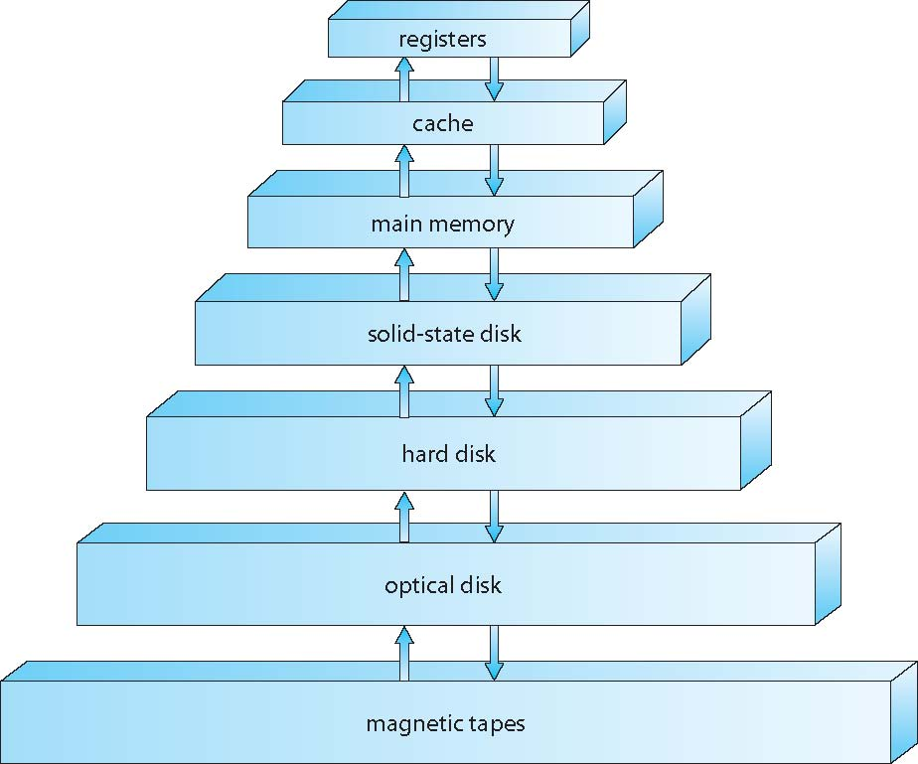
Storage-Device Hierarchy

Slide 27
Caching
Caching – copying information into faster storage system; main memory can be viewed as a last cache for secondary storage
Important principle, performed at many levels in a computer (in hardware, operating system, software)
Information in use copied from slower to faster storage temporarily
Faster storage (cache) checked first to determine if information is there
If it is, information used directly from the cache (fast)
If not, data copied to cache and used there
Cache smaller than storage being cached
Cache management important design problem
Cache size and replacement policy

Slide 28
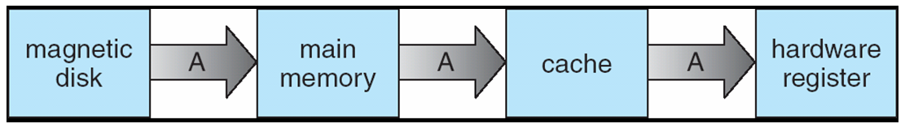
Migration of Integer A from Disk to Register
Multitasking environments must be careful to use most recent value, no matter where it is stored in the storage hierarchy Multiprocessor environment must provide cache coherency in hardware such that all CPUs have the most recent value in their cache
Distributed environment situation even more complex
Several copies of a datum can exist

Slide 29
Direct Memory Access Structure
Used for high-speed I/O devices able to transmit information at close to memory speeds
Device controller transfers blocks of data from buffer storage directly to main memory without CPU intervention
Only one interrupt is generated per block, rather than the one interrupt per byte

Slide 30
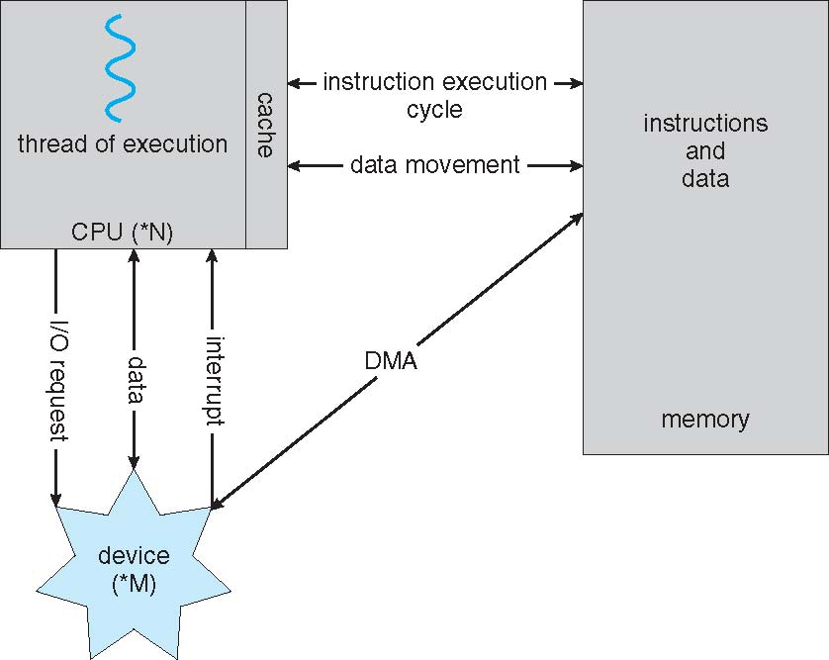
How a Modern Computer Works
A von Neumann architecture

Slide 31
Computer-System Architecture
Most systems use a single general-purpose processor
Most systems have special-purpose processors as well
Multiprocessors systems growing in use and importance
Also known as parallel systems, tightly-coupled systems
Advantages include:
Increased throughput
Economy of scale
Increased reliability – graceful degradation or fault tolerance
Two types:
Asymmetric Multiprocessing – each processor is assigned a specie task.
Symmetric Multiprocessing – each processor performs all tasks

Slide 32
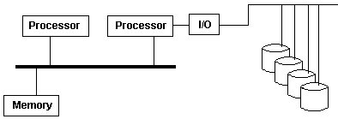
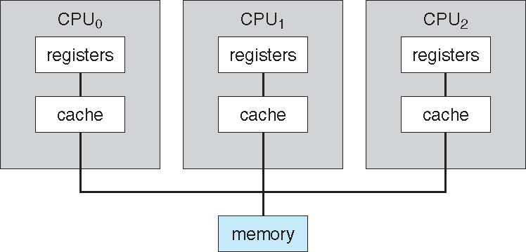
Multiprocessors systems
Two types of Multiprocessing:
Asymmetric Multiprocessing - assigns certain tasks only to certain processors. In particular, only one processor may be responsible for handling all of the interrupts in the system or perhaps even performing all of the I/O in the system
Symmetric Multiprocessing - treats all of the processing elements in the system identically
Key role – the scheduler

Slide 33
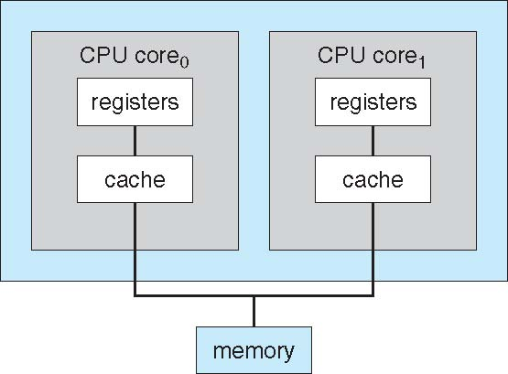
A Dual-Core Design
Multi-chip and multicore
Systems containing all chips
Chassis containing multiple separate systems

Slide 34
Operating System Structure
Multiprogramming (Batch system) needed for efficiency
Single user cannot keep CPU and I/O devices busy at all times
Multiprogramming organizes jobs (code and data) so CPU always has one to execute
A subset of total jobs in system is kept in memory
One job selected and run via job scheduling
When it has to wait (for I/O for example), OS switches to another job
Timesharing (multitasking) is logical extension in which CPU switches jobs so frequently that users can interact with each job while it is running, creating interactive computing
Response time should be < 1 second
Each user has at least one program executing in memory process
If several jobs ready to run at the same time  CPU scheduling
If processes don’t fit in memory, swapping moves them in and out to run
Virtual memory allows execution of processes not completely in memory

Slide 35
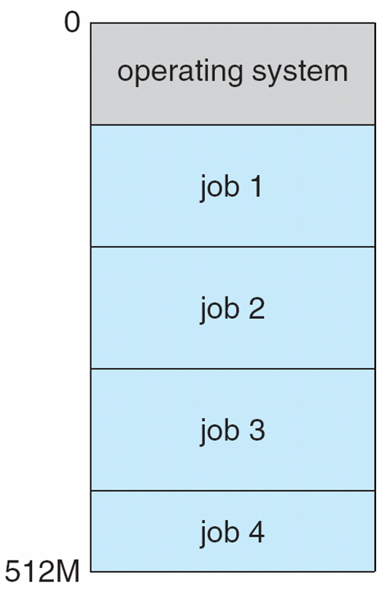
Memory Layout for Multiprogrammed System

Slide 36
Operating-System Operations
Interrupt driven (hardware and software)
Hardware interrupt by one of the devices
Software interrupt (exception or trap):
Software error (e.g., division by zero)
Request for operating system service
Other process problems include infinite loop, processes modifying each other or the operating system

Slide 37
Operating-System Operations (cont.)
Dual-mode operation allows OS to protect itself and other system components
User mode and kernel mode
Mode bit provided by hardware
Provides ability to distinguish when system is running user code or kernel code
Some instructions designated as privileged, only executable in kernel mode
System call changes mode to kernel, return from call resets it to user
Increasingly CPUs support multi-mode operations
i.e. virtual machine manager (VMM) mode for guest VMs

Slide 38
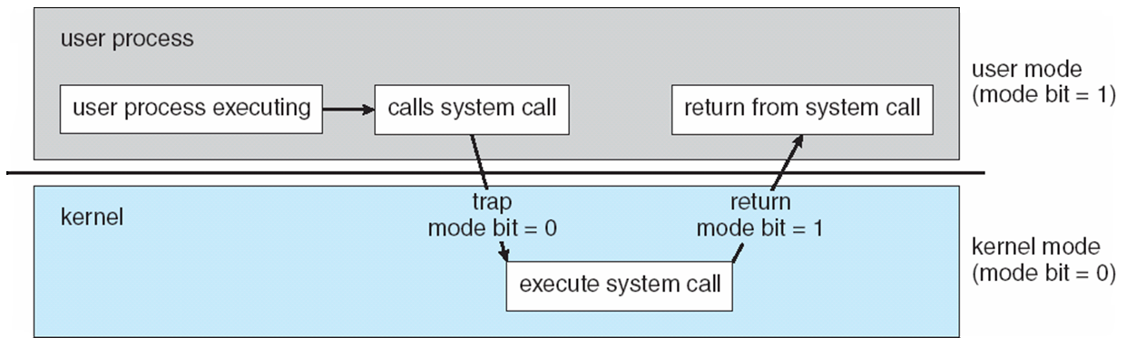
Transition from User to Kernel Mode
Timer to prevent infinite loop / process hogging resources
Timer is set to interrupt the computer after some time period
Keep a counter that is decremented by the physical clock.
Operating system set the counter (privileged instruction)
When counter zero generate an interrupt
Set up before scheduling process to regain control or terminate program that exceeds allotted time

Slide 39
Example
Which of the following instructions should be privileged?
Read the clock.
Clear memory.
Issue a trap instruction.
Turn off interrupts.
Modify entries in device-status table.
Switch from user to kernel mode.
Access I/O device.

Slide 40
Example
Which of the following instructions should be privileged?
Read the clock.
Clear memory.
Issue a trap instruction.
Turn off interrupts.
Modify entries in device-status table.
Switch from user to kernel mode.
Access I/O device.

Slide 41
End of Chapter 1

