Slide 1
Celebrity Recognition System
Małgorzata Hadasz, Michał Gozdera, Aleksandra Nawrocka

Slide 2
Requirements
Functional
Non - functional
The user can upload the image to the system
The user can sign up for the newsletter
The user can delete all information about a given celebrity
The system can provide the report about the celebrities found in the last 10 min
The system can send those reports to users, who subscribed to the newsletter
Scalability
High Availability
Backup
Disaster Recovery
Cost effectiveness

Slide 3
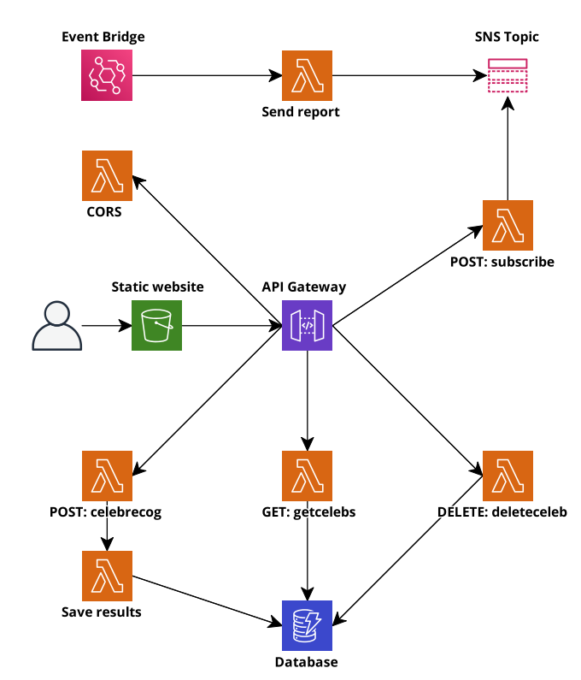
Architecture

Slide 4
Technologies used in the core project
Used
Possible alternatives
Lambda functions
API Gateway Service
DynamoDB
Event Bridge + scheduled Lambda + SNS Topic with subscriptions
Front end app hosted in S3
EC2 instance(s) with the app deployed
Custom API Gateway hosted on EC2 (possibly with a load balancer)
RDS
Recurring job implemented from scratch and hosted on EC2
AWS Amplify

Slide 5
Technologies used in CI/CD
Used
Possible alternatives
CodePipeline
Github -> CloudFormation
Github -> S3 -> Lambda function
CodeCommit as a trigger
CodeBuild

Slide 6
Backup
CloudFormation templates and code (frontend, Lambda functions) can be kept in S3 buckets in multiple Regions
For DynamoDB database on-demand backups can be configured with usage of AWS Backup Service
Scheduled backups
Copies of backups across Regions (by opting into multiple Regions)
Transition of backups to cold storage for lower costs
No degradation in performance during backup process

Slide 7
Disaster Recovery
As for API Gateway and Lambda functions we are charged only for what is used there are no drawbacks in having instances of these services in multiple Regions
So to have real-time RTO we would opt for active/active approach:
Two copies of the environment (frontend in S3 bucket, API Gateway, Lambda functions) in different Regions
Routing between Regions with Amazon Route 53
Global tables set up for DynamoDB to acquire a fully managed, multi-Region, and multi-active database
RPO value controlled by setting on-demand backups schedule for DynamoDB (probably 1 hour)

Slide 8
Technical tips & tricks
API Gateway integrations can be set up with the use of the CloudFormation template, but the permission for invoking a Lambda function has to be granted to the API Gateway (confusing cause in the console it is done automatically)
CORS configuration: we needed to add OPTIONS endpoints to the API Gateway to handle the CORS request (with the PROXY integration probably the backend side is responsible for coping with CORS, not the API Gateway)
To avoid creating multiple stacks, one can set up a pipeline that deploys to CloudFormation

Slide 9
Interesting patterns, useful tools, solutions to complicated domain logic problems
Amazon Rekognition – useful service for data recognition tasks, highly precise and fast:
Celebrity recognition
Facial attribute detection
Text detection in images
…
Pattern: creating lambda functions to follow the Single Responsibility Principle
SNS notification service + EventBridge
NoSQL database (DynamoDB) for fast and simple, easily modifiable storage
CodePipeline: triggered by git commit, ensuress continuous integration

