Slide 1

GRADUATION PROJECT | ACADEMIC YEAR 2025 / 2026
Superstore Analytics:
Insights into Customer Behavior
A combined Business Intelligence, Forecasting, and Machine-Learning study
Prepared by Hamzeh Alhindawi · Hadeel Almasri
Supervised by Dr. Ayman Mansour
University of Petra · Faculty of Information Technology · Department of BI & Data Analysis

Slide 2
Agenda
01
Introduction & Problem
02
Methodology & Tools
Background, problem statement, project objectives.
CRISP-DM workflow with Python, Power BI, RapidMiner.
03
Dataset & Cleaning
04
Exploratory Data Analysis
Source, schema, data-quality fixes, final dataset.
Eight charts revealing the structure of sales & profit.
05
Forecasting & Segmentation
06
ML Classification
Prophet 12-month forecast and RFM customer tiers.
Random Forest profitability classifier + confusion matrix.
07
BI Dashboards
08
Results & Recommendations
Power BI interactive views and RapidMiner workflow.
Headline numbers, business actions, next steps.
Superstore Analytics — Graduation Defense

Slide 3
Introduction & Background
Why retail analytics?
8,708
4
Retailers generate enormous transactional data, but few translate it into action.
Business Intelligence (BI) and Machine Learning (ML) close the "data-to-decision" gap.
Superstore is a publicly available, realistic retail dataset spanning four years and four U.S. regions.
This project combines descriptive, predictive, and prescriptive analytics on a single dataset.
cleaned transactions
years of history
$2.99M
793
total sales
unique customers
"In a tightening retail market, decisions must be guided by evidence, not intuition."
Superstore Analytics — Graduation Defense

Slide 4
Problem Statement
Retailers have data — but lack a coherent analytical framework.
Q1
Q2
Q3
Where do revenue and profit come from — and where are they leaking?
Are aggressive discounts eroding margin instead of growing volume?
Is the business growing year over year, and what is the next-year forecast?
Q4
Q5
Q6
Which customers are most valuable, at risk, or already lost?
Is shipping consistent across regions and modes?
Can the profitability of an order be predicted before it is confirmed?
Without an analytical framework, retailers continue unprofitable promotions and misallocate budget.
Superstore Analytics — Graduation Defense

Slide 5
Project Objectives
01
Clean and prepare
02
Explore and visualize
03
Forecast demand
Deliver a validated dataset by removing duplicates, normalizing dates, harmonizing labels, imputing missing values, and dropping outliers.
Produce eight thematic charts describing sales and profit by category, region, sub-category, segment, and time.
Train a Prophet model on monthly sales and forecast twelve months ahead with calibrated uncertainty intervals.
04
Segment customers
05
Classify profitability
06
Build dashboards
Apply the RFM framework to score 793 customers and group them into actionable behavioural tiers.
Build and benchmark Logistic Regression vs Random Forest, evaluate with confusion matrix and standard metrics.
Create an interactive Power BI dashboard and a no-code RapidMiner workflow that mirror the Python results.
All 8 objectives stated in Chapter 1 of the report were met fully and cross-validated.
Superstore Analytics — Graduation Defense

Slide 6
Methodology — CRISP-DM Workflow
Iterative six-phase analytical lifecycle
Business
Understanding
Data
Understanding
Data
Preparation
Modeling
Evaluation
Deployment
Step 1
Step 2
Step 3
Step 4
Step 5
Step 6
Identify the questions retailers care about.
Inspect rows, columns, types, and quality.
Clean and validate the analytical dataset.
EDA, Prophet, RFM, classification.
Cross-tool validation; metric checks.
Dashboards & graduation report.
Quality controls applied throughout
Before/after counters audit every cleaning step.
Totals reconciled across Python and Power BI.
Charts pruned to a single message each.
Classifier evaluated on a held-out test set with stratified sampling.
Superstore Analytics — Graduation Defense

Slide 7
Tools & Technologies
Three complementary platforms cover the full code-to-no-code spectrum
Python
Power BI
RapidMiner
01
02
03
Data preparation, EDA,
Prophet forecasting, scikit-learn
classification.
Interactive dashboards, DAX
measures, slicers, drill-through
for decision-makers.
Visual no-code workflow
for categorical aggregations
and benchmark charts.
pandas · numpy · matplotlib · seaborn · prophet · scikit-learn
Power Query · DAX · CALENDARAUTO
Read CSV · Generate Attributes · Filter · Aggregate
Integrated pipeline → cross-validated insights → defensible recommendations
Superstore Analytics — Graduation Defense

Slide 8
Dataset Overview
Superstore retail dataset — open dataset from Kaggle, four years of U.S. transactions
8,708
30
4
17
cleaned
transactions
columns including
9 engineered
years
(2014 – 2017)
product
sub-categories
Column groups & roles
Group | Columns | Examples
Identifiers | 3 | Row ID, Order ID, Customer ID
Time | 6 | Order Date, Ship Date, Order Year, Quarter, Month
Customer | 2 | Customer Name, Segment
Geography | 5 | Country, State, City, Postal Code, Region
Product | 4 | Product ID, Product Name, Category, Sub-Category
Financial | 5 | Sales, Quantity, Discount, Profit, Profit Margin
Engineered | 5 | Ship Days, Is Profitable, Has Discount, …
Class balance for ML target (Is Profitable): ~81.5% profitable / ~18.5% loss-making
Superstore Analytics — Graduation Defense

Slide 9
Data Cleaning Pipeline
Raw 9,994 rows → validated 8,708 rows
1
Remove duplicates
# Outlier filter (Step 6)
df = df[df['Sales'] > 0]
df = df[df['Sales'] < 50000]
df = df[df['Profit'] > -5000]
df = df[df['Profit'] < 50000]
df = df[df['Quantity'] > 0]
df = df[(df['Discount'] >= 0) & (df['Discount'] <= 1)]
df.to_csv('Clean_Superstore.csv', index=False)
2
Parse mixed date formats (5 formats)
3
Strip "$" from Sales and convert to numeric
4
Standardize categorical labels (4 columns)
5
Impute missing values (median / mode)
6
Drop outliers and impossible values
Final dataset: 8,708 rows × 30 columns · zero missing values · passes all sanity checks
Superstore Analytics — Graduation Defense

Slide 10
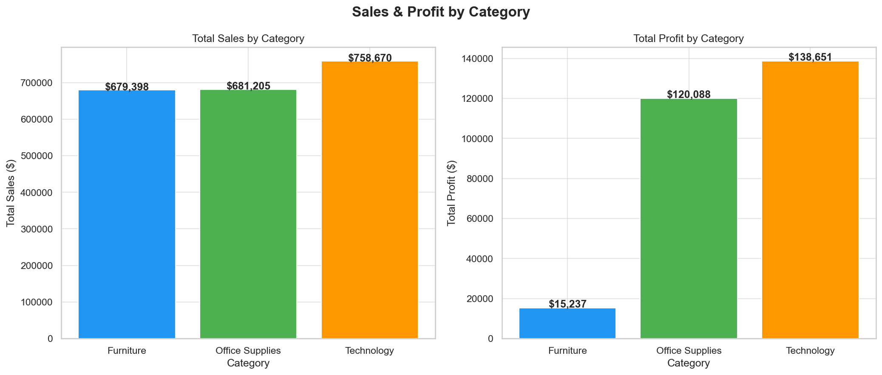
EDA — Sales & Profit by Category
Key insight
Office Supplies dominates revenue, but Technology delivers the same profit on 47% less revenue.
Office Supplies: $1.44M sales · $113K profit
Technology: $0.76M sales · $115K profit
Furniture: $0.79M sales · only $13K profit
Revenue ≠ profitability. A second axis is required.
Action: review pricing & product mix in Furniture before any further marketing investment.
Superstore Analytics — Graduation Defense

Slide 11
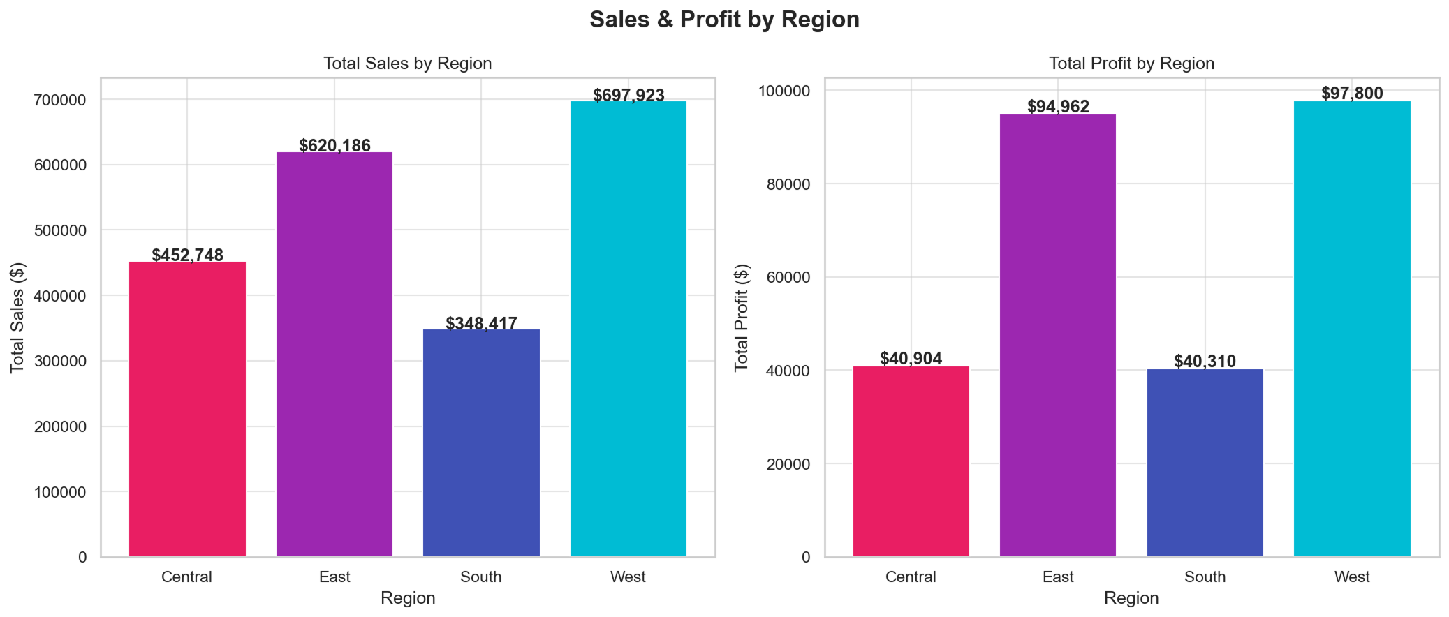
EDA — Sales & Profit by Region
Geography matters
West & East deliver two-thirds of revenue and the bulk of profit.
East: $951K sales · $82K profit
West: $869K sales · $88K profit (highest margin)
Central: $626K sales but only $32K profit
South: smallest but healthy margin
Central is the operational efficiency hot-spot.
Action: invest growth budget in West; launch operational review in Central.
Superstore Analytics — Graduation Defense

Slide 12
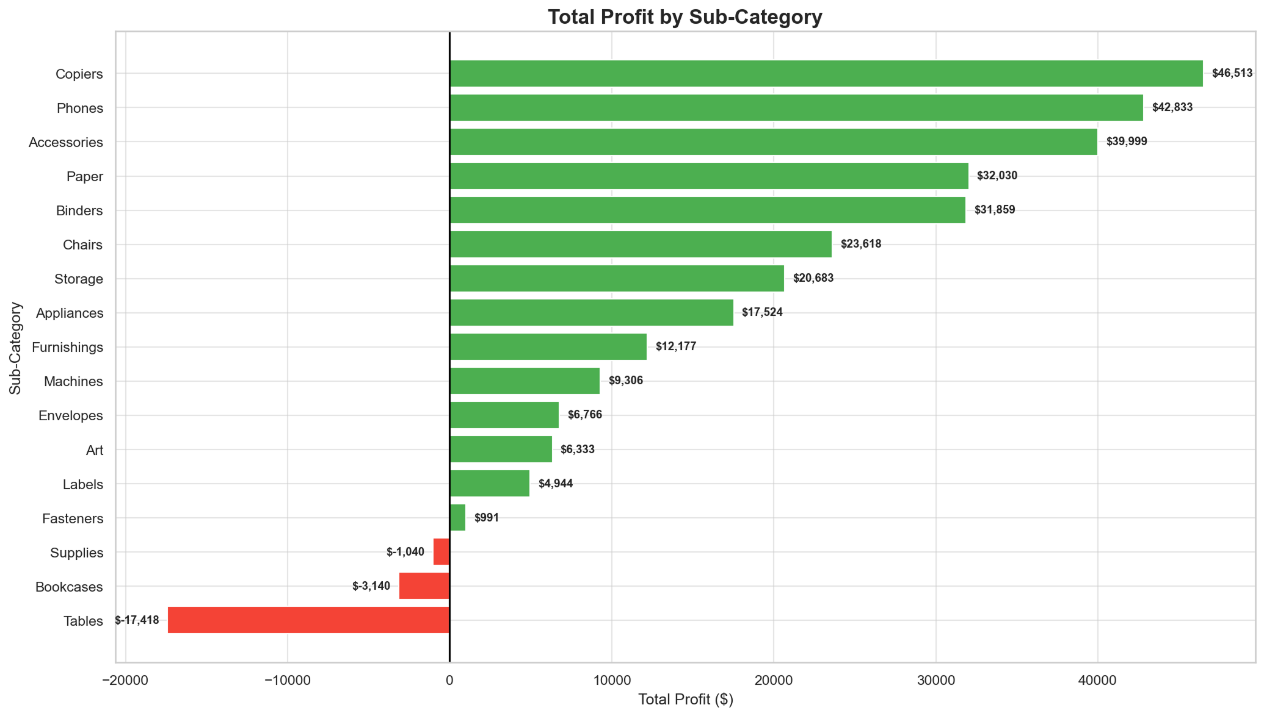
EDA — Profit by Sub-Category
Loss-makers exposed
Loss-makers (red)
Tables -$15,754
Bookcases -$2,482
Supplies -$1,169
Stars (green)
Phones $37,628
Copiers $37,178
Accessories $36,673
-$19,400
combined four-year loss
Action: discontinue or reprice Tables, Bookcases, and Supplies.
Superstore Analytics — Graduation Defense

Slide 13
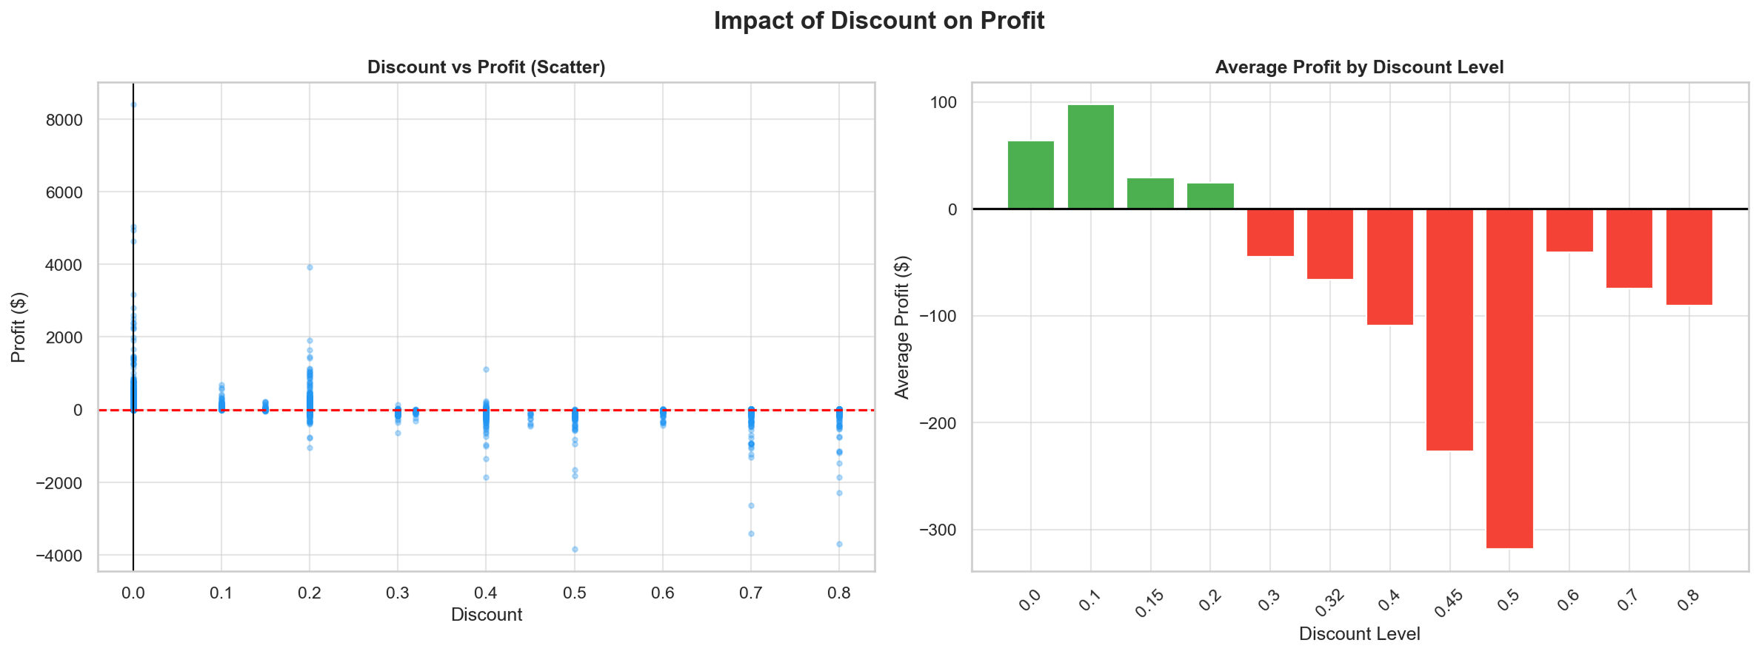
EDA — Discount vs Profit (the big finding)
20%
discount threshold
0%
+$65
10%
+$101
20%
+$25
30%
-$47
40%
-$109
50%
-$323
Action Cap discounts at 20%. Anything beyond requires managerial approval — confirmed by Pearson r = -0.234 and ML feature importance of 0.62.
Superstore Analytics — Graduation Defense

Slide 14
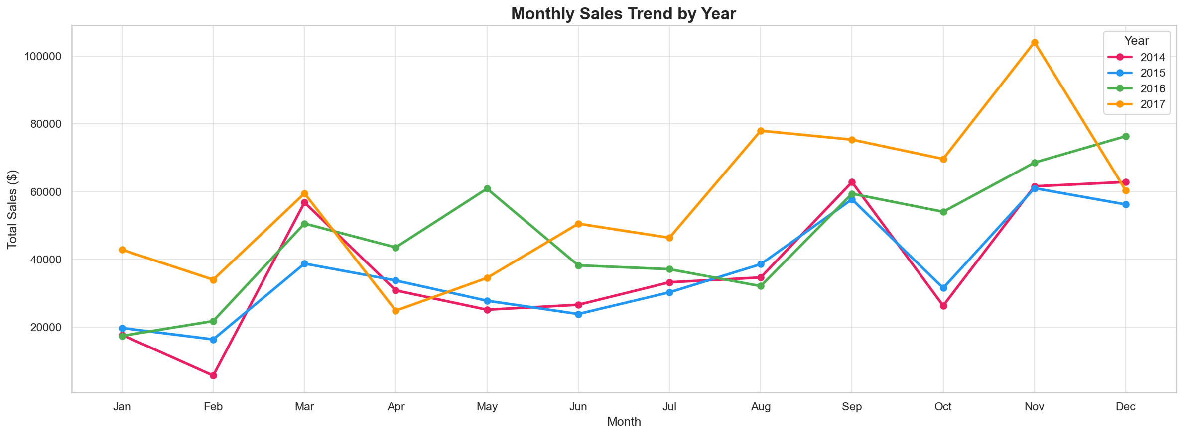
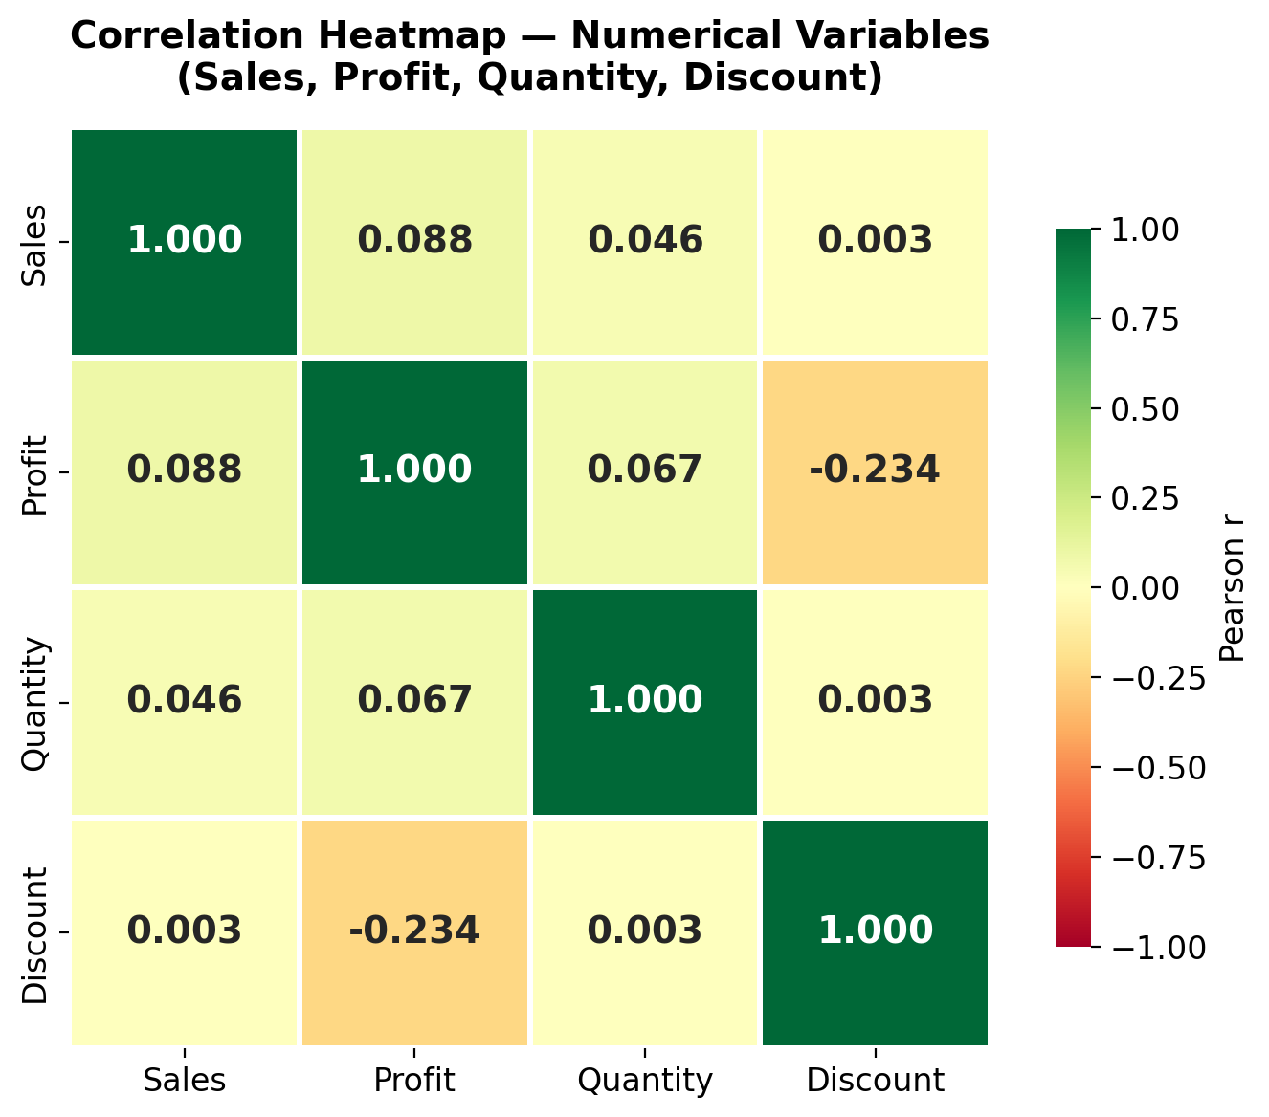
EDA — Time Trends & Correlation
Monthly trend by year
Correlation heatmap
Holiday peaks
Growing levels
Discount drives loss
Every year shows a strong Q4 spike — staffing & inventory must follow.
2017 sales up +88% over 2016. Trigger to investigate the success drivers.
Profit ↔ Discount r = -0.234 — strongest signal in the matrix.
Superstore Analytics — Graduation Defense

Slide 15
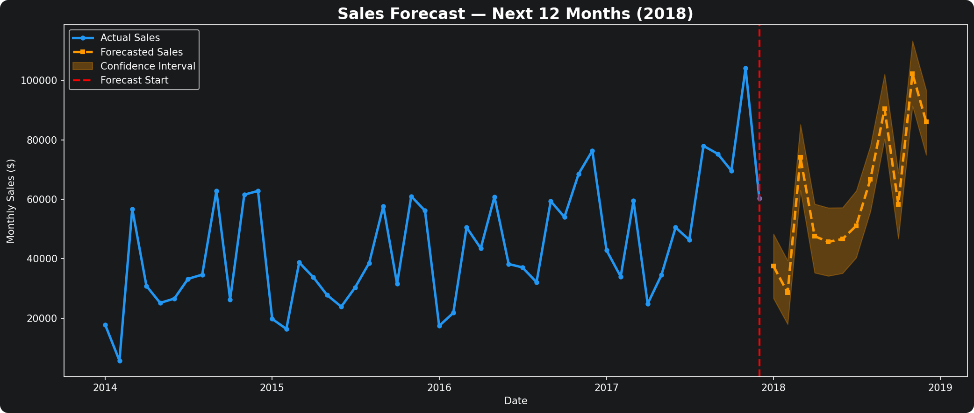
Forecasting — Prophet (12 months ahead)
Model configuration
Granularity: monthly
Yearly seasonality: ON
Daily/weekly: OFF
Mode: multiplicative
Horizon: 12 months
Insights
Trend remains upward
Strong holiday peak in Q4 2018
Confidence band widens with horizon
Plan inventory and staffing for Q4 2018 at 2017 levels plus the trend uplift, with safety stock around the upper confidence bound.
Superstore Analytics — Graduation Defense

Slide 16
RFM Customer Segmentation
793 unique customers grouped into 5 actionable tiers based on Recency, Frequency, Monetary value
★
♥
↑
!
×
Champions
Loyal Customers
Potential Loyalists
At Risk
Lost Customers
207
194
190
142
60
customers
customers
customers
customers
customers
Recent + frequent + high spend
High value, slightly less recent
Right pattern, not yet retained
Engagement declining
No longer active
Differentiated marketing strategy: reward Champions, retain Loyalists, upsell Potentials, reactivate At-Risk, win-back-or-retire Lost.
Superstore Analytics — Graduation Defense

Slide 17
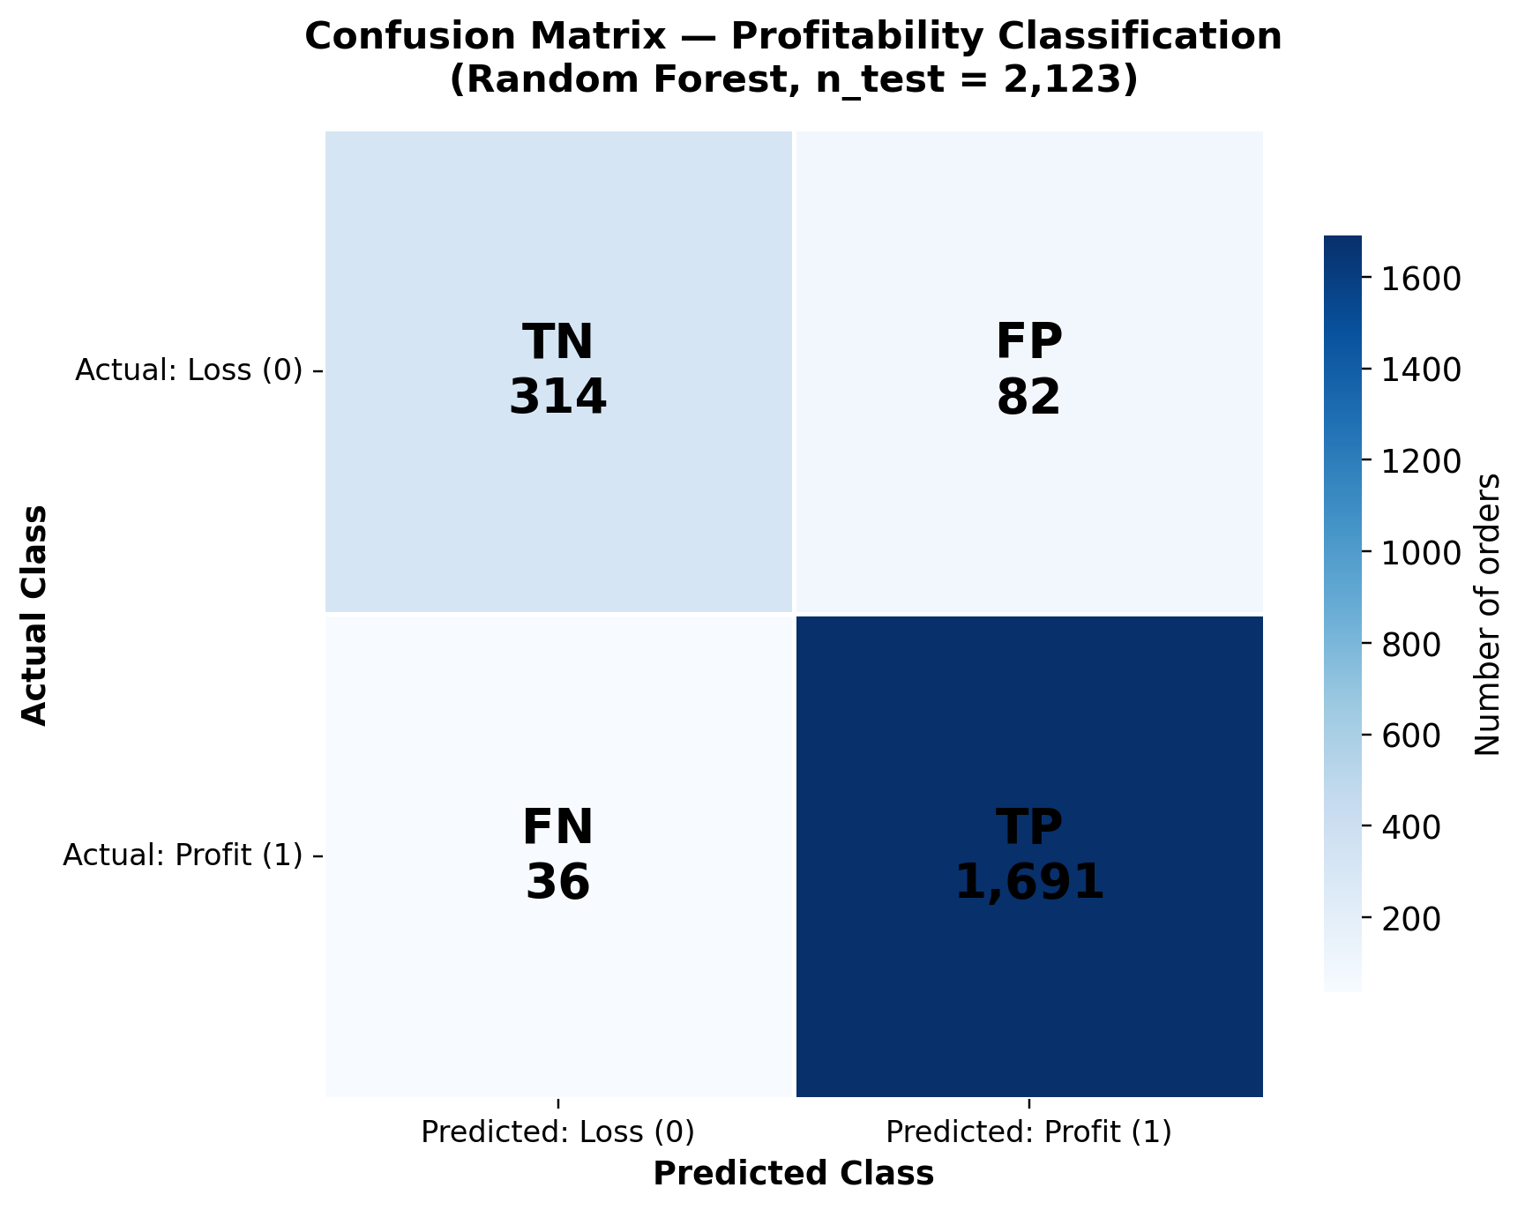
ML Classification — Confusion Matrix
TP
TN
1,691
314
Profitable orders correctly approved
Loss orders correctly flagged
FP
FN
82
36
Loss orders missed by the model (Type I)
Profitable orders falsely flagged (Type II)
Test set summary
2,123 orders held out for evaluation. 2,005 correct, 118 incorrect.
Cost-asymmetry: each FP destroys money directly, each FN costs only review time. The model is well-balanced for this trade-off.
94.4% accuracy · ROC-AUC 0.984 · ready for deployment as an order-validation flagger.
Superstore Analytics — Graduation Defense

Slide 18
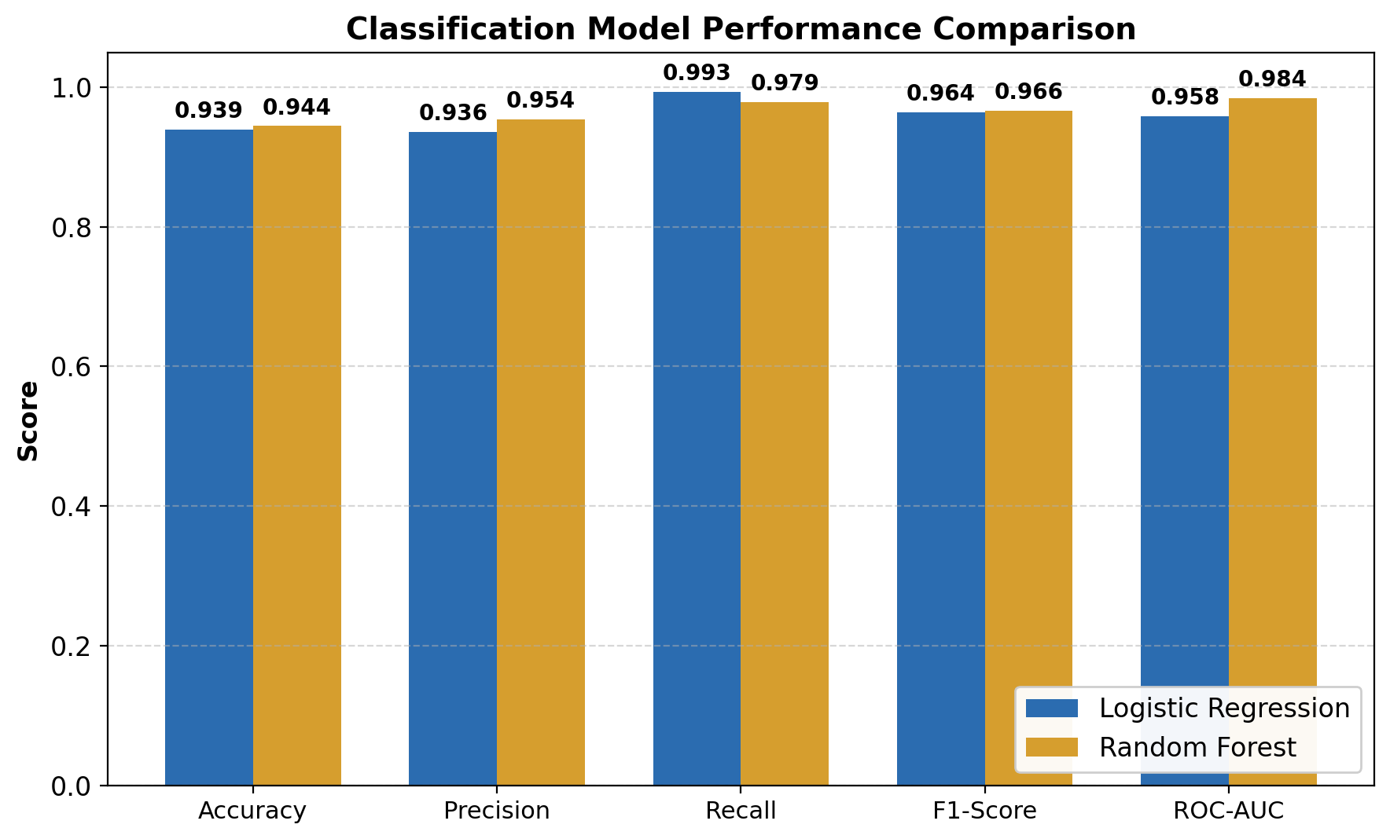
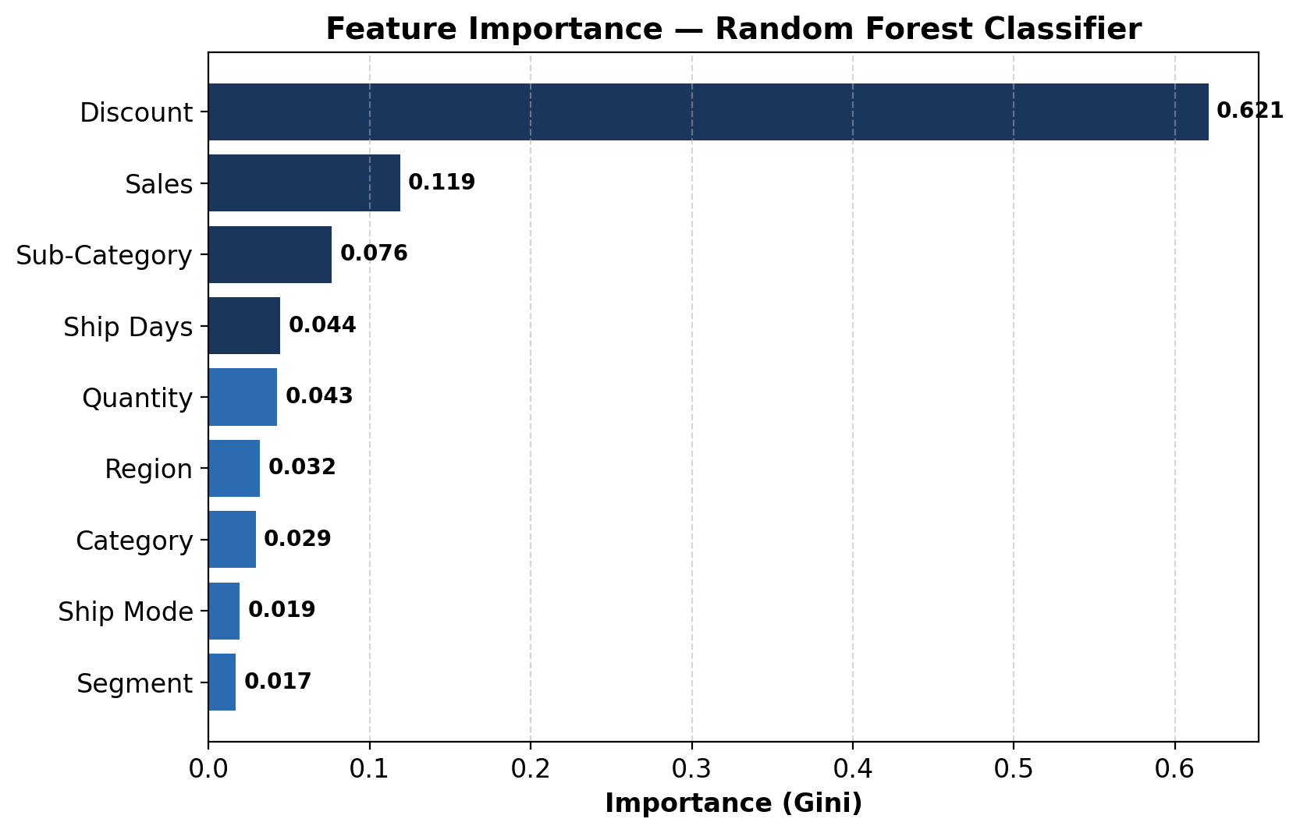
ML — Performance Metrics & Feature Importance
Logistic Regression vs Random Forest
Feature importance (Random Forest)
Metric | Logistic | RF | Winner
Accuracy | 0.939 | 0.944 | RF
Precision | 0.936 | 0.954 | RF
Recall | 0.993 | 0.979 | LR
F1-Score | 0.964 | 0.966 | RF
ROC-AUC | 0.958 | 0.984 | RF ✓
Discount = 0.62 importance
Three times larger than the next feature.
Independent confirmation of the EDA insight: discount governance is the highest-leverage action.
Superstore Analytics — Graduation Defense

Slide 19
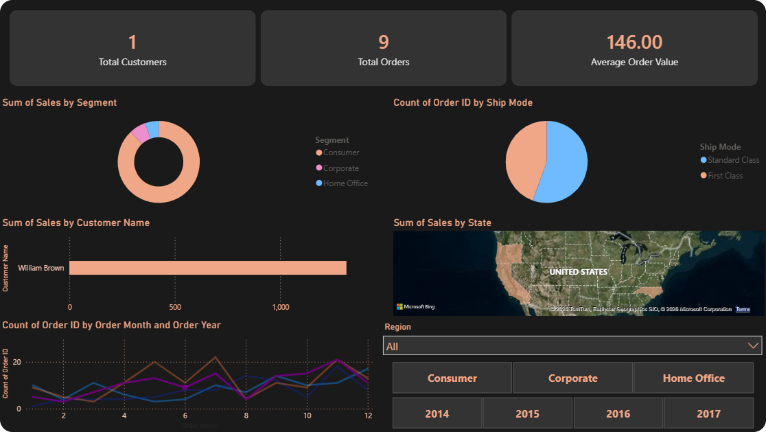
Power BI — Interactive Dashboard
Three pages
01
Executive Overview
Sales · Profit · Margin · Orders KPIs.
02
Regional & Segment
Choropleth + cross-filtered matrix.
03
Profitability
Discount × profit + DAX cost cards.
Built with: DAX · Power Query
Slicers + cross-filtering let any manager drill from headline KPIs to a single state in seconds.
Superstore Analytics — Graduation Defense

Slide 20
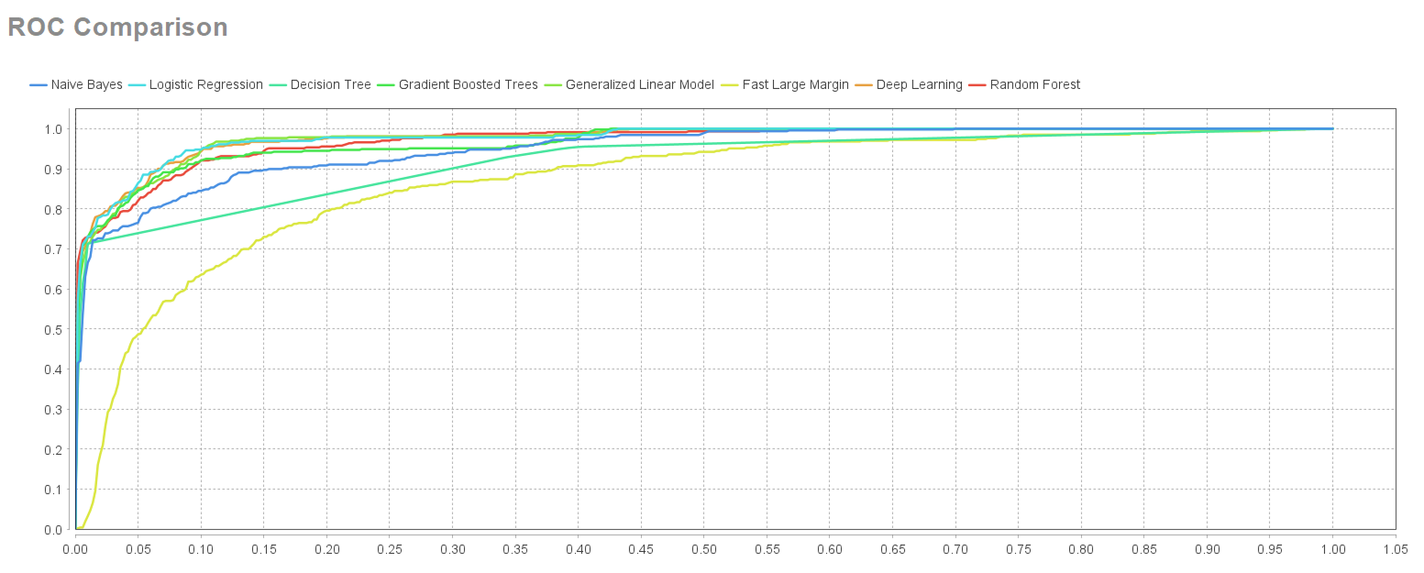
RapidMiner — No-Code Workflow
Operator chain
1
Read CSV
Load Clean_Superstore.csv
2
Generate Attributes
Profit Margin = Profit/Sales
3
Filter Examples
Drop non-positive sales
4
Aggregate
Totals per category & region
5
Visualize
Built-in charts in Result view
Same conclusions as Python and Power BI — confirming the analysis is tool-independent.
Superstore Analytics — Graduation Defense

Slide 21
Results — Headline Numbers
$2.99M
$240K
+88%
20%
Total Sales
Total Profit
2017 Growth
Discount Cap
2014 – 2017
8.06% margin
vs 2016
beyond destroys value
94.4%
0.984
207
60
Classifier Accuracy
ROC-AUC
Champions
Lost Customers
on held-out test
excellent ranking
highest-value buyers
win-back targets
Triangulated across Python, Power BI, and RapidMiner — robust to tool choice.
Superstore Analytics — Graduation Defense

Slide 22
Managerial Recommendations
Pricing & Promotion
Customer Strategy
Cap automatic discounts at 20%
Review Tables, Bookcases & Supplies
Pilot price-elasticity tests
Loyalty program for 207 Champions
Reactivation for 142 At Risk
Win-back test for 60 Lost
Operational Excellence
Analytics Capability
Investigate 2017 surge for replay
Operational review of Central region
Tackle the long tail of slow shipments
Deploy Power BI to regional managers
Quarterly forecasting cycle
Embed RF classifier in order pipeline
Quick wins delivered first; structural changes scoped on a quarterly cadence.
Superstore Analytics — Graduation Defense

Slide 23
Limitations & Future Work
Limitations
Future Work
Only 4 years of history
Fictitious dataset — refunds, taxes, returns absent
RFM uses only 3 behavioural signals
Univariate forecasting (no exogenous regressors)
No deployment monitoring for concept drift
Customer Lifetime Value (BG/NBD, Pareto/NBD)
Market-basket analysis (Apriori, FP-Growth)
Recommendation system (collaborative filtering)
Multivariate forecasting (TFT, LSTM)
Pricing optimization on the discount curve
Streaming analytics and real-time alerts
Superstore Analytics — Graduation Defense

Slide 24
Conclusion
What we built and what it means
✓
✓
✓
Complete pipeline
Cross-tool validation
Actionable output
Cleaning, EDA, forecasting, segmentation, classification, and dashboards in one cohesive project.
Python, Power BI, and RapidMiner converge on the same conclusions.
Concrete, defensible recommendations for pricing, customers, operations, and analytics.
Data analytics replaces assumption with measurement —
and turns a dirty CSV into a strategic asset.
Superstore Analytics — Graduation Defense

Slide 25
Thank You
Questions · Discussion · Defense
Hamzeh Alhindawi · Hadeel Almasri
Supervisor: Dr. Ayman Mansour
Department of Business Intelligence and Data Analysis · University of Petra
Superstore Analytics — Insights into Customer Behavior | May 2026

