Slide 1
Please make a copy!
File -> Make a Copy
Remember to include your workbook and this presentation in your submission!

Slide 2
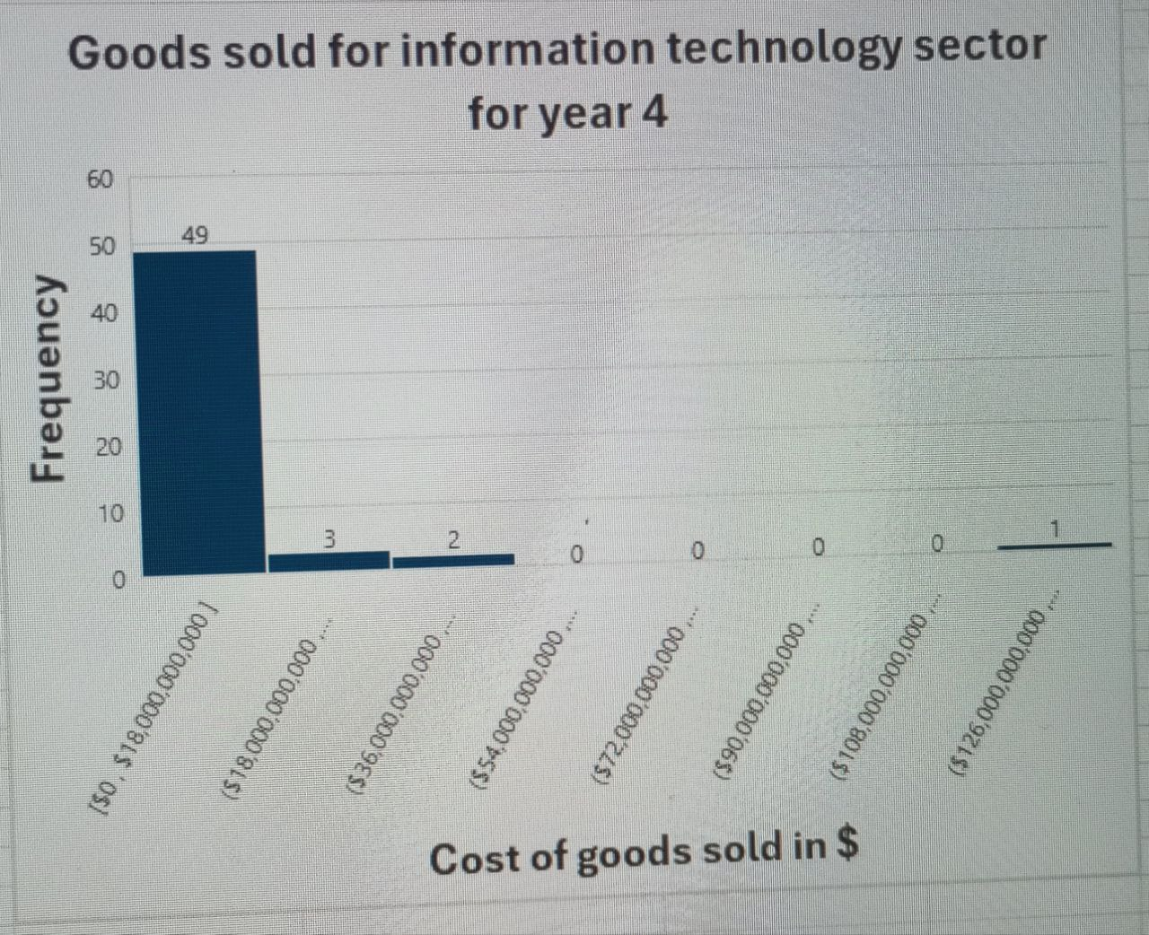
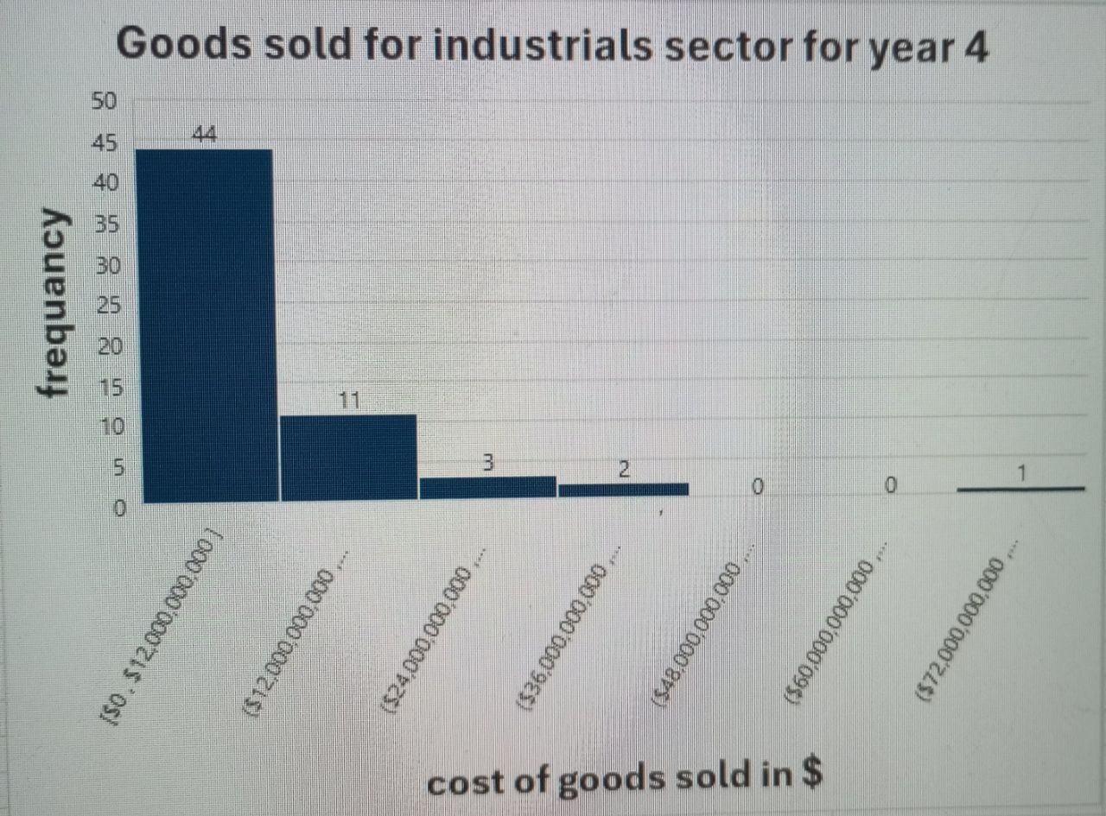
Does Information technology sell goods more than industrials sector in year 4?
Here are the histograms for the annual cost of goods sold for information technology and industrials sectors for year 4.
Both distributions are right-skewed. That mean means of each is higher than madian.
The median of information technology in year 4 is $2,212,500,000 while the median of industrials in year 4 is $5,752,978,000. Average of IT is $8,183,342,926 and average of industrials is $10,243,544,450. IT companies average goods sold are less than industerial companies average goods sold.
The range of goods sold costs for IT sector is $131,183,212,000 which is greatly more than industrials sector which is $80,098,900,000. The standard deviation of IT is 19317430845 and the standard deviation of industrieals is 12990860726. It looks like companies in the information technology sector have more significant variability in the goods sold cost they receive because their range is more spread out.

