Slide 1
Team Member: 1) Hadeer Youssif 3) Hiady Atef 2) Noran Hassan 4) Nourhan Hanna Project Sponsor :DR/Tarek Gammal Wasting time correcting exams Executive Summary : The problem of correcting exams takes a lot of time and effort, and there are also mistakes in correction , to solve these problems , we will implement an electronic correction system Deliverables : 1.Required Information : We collect data that will explain the examination . 2.Design : We follow the college system to know what the examination system is. 3.development/coding : -Design the backend, which should contain: 1)Server 2)Data base -Design the frontend. 4.Integration : Combine the previous steps and test them to ensure that they work efficiently . •Project Resources : 1.Good internet connection. 2.Server. 3.Trainers who train students on the online examination system. Project scope statement : Objectives : Objectives are to apply the electronic correction system to reduce the time spent on correction and reduce the stress of students waiting for results. Project exclusions :This system will be applied in the Faculty of Computers and Information . The students to whom this system is applied are the students who are tested in the laboratory building only •Budget : We need instructors to train students how to handle the new test system. Each instructor has a specific cost within the 120,000 budget for instructors.

Slide 2
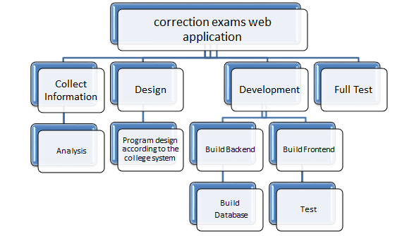
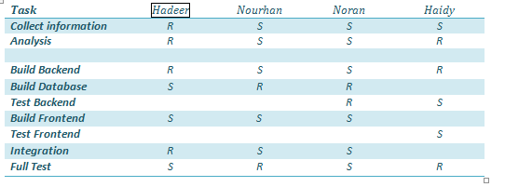
WBS :
R = Responsible S = Supports/Assists
Responsibility Matrix :

Slide 3
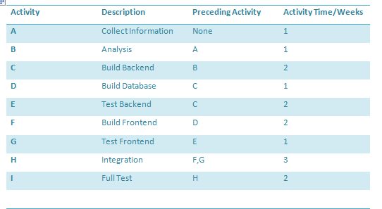
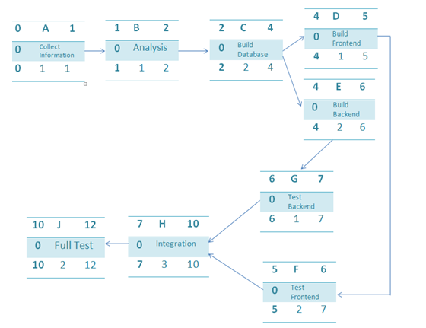
Network Information:
Network :

Slide 4
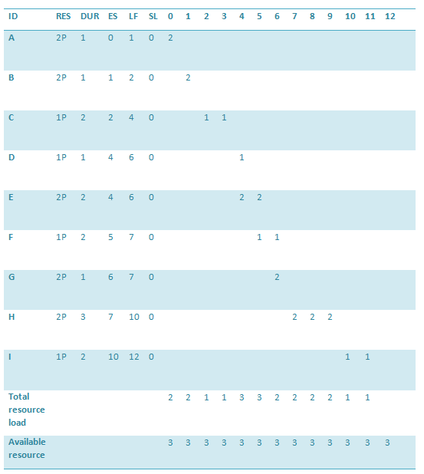
Gantt Chart :

Slide 5
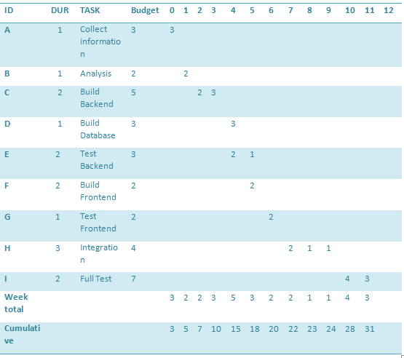
•
Budget Baseline:

Slide 6
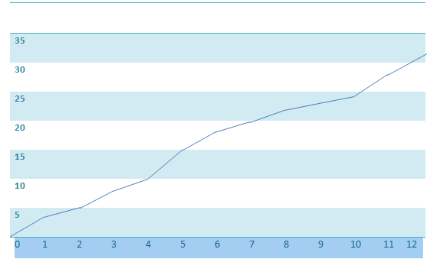
Cumulative Baseline Budget:
•Risk and Issue Management Plan :
-Data loss.
-A problem occurs in the Internet.
-System hack.
-Data entry mistake.

