Slide 1

DSI Capstone – Presention1
Hang (Haden) Liu

Slide 2
Project Background
Flight records among US cities during Jan 2020
Target: whether a future flight in Jan 2021 will be delayed or not.
Algorithm: Classification (binary answer)

Slide 3
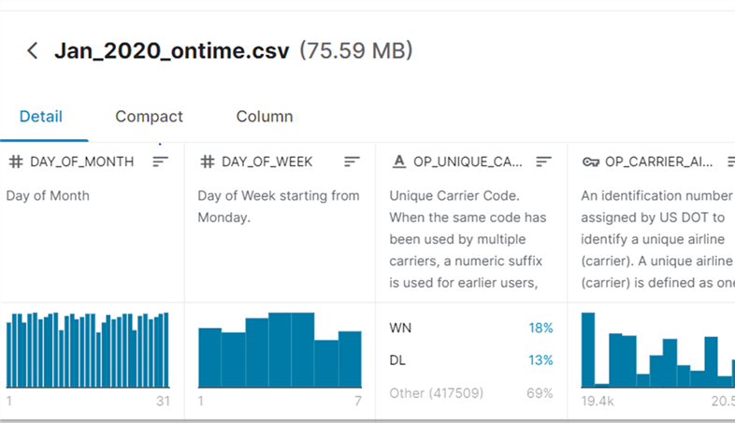
Dataset Recap.
URL: https://www.kaggle.com/divyansh22/flight-delay-prediction
Initial Features: 21
Flight Records: 607346
Feature Classifications:
Date & Time
Airline & Aircraft
Location
Distance
Status

Slide 4
EDA – Basic & pre-processing
Main Data Types: Integer, float & object
Null values dealing: deleted since no suitable replacement values
Delayed flight amount percentage: approx. 13.73%

Slide 5
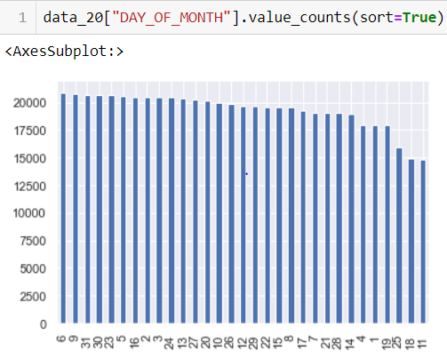
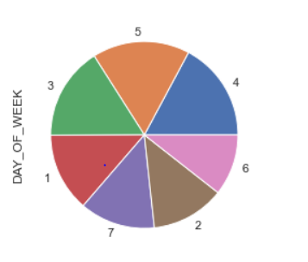
EDA – Visualization & insights
Date Distribution of flights

Slide 6
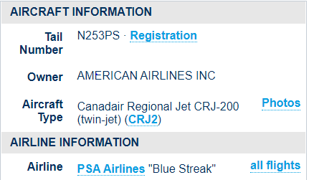
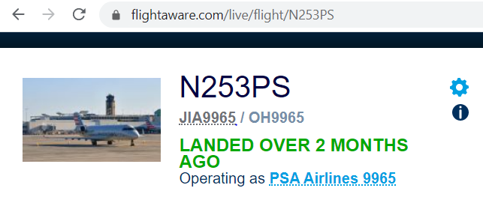
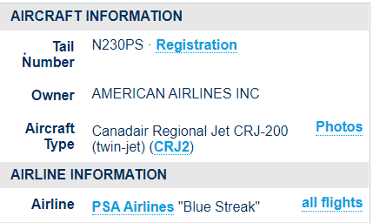
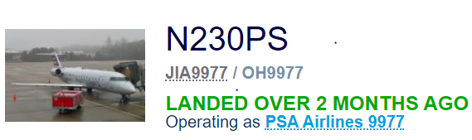
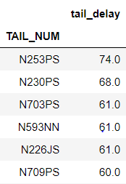
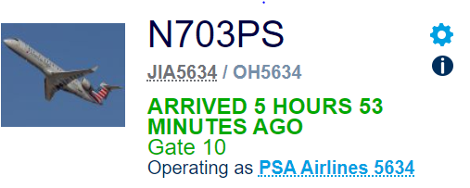
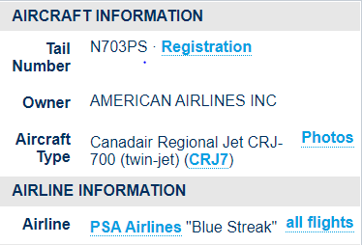
EDA – Visualization & insights
Aircraft & Tail-Num Distribution for Delay
. PSA operated CRJ regional aircrafts experienced more delays

Slide 7
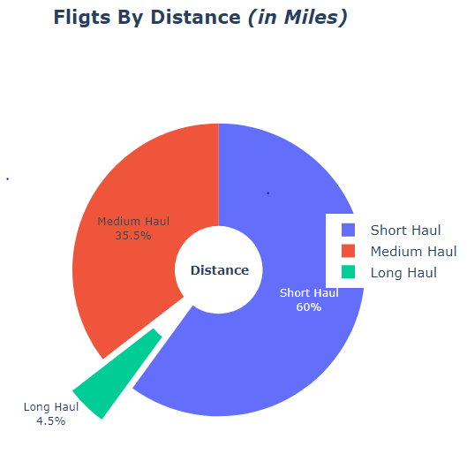
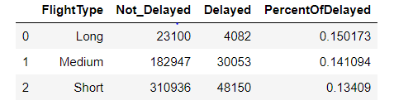
EDA – Visualization & insights
Flying Distance distribution for Delay
Short Haul - Distance <800 miles
Medium Haul - Distance 800-2200 miles
Long Haul - Distance >2200miles

Slide 8
Modelling – Algorithm & Features
Using classification to identify whether a future flight will be delayed
‘ARR_DEL15’
Features:
'DAY_OF_MONTH’,
'DAY_OF_WEEK’,
'OP_CARRIER_AIRLINE_ID’
'OP_CARRIER_FL_NUM’
'DEP_TIME’
'DEP_DEL15’
'ARR_TIME’
'CANCELLED’
‘DIVERTED’
‘DISTANCE’
‘TAIL_DELAY’

Slide 9
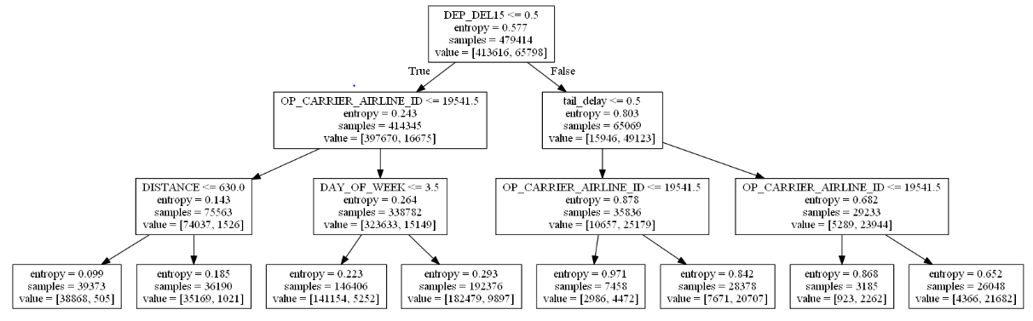
Modelling – Decision Tree
 | Accuracy | Precision | Recall
Max depth 0 | 89.25% | 60.81% | 61.51%
Max depth 1 -3 | 93.15% | 75.30% | 74.80%

Slide 10
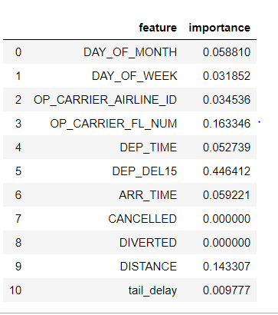
Modelling – Decision Tree. Cont.
. Features with stronger impact on delay:
DEP_DEL15 (binary)
Flight Num
Distance

Slide 11
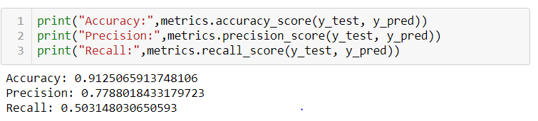
Modelling – Logistics Regression
 | Accuracy | Precision | Recall
LR Model | 91.25% | 77.88% | 50.31%
 | Positive | Negative
Positive | 126400 | 2928
Negative | 10180 | 10309

Slide 12
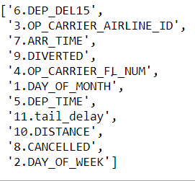
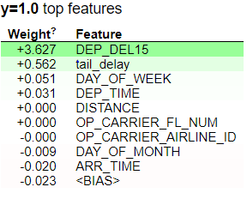
Modelling – Logistics Regression. Cont.
RFE feature importance selection ELI5 with LR

Slide 13
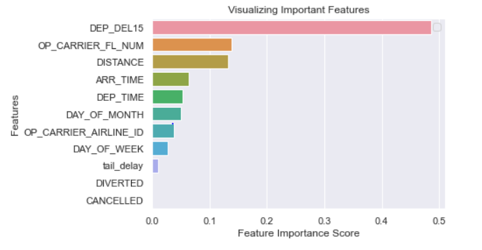
Modelling – Random Forest
Accuracy: 93.08%
Feature Importance:

Slide 14
Modelling with Feature modification – Logistics Regression & Random Forest
 | Accuracy | Precision | Recall
LR | 86.32% | 0.0 | 0.0
RF | 86.69% | 0.0 | 0.0
Traditional Classification Models perform not well without the feature DEP_DEL15

Slide 15
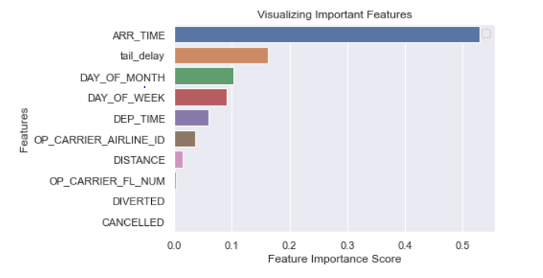
Modelling with Feature modification – Gradient Boosting Classification
Accuracy: 86.53%
Feature Importance:
 | Positive | Negative
Positive | 154558 | 463
Negative | 23760 | 1000

Slide 16
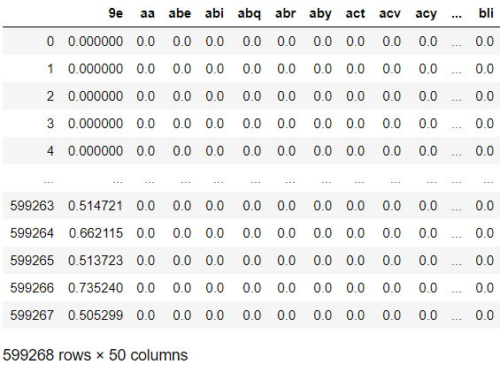
NLP Applications
. Combine 2 object features: Airline (2-words), Airport (3-words)
. Create dummies data frame with TfidfVectorizer model
. Apply Classification models & ELI5 to obtain feature importance

Slide 17
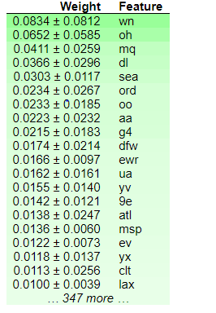
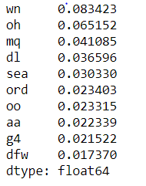
NLP Applications – cont.
 | Accuracy
DTC | 86.32%
RF | 86.30%
ELI5 Importance – with Random Forest
Feature Importance – Random Forest

Slide 18
NLP Applications – cont.
Feature importance list based on ELI5
Airlines
Southwest Airline | WN
PSA Airline | OH
Envoy Air | MQ
Delta Airline | DL
American Airline | AA
Airports
Seattle | SEA
Charlotte | CLT
Chicago | ORD
Atlanta | ATL

Slide 19
Difficulties & Future Development
. Feature modification with weather web or API
. Research on difference of feature importance between models
. Accuracy and useability of NLP

