Slide 1

DSI Capstone Project – Presentation 2
Hang (Haden) Liu

Slide 2

Project Background
Flight records among US cities during Jan 2020
Target: whether a future flight in Jan 2021 will be delayed or not.
Algorithm: Classification (binary answer)

Slide 3
Project Development Steps
Data set collection & Algorithm classification
Data pre-processing & EDAs
Classification modellings with feature modifications
Attempts to NLP
Feature importance visualizations

Slide 4




Target users
Individual Travellers
Booking Websites
Airlines
Aviation Authorities

Slide 5
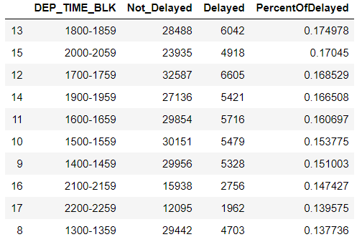
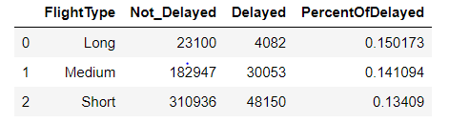
Target users – travellers & commuters
Modify the travel plan
Choose off-peak date
Optimize the traveling route
Select suitable airline

Slide 6
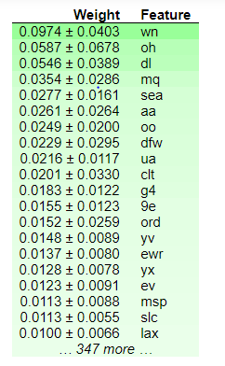

Target users – Travel agency & booking sites
. Modify the discount, promotion and policies with NLP
. Modelling – based reviewing on marketing & supplier strategies
NLP on Airport & Airline
Modelling with dummy DF
Feature importance & future data modelling

Slide 7
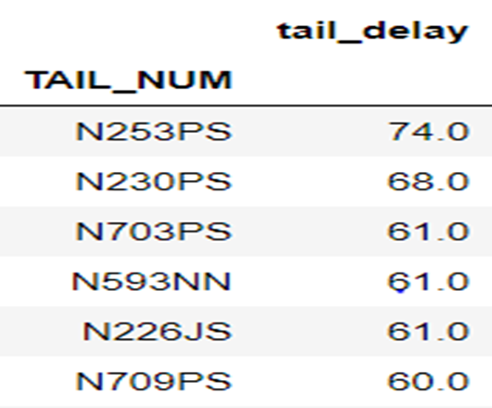
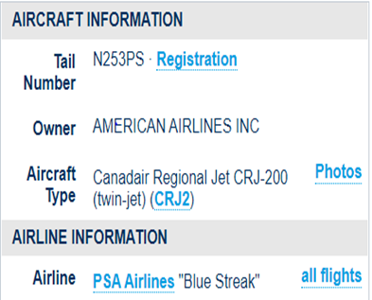
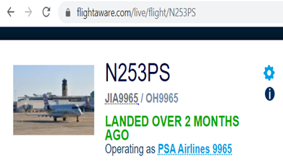
Target users – Airlines & authorities
Routing & timing optimization
Reviewing on aircraft procurement & allocations
EDA on tail-num delay counts
Strategy optimization
Feature importance on modelling

Slide 8
User interactive design and future development
Demo URL:
https://flight-delay-demo-streamlit-v3.herokuapp.com/

