Slide 1

DSI Project 2 – Exploratory Data Analysis
Haden (Hang) Liu

Slide 2
Brief Introduction
Assist to decision making with data analysis and visualization techniques.
SAT scores by state – Education
Drug use by age – Social and security

Slide 3
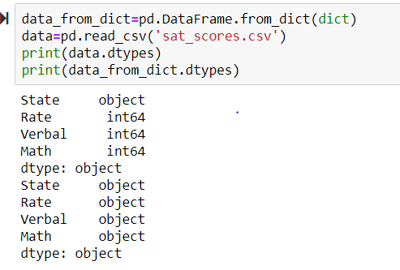
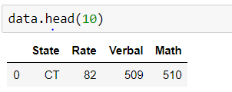
Dataset Loading & Cleaning
Load Dataset with internal function (read_csv)
Basic exploration to data structures

Slide 4
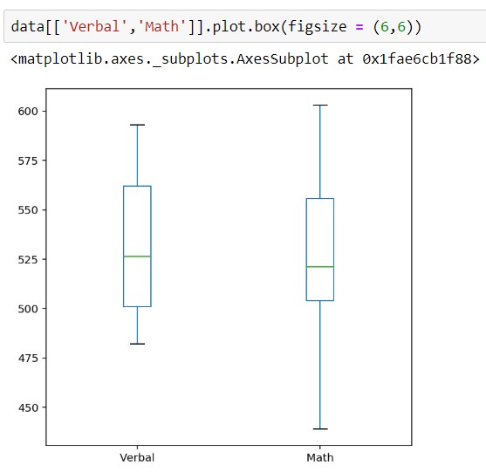
Data Visualization & Findings 1 (SAT Scores)
Range between the highest and lowest results in Math is greater than Verbal test
More assistance needed to students with low math result

Slide 5
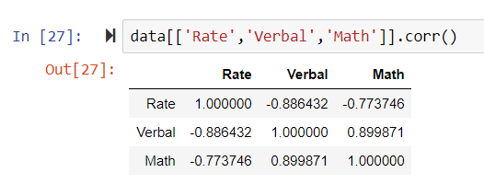
Data Visualization & Findings 2 (SAT Scores)
Strong correlation coefficient between performance of 2 subjects

Slide 6
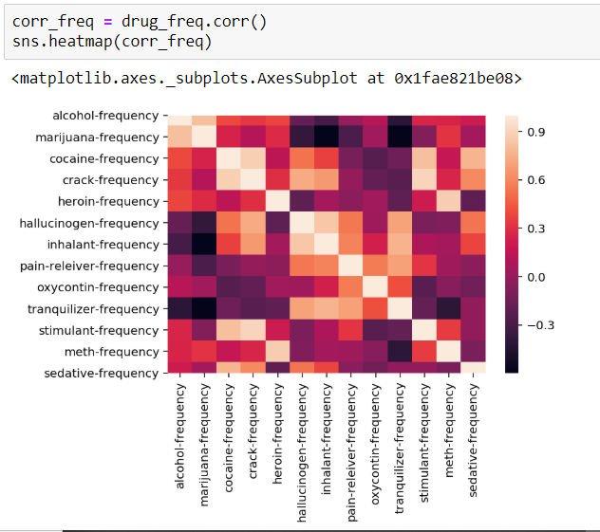
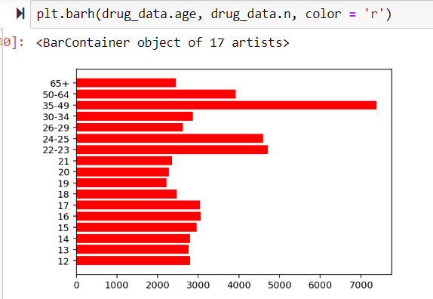
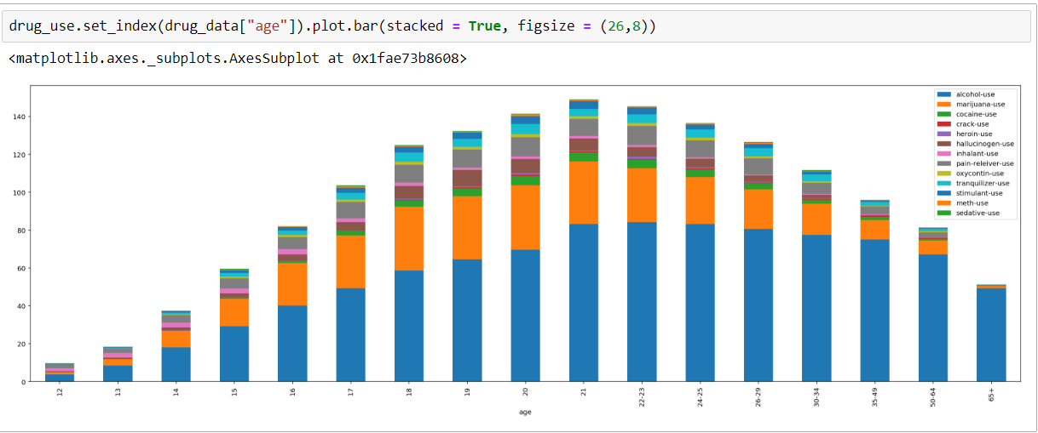
EDA & Findings 1 (Drug use by age)
Young people (age 18 – 30) has higher usage of alcohol and drug than other age groups
The age group 35-49 has largest number of drug users
There are stronger correlations between use of particular pairs of drug:
e. g:
marijuana – alcohol
crack - stimulant

Slide 7

Hypothesis Test 1
Question: any statistics significance between average use frequency between meth and heroin
T-test running show P-value > 0.05
Can not reject non-hypothesis

Slide 8
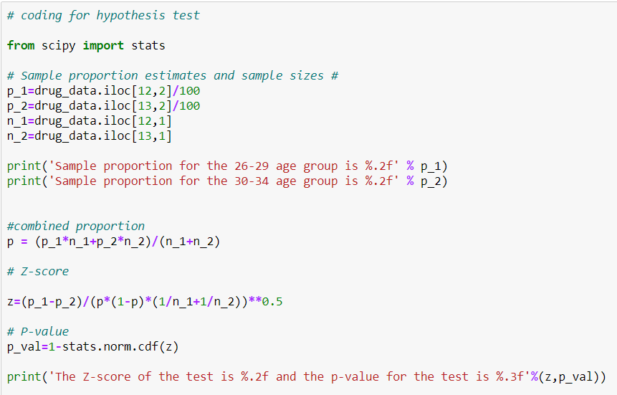

Hypothesis Test 2
H0: no statistics significance between probability of drug use between 2 age groups
Result: reject H0 with Z test

Slide 9
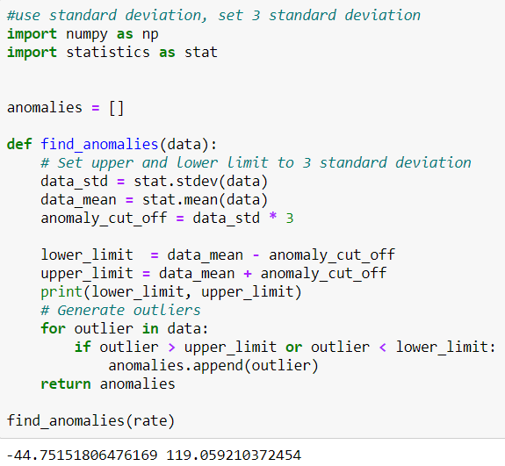
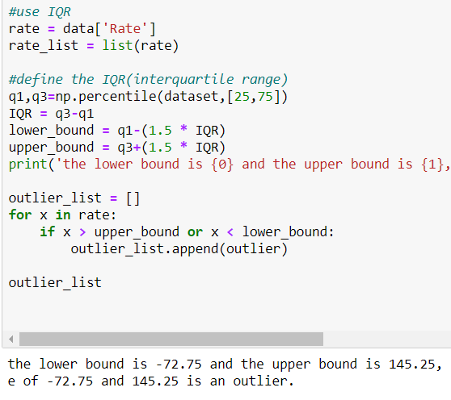
Outlier Analysis
IQR Calculation
STD Calculation
Result: No outlier exists in rate column (SAT Dataset) based on 2 methods

Slide 10

Spearman Correlation
Non – Parametric Test
Data must be ranked.
Steps:
ranking 2 columns.
calculate difference (d) of ranking of each row and square it.
Use formula

Slide 11
Challenges
Hypothesis Tests

