Slide 1

DSI Project 3 – Regression Analysis with Housing Data
Hang(Haden) Liu

Slide 2
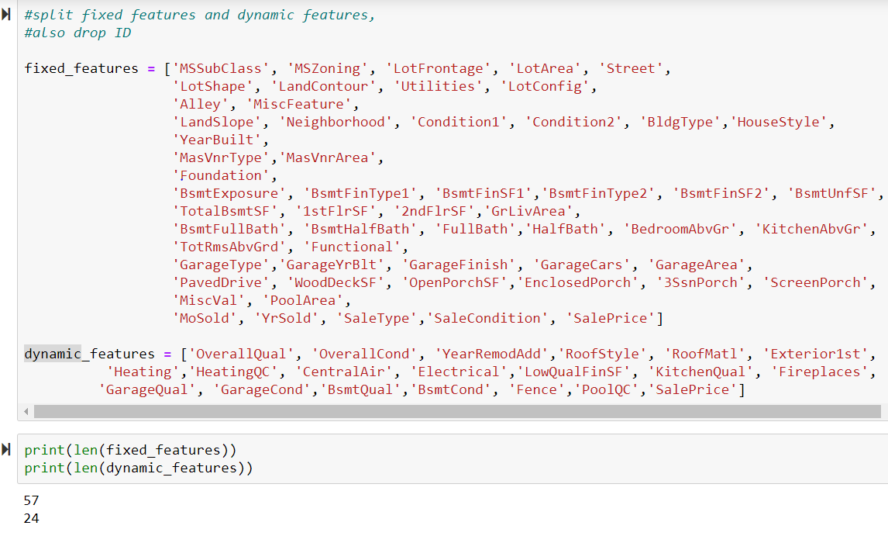
Project Background
. One CSV file with sold property information
. Features with classifications:
property information, sold year, etc (X)
Sale Price (y)
. Fixed features & dynamic / renovate features

Slide 3


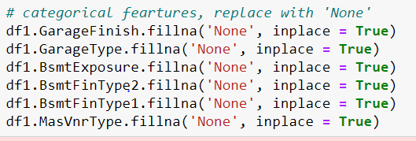
Q1 : Data cleansing & feature re-engineering
. Requirement: predict sales price with fixed features
. Drop features
1. with large amount null values
2. not relate to property
. Impute null values with medium or other values

Slide 4
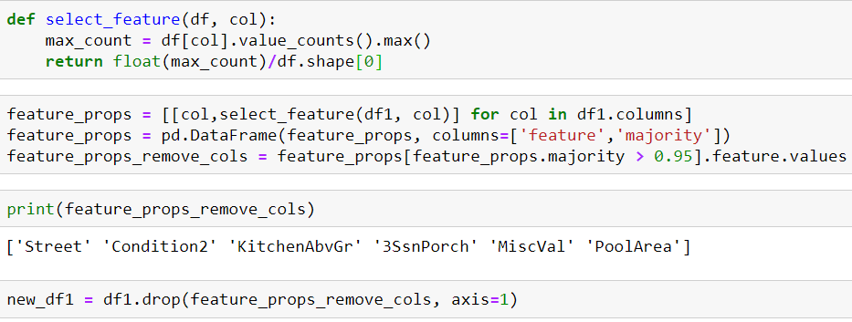
Q1 : Data cleansing & feature re-engineering ( cont. )
. Remove features with low level of value diversity
. Adding new features – TotalSF ( total internal area of house )

Slide 5
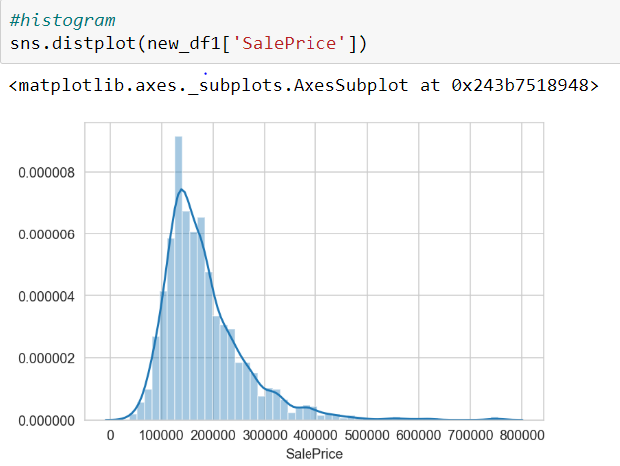
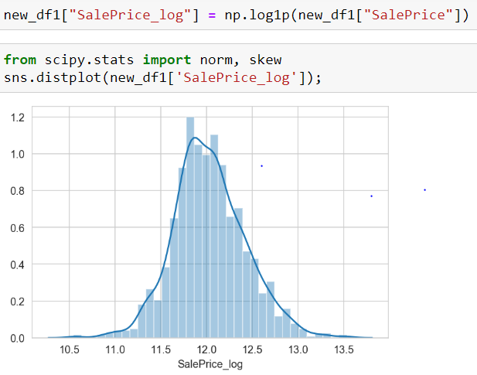
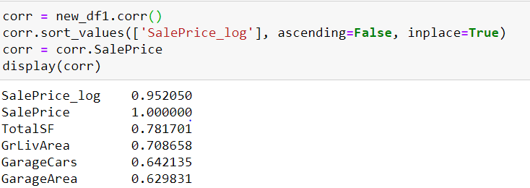
Q1 : Data cleansing & feature re-engineering ( cont. )
. Modify y column to better normal distribution
. More feature dropping based on correlation analysis with y
e.g. GarageCars vs GarageArea

Slide 6
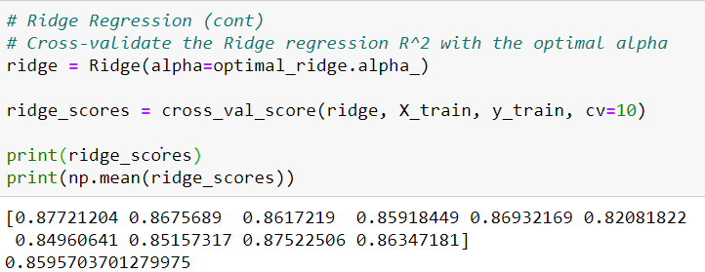
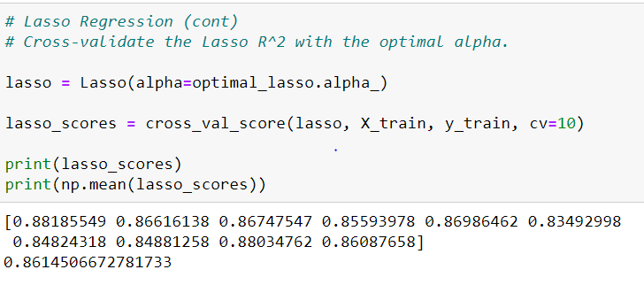
Q1: Modelling
. 2 models: Ridge & Lasso Regression
- Lasso model obtained better cross- validation score

Slide 7
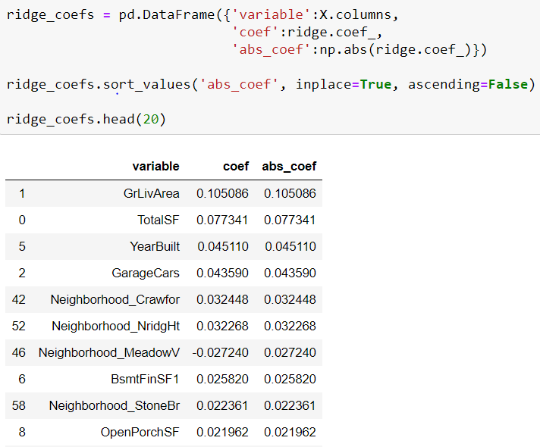
Q1: Coefficients of variables
Best predictors of Sale Price:
Above grade living area (GrLivArea)
Total square feet (TotalBsmtSF + 1stFlrSF + 2ndFlrSF)
Year Built (YearBuilt)
Size of garage in car capacity (GarageCars)
Physical locations within city limits (Neighbourhood)
Basement finished square feet (BsmtFinSF1)
Open porch area in square feet (OpenPorchSF)

Slide 8
Q2: Main requirement differences with Q1
Predict residuals from Q1 models with dynamic features
Similar logics with Q1 for feature re-engineering

Slide 9
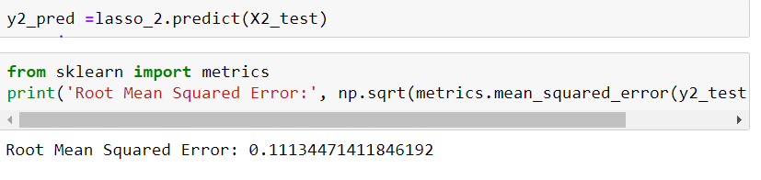
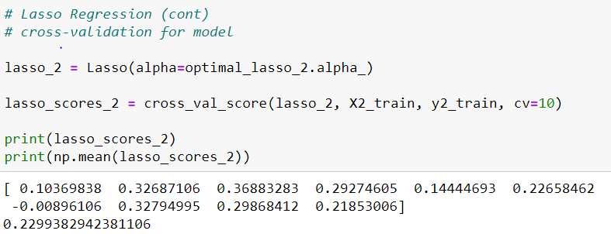
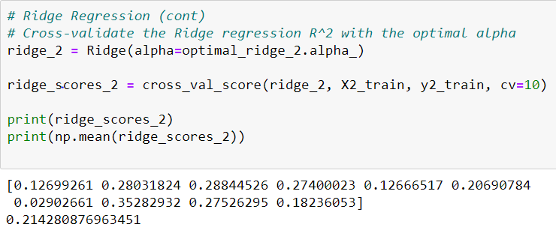
Q2: Modelling & summary
2 models: Ridge and Lasso
- Lasso perform better cross validation score
Best predict features (coefficient based )
Overall condition
Overall quality
Remodel date (YearRemodAdd)
Exterior covering on house (Exterior1st)
Trusted model based on low RMSE

Slide 10
Q2: Modelling & summary (cont.)

