Slide 1
Personal Portfolio Demo
Hang (Haden) Liu

Slide 2
Development Purpose
Present technical skills and project experience to potential employers.
Convenient and one-stop access to resume, LinkedIn and Github

Slide 3
Target Audiences
Industrial Employers
LinkedIn Connections
Other Networking Connections

Slide 4
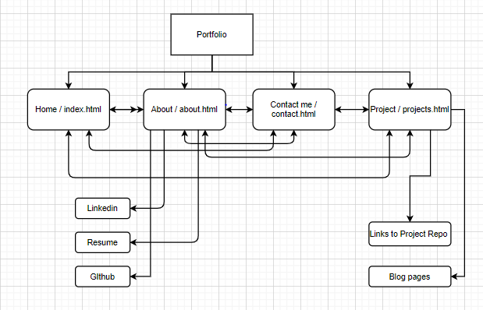
Sitemap

Slide 5
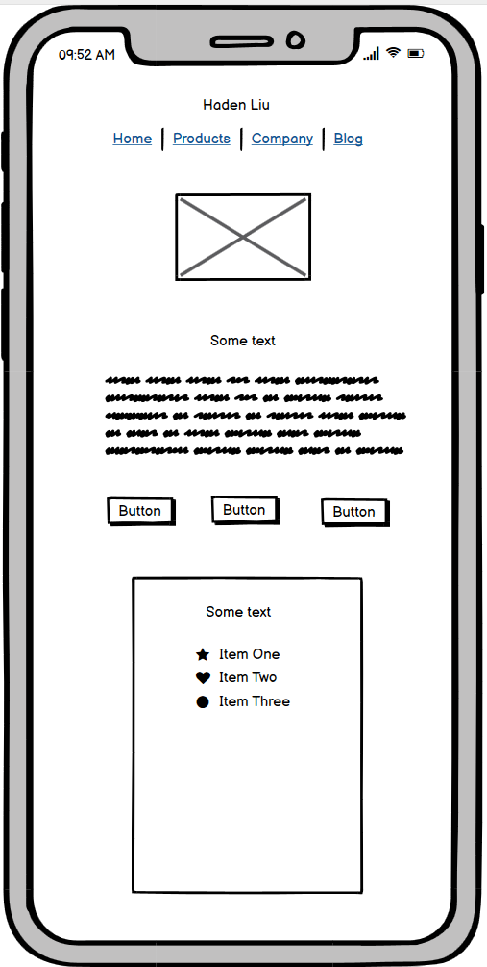
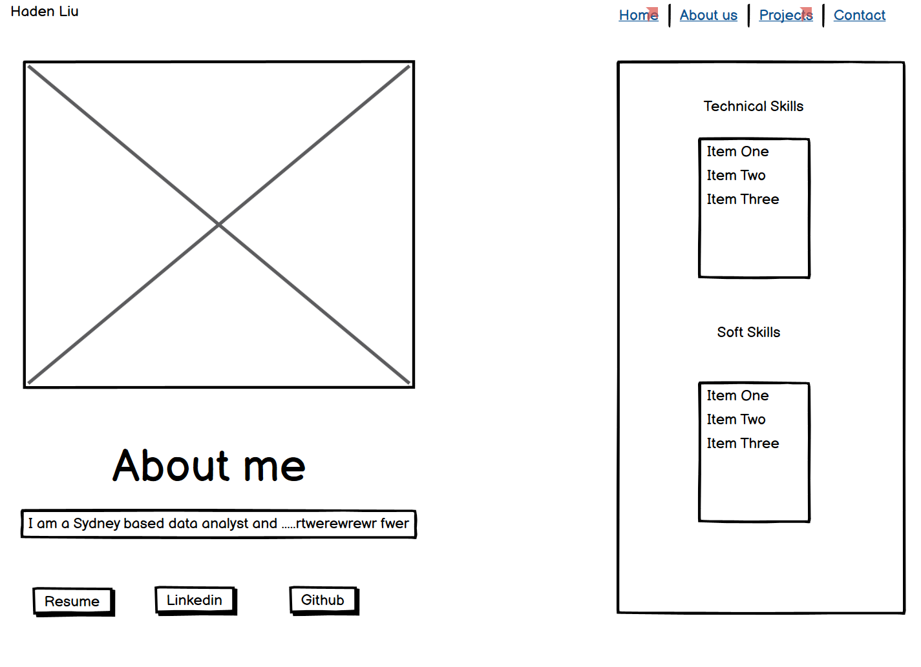
Wire Frame Design

Slide 6
Technologies
HTML5
CSS3
Bootstrap4

Slide 7
Demo
Deployed URL: https://gracious-keller-0564ad.netlify.app/index.html

